Slide 1
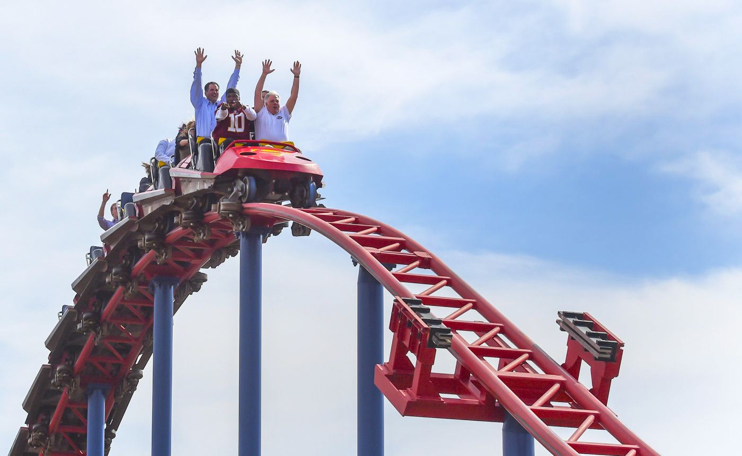
多维阅读 第16级
A Taste of
Terror
尖叫时刻

Slide 2
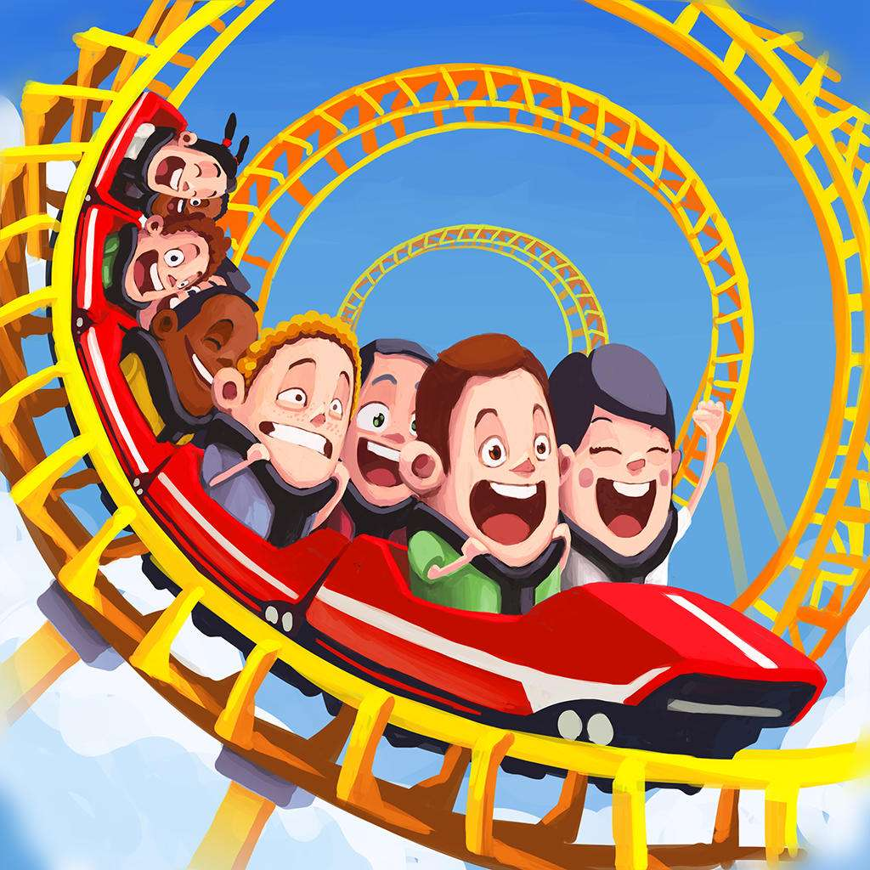
Activity 1
a roller coaster
What can be regarded as a taste of terror?

Slide 3
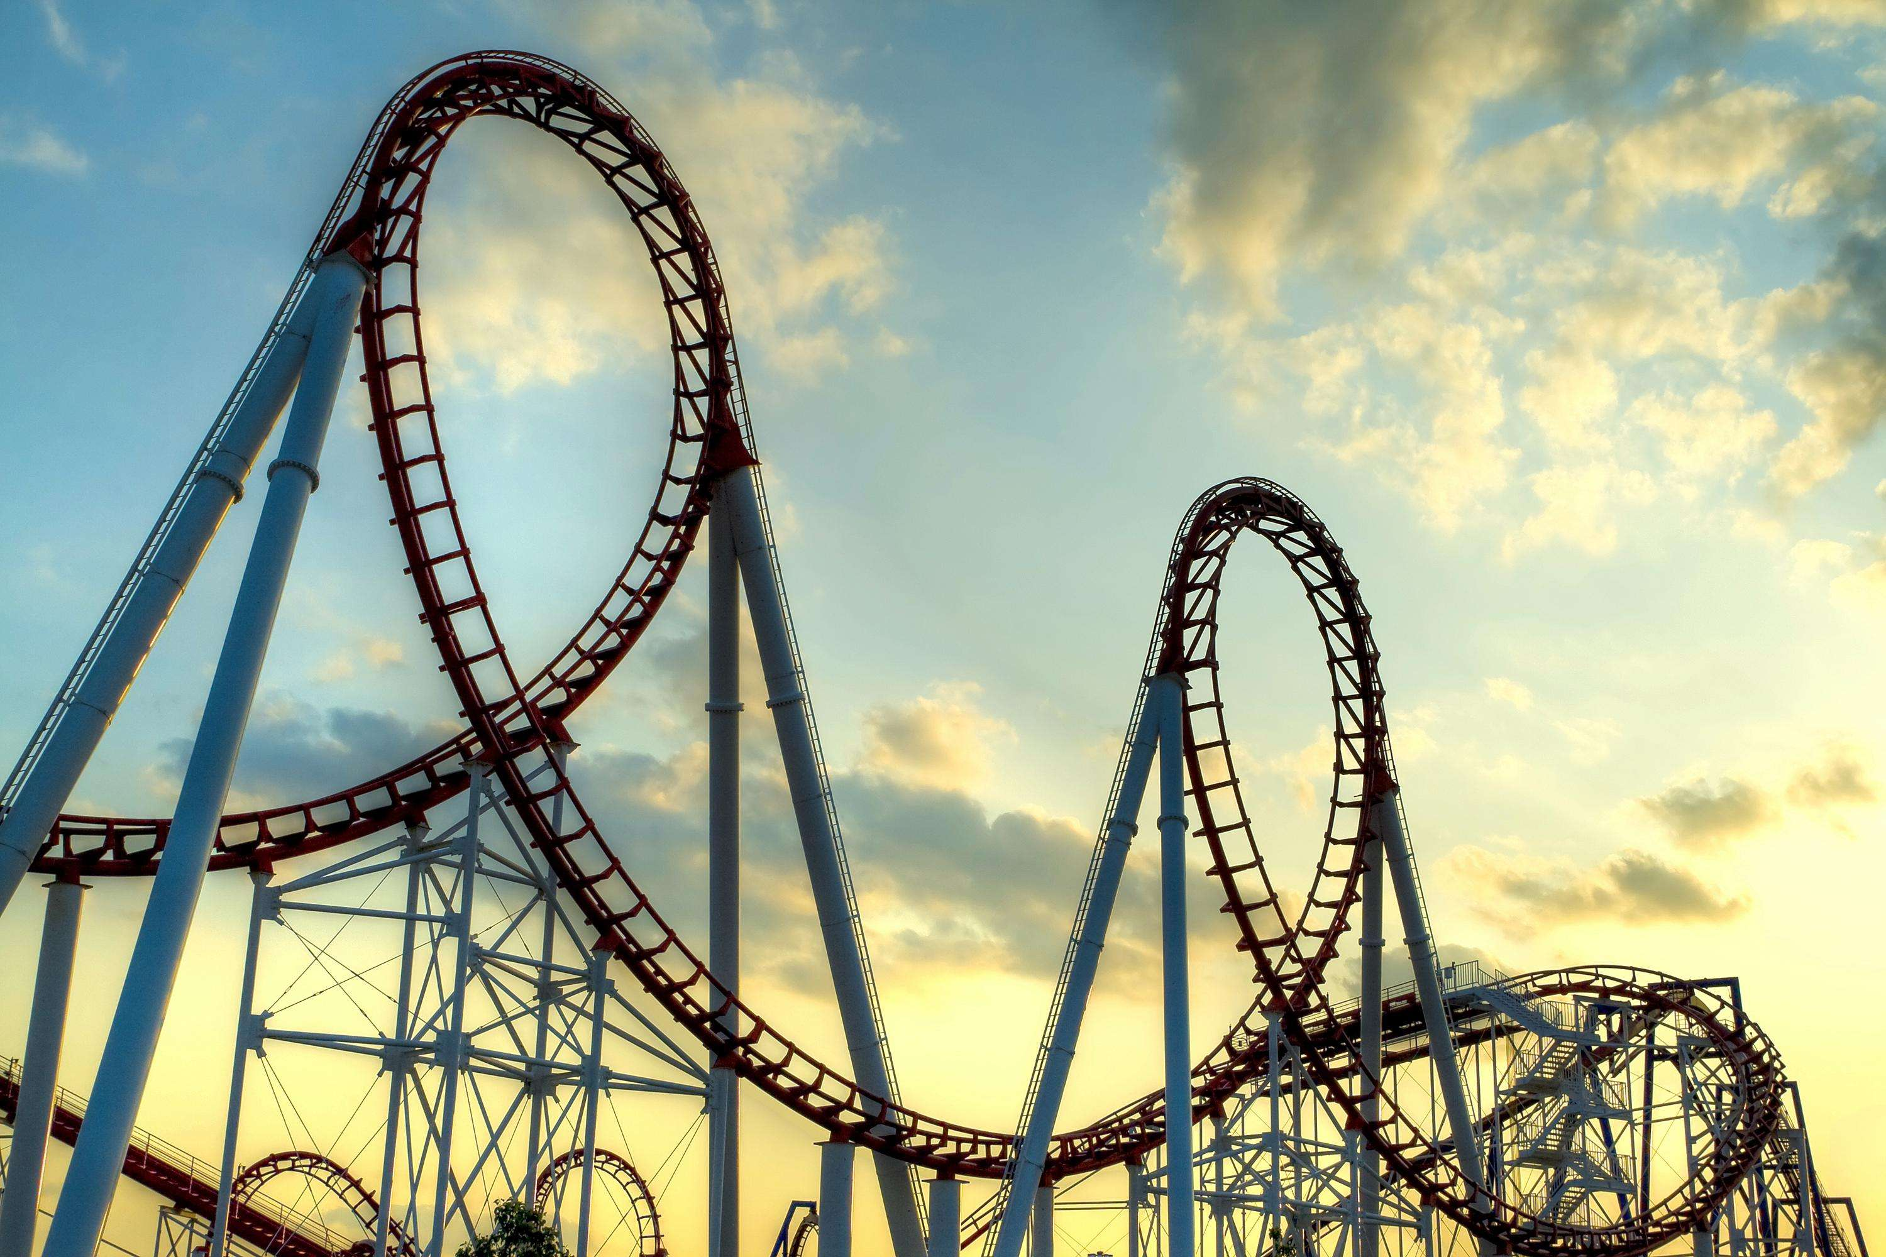
Activity 2
1. Why do people love to ride roller coasters?
2. How do people feel when they are riding a roller coaster?

Slide 4
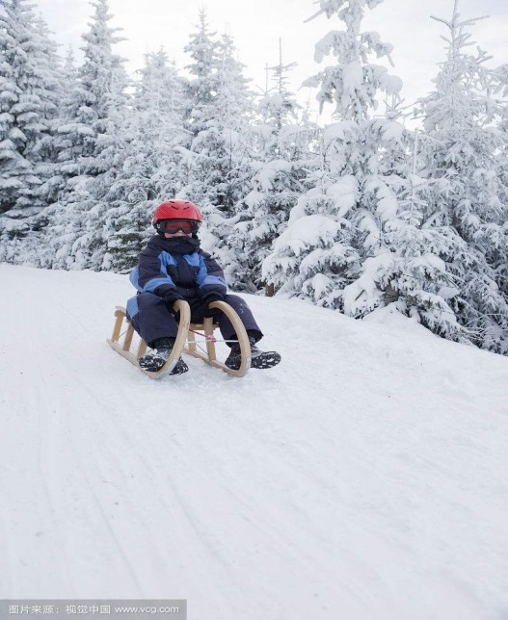
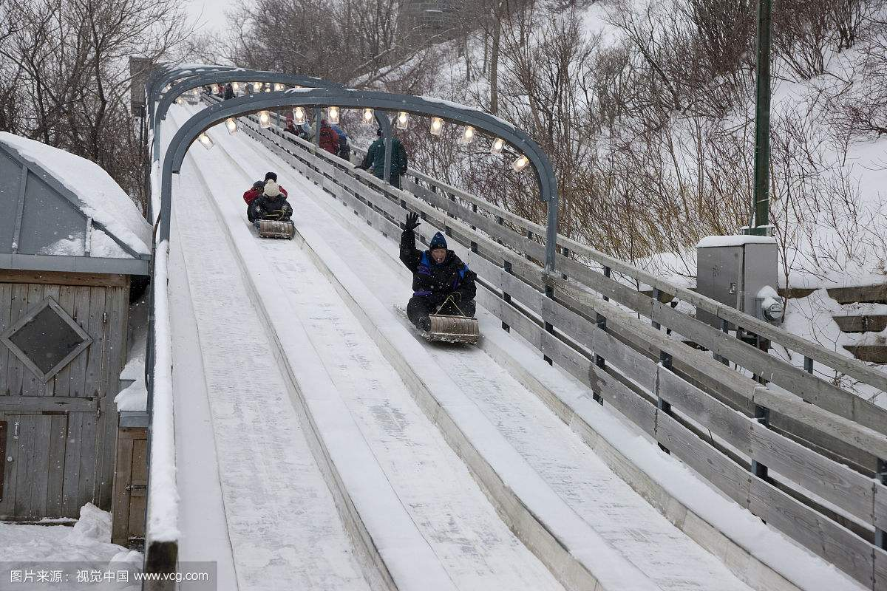
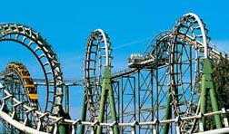
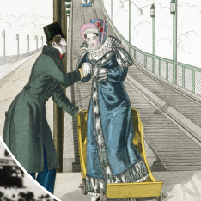
From the first roller coaster, how did roller coasters develop?
Toboggan
Wooden sled
A slide with railway lines & a gravity cart
Kingda Ka

Slide 5
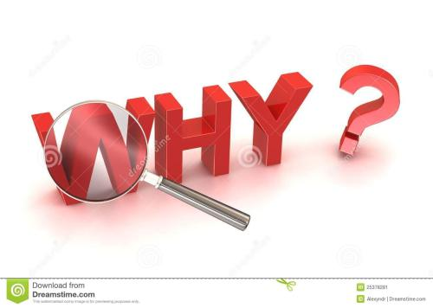
1. How can you feel the fastest speed when you
are riding a roller coaster according to Colin
McWilliam?
2. What is the roller coaster Thirteen like? Why
do you think people can’t ride Thirteen if
they’re too young or too old?
3. What do you think Nicola means by “We drop
like screaming stones”?

Slide 6
Oral presentation
Activity 3
Introduce the development of roller coasters and the reasons for its popularity.

Slide 7
Reading circle
Activity 4
Work in groups of four, read the text again and each undertakes one of the following tasks.
Discussion leader
Word master
Interviewer
Connector

Slide 8
Discussion leader:
1. Raise two questions based on the text and
write down your answers.
2. Share the questions in your group and make
sure your group members can answer them.
3. Ask your group to comment on your
questions and invite them to help you improve
the questions.
4. Organize your group discussion.

Slide 9
Word master:
Collect words or phrases related to the roller
roaster riding experiences. Choose at least five
words, prepare explanations for each word, and
think about the reasons for choosing them.
2. Share your words in your group.
3. Ask your group members to add more words
and explain the reasons.

Slide 10
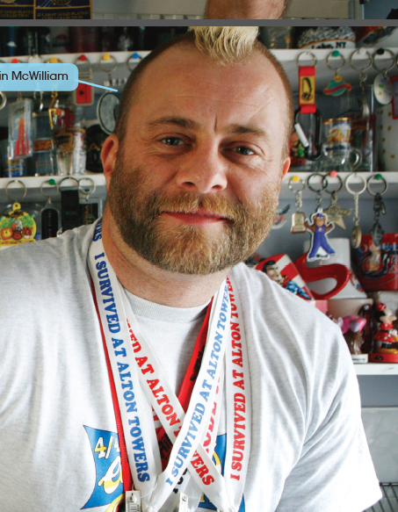
Interviewer: Suppose you have a chance to interview Colin McWilliam.

Slide 11
Prepare two questions to ask Colin McWilliam, for
example, things that you don’t understand about
roller coasters or something you would like to know.
e.g. When did you take your first roller coaster ride?
Why are you so addicted to riding roller coasters?
Can you share your most unforgettable riding experience with us?
Have you ever thought of building your own roller
coaster?
2. Discuss your questions with your group members and
ask them for possible answers.
3. Act out the interview. For example, you say, “Good
morning, Mr Colin McWilliam. I heard that you have ridden
more than 500 different rides. That’s really impressive. May I ask you some questions?”

Slide 12
Connector:
1. Write down your feeling after reading the book
and what the book made you think about. What can you learn from the book? Have you ever had a taste of terror? Is there anything scary or
adventurous that you want to try? What
can terrors or adventures bring to us?
2. Share your connections in your group.
3. Ask your group members what they have
thought about after reading the book.

Slide 13
Discussion
Activity 5
1. Why did the authors write the book?
2. Why do we want a taste of terror sometimes?

Slide 14
Homework
Design a scary roller coaster according to the
illustrations on page 14.
or
Write something about “why we need to be adventurous”.

