Slide 1
Abby’s Lesson 小聪明，大麻烦
多维阅读 第16级

Slide 2
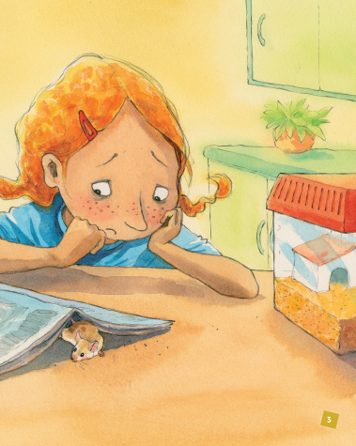
Activity 1
Tobias
1. What’s the title?
2. Who is the girl? What else can you see in the picture?

Slide 3
Activity 1
3. How does the girl feel probably? Can you guess why she feels like that?
4. What might be Abby’s lesson?

Slide 4
Activity 2：Read the book based on the questions.
Setting 1 (before the trip)
What did Abby’s father want her to do and how did she feel about it? What did she decide to do then?
2. What might happen next?

Slide 5
Activity 2：Read the book based on the questions.
Setting 2 (during the trip)
1. What happened at the airport? How did Abby feel when her bag was rolling under the x-ray?
2. What did Abby do on the plane? What happened then? How did Abby feel when the woman found Tobias? How did Abby deal with the situation? What might happen next?

Slide 6
Activity 2：Read the book based on the questions.
snooze: to sleep lightly for a short time
leap: to jump
scream: to cry
shove: to push

Slide 7
Activity 2：Read the book based on the questions.
Setting 3 (at the end of the trip)
1. What did Abby’s father fill in the form before they landed? What may happen next?
2. What did the man at the x-ray do? What did the police officer say to Abby’s father?
3. How did Abby feel? What did she say to the police officer?
4. What happened as a result?

Slide 8
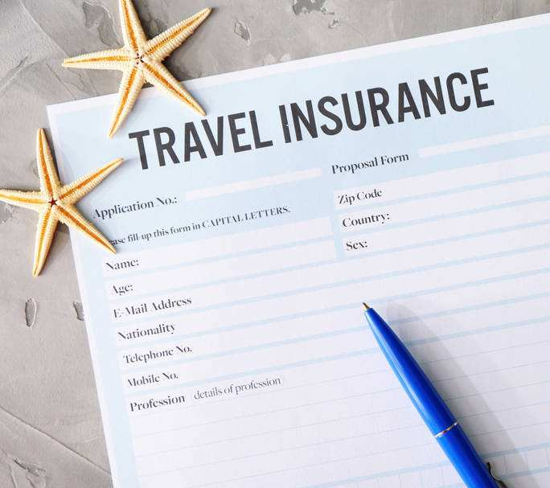
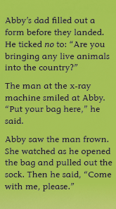
Activity 2：Read the book based on the questions.
frown: to make an angry, unhappy, or confused expression, moving your eyebrows together

Slide 9
Activity 3： Outline the story.
What happened in the story? Please outline the story with some key words.
(You may use a mind map, timeline or other graphic organizers. Or just finish the chart on the worksheet. )

Slide 10
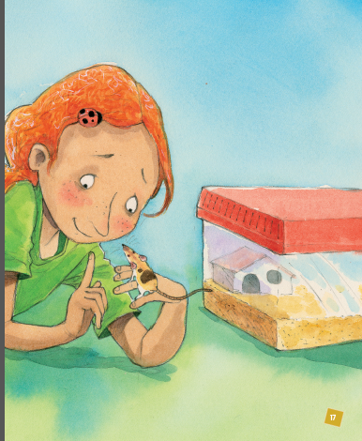
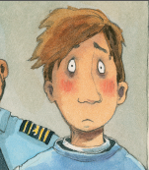
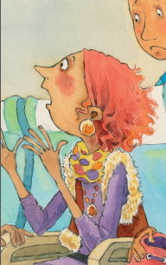
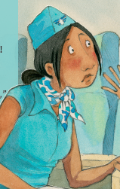
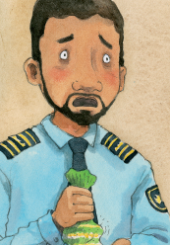
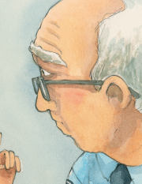
Activity 4： Work in groups and tell the story.
(Each student may choose one of the characters in the story.)

Slide 11
Activity 5： Read the story again and find out Abby’s
actions and the results of each action.

Slide 12
Activity 6：Discuss and share.
1. What is the most important lesson you learned from the story?

Slide 13
Activity 6：Discuss and share.
2. Have you had or have you heard about a similar experience like Abby’s? Please talk about it based on the following questions:
What did you (or the person) do and why?
What happened as a result?
What lesson did you learn from it?

Slide 14
Homework
Work in groups of four to act out the story.
or
Write an email to Abby to express your opinions on her behaviors (行为) or give her some advice.

