Slide 1
Down the Drain
多维阅读第16级
别扔了！

Slide 2
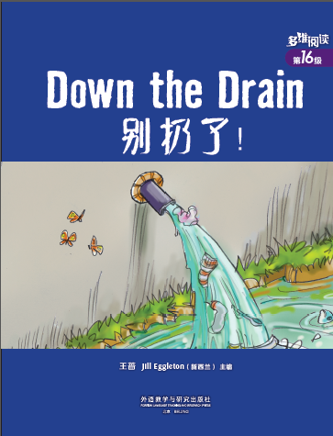
What can you see from the cover?
What’s the title and what do you think the meaning of the title is?
What usually goes down the drain?
Look at the cover, is there anything unusual running from the drain into the river? What are they?

Slide 3
What might happen in the story?
Where do you think the socks and spoons are from?
Who do you think throw them into the drain?
Why do you think they’re thrown into the drain?
What effect do you think they will have on the river?

Slide 4
Please read the book, answer the following questions and work out the structure of the story.
What did Kat and Jack like doing by the river?
What was the “Down the drain” game?
What did Kat and Jack put into the drain? What couldn’t run into the river? Why?
What happened to Mrs Duggan one day when she was going out in her new shoes?
How was the problem solved? Why did Mr and Mrs Duggan get angry?
What did the Duggans do on the beach on weekends? Why do you think they did so?

Slide 5
Please read the book, and add necessary information to finish your mind map.

Slide 6
Please work with your partner, retell the story and think about:
What did Mr and Ms Duggans do and say to their children when they found the problem of the drain and after the problem was solved?
What do you think of their way of teaching their children?

Slide 7
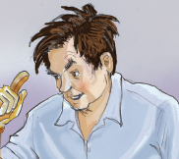
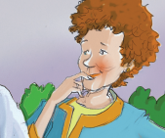
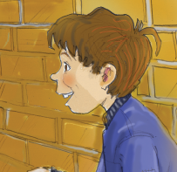
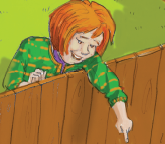
The family will have a “family meeting” to talk about the experience. Please take your role and prepare for the meeting.
Mr Duggan
Mrs Duggan
Jack
Kat
Please refer to Activity 3 in your worksheet. The questions will help you finish the task.

Slide 8
Work in groups and think about:
What do you think of Kat and Jack’s game “Down the drain”?
Have you done anything harmful to “kill” seas, lakes and rivers without realizing it?
Have you done anything to make up for the mistakes? If yes, please introduce what you have done. If no, please tell what you should do in the future.

Slide 9
Choose one of the projects to do:
(1) If you are Kat/Jack, prepare a speech and write it down to tell your classmates about what you did with the drain, what lesson you’ve learnt from the experience and your advice on how to protect seas, lakes and rivers.
(2) What activities in our daily life are wasting water or “killing” seas, lakes and rivers? What do you think you can do in everyday life to avoid “killing” them? Make a poster to show the “cause and effect” relationship between them.
(3) 课后和小组成员一起利用网络或者图书馆查询资料。了解你所在地区的水资源现状（水资源分布、人均水资源占有量、水资源短缺和受污染的原因、目前保护水资源的办法等），制作海报并在全班展出。

