Slide 1
Almost Gone
濒危动物
多维阅读第15级

Slide 2
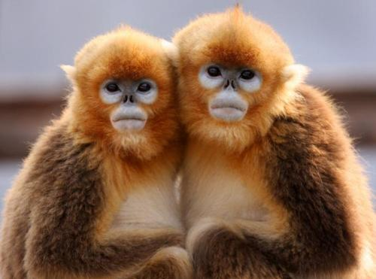
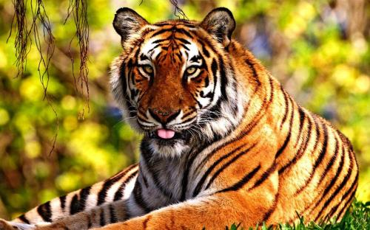
Activity 1
Almost Gone
How do you understand the title Almost Gone?
Can you name some animals that are almost gone?

Slide 3
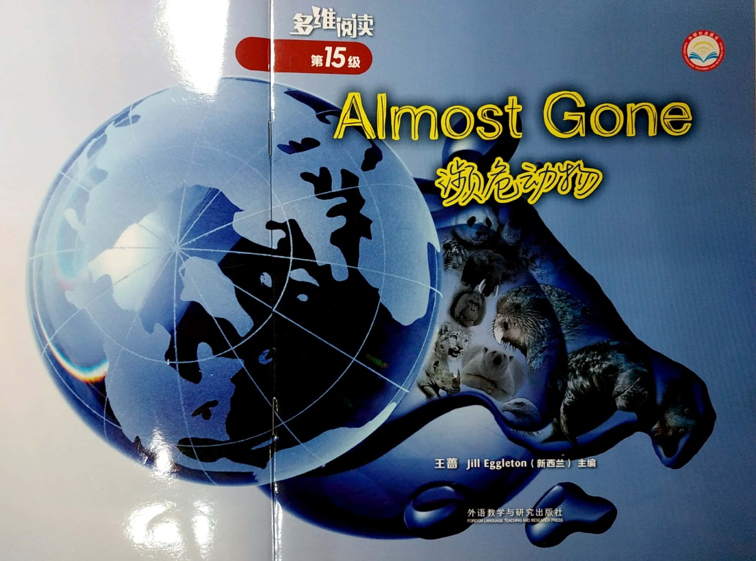
Activity 1
Can you predict what the book might talk about based on the pictures and the title？

Slide 4

Activity 2
1st reading
Almost Gone
Read and check your prediction.
What does the book mainly talk about?

Slide 5
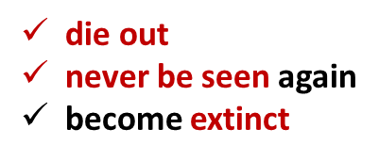
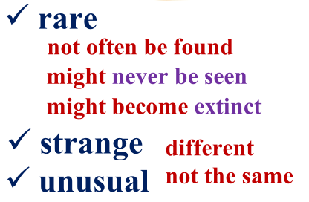
Activity 2
What does the book mainly talk about?
Lost Forever
Looking for Rare Animals
A Strange Parrot
A Bat, a Cat or a Squirrel？
Another Unusual Animal
A Place in the World

Slide 6
Activity 2
2nd reading
Step 1: Read the book and think about the question.
What did Mark and Stephen find about the rare animals?

Slide 7

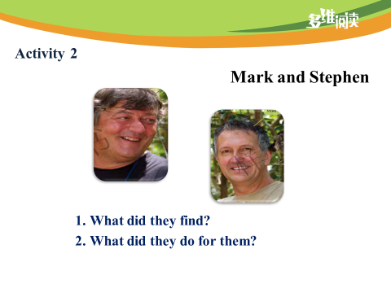
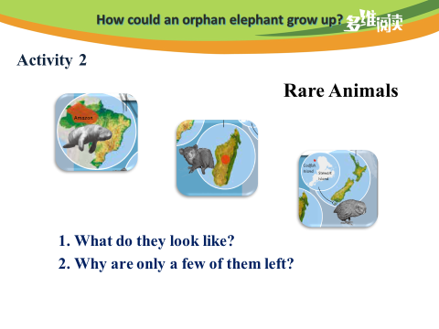
Activity 2
Step 2: Share and discuss in groups.

Slide 8
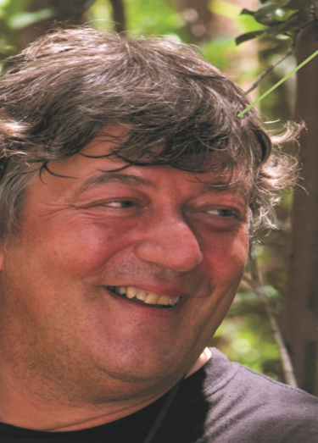
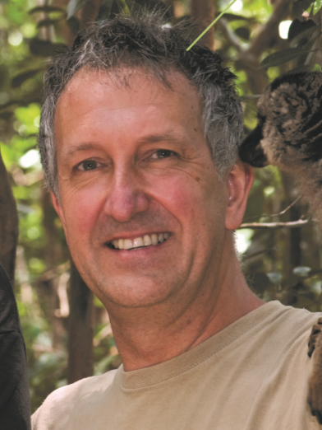
Activity 2
Mark and Stephen
What did they find?
What did they do for them?

Slide 9


Activity 2
Mark and Stephen
What did they find?
Some rare animals: a strange parrot, the aye-aye and an unusual manatee.

Slide 10


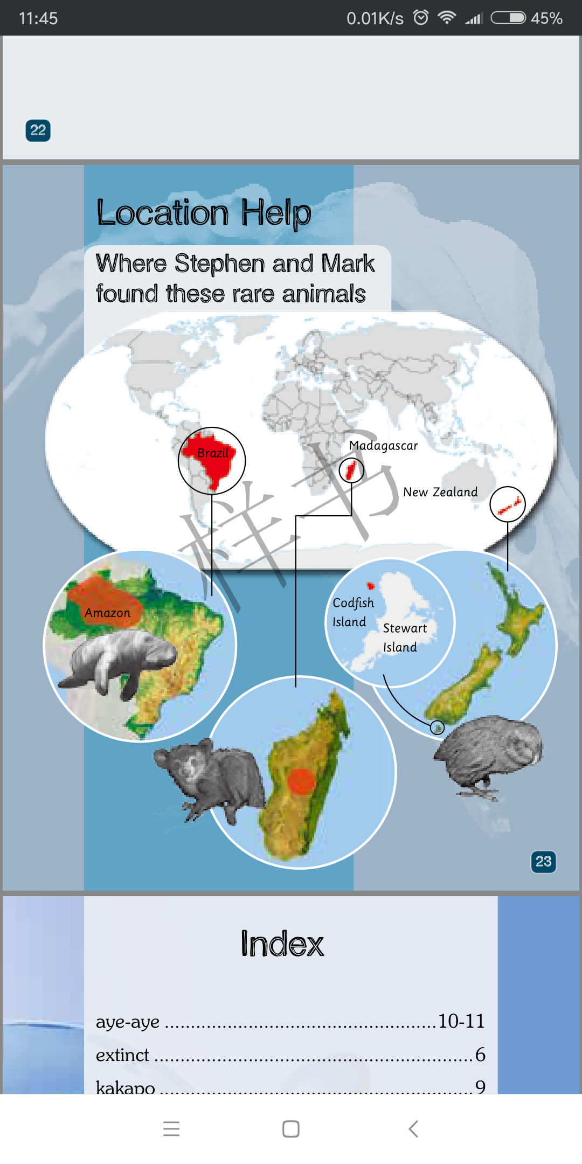
Activity 2
Mark and Stephen
What did they do for them?

Slide 11


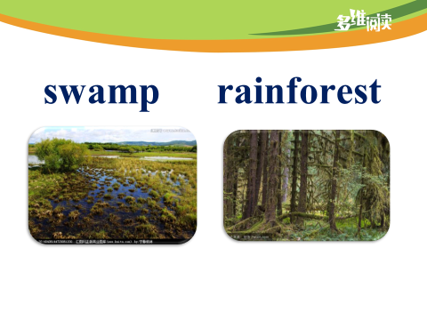
Activity 2
Mark and Stephen
What did they do for them?
Mark and Stephen wanted to find some rare animals. They had to climb mountains and cross rivers. They had to walk through swamps and rainforests.

Slide 12


Activity 2
Mark and Stephen
What did they do for them?
Mark and Stephen made a
film about these animals.

Slide 13
Activity 2
Rare Animals
1. What do they look like?
2. Why are only a few of them left?

Slide 14
Activity 2
A Strange Parrot
What does it look like?
The biggest parrot in the world.
This parrot cannot fly.

Slide 15
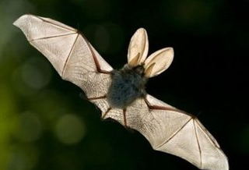
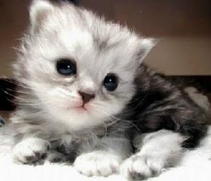
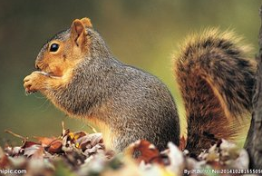
Activity 2
The Aye-aye
What does it look like?
A Bat, a Cat or a Squirrel?
The aye-aye has bright eyes.
It has ears like a bat. It has a body like a cat and a tail like a squirrel.

Slide 16
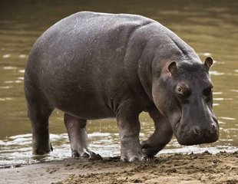
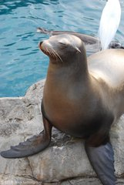
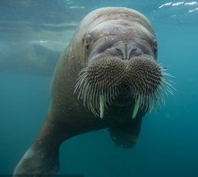
Activity 2
A Manatee
What does it look like?
A manatee looks a bit like a seal and a bit like a hippo. It has whiskers like a walrus.

Slide 17
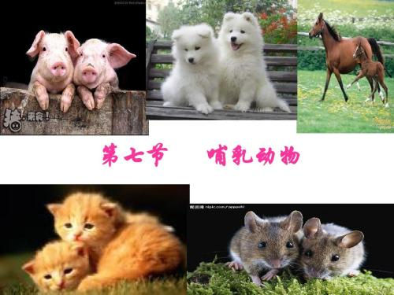
mammal

Slide 18
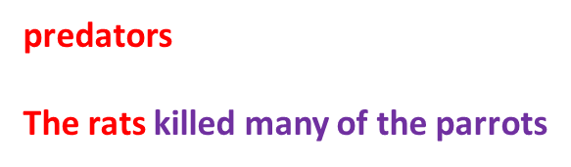
Activity 2
A Strange Parrot
Why are only a few of them left?
Many years ago, it did not have predators. Then animals like rats came to where it lived. The rats killed many of the parrots.

Slide 19
Activity 2
The Aye-aye
Why are only a few of them left?
Some people think the aye-aye is a pest. They think it brings bad luck.
People have cut down a lot of trees where the aye-aye lives, too.
an animal or plant that is a nuisance to people

Slide 20
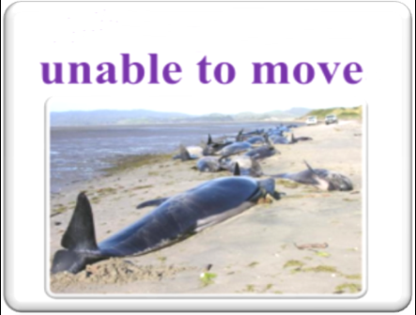
Activity 2
A Manatee
Why are only a few of them left?
In some places where manatees live, the water in the river gets low. Then the manatee swims to where there is more water. Many get stranded.
Some are killed by other animals and people, too.

Slide 21

Activity 2
3rd reading
Draw a mind map to show how and what Mark and Stephen found about the rare animals.
or

Slide 22
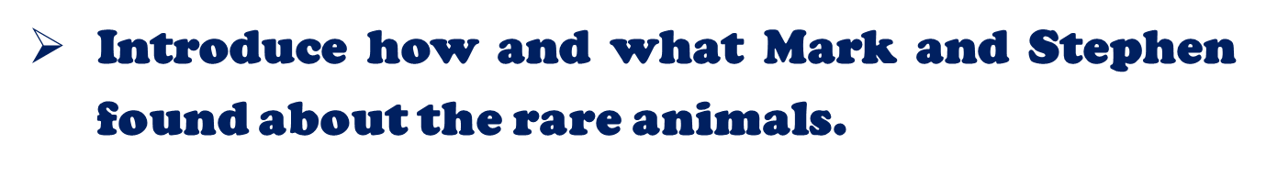
Activity 3

Slide 23
Activity 3
Discussion
About the rare animals
How do you think the parrot might get away from predators?
Why do you think people cut down the trees?
Why do you think the water in the river gets low?
Why do you think some animals might be lost forever?

Slide 24


Activity 3
Discussion
About Mark and Stephen
Why do you think Mark and Stephen wanted to find the rare animals?
Why do you think Mark and Stephen made a film about the animals?
What is the meaning of what Mark and Stephen have done?

Slide 25
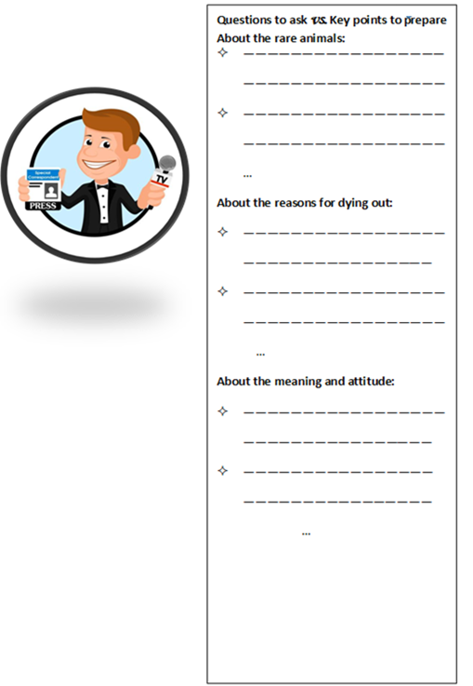
Activity 4
Interview

Slide 26
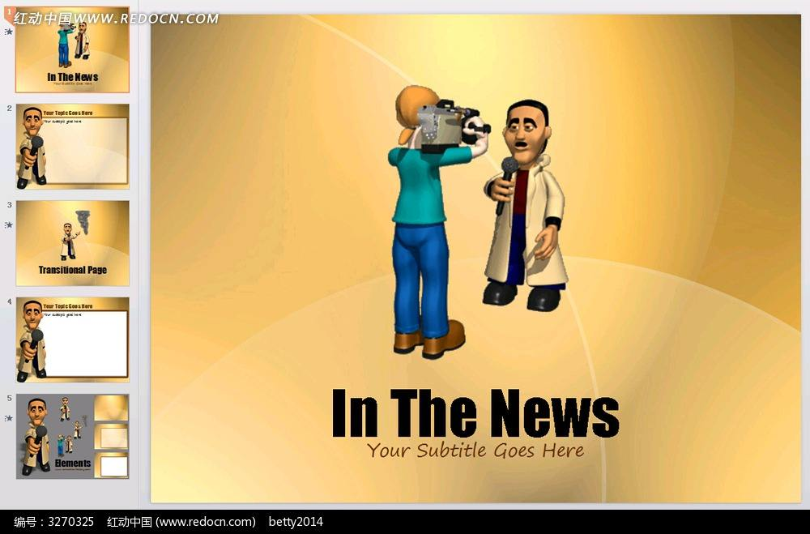





Activity 4
Interview
Interviewer

Slide 27
Activity 5
Discussion
Why does the author write the book?
What can we learn from Mark and Stephen?

Slide 28

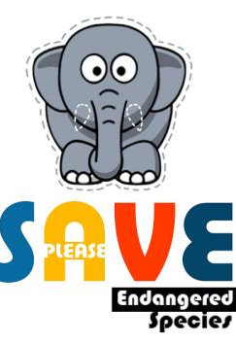
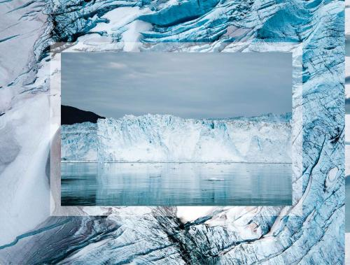



Slide 29
Assignment
Make a poster to introduce how Mark and Stephen looked for the rare animals.
or
Make a poster to introduce other endangered animals.

Slide 30


