Slide 1
A Dream Comes True
多维阅读第15级
威廉的风车

Slide 2
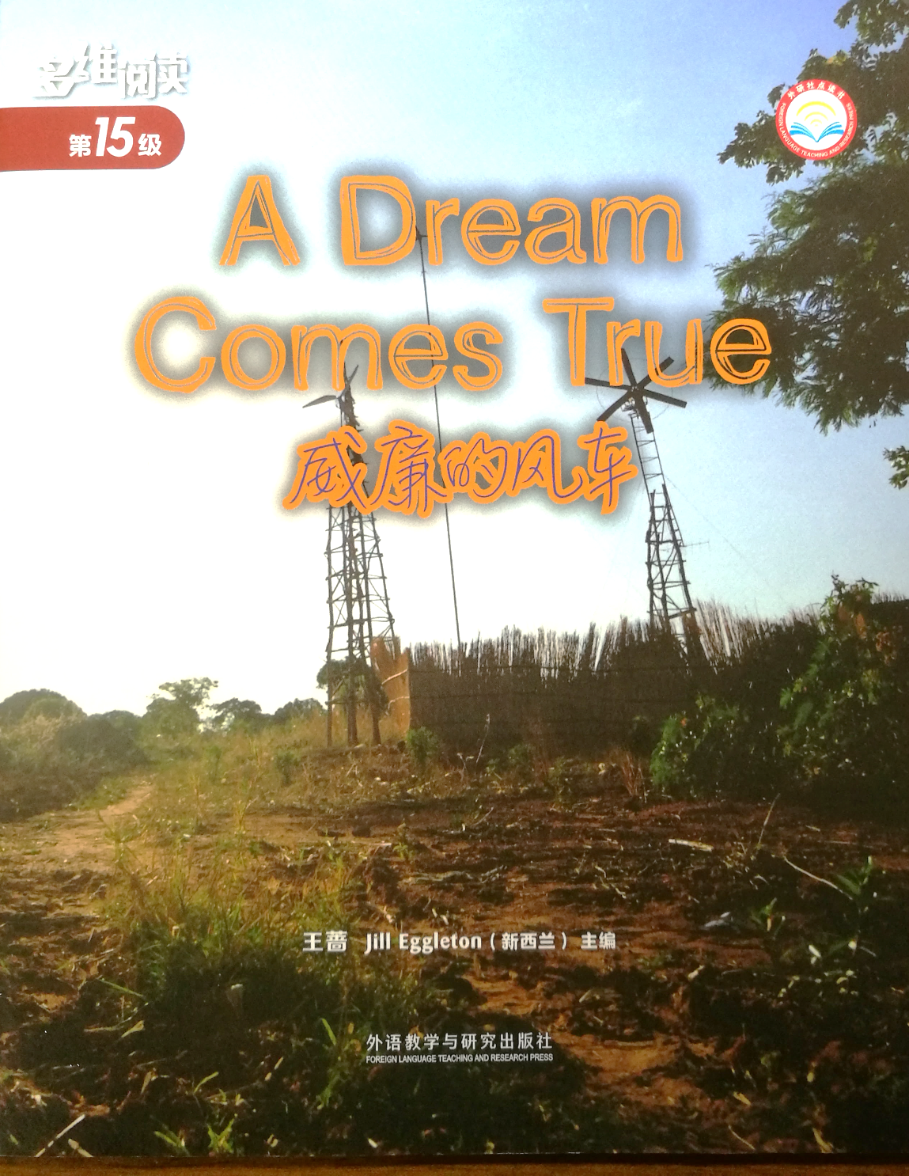
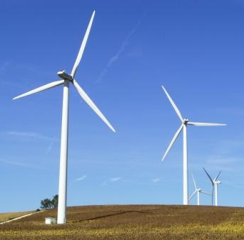
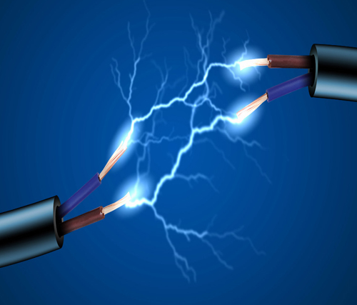
windmill
electricity
Notes:
封面图片
T: Look at the cover of the book. What can you see in the picture?
1. What are the two tall structures?（T teaches the word “windmill”.）
2. Are they the same as those we usually see?
3. What are they used for? （T teaches the word “electricity” if necessary.）
4. What’s the title of the book？Whose dream do you think it might be and what might the dream be?

Slide 3
Read the book and answer the questions.
William’s Dream
1. Where did William live?
2. How do people there make a living?
3. What was William interested in?
4. What did he often do? Why?
5. Why did William want to go to high
school?
6. What was William’s dream?

Slide 4
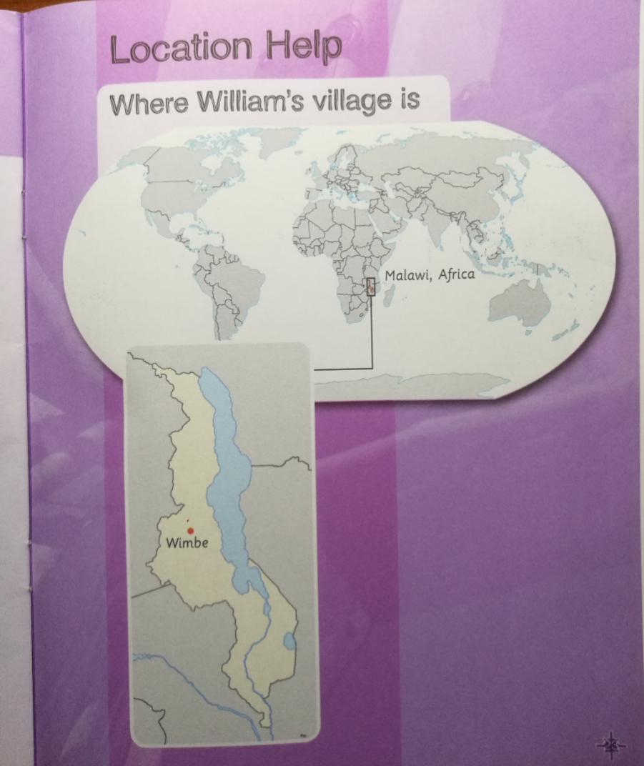
William’s Dream
1. Where did William live?
Malawi, Africa

Slide 5
William’s Dream
2. How do people there make a living?
They grow crops.
3. What was William interested in?
4. What did he often do? Why?
He was really interested in machines.
He often took the machines apart and
put them back together. He liked to find
out how they worked.

Slide 6
William’s Dream
5. Why did William want to go to high
school?
6. What was William’s dream?
Because he wanted to learn as much
as he could.
His dream was to learn how to help his
family.

Slide 7
A Difficult Time
What problems did the drought cause to William’s family?
They didn’t have much food or money.
They could have only one meal a day.
Sometimes William’s father went
without a meal so that his family could
survive.
William’s parents didn’t have money
for William to go to high school.

Slide 8
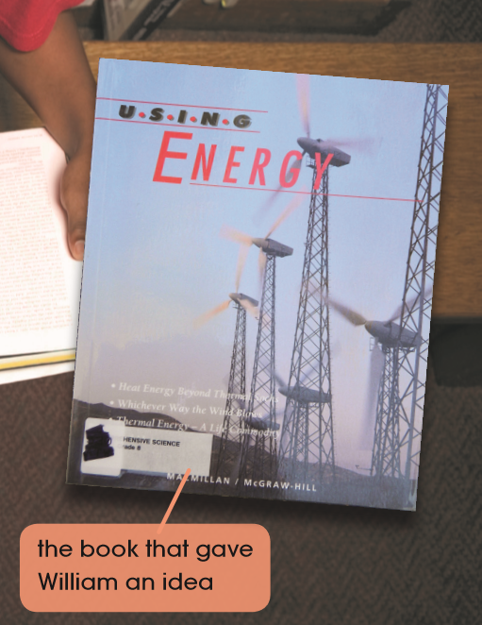
William’s Idea
Where did William go when
he couldn’t go to school?
2. What book did he see one day?
3. What idea did the book give him?
He went to the library.
He saw a book with windmills on the
cover.
He could build a windmill.

Slide 9
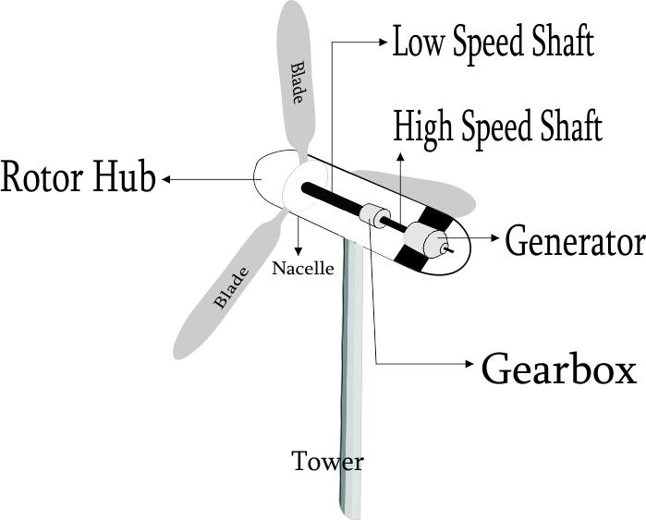
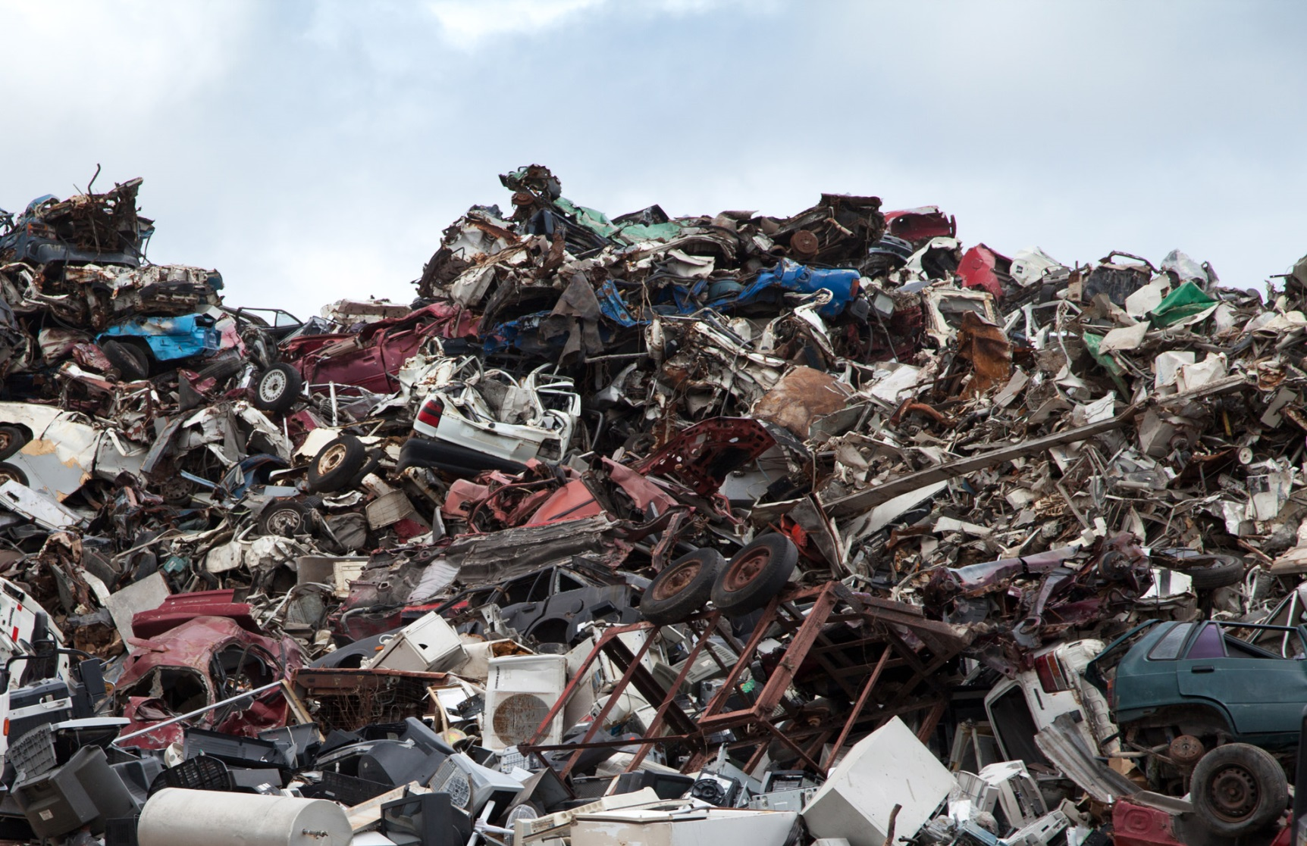
Solving Problems
1. How did William learn the book?
2. Where did William go to find what he
needed to make a windmill?
A scrapyard
He used a dictionary to work out the
words he didn’t know. He followed the
diagrams in the book.
A diagram
He went to scrapyards to find what he
needed.

Slide 10
Solving Problems
3. What did some kids do and say about
William’s action? How did William react?
They laughed at him and said he was
crazy!
William didn’t stop his work.

Slide 11
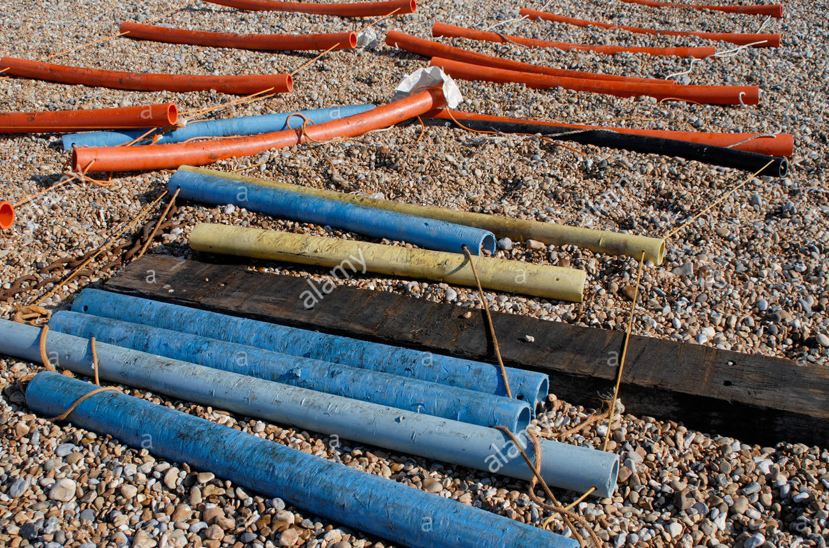
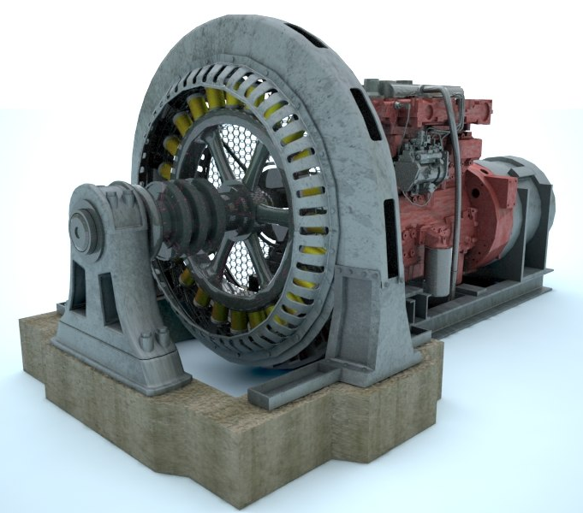
From Old Junk to a Windmill
1. What did William and his friends find in
the scrapyards?
2. What did the people do when he tried to
put it up?
They found plastic pipes, a broken
bicycle and an old generator.
plastic pipes
They laughed at him.
a generator

Slide 12
From Old Junk to a Windmill
3. Did he succeed? What did people do then?
Yes, he did.
They began to cheer.

Slide 13
A New Life for Wimbe
1. How did William’s windmill change the
life of the people in Wimbe?
The women didn’t have to walk for hours
to get water. The windmill pumped water
for them and their crops.
The homes in Wimbe had lights at night.

Slide 14
A New Life for Wimbe
2. What did William prove?
He proved that a small idea can grow
into something big. You just have to
keep trying.

Slide 15
Draw a mind map about William’s story.

Slide 16
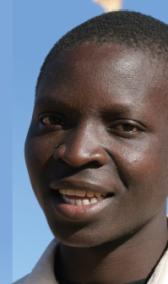
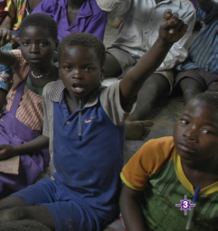
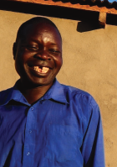
Choose a role to tell the story with your
mind map.
another child
in Wimbe
William
William’s father

Slide 17
List the reasons.
Why could William make the windmill successfully and make his dream come true?
_________________________________________________________
2. __________________________________________________________
3. __________________________________________________________
4. __________________________________________________________
…

Slide 18
Discuss in groups.
1. What do you think of William? What is
the most important thing you have learnt from him?
2. What dream did you have?
What difficulty did you have in realizing your dream?
How did you deal with the difficulty?
Do you think your attitude and solution
were right or proper?
If not, what do you think you should do?

Slide 19
作业：
写写你读完这个故事的体会和感受，可以
结合自己对于梦想、学习的态度以及遇到
困难时的表现进行反思；
2.在网上查阅有关威廉的风车后来发展的情
况，并讲述给你的同学；
3.和你的同伴在网上搜集有关风车制造的知
识，共同完成一个poster, 展示利用风车
发电的原理和优势。

