Slide 1
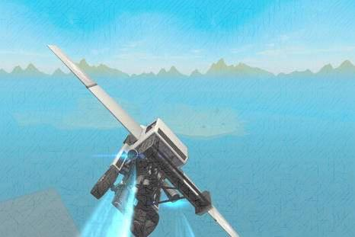
多维阅读第15级
Skycar

Slide 2
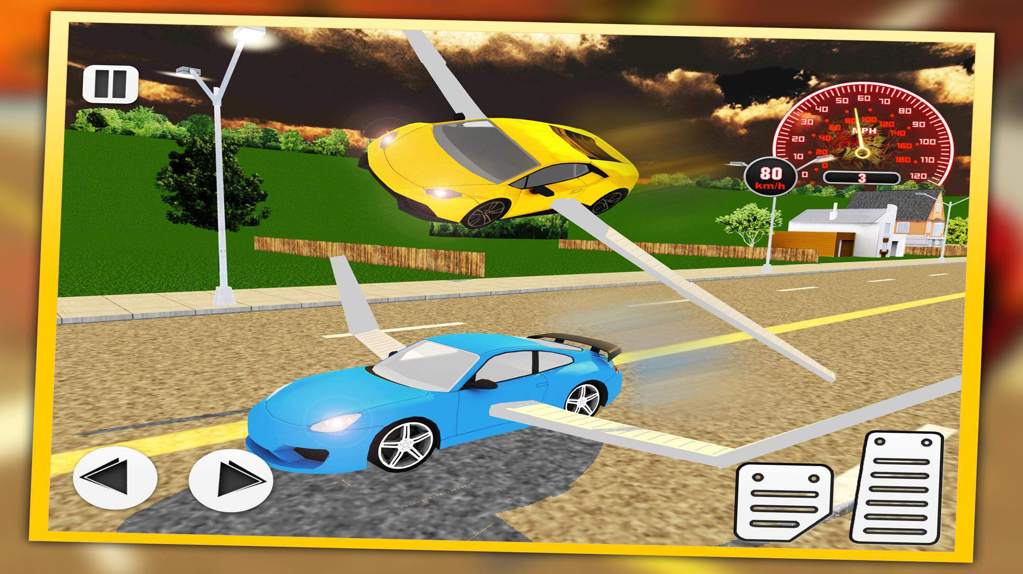
Activity 1
What do you think the book will be about?

Slide 3
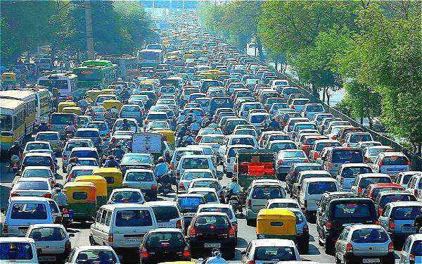
Problem
Activity 2
1. What problem happens everywhere?
2. How do people feel about the problem?

Slide 4
Analysis
1. What is the possible solution to this problem?
2. What is the problem with the possible solution?

Slide 5
Solution
1. Who solved the problem?
2. How does the skycar work?
3. How did the test journey go?
4. What do you think the future of the skycar would be like?

Slide 6
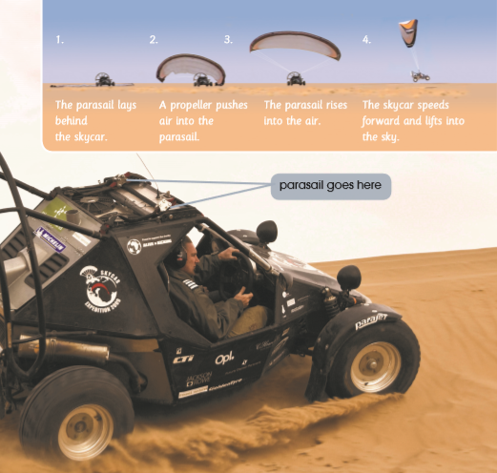
Talk about how the skycar works.
Activity 3

Slide 7
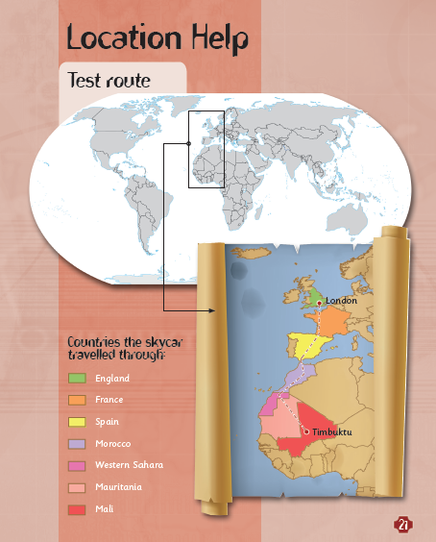
Describe the test journey.

Slide 8
Landscape

Slide 9
Draw out the framework of the skycar.
Activity 4

Slide 10
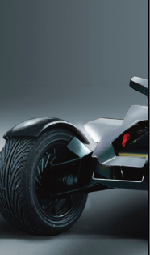
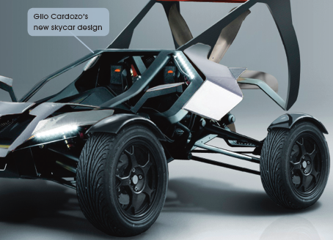
Analysis
Analyze the strengths and weaknesses of the skycar.

Slide 11
Discussion
1. Suppose the skycar is coming to our city, do you think it’s a good or bad idea? Why?
2. Put forward suggestions to have the skycar zoom around in the sky in our city.

Slide 12
Discussion
Activity 5
1. What led to Gilo Cardozo’s success?
2. Why does the author write this book?
3. In everyday life, how can we meet challenges and overcome difficulties?

Slide 13
Assignment（二选一）
1. Design a poster or advertisement to promote the skycar.
2. Write about how you solve a problem or
challenge in your life.

Slide 14
Thank you!

