Slide 1
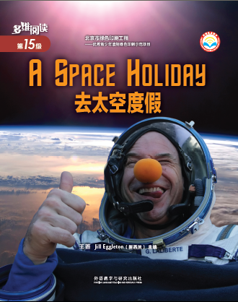
Who is the person on the cover? Where is he?
Wearing a clown nose
Guy Laliberte
In space
In a space suit

Slide 2
Work in groups and discuss:
Have you or anyone around you ever been to space for a holiday? Why? Why not?
What do you think people can do or see on a space holiday?
What difficulties do you think people will have on a space holiday?
What can people do to overcome the difficulties?

Slide 3
Read the book and find out:
Before the space holiday:
What’s Guy’s dream? Why could he make his dream come true?
To have a holiday in space.
He made a lot of money and could pay millions of dollars to make his dream come true.
What was Guy doing in the picture on page 5? Why did Guy have to do so?
He was getting tested in a chair that spun around and around. He had to get his body ready and be very fit for the space holiday.
Think about the questions above and finish Activity 1 in your worksheet.

Slide 4
Read the book and find out:
During the space holiday:
Where was Guy in the picture on page 7? What was he going to do?
Who were the group of people in the picture on page 7? What were they cheering for?
What did Guy have to learn in space? Why did he have to learn these?
What was the message Guy wanted to send from space to people on Earth?
Think about the questions above and finish Activity 1 in your worksheet.

Slide 5
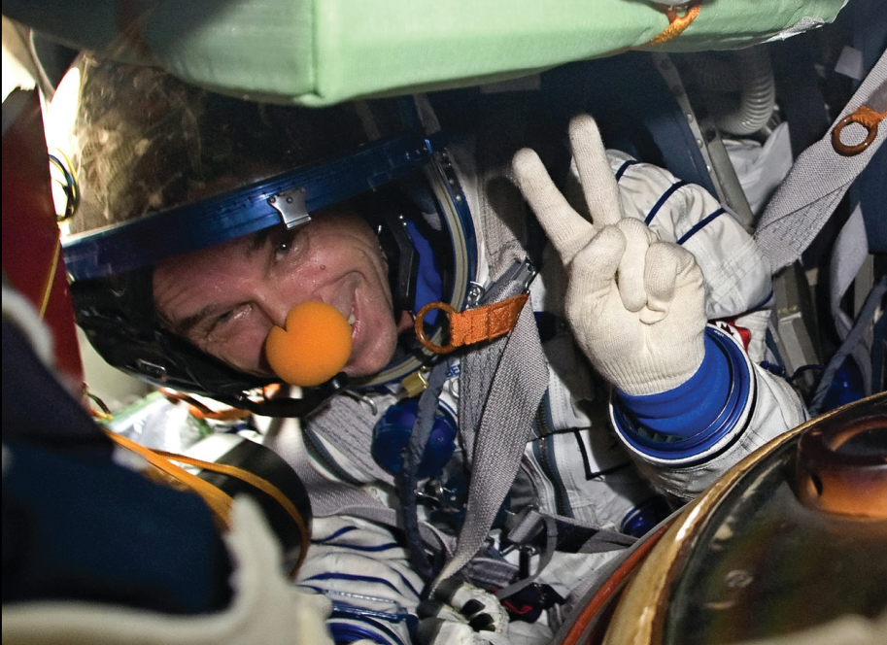
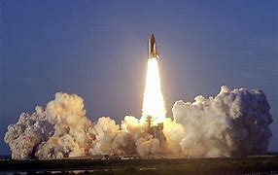
During the space holiday:
Where was Guy in the picture on page 7? What was he going to do?
He was in the hatch and ready to blast off.

Slide 6
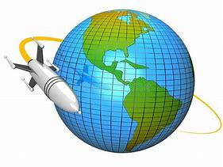
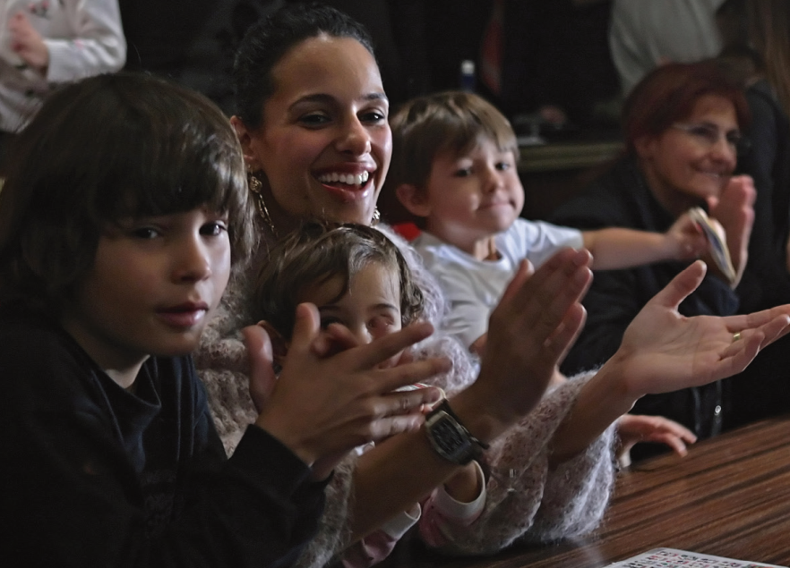
During the space holiday:
Who were the group of people in the picture on page 7? What were they cheering for?
Guy’s family.
Because the rocket reached the orbit safely.

Slide 7
During the space holiday:
What did Guy have to learn in space? Why did he have to learn these?
He had to learn different ways to eat, drink, go to the bathroom and what to do in an emergency.
Because there’s almost no gravity in space.
a force that pulls everything towards Earth
something very dangerous that happens suddenly

Slide 8
During the space holiday:
What was the message Guy wanted to send from space to people on Earth?
He wanted people to think about how important clean water is for everyone on Earth and remember to take care of Earth.

Slide 9
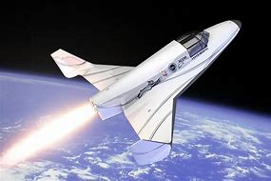
Read the book and find out:
After the space holiday:
What are scientists’ ideas on space holidays in the future?
There could be a spacecraft for short trips or a fancy hotel that orbits Earth.
Think about the question above and finish Activity 1 in your worksheet.

Slide 10
Work with your partner. Suppose one of you is Guy and the other is a reporter.
Guy--you’ll talk about your experiences of the space holiday in an interview and answer the questions raised by the “reporter”.
Reporter--you’ll interview “Guy” and ask him questions about his experiences and purpose of the space holiday.
Read the book again and prepare for the interview respectively.

Slide 11
Work in groups and think about what space holiday would be like in the future.
How will people go to space for a holiday?
What will people enjoy doing during a space holiday?
What difficulties will people have during a space holiday? What will people do to overcome them?

Slide 12
Choose one of the projects to finish:
Finish the task on page 14 and make a poster of it.
(2) Work in groups, get more information about Poetic Social Mission, and make a poster of it. You may get help on the Internet or from a library.

