Slide 1

多维阅读第15级
Sam’s Story

Slide 2


What can you see in the picture?

Slide 3

What’s the name of the person in the picture?
How does he look like?

Slide 4
What might be talked about in the book?
What do you want to read about?

Slide 5

Reading Time
Is your prediction right?
Can you find what you want to know in the book?

Slide 6
What can you learn about Sam?
Learning tips:
Collect key information on Sam.
Use the information to draw a mind-map.

Slide 7
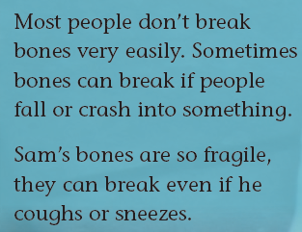

fragile

Slide 8


What did Sam think about his unusual appearance?
What did he want to do?

Slide 9

How did Sam’s wheelchairs help him?
How did Sam deal with the problems caused by the wheelchairs?
How did Sam help other disabled people?
What do you think of his words on page 12?

Slide 10
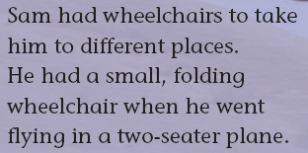
folding

Slide 11
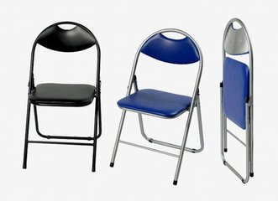
folding
folding chairs

Slide 12
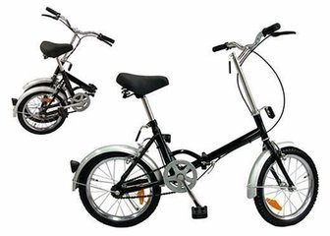
folding
folding bicycles

Slide 13
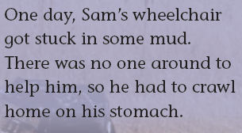
crawl

Slide 14

crawl

Slide 15
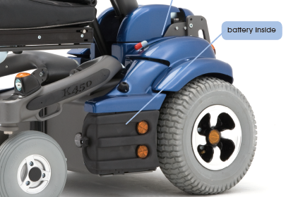

battery

Slide 16
Reading Time
What kind of person is Sam?

Slide 17

Discussion
What kind of person is Sam?
Learning tips:
Add more information to your mind-map.

Slide 18
Story Time
Let’s share Sam’s story together.
Learning tips:
Tell Sam’s story with the help of your mind-map.

Slide 19


Role Play—
An interview about Sam’s basic information and personalities

Slide 20
Discussion
What attitude shall we hold toward life when we are faced with difficulties?
Can you give any examples to support your opinion?

Slide 21
Further Study
Option One: Work in group to make a poster introducing a person similar to Sam. Present the poster in class.
Option Two: Suppose you had met Sam, who was visiting China! Work in groups to direct and perform a play titled “ I Met Sam in His Wheelchair!”.
Learning tips:
Choose one task. Finish it with the help of what you learn from the book.

