Slide 1
多维阅读第15级
One More Time
乔，不可以

Slide 2
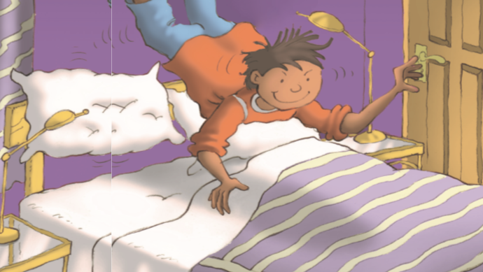
One More Time
Notes:
学生看封面预测故事内容，教师提问：
1. What is the boy doing?
2. What’s the title and how do you understand it?
3. What might happen if he did it one more time?

Slide 3
Who?
What?
Where ?
Why?
Notes:
学生看 Setting 1, 根据图片预测内容。

Slide 4
Read Setting 1 to find out:
1. What did Joe’s mum want him to do and how did he feel about it?
What did he do then?
What did his mum say to him and how did he react?
4. What happened as a result?
5. How did Joe solve the problem?
Notes:
学生阅读验证预测，同时回答问题，感知和提取故事基本要素。

Slide 5
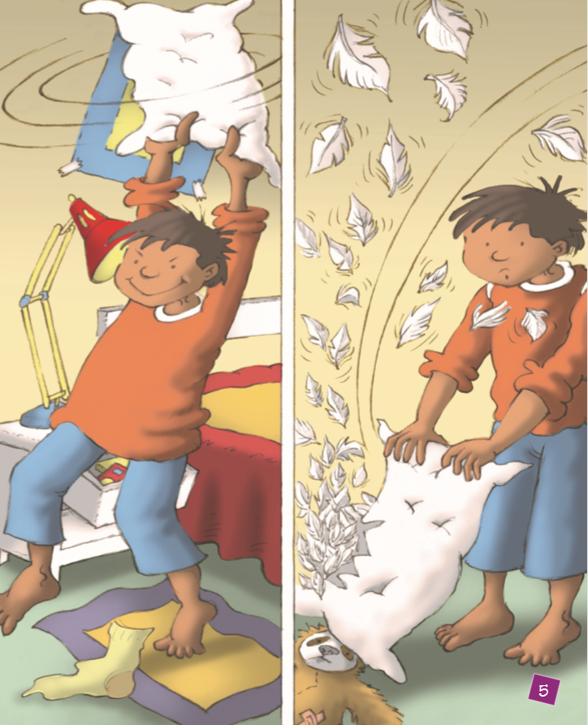
Guess the meaning of the words.
Joe whacked the sloth with the pillow, but it didn’t bulge. He wracked it again and again.
He gave the sloth a huge whack. But the pillow ripped and out floated a cloud of white feathers.
hit sth. hard
became torn

Slide 6
Who?
What?
Where ?
Why?
Notes:
教师提问：What might happen next?
学生看 Setting 2, 根据图片预测内容。

Slide 7
Read Setting 2 to find out:
How did Joe clean the bird cage? Why?
What did his mum say to him and how did he react?
What happened as a result?
How did Joe solve the problem?
Notes:
学生阅读验证预测，同时回答问题，感知和提取故事基本要素。

Slide 8
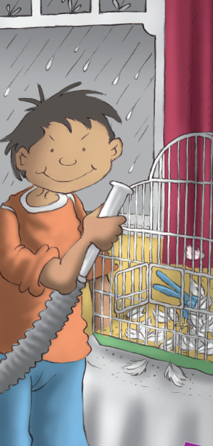
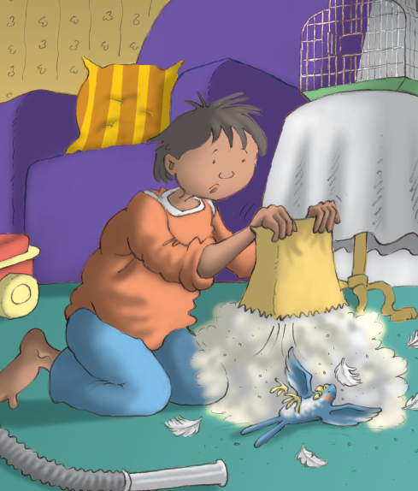
Guess the meaning of the words.
Joe poked the cleaner into a pile of feathers. They flew like snowflakes around the cage. He didn’t notice the bird and it was sucked up the hosepipe.
pushed
drawn in

Slide 9
Who?
What?
Where ?
Why?
Notes:
教师提问：What might happen next?
学生看 Setting 3, 根据图片预测内容。

Slide 10
Read Setting 3 to find out:
What did Joe do next? Why?
What did his mum say to him and how did he react?
What happened as a result?
Notes:
学生阅读验证预测同时回答问题，感知和提取故事基本要素

Slide 11
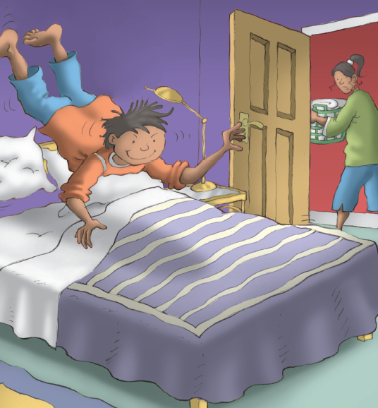
Guess the meaning of the words.
Joe had just finished a really big flip when his mum went past the door.
Joe bounced really high. For just a second he felt as if he was flying like a bird.
turn over
moved up and down

Slide 12
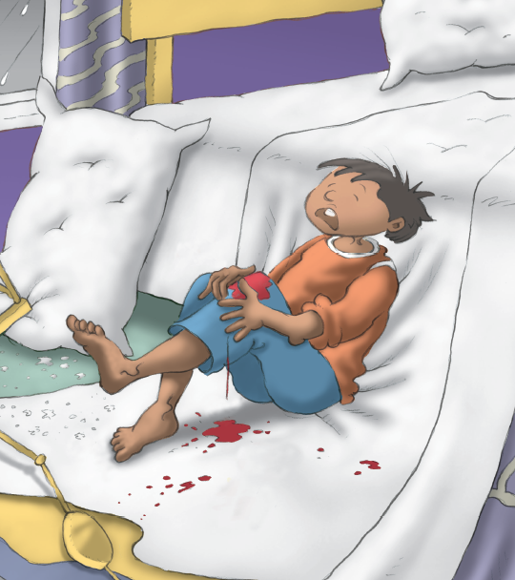
Guess the meaning of the words.
broke into small pieces
Then he lost control. His feet came down on a glass table. A lamp crashed onto the floor and the glass table shattered. Joe saw red blood dripping on the white sheets and he screamed. It was a long, loud scream and then he fainted.
falling in drops
gave a loud and high cry

Slide 13
Draw a mind-map to show the development of the story.
in Mum’s bedroom
in the living room
in Joe’s bedroom
Notes:
如果需要，可以示例学生如上图所示绘制思维导图。
绘制过程中，教师提醒学生不要抄写大段文字，只需要写关键词。

Slide 14
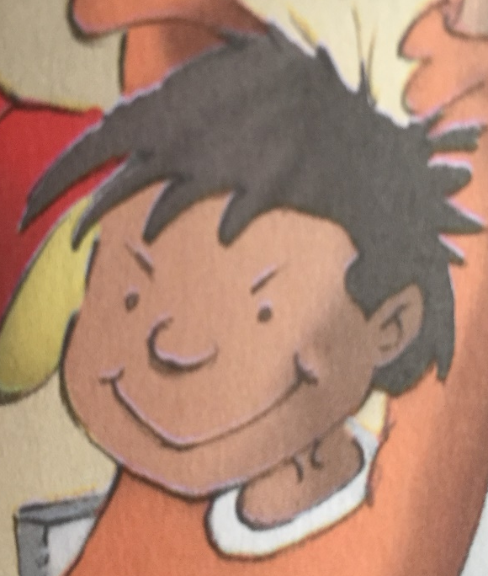
Work in pairs and tell the story.
It was raining today. My son Joe didn’t go out to play …
It was raining today. I didn’t go out to play …
Notes:
学生两人一组，一人从妈妈的角度讲述故事，一人从Joe的角度讲述故事，只能依据思维导图，不能看书。
同伴练习，然后全班分享。

Slide 15
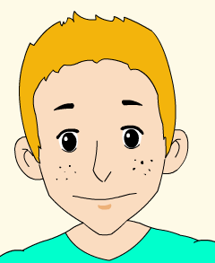
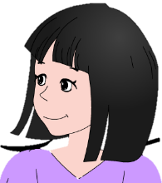
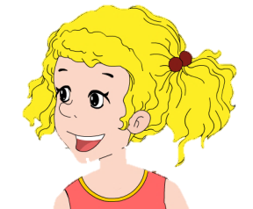
Read and share in groups of four.
We are Joe’s classmates.
Black
Ella
Curly
Betty
Notes:
教师介绍阅读圈活动。

Slide 16
Read and think:
Ella
Differences
Why didn’t Mum just stop Joe from doing all that?
What will your mum do if you refuse to follow her rules?
Can you find out some similarities or differences about education between Joe’s family and your family?
Similarities

Slide 17
Read and think:
Betty
Among all the things Joe did, what are sensible and what are not? Try to give your reasons.
I think it’s sensible/it isn’t sensible for Joe to ___________________________________________ because ___________________________________.

Slide 18
Come up with other ways to avoid the problems.
Black
What would you do:
when feeling bored on a rainy day?
when your mum told you not to do something?
after making some trouble?

Slide 19
Share similar experience.
Curly
1. What did you (or the person) do and why?
2. What happened as a result?
3. How did you (or the person) solve the problem?
4. What did you learn from it?

Slide 20
Discuss and share in groups.
Why is the story titled One More Time?
What is the most important lesson you learn from the story?

Slide 21
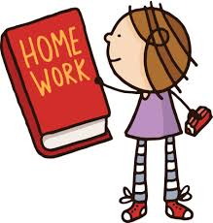
Assignment
Please choose one to finish:
Write a card to Joe to express your opinions on his behaviors or give him some advice.
Write your opinions about this story or family education. You can also reflect upon (反思) your own ways of doing things.
Work in groups of four to act out: Imagine you and your classmates go to visit Joe in the hospital. What would you say to him and how would Joe respond to you?

