Slide 1
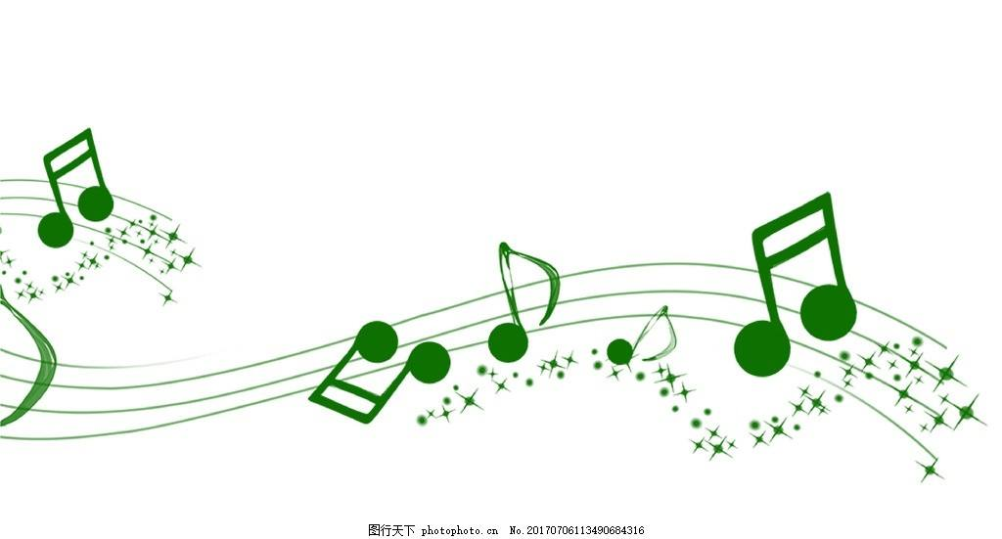
多维阅读 第15级
Chicken Beat

Slide 2
Look at the cover of the book.
1. What can you see from the cover?
2. What’s the title and what do you think the meaning of the title is?
3. How many characters are there in the book? And who are they?

Slide 3
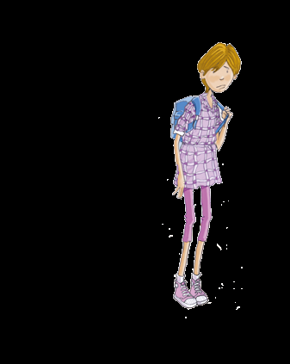
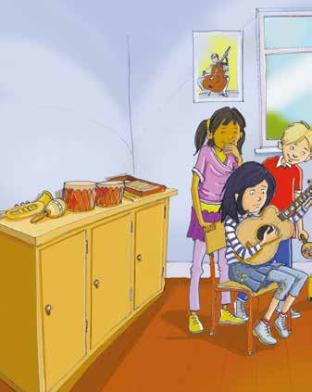
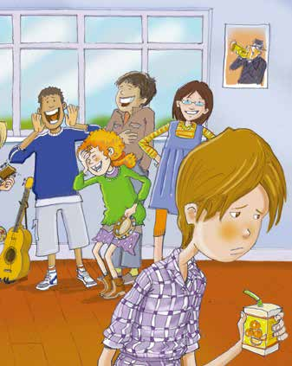
Read pp 2-5.
1. What was Betty like?
2. What did the kids do to Betty?
3. What was Ella like?
4. What did Ella do to Betty?
Tall but not popular.
They made up a silly chant.
Cool and popular.
Nothing.

Slide 4
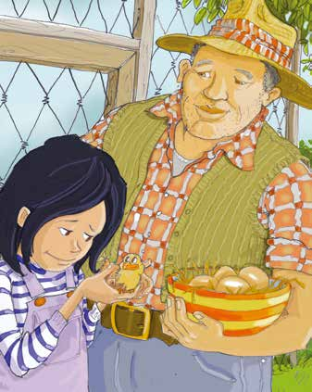
Read pp 6-9.
1. What did Ella see one weekend?
2. What happened to the little chicken?
3. What did Ella do to the little chicken?
A little chicken with few feathers.
Other chichens pushed it away and pecked it.
She took it home.

Slide 5
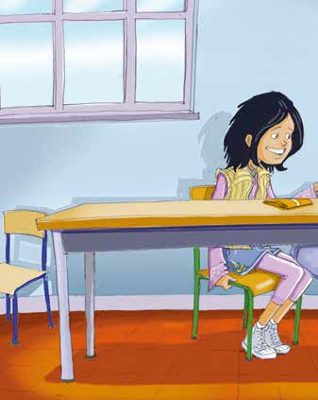
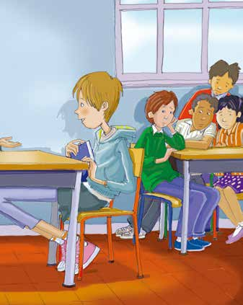
Read pp 10-17.
1. What did Ella do to Betty?
2. What did Ella and Betty do together?
3. What’s the name of the band?
4. What happened to Betty finally?
She talked to Betty.
They started a band.
Chicken Beat.
Betty became the band leader and they won a competition.
Betty finally accepted who she was.

Slide 6
Draw a mind-map to
show how Ella helpd Betty.

Slide 7
Please retell the story to one of your friends.

Slide 8
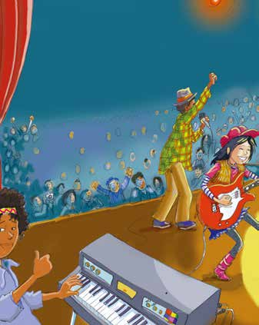
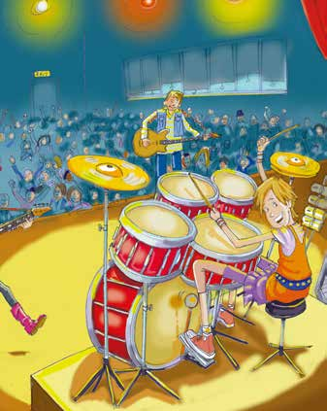
Discuss with your partner.
Why could Betty become popular?

Slide 9
Challenge yourself.
Imagine you are Ella and Betty and their classmates Black and Curly. Please take your own challenges and prepare for them.
Choose one:
Cultural Collector | Creative Connector
Character Captain | Moral Master

Slide 10
Cultural Collector
Can you find out some cultural similarities and differences between Betty and Ella’s school and your school?
Character Captain
1. If you are Betty, do you like yourself? Why or why not？
2. If you are Black, do you like Betty? Why or why not？

Slide 11
Creative Connector
If you are Curly, can you share some similar experience like Betty or Ella with the pattern?
I recall a similar story like Betty’s…
I recall a similar story like Ella’s…
Moral Master
1. If you are Ella, will you help Betty? Why or why not?
2. If you are Betty, what will you do to get on well with others?

Slide 12
Challenge yourself.
Cultural Collector Similarities and differences. | Creative Connector Similar experience like Betty or Ella.
Character Captain 1. If you are Betty, do you like yourself? Why or why not？ 2. If you are Black, do you like Betty? Why or why not？ | Moral Master 1. If you are Ella, will you help Betty? Why or why not? 2. If you are Betty, what will you do to get on well with others?

Slide 13
First, find out some cultural similarities and differences between Betty and Ella’s school and your school.
Then, imagine you are Ella. Your job is to answer one question.
If you are Ella, will you help Betty? Why or why not?
Imagine you are Betty. Your job is to answer two questions.
If you are Betty, do you like yourself? Why or why not?
If you are Betty, what will you do to get on well with others?

Slide 14
Imagine you are Black. Your job is to answer one question.
If you are Black, do you like Betty? Why or why not?
Imagine you are Curly. Your job is to share a similar experience like Betty or Ella with the pattern:
I recall a similar story like Betty’s…
I recall a similar story like Ella’s…

Slide 15
Let’s complete the poem.
I am Ella.
I am a ______ kid in my class.
I didn't care about Betty at first because_________.
But later I found that Betty_________________.
I began to help Betty because ______________.
We started a band.
I am Betty.
I am a _____ kid in my class.
I didn‘t like myself at first because ______________.
But later I found that I ___________________.
I started to like myself because ______________.
We started a band named _______________.

Slide 16
Role-play
Imagine Ella never helped Betty, what would the story be like?
Work in groups of four and each student chooses one of the roles.

Slide 17
Think and share.
What will you do if
you are not welcomed in class?
one of your classmates is not welcomed in class?
Remember:
True happiness comes from helping others.

Slide 18
Assignment
Write down what you should do if you are not welcomed in class.
or
Write down what you should do if you find one of your classmates is not welcomed in class.

Slide 19
Thank you!

