Slide 1
Orphan Elephants
多维阅读第14级

Slide 2
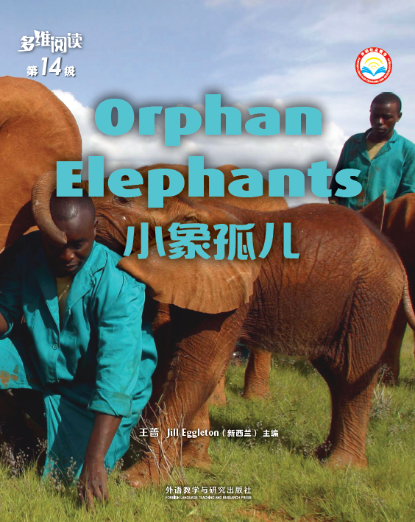
Read the cover of the book and answer the questions.
What can you see in the picture?
2. What’s the title? Can
you guess why these
elephants become
orphans?

Slide 3
Enjoy the reading time！

Slide 4
Read pages 2-5 and answer the question.
Why do these elephants become orphans?
REASON 1: Their mothers have been killed.
REASON 2: They are separated from mothers when they cross rivers because of dangerous environment.

Slide 5
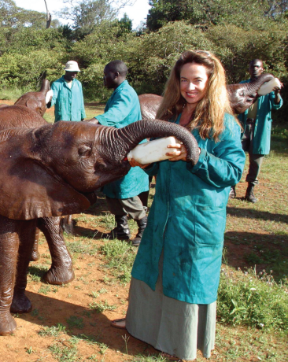
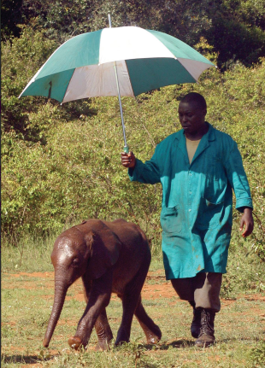
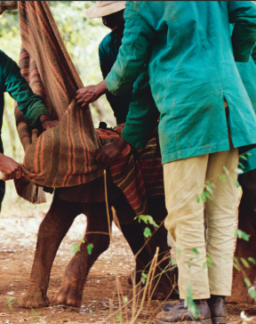
Guess the story.
When elephants become orphans, …
1. Where are they?
2. What are people doing there for them?

Slide 6
Read pages 6-13 and answer the questions.
1. Where are these elephants?
2. What are people doing there for them?

Slide 7
Read pages 6-13 and answer the questions.
1. Where are these elephants?
They are in a special park.
2. What are people doing there for them?
People take care of the orphan elephants, say, teach them how to feed/drink, put an umbrella over them.

Slide 8
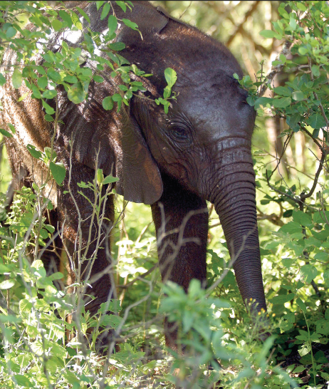
Complete the chart about
Dika’s life experience.

Slide 9
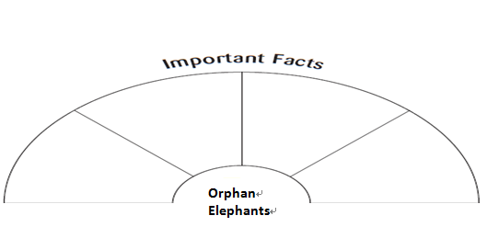
Pair Work
Talk and write four important facts about orphan elephants.

Slide 10
Group Work
Tell the story of orphan elephants.
Step 1
Group A：
Keeper
Group B：
Dika
Group C：
Student
Roles:

Slide 11
Group Work
Tell the story of orphan elephants.
Step 2
3 students from 3 groups

Slide 12
Group Work
Discussion
Why don’t orphan elephants forget where
they were cared for?
(Students’ own answers. For example, because
keepers help them.)
2. Can you guess what will happen if orphan
elephants are not taken to the park? Why?
(Students’ own answers. For example, they may get sick or die.)

Slide 13
Group Work
Discussion
Why does the author write the book?
(Students’ own answers. For example, the
author wants to tell us that people
should protect elephants.)

Slide 14
Group Work
Discussion
1. Can elephants and people get along well?
2. What can we do to protect animals?

Slide 15
Summary

Slide 16
Homework
Prepare a report about orphan elephants in this book.
Note 1: Reasons of becoming orphans, life in
the park, and your feelings about this story.
Note 2: A video, a written passage or a poster.
(2) Search more information about the orphan
elephant parks in Kenya and Sri Lanka. Then
write down a report of your research.

Slide 17
Find out more information.
The video:
Born to Be Wild

