Slide 1

多维阅读第14级
Jobs for Sniffer Dogs

Slide 2
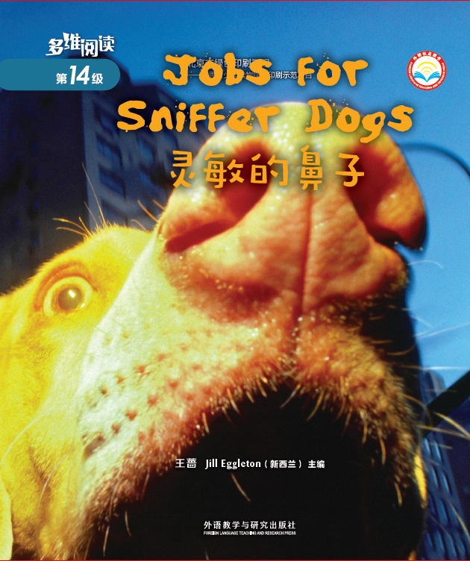
Answer some questions
1. What can you see on the
cover?
2. What’s the title and what do
you think the meaning of
the title is?
3. Can you guess what we will
talk about in class?

Slide 3


Open the books and
enjoy the reading time

Slide 4
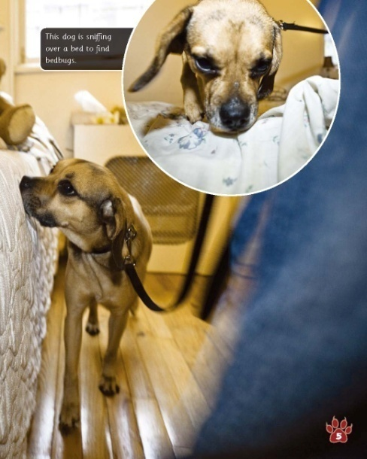

Read and answer
Read pages 2-5 and answer the questions.
1. Is it very hard for people to find bedbugs? Why?
2. What will bedbug sniffer dogs do when
they smell the bedbug?
Yes. Because they are very small and can sneak into places through tiny cracks.
They will stop sniffing.
How do you think the sniffer dog might know the smell of a bedbug?

Slide 5
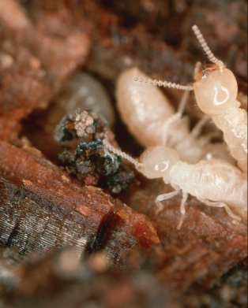
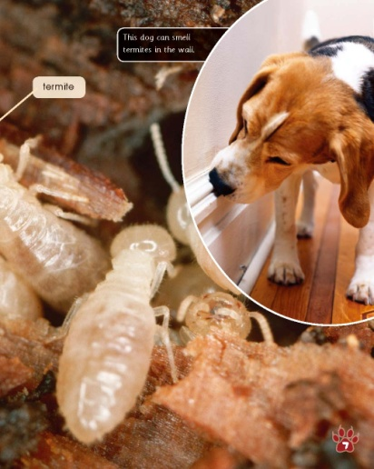
Read and answer
Read pages 6-7 and answer
the questions.
1. Where do termites hide?
2. Is it very hard for termite sniffer dogs to find a termite?
Why?
They hide in the walls.
No. Because they are trained to know the smell of
different insects and they know the smell of a termite.
What do you think might happen to a house that has termites?

Slide 6
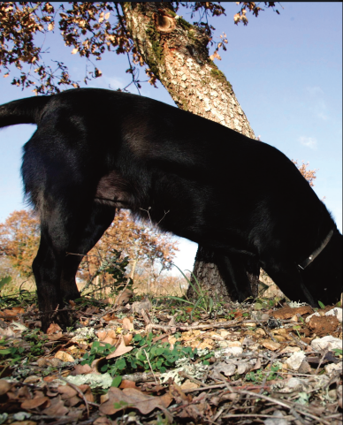
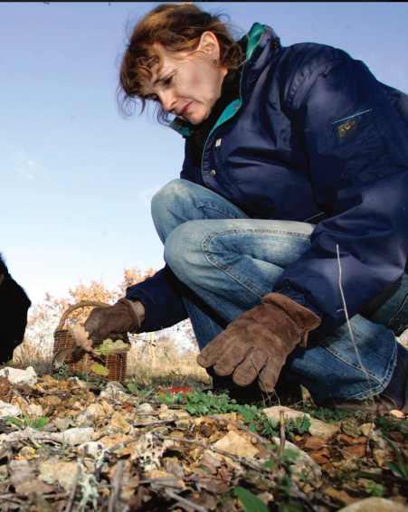
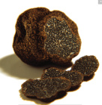
Read and answer
Read pages 8-11 and answer
the questions.
1. What are truffles like?
2. What will truffle sniffer dogs do when
they smell a truffle?
They are like big mushrooms.
They scratch the ground and then dig it up.
Why do you think truffles cost a lot of money?
Why do you think dogs are not trained with a truffle first?

Slide 7
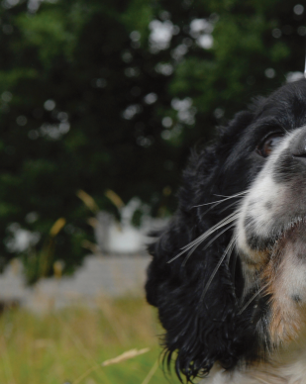
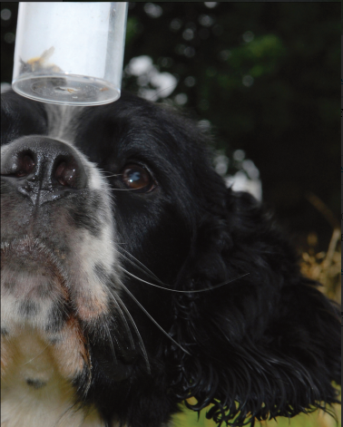
Read and answer
Read pages 12-13 and answer
the questions.
1. What is Toby’s job?
2. What will scientists do with the bumblebee nest?
His job is to find bumblebee nests.
They will find out more about bees.
How do you think sniffer dogs might help people in other ways?

Slide 8

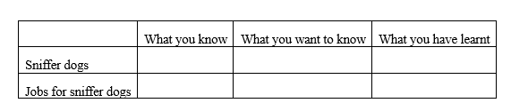
Read for detailed information
Complete the KWL table.

Slide 9

Read for detailed information
List out the important facts and interesting facts about
jobs for sniffer dogs.

Slide 10


Group work
Based on the KWL table and facts, introduce
sniffer dogs’ jobs.
Share your opinions about their jobs.

Slide 11

Read for deeper meaning
Questions:
Why is the book titled Jobs for Sniffer Dogs?
Why does the author write the book?

Slide 12

Summary

Slide 13

Homework
小组成员合作，制作一幅海报，介绍一种帮助人类的动物，包括该动物的简介、工作状态等，并在全班进行展示。
课后和小组成员一起利用网络或者图书馆查询资料，看看是否有其他类别的嗅探犬，并在全班汇报调查结果。

