Slide 1

Reaching the Top
多维阅读第14级

Slide 2

Look at the cover and answer the questions.
1. What is the title
of this book?
2. Can you guess where
the top is? Is it easy
to reach the top?

Slide 3

Enjoy the reading time!

Slide 4
Read pages 2-3 and check your guess.
1. Where is the top?
The top is in the rainforest. The top of these trees is called the canopy.
2. Is it easy to reach the treetops? Why?
No, it isn’t.
Students’ own answers.
(For example, because it is tall.)

Slide 5
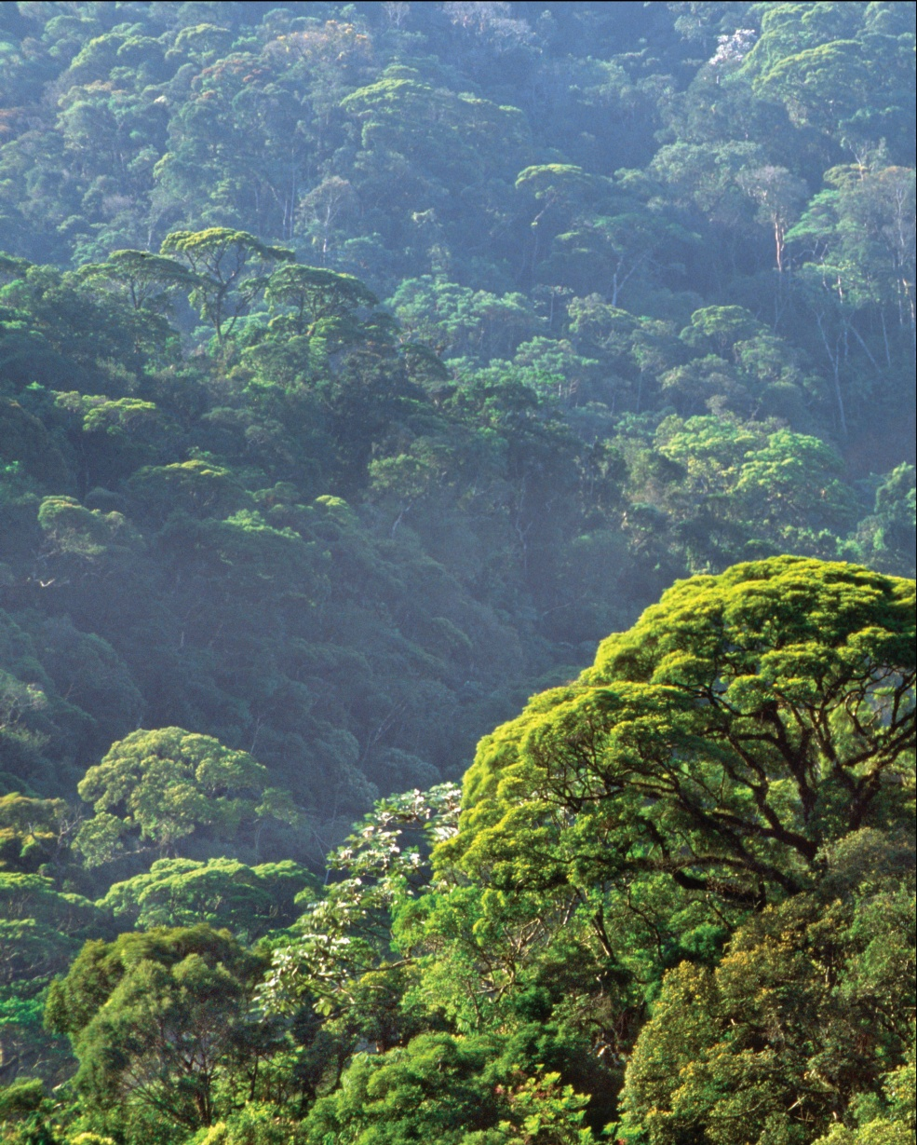
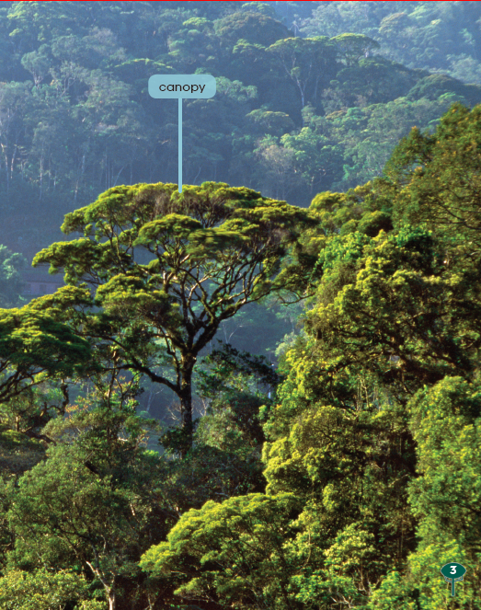

Slide 6
Read pages 4-5 and answer the questions.
Who is the scientist?
The scientist is Meg.
2. Why do you think the scientist likes to
climb to the treetops?
(Students’ own answers. For example, because she has always liked trees.)

Slide 7
Read pages 6-11 and answer the questions.
What are the three ways to reach the treetops?
They are a walkway through the trees, the canopy raft and tower cranes.

Slide 8
Read Pages 6-11 and answer the questions.
2. How the scientist uses each way to reach
the treetops?
A walkway is like a bridge. It goes between the trees.
A hot air balloon drops the raft onto the trees.
The tower crane can go up and down.

Slide 9
Read pages 12-13 and answer the questions.
1. What did Meg and his sons do in the
treetops?
They slept in trees and ate bugs. They had many adventures in trees.
2. What does Meg want to find in the
treetops in the future?
Meg wants to help find the secrets of the treetops.

Slide 10
Pair Work
Read and discuss.
What are the features of each way to reach the treetops?
(Students’ own answers. Such as height limitation, tools preparation, convenience and so on)

Slide 11
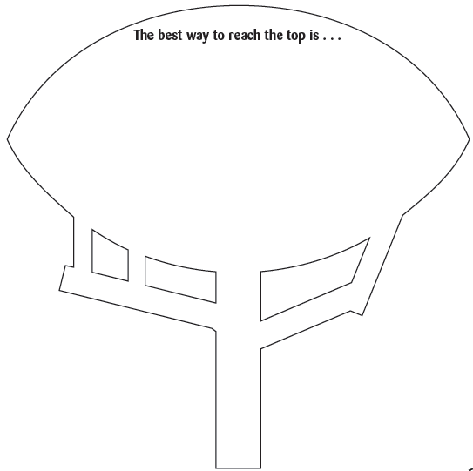
Pair Work
Complete the mind-map.
Way 3: _________
Feature: ____________
Way 2: _________
Feature: ____________
Way 1: _________
Feature: ____________
Activities in the treetop: _________________________

Slide 12
Pair Work
Introduce the story.
If you were Meg, introduce your adventures of reaching the canopy.
Tips: 1. What is the canopy?
2. How do you use each way to reach the
canopy?
3. What do you do in the canopy?

Slide 13
Group Work
Speak your mind.
1. Which way is the best way to reach treetops
in the forest among these three ways? Why?
2. Can you think out another way to reach
treetops in the rainforest?
(Students’ own answers. )
(Students’ own answers. )

Slide 14
Group Work
Speak your mind.
Choose one question and discuss it in groups of four.
1. What do you think of Meg?
(Students’ own answers. )
2. Can you share your adventure experience?
(Students’ own answers. )

Slide 15
Group Work
Role-play.
Meg and his two sons are interviewed in the CCTV 9 program Nature. Today, the program introduces adventures of treetops in the rainforest.
Role 1: Meg
Roles 2&3: Meg’s two sons(Rick and Sam)
Role 4: Host

Slide 16

Summary

Slide 17
Homework
1. Find another way to reach the treetops in
rainforest and describe it in some sentences.
2. Go to the library or search on the Internet
to find out more information about Canopy
Meg, including her experience, difficulties,
awards and contribution. Then write down
a report.

