Slide 1
多维阅读第14级
Ollie and Ruby

Slide 2
Answer some questions
What’s the title?
What can you see on the cover?
What are Ollie and Ruby?
Are they good friends?

Slide 3
Let’s enjoy reading together!

Slide 4
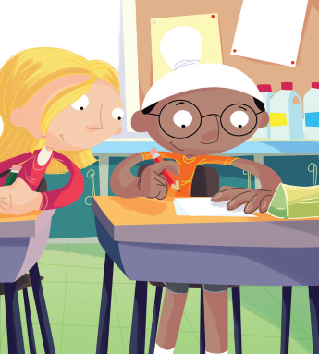
Read and answer
Read pages 2-3 and answer the questions.
1. How did Ruby do maths?
She copied Ollie.
What do you think was wrong about Ruby doing maths this way ?

Slide 5
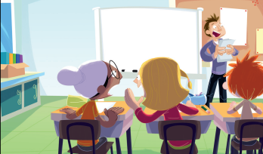
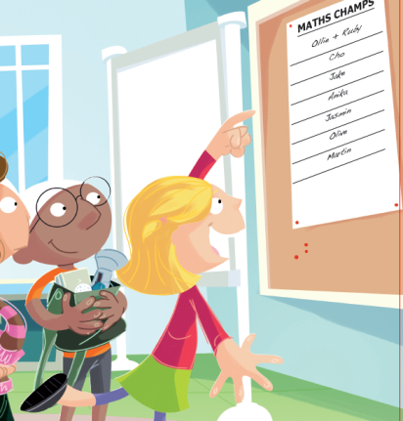
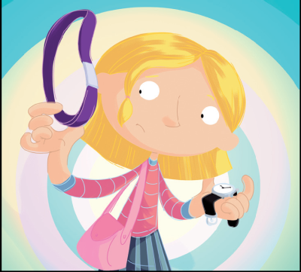
Read and answer
Read pages 4-11 and answer the questions.
1. What was Ruby’s result in her maths test?
2. What do you think is wrong with what Ollie
and Ruby were doing? Why do you think that?
3.Do you think Ollie was right? Was it worth it?
4. What do you think might happen to the watch?
She got one hundred percent in it.
(Students’ own answers. )
(Students’ own answers. )
Ollie would keep it.

Slide 6
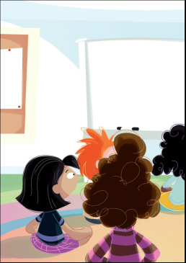
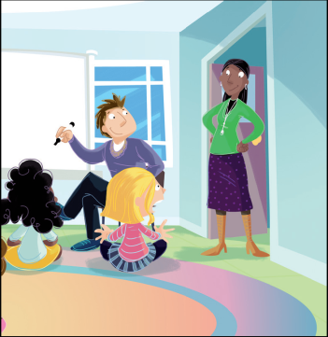
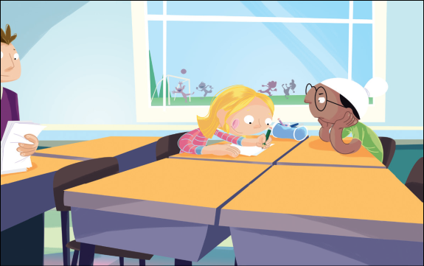
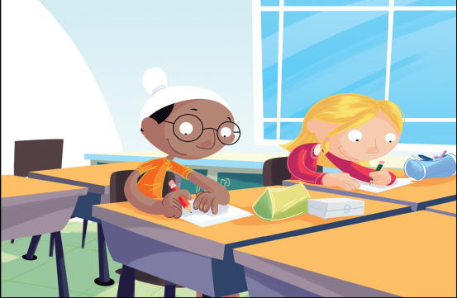
Read and answer
Read pages 14-17 and answer the questions.
1. Who did the principal talk to first?
2. What did Ollie have to do at lunchtime for
five weeks?
3. What did Ruby have to do every lunchtime?
4. Why did Ruby find about her maths?
Ollie Simmons.
He was going to teach Ruby maths.
She had to do maths.
She found she could do maths after all.
What do you think Ruby learnt from this?
What do you think Ollie learnt?

Slide 7
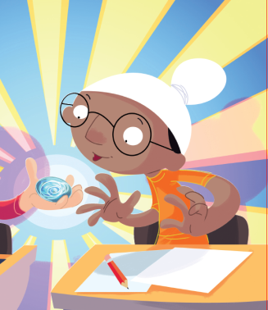
Read and complete the mind-map
of the story
How Ollie and Ruby helped each toher before the principal talked
How Ollie and Ruby helped each other after the principal talked
How Ollie and Ruby helped each other before the principal talked

Slide 8
Discuss in groups
Based on the mind-map, introduce the story Ollie and Ruby.
2. Share how Ollie and Ruby changed and what
they could learn from the experience.

Slide 9
Reading circle
Tasks for different characters.
Sentence Master | Share some impressive or expressive sentences from the book with group members and tell the reason.
Character Analyzer | Analyze some main characters with both descriptive words and supporting details from the book.
Theme Analyzer | Analyze the theme and tell the writer’s purpose.
Moral Master | Find more ways to help Ruby.

Slide 10
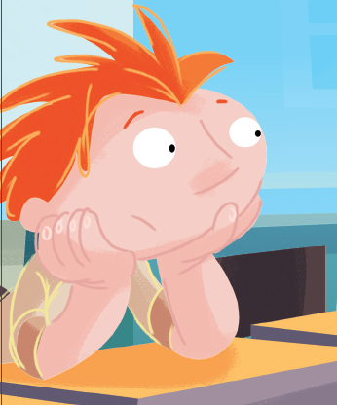
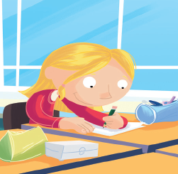
Role play
Imagine Ollie never helped Ruby to cheat in the exam,
what would the story be like? What could you do to
help Ruby?

Slide 11
Summary

Slide 12
Homework
小组合作，列举帮助他人提高学业的方法。
小组合作，制作主题为“Say No to Cheating”的海报，号召同学们诚信学习。

