Slide 1
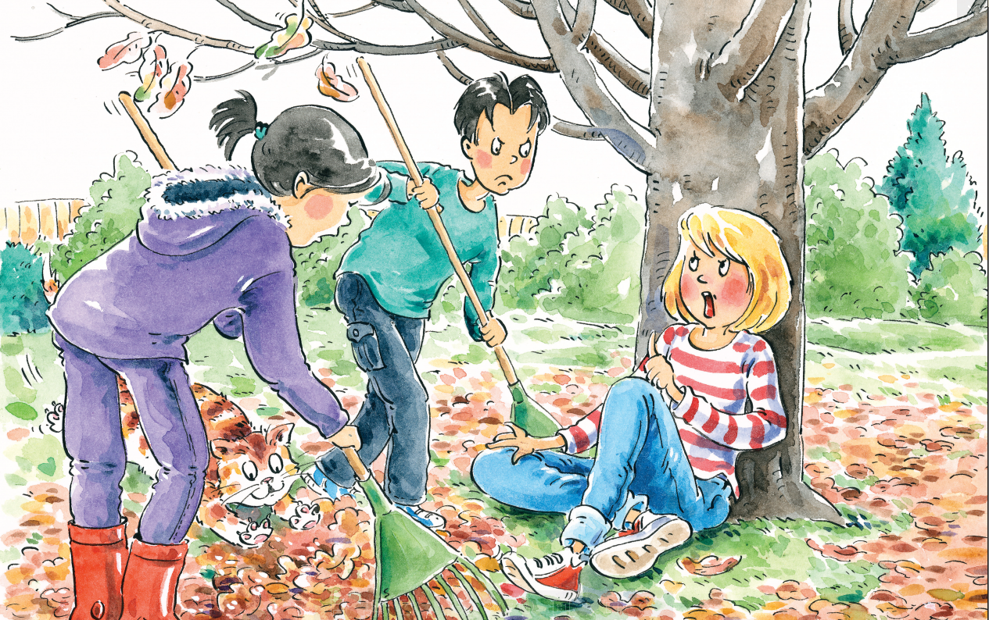
多维阅读第14级
Bossy Cousin Kate

Slide 2
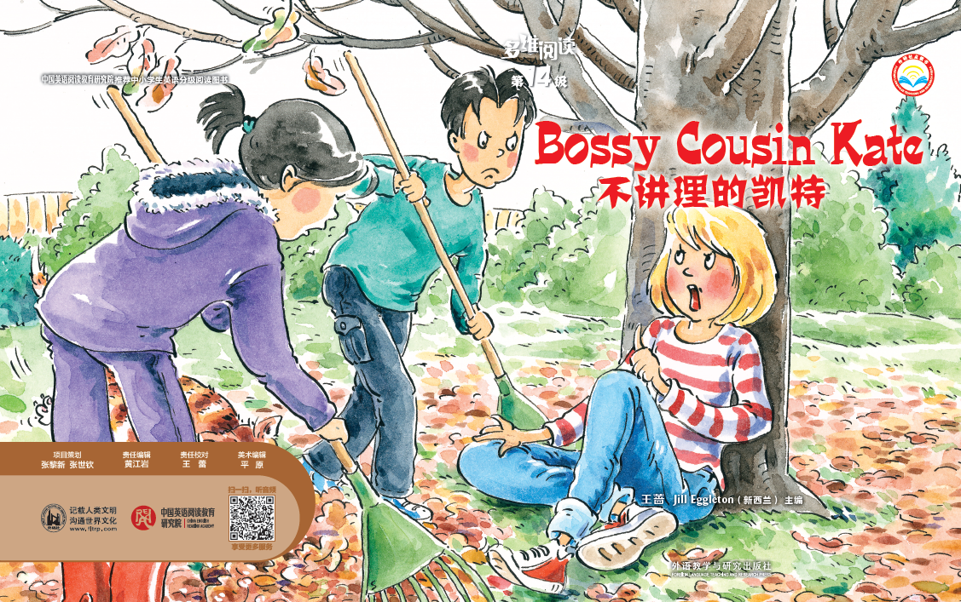
Answer some questions
1. What’s the title?
2. What’s the meaning of “bossy”?
3. How many characters are there? And who are they?
4. What do you think might happen to them?

Slide 3
Open the book and
enjoy the reading time

Slide 4
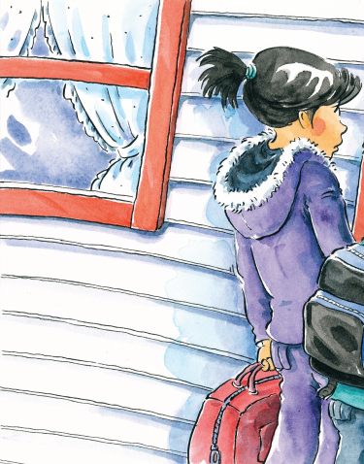
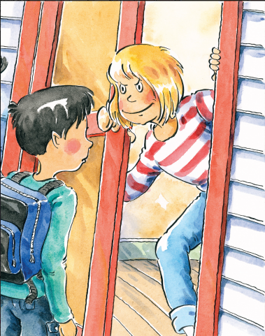
Read and answer
Read pages 2-3 and answer
the questions.
1. What was Kate like?
2. What trouble do Kate’s cousins have?
She was really bossy.
Their trouble is that Kate likes to get
her own way.
Why do you think Cousin Kate likes to get her own way?

Slide 5
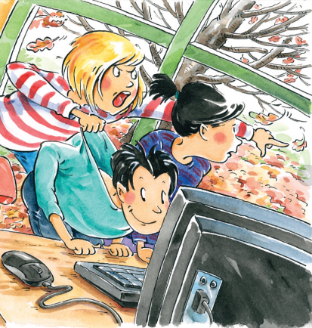
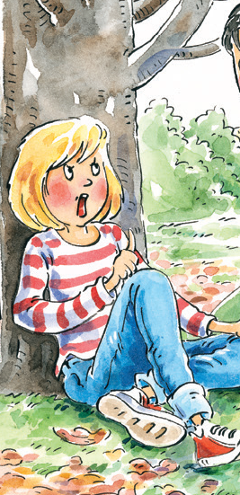
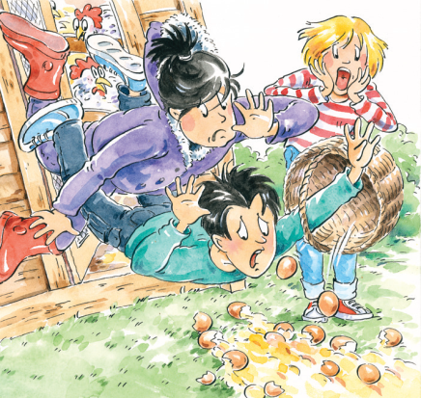
Read and answer
Read pages 4-13 and answer the questions.
1. Why did Kate’s cousins have to do what she said?
2. What did Kate ask her cousins to do first?
3. What did Kate do while her cousins were working?
4. What did Kate ask her cousins to do next?
5. What happened when Kate’s cousins rushed
out of the henhouse?
Because they wanted to play the game.
She asked them to rake the leaves up.
She sat on the ground and watched them.
She asked them to get every egg under the hens.
They fell over and broke the eggs.

Slide 6
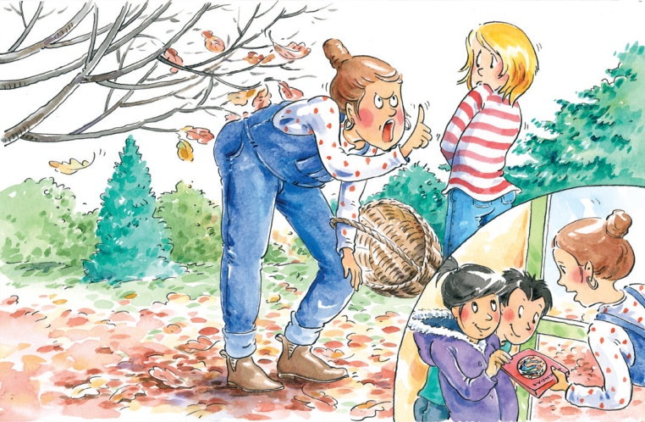
Read and answer
Read pages 14-17 and answer
the questions.
How did Kate’s mother feel when
she knew the whole things?
2. What did Kate’s mother finally do?
She was really cross.
She asked Kate to work for the computer game and
gave it to Kate’s cousins to take home.
Do you think what happened in the end was right? Why or why not?

Slide 7
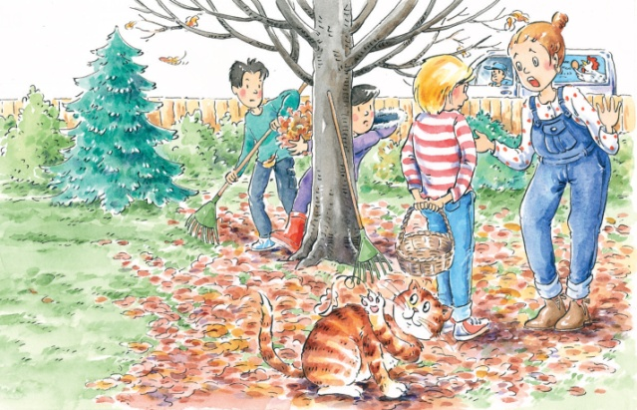
Read for detailed information
Complete the mind-map of the story.
Before Kate’s mother got home
After Kate’s mother got home

Slide 8
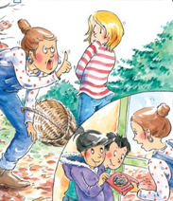
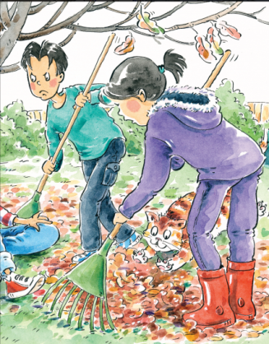
Retell the story
Put the pictures in the right order and retell the story.

Slide 9
Read for deeper meaning
Imagine you were Kate, her cousins,
classmate and mother.
1. Work in groups of four.
2. Take your own challenges and answer your questions.
3. Write down your answers in 5-8 minutes.
4. Share your answer with others in your group.

Slide 10
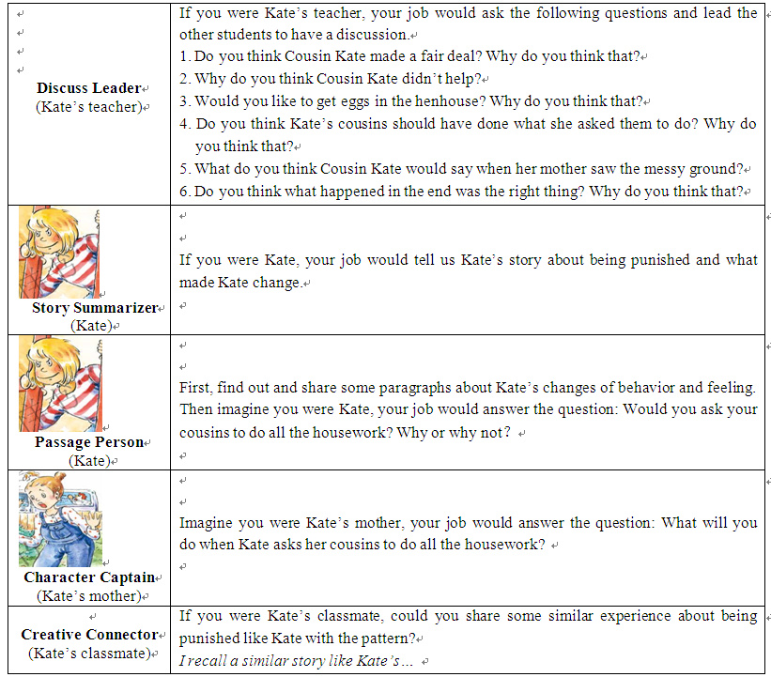
Read for deeper meaning

Slide 11
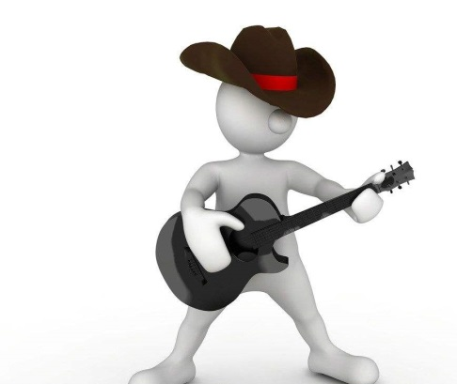
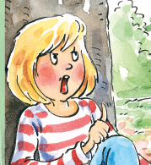
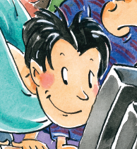
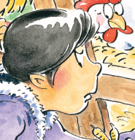
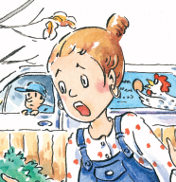
Role play
Imagine Kate’s cousins refused to help her do the
housework, what would the story be like?

Slide 12
Summary

Slide 13
Homework
Write down how we can get on well with our cousins.
Write down what might happen to Kate after her cousins leave her home.

