Slide 1
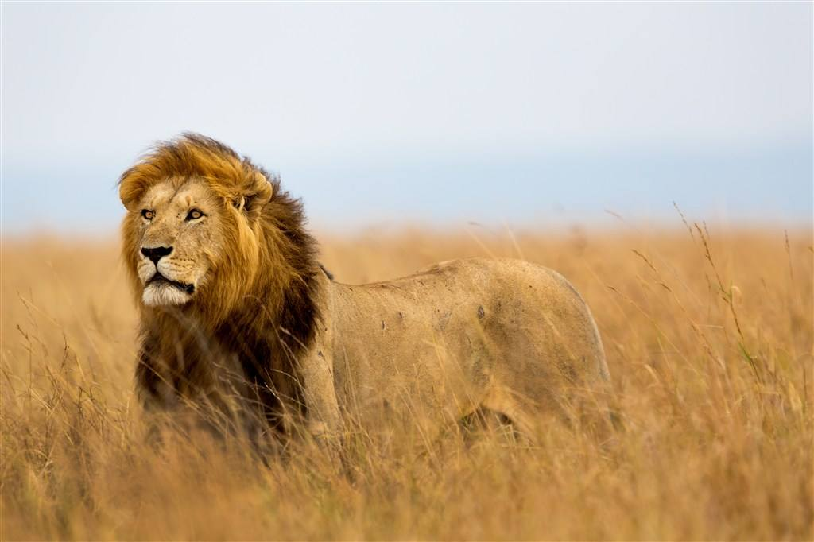
A Lion’s Story
景山学校远洋分校 郝娜

Slide 2
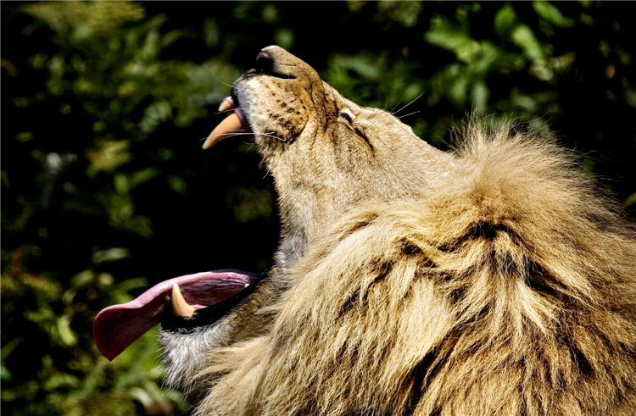
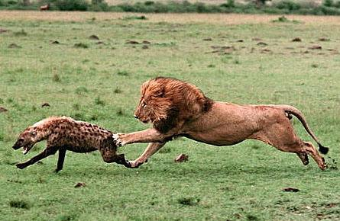
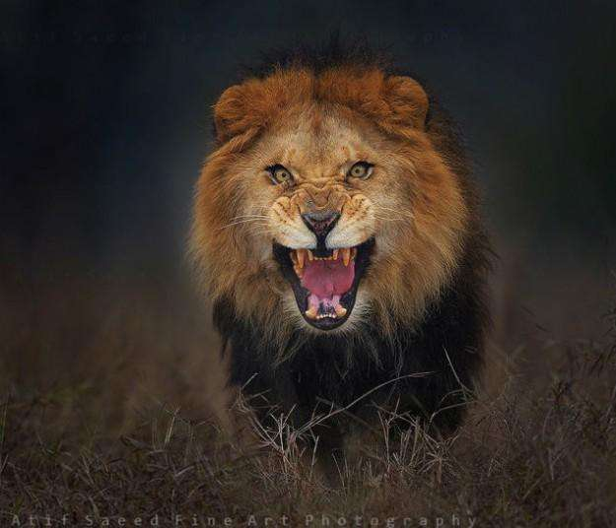
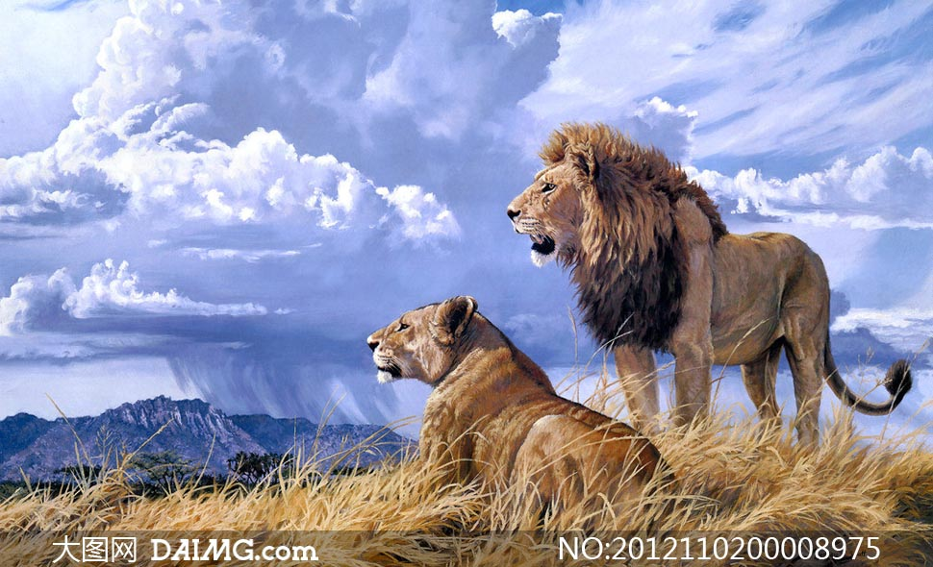
What do you think of lions?
sharp teeth
sharp paws
aggressive
dangerous

Slide 3
What questions do you have about this picture?
a lion cub

Slide 4
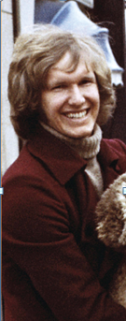
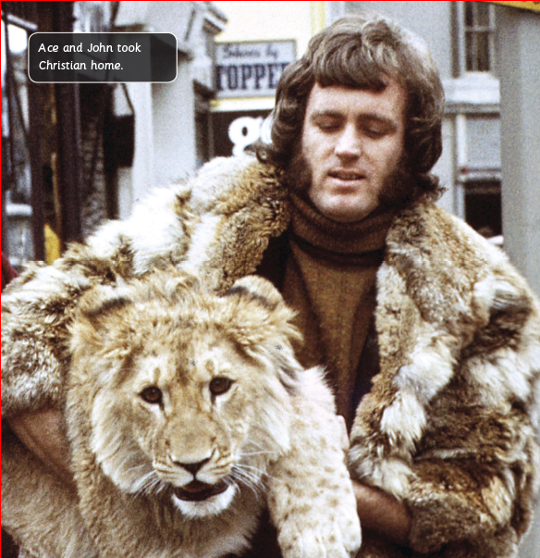
1) Living in a Shop
2) A Lion Cub for Sale

Slide 5
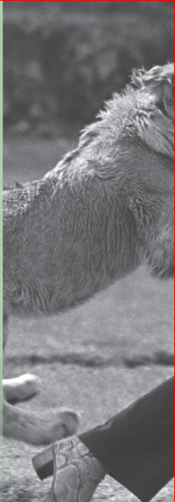
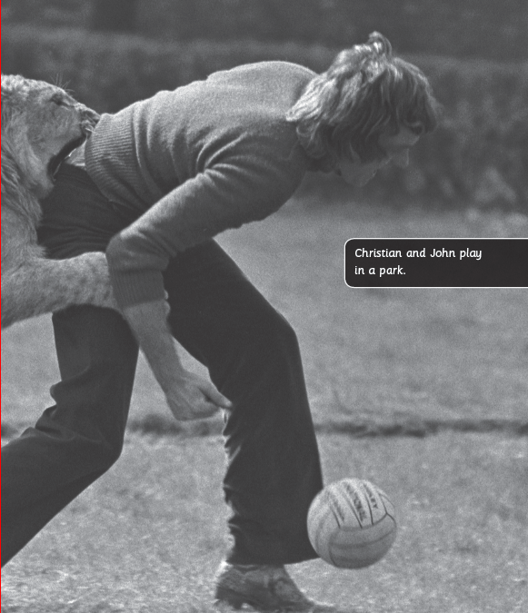
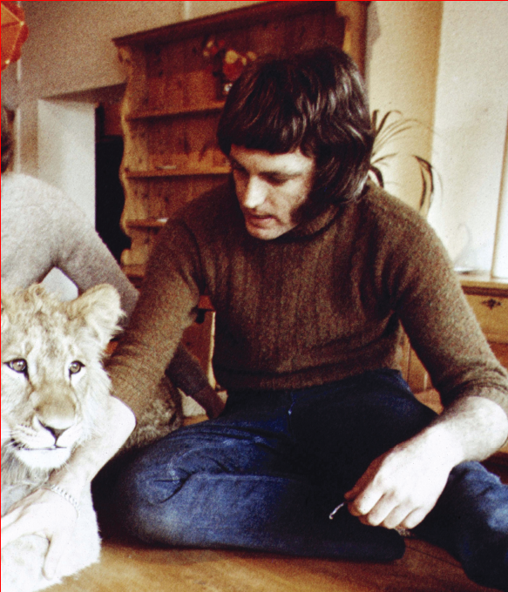
3) A Lion Cub Pet
4) The Lion Cub Grows

Slide 6
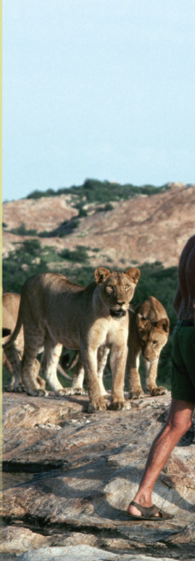
5) A Different World
6) The End of the Story

Slide 7
Can you tell what the story is mainly about？
1) Living in a Shop (P4)
2) A Lion Cub for Sale (P6)
Student 1 and Student 2
3) A Lion Cub Pet (P8)
4) The Lion Cub Grows(P10)
Student 3 and Student 4
5) A Different World (P12)
Student 5 and Student 6

Slide 8
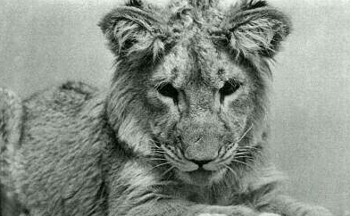
Read and answer.
Q1: Where did Christian (the lion cub) live?
Q2: Who was Christian with (和……一起)?
Q3: What did Christian do?

Slide 9
Group work
Find somebody who reads a different part.
Exchange the information.
Take notes on your worksheet.

Slide 10
where
who
what
in a big shop
in London
visitors from all over the world
stayed in a cage
scratched the carpet
made a mess
got out of his cage
in Ace&John's
home
Ace and John
made a good pet
/ basement
in the wild
in Africa
George Adamson and other lions
learnt how to live in the wild

Slide 11
Read for details
Christian was put up for sale in the shop because__________________________________________
Christian came to Ace & John’s home because__________________________________________
Christian went to live in the basement because__________________________________________
Christian was taken to live in the wild in Africa because__________________________________________
he made a big mess.
they bought him as a pet.
he grew too big.
he grew bigger. It’s hard to look after him and it cost a lot to feed him.

Slide 12
After one year, would Christian still know them?

Slide 13
The end of the story
“When Christian saw Ace and John, he jumped up on them. He put his paws on their shoulders and licked their faces. He knew they were his friends.”
What did they feel when they met each other after a year?
How do you know?

Slide 14
Can you imagine Christian’s life after he returned to nature (自然)?
live freely and happily

Slide 15
Imagine you’re Christian and tell the story.
6 small groups
Prepare the group task
Draw a mind map
Presentation

Slide 16
Pick a role and complete the task.
Ace
George Adamson
William
Jennifer
John
Li Hua
A student
A animal protector
A neighbour

Slide 17
Role play discussion and report.
Ace
Please retell the story of you and Christian.
In what ways do you think Christian was like a person?
John
George Adamson
What difficulties or dangers did Christian meet when he first lived in the wild?

Slide 18
Role play discussion and report.
Was it safe for Ace & John to keep a lion as a pet? Why？
William
If Ace & John hadn’t sent Christian to Africa, what would have happened?
Jennifer
Does any part of the story remind you of a similar experience? Share with us.
Li Hua

Slide 19
Was it a good idea to have Christian as a pet? Were Ace & John right to let Christian go free?
Role play–a TV chat program.

Slide 20
What will you think about if you want to keep a pet?

Slide 21
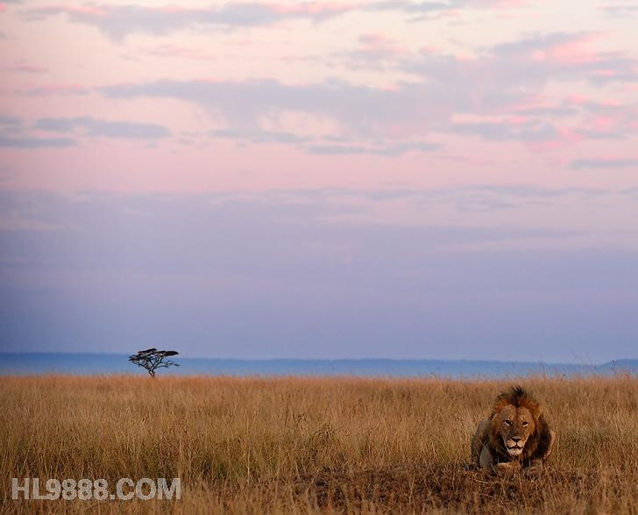
A better thing than love is to know how to really protect and help animals.

Slide 22
Homework
（1）Imagine you are Ace or John. Write a letter about Christian to a friend:
How did you feel when you kept him as a pet?
Why did you have to send him to Africa?
What did you worry when you sent him away?
What do you think of your decision to let him go free?
（2）Write a book review after you read the story.
What is the story about?
Which part do you like best?
Which part do you want to know more?
How do your feel after you read it?

