Slide 1
多维阅读第13级

Slide 2
Questions for the cover picture.
What’s this in the picture? What’s the name of it?
Where do orca whales live? How old can they live to be? Are there anything else you know about it? What else you know about it?
Why is the book titled Born to Be Free? Can you guess what happened to the orca whales?
What do you think might be different about an animal that’s away from its home?

Slide 3
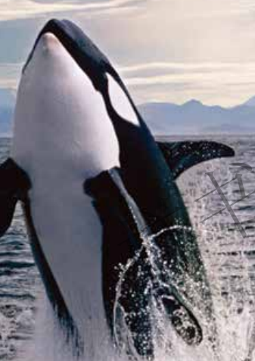
Reading Time

Slide 4
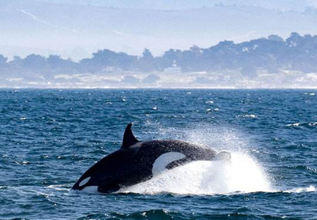
Read and draw the clue
At home and away home
Be wild and be caught
Set free or not

Slide 5
At home and away home
1. Where do orca whales live?
2. What can they do in the sea?
3. Where do people put them?
4. What do people do to them?
5. Why do you think orcas might attack their
trainers?

Slide 6
Be wild and be caught
1. Who do they live with in the sea?
2. What are the facts between those who live in
the sea and those in the pool?
3. What did the first caught orca do in the pool?
4. Why do you think the orca swam around and
around the pool?
5. Why do you think a trainer cannot always
know what an orca might do?

Slide 7
Set free or not
1. Where do orcas stay before they are put back
in the sea? Why?
2. What will happen after orcas are set free?
3. Who was Keiko?
4. How long had he stayed with people before he
was put back in the sea?
5. Why do you think an orca has to stay in a pen
for a while?
6. What happened to him after he was set free?

Slide 8
Read and draw
at home
Orca Whales
(also named _______)
be wild
be caught
away home

Slide 9
Read and think
Be free
Be not free

Slide 10
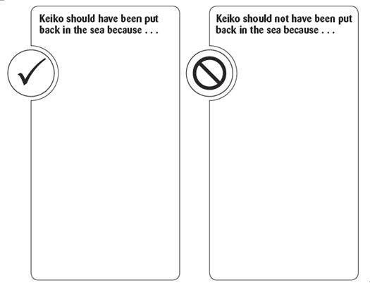
Free talk

Slide 11
Think about
1. Why is the book titled Born to Be Free?
2. Why does the author write the book?
3. What can we do to protect animals?

Slide 12
Homework
●学生与小组成员合作，制作一幅海报，介绍虎鲸，包括介绍其生存区域、环境及现状等，如有必要可以介绍我们该如何保护它们。在全班进行展示。
●课后和小组成员一起利用网络或者图书馆查询资料。了解更多关于虎鲸、Keiko，或者其他娱乐人类的动物的生存现状。在全班汇报调查结果。

