Slide 1
多维阅读第13级
Food for All

Slide 2
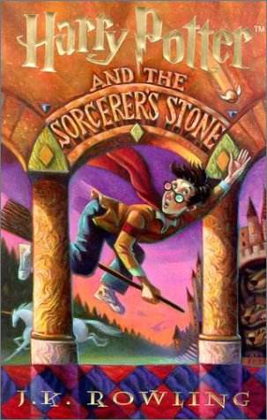
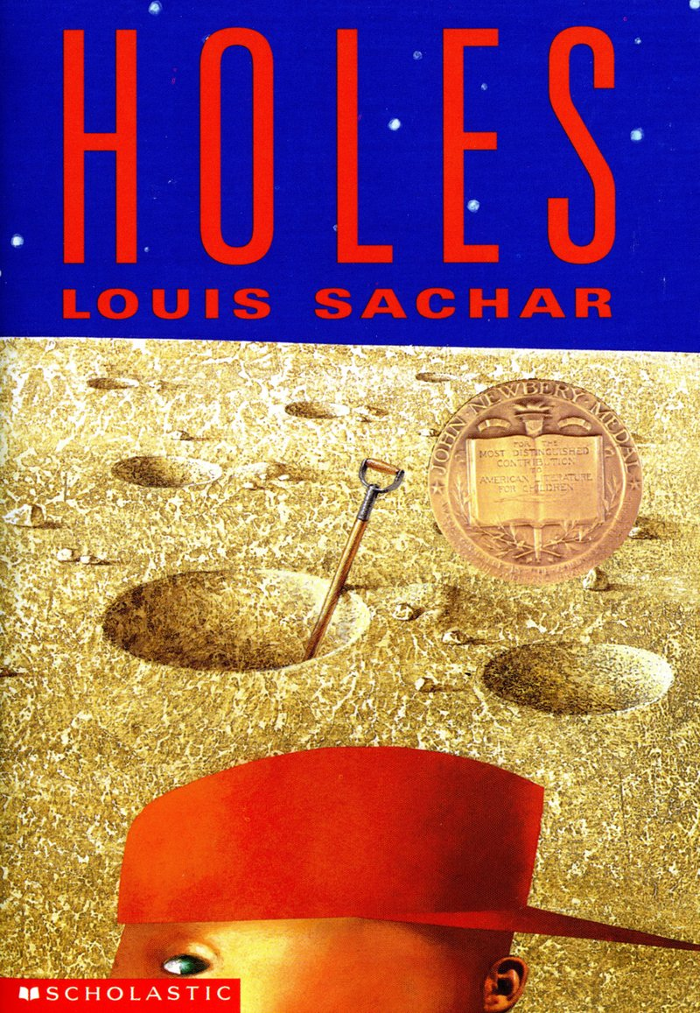
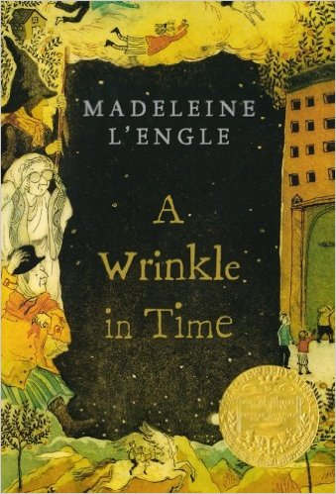

Slide 3
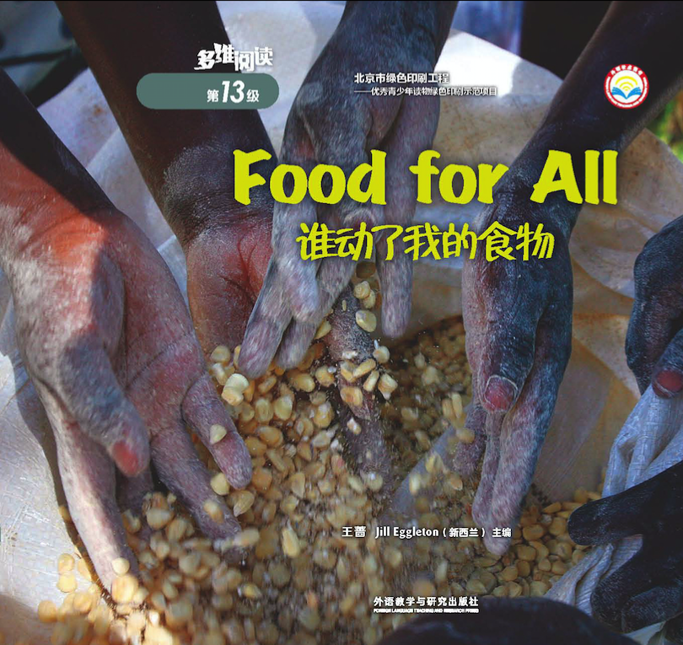
Non-Fiction

Slide 5
Text Features

Slide 6
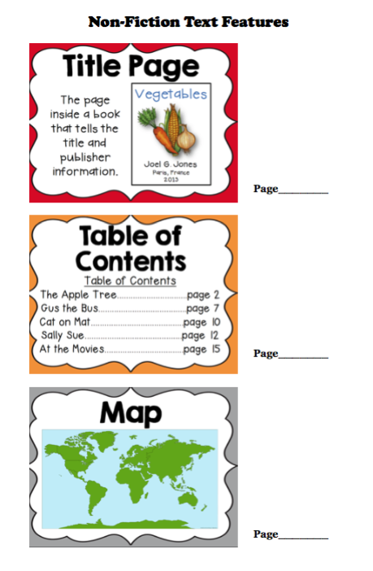
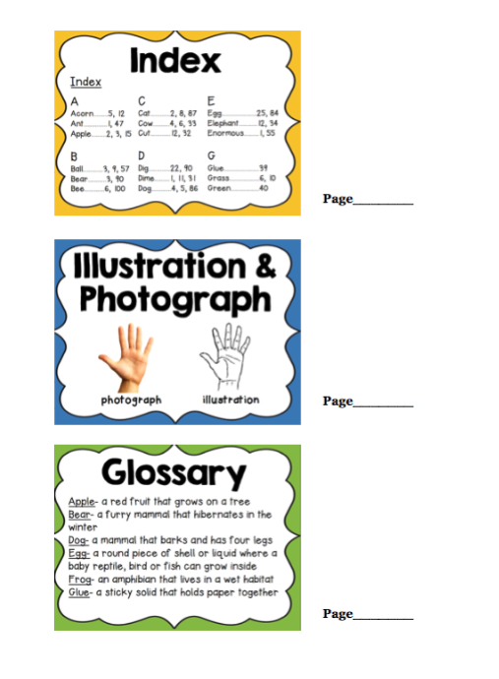
cover

Slide 7
Remember
Text features can help us
read this book.

Slide 8
Listen and Find out
What makes people hungry according to the text?

Slide 9
How many animals are there in the book?
What are they?

Slide 10
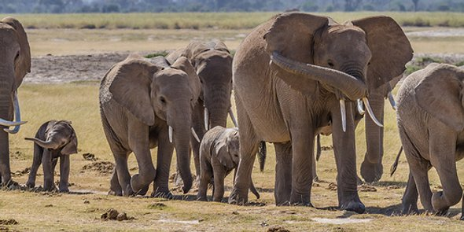
elephants

Slide 11
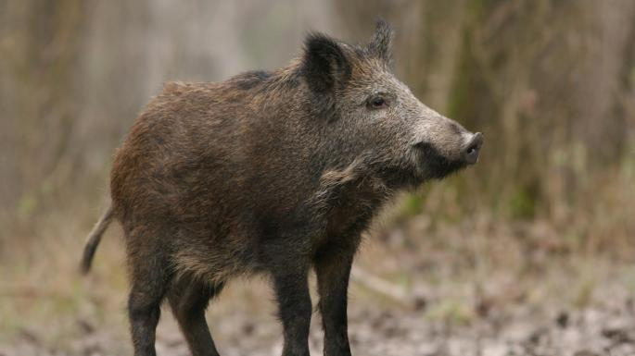
wild pigs

Slide 12
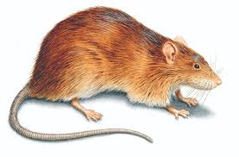
rats

Slide 13
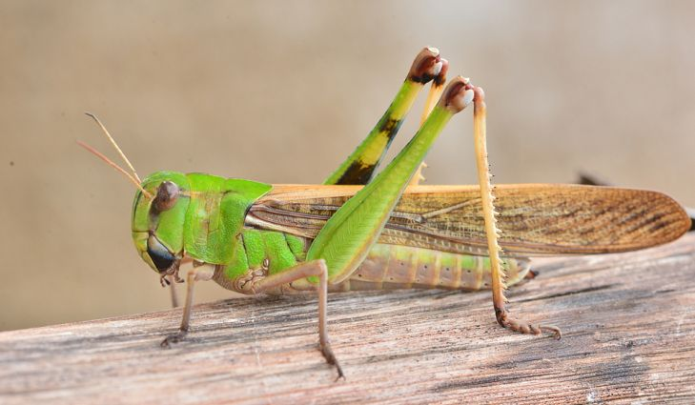
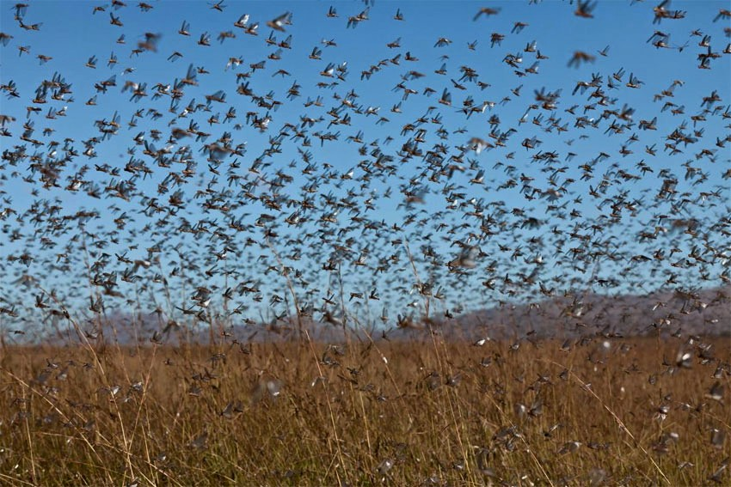
locusts

Slide 14
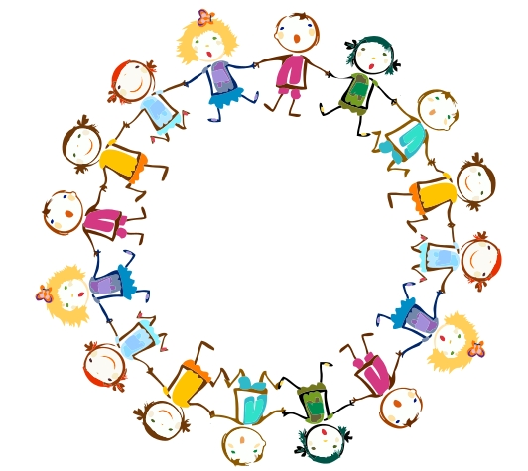
Reading Circle

Slide 15
Reading Circle
1
2
3
4
Group Leader
Word Master
Summarizer
Connector

Slide 16
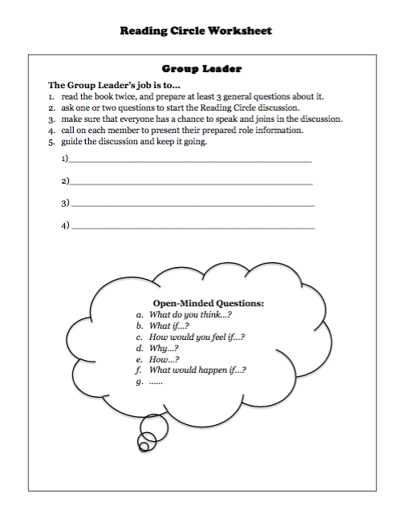

Slide 17
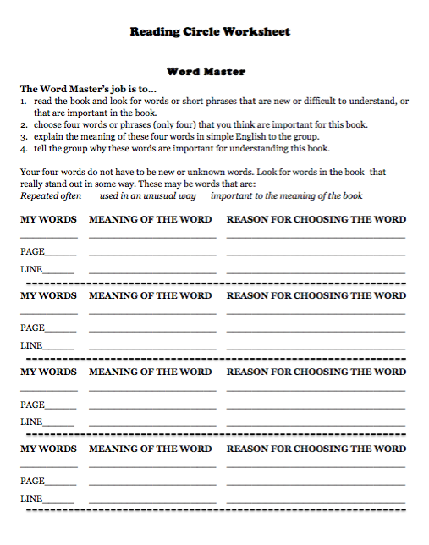

Slide 18
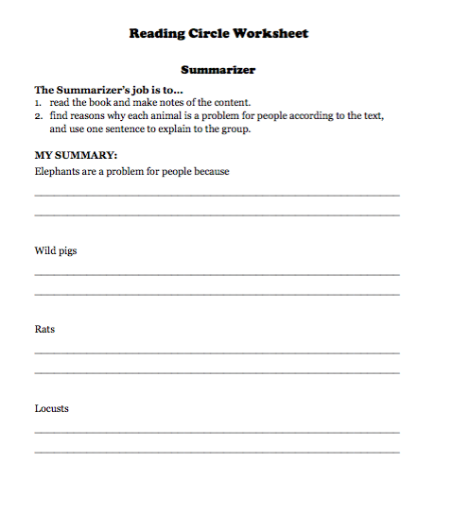

Slide 19
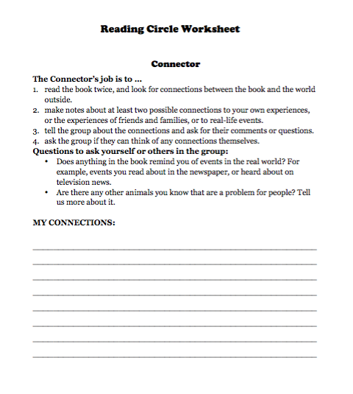

Slide 20
Reading Circle
Summarizer
Word Master
Connector
Group Leader

Slide 21
Reading Circle

Slide 22
After Class
Search for information
Are there any other animals that can destroy people’s crops? Why do they do that?

