Slide 1
Trappers and Egg Hunters
多维英语第13级
《鳄鱼猎手》

Slide 2
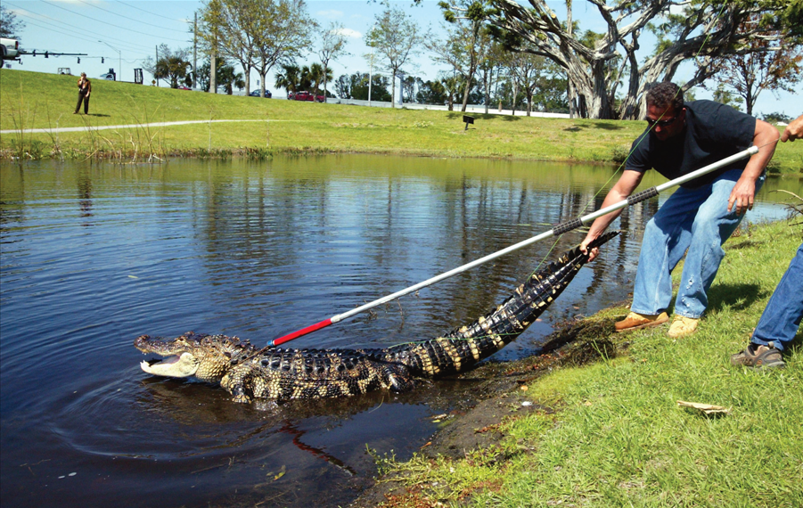
Read cover picture.
What can you see in the picture?

Slide 3
Read the cover picture.
What can you see in the picture?

Slide 4
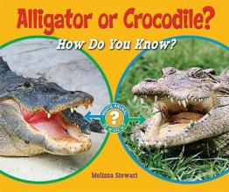
alligator
 | Alligator | Crocodile
Habitat | Southern U.S. and China | Africa, Australia, and America
Lifespan | 30–50 years | 70–100 years
Snout（口鼻部） | Wider U-shaped snout | Longer V-shaped snout
Nesting（筑巢） | mounds of vegetation surrounding freshwater | in mud or sand
crocodile
trapper
hunter

Slide 5
Read pages 4-7.
Answer the questions:
1. What does a trapper do to handle the big alligator?
2. Why does a trapper have to move the alligator away?
3. What can people do to move alligators away?

Slide 6
Read pages 8-13.
Work in groups of three, and each of you will have your own role.
Word Master
Discussion Leader
Summarizer

Slide 7
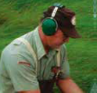
Finish the following table, and write down how to hunt for eggs.
Taking care
Hunting for eggs
Handling the eggs

Slide 8
Read pages 14-15.
Answer the following questions:
1. What is an alligator farm like?
2. What do you think might happen to the alligators on the farm?

Slide 9
After you read the book, think about the questions.
What do you think of “trappers” or “egg hunters” as jobs?
Why do people start an alligator farm?
What did an alligator appear on doorsteps?

Slide 10
Homework
Make a poster of trappers and egg hunters.
Make a list of questions for interviewing a trapper or an egg hunter
about their work.

