Slide 1
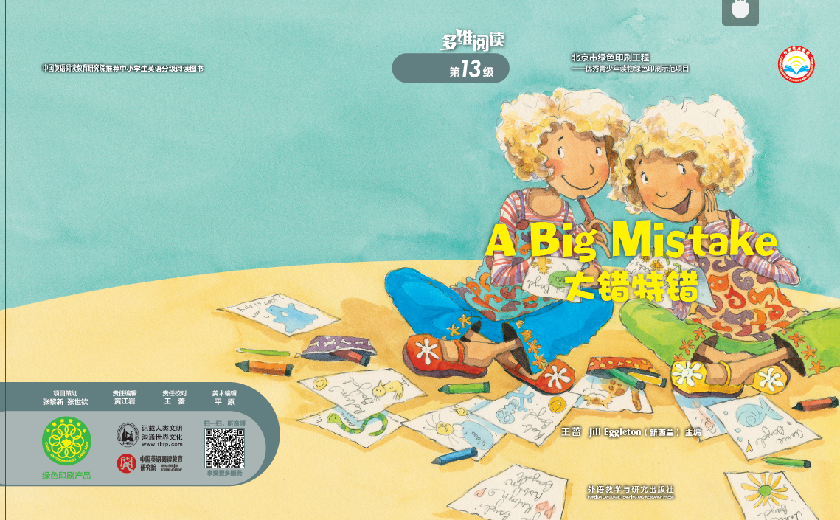

Slide 2
Read the cover carefully & answer.
What’s this story
called?
2. What’s the mistake?
How do you know?
3. Who’re in the story?
What might their
relations be? Why?
4. What else do you
know from the cover?

Slide 3
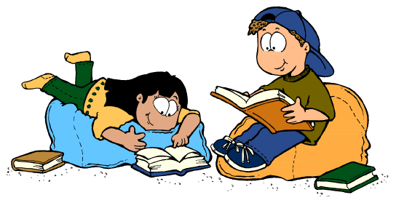
Open the storybook & read!
1. Who’re in the story? What's their relationship?
How do you know?
2. What’s the mistake? How do you know?

Slide 4
Read carefully in your group.
Please work in groups of 4 and number each member with 1-4. Each member will have a different task in different act. When you finish your task, remember to share what you’ve found with your group members.
All No 1 put up your hands, please! No 2, No 3, and No 4! Are you all clear about your tasks?

Slide 5
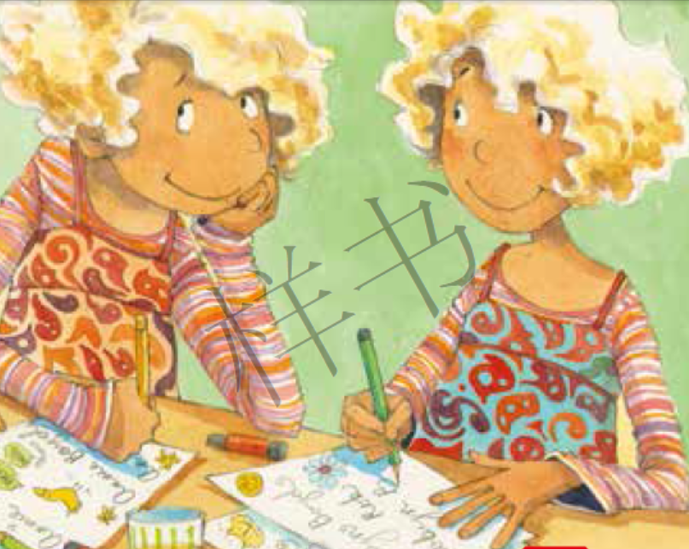
Read and answer.
Read Act 1 on Pages 4-5.
No 1: Look at the pictures, can you guess what might Act 1
talk about?
No2: Read Act 1 and find out:
Who are in the story?
Where are they?
What are they doing?
Why do they do that?
No3: What does “sign” mean? How do you know?
No 4: Do you have any other questions for discussion?

Slide 6
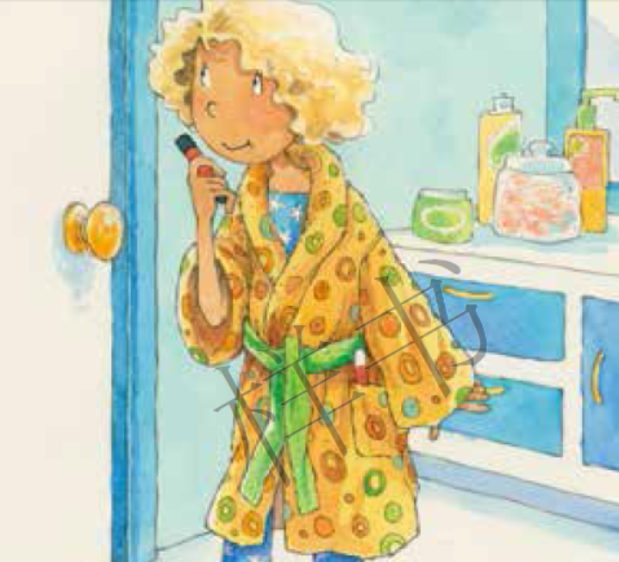
Read and answer
Read Act 2 on Pages 6-7.
No 2: Look at the pictures, can you guess what might Act 2
talk about?
No 3: Read Act 2 and find out:
Who’s in the story?
Where’s he/she?
What’s he/she doing?
Why does he/she do this?
No 4: What does “blank” mean? How do you know?
No 1: Do you have any other questions for discussion?

Slide 7
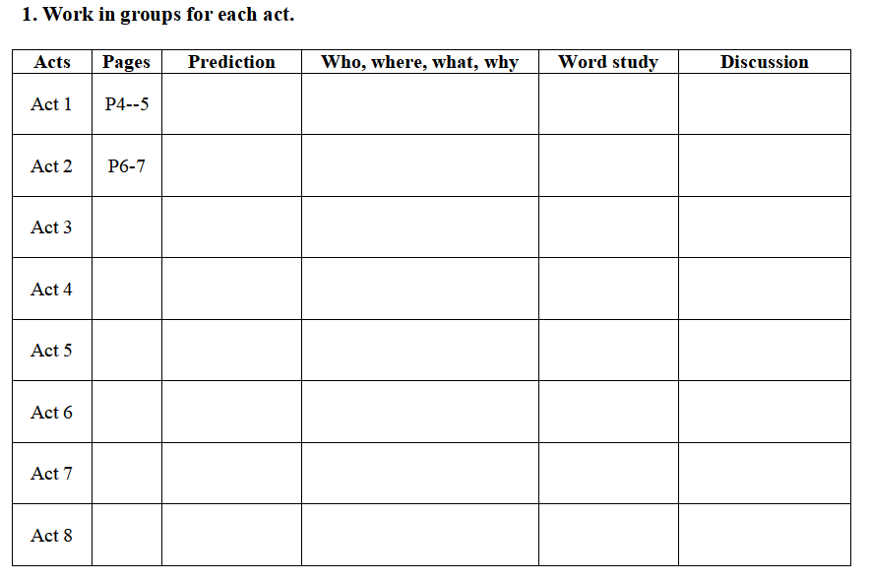
How many acts are left? Can you read them and change roles in your group task? and try to finish Ex. 1 of the worksheet.
Time to think!
1. What’s this story mainly about?
2. What happened at first? And later?
3. Who made the mistake?
4. What’s the solution?

Slide 8
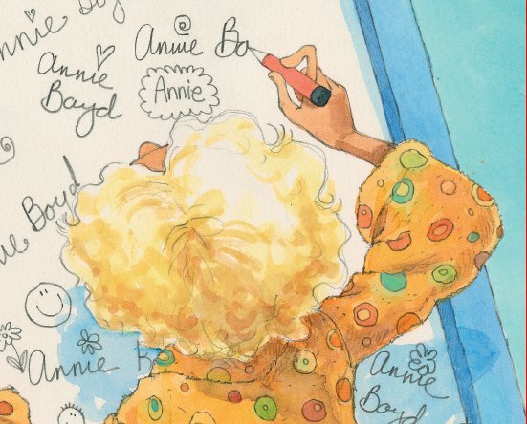
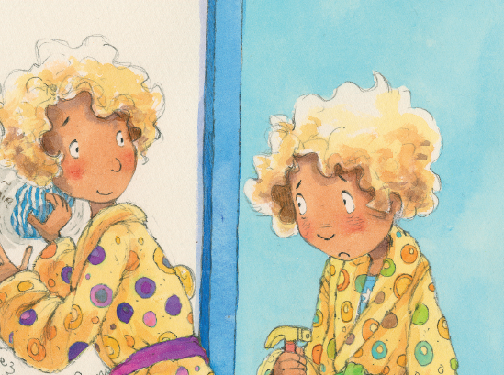
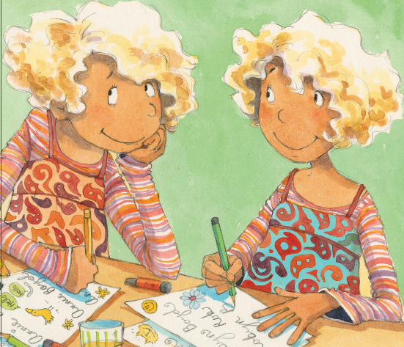
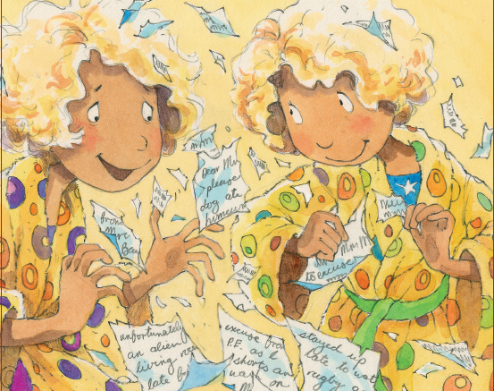
Order & retell.
A.
B.
C.
D.

Slide 9
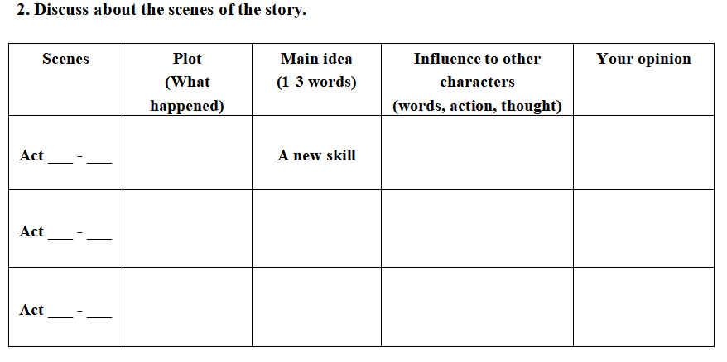
Read again & think.

Slide 10
Think & share.
1. Have you ever signed others’ names?
2. If so, what happened at last? Do you want to make any change?
3. Have you ever made any other mistakes?
4. What can you do with
the mistakes?

Slide 11
Time to share your story.

Slide 12
Summary
What's the mistake in this story and your story?
Are they BIG? Why?
How should we deal with a mistake?

Slide 13
Homework
Options:
Retell the story orally.
2. Write about your own story
(Use illustrations where necessary).

