Slide 1
多维阅读第13级

Slide 2
Questions for cover picture.
What can you see on the cover?
What’s the title?
What may be talked about in the story?

Slide 3
JIGSAW

Slide 4
D
The kids in Room 22 were scared of Nick Nelly. Sometimes he was really mean. He pushed kids in line and said, "Get out of the way and let me in front." He put out his foot and tripped kids up. Then he said, "Look where you're walking!"
G
At lunchtime, Jake went to play soccer.
"Hey, new kid!" shouted Nick. "You're too skinny to play soccer. We don't need you."
Jake just smiled. "You will," he said.
Jake kicked the ball hard. It went past Nick like a rocket from a launching pad.
A
When Jake went to the bathroom, Nick snatched his pencil.
"Hey, new kid!" said Nick.
"This is a good pencil."
"You can have it," said Jake. "It's my sister's. She likes pink but I don't."
The kids laughed. But Nick didn't. He went red again!.
E
Jake was in front of Nick in the line.
"Hey, new kid!" Nick said.
"Let me in front."
But Jake just smiled at Nick. "No!" he said.
"I won't"
Nick went red. He was furious. Kids never said no to him. The teacher was looking. He couldn't do anything. Not yet!launching pad.
B
One day, a new kid called Jake came to Room 22. He was short and skinny. He had red hair and freckles. When the teacher wasn't looking, Nick made a face at Jake. Some kids laughed. Nick liked it when laughed. He made more faces.
F
Jake could play soccer really well. He could stop every ball.
Jake kicked the ball to Nick. "Stop this!" he shouted. Nick tried but he slid over in the mud.
The kids laughed but Jake didn't. He went over to Nick. "My Dad showed me how to play," he said.
"You're lucky," said Nick.
"I haven't got a Dad."
"I'll show you then," said Jake.
C
At the end of the year, Jake's family had to move again. On his last day at school, Nick gave him a note.
You showed me how to play soccer and you showed me how to be a friend_________________________
Thanks._______________________
I’ll miss you.__________________
P.S. I still have the pink pencil.
H
So every day, Jake showed Nick all he knew about soccer. He showed him how to hit the ball with his head and how to stop a fast ball.
After that, Nick and Jake were friends. And, no one was ever scared of Nick Nelly again.

Slide 5
Share in class
D
The kids in Room 22 were scared of Nick Nelly. Sometimes he was really mean. He pushed kids in line and said, “Get out of the way and let me in front.” He put out his foot and tripped kids up. Then he said, “Look where you’re walking!”
B
One day, a new kid called Jake came to Room 22. He was short and skinny. He had red hair and freckles. When the teacher wasn’t looking, Nick made a face at Jake. Some kids laughed. Nick liked it when they laughed. He made more faces.
E
Jake was in front of Nick in the line. “Hey, new kid!” Nick said, “Let me in front.”
But Jake just smiled at Nick. “No!” he said. “I won’t.”
Nick went red. He was furious. Kids never said no to him. The teacher was looking. He couldn’t do anything. Not yet!
A
When Jake went to the bathroom, Nick snatched his pencil.
“Hey, new kid!” said Nick, “This is a good pencil.”
“You can have it,” said Jake. “It’s my sister’s. She likes pink but I don’t.”
The kids laughed. But Nick didn’t. He went red again!
F
Jake could play soccer really well. He could stop every ball.
Jake kicked the ball to Nick. “Stop this!” he shouted. Nick tried but he slid over in the mud.
The kids laughed but Jake didn’t. He went over to Nick. “My Dad showed me how to play,” he said.
“You’re lucky,” said Nick. “I haven’t got a Dad.”
“I’ll show you then,” said Jake.
H
So every day, Jake showed Nick all he knew about soccer. He showed him how to hit the ball with his head and how to stop a fast ball.
After that, Nick and Jake were friends. And, no one was ever scared of Nick Nelly again.
G
At lunchtime, Jake went to play soccer.
“Hey, new kid!” shouted Nick. “You’re too skinny to play soccer. We don’t need you.”
Jake just smiled. “You will,” he said.
Jake kicked the ball hard. It went past Nick like a rocket from a launching pad.
C
At the end of the year, Jake’s family had to move again. One his last day at school, Nick gave him a note.
You showed me how to play soccer and you showed me how to be a friend_________________________
Thanks._______________________
I’ll miss you.__________________
P.S. I still have the pink pencil.
Notes:
1. Why do you think it happened first? (about the order)
2. What was Nick like at the beginning of the story?
3. What did Nick do to others?
4. What did the kids think about Nick at first?
5. Why do you think Nick Nelly was mean?
6. What was Jake like?
7. What did Nick do to Jake?
8. Do you think Jake should have let Nick have his pencil? Why do you think that?
9. What did Jake do when he knew Nick couldn't play soccer well?
10. Why do you think Jake just smiled?
9. What happened to them finally?

Slide 6
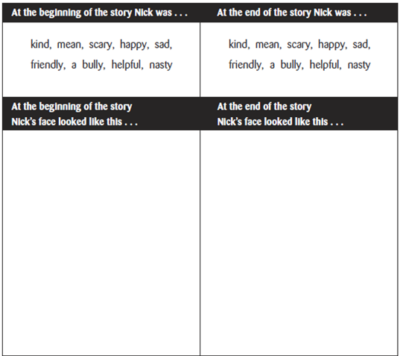
Read and think

Slide 7
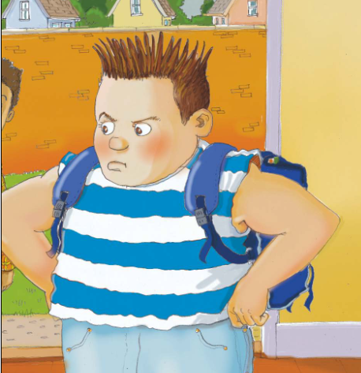
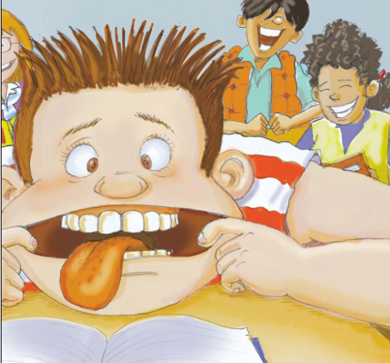
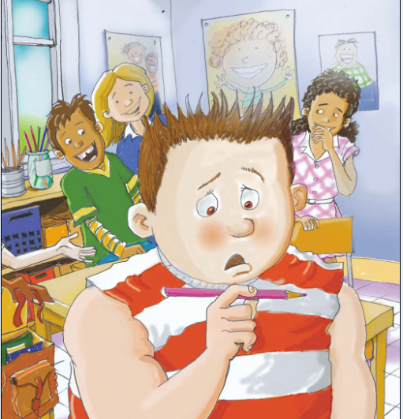
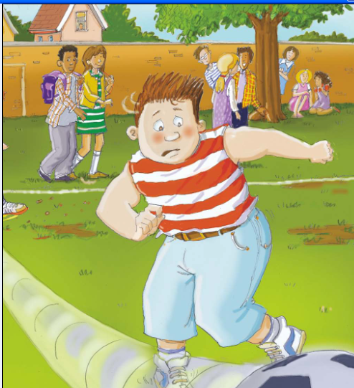
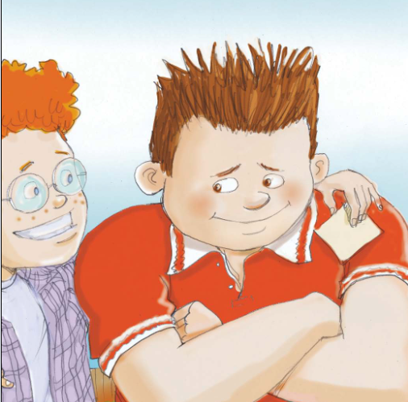
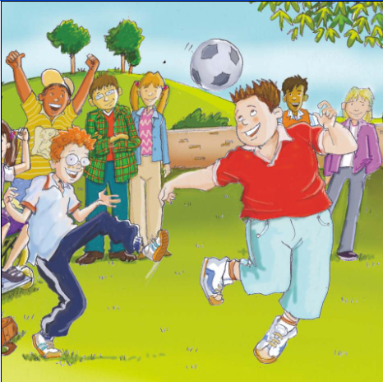
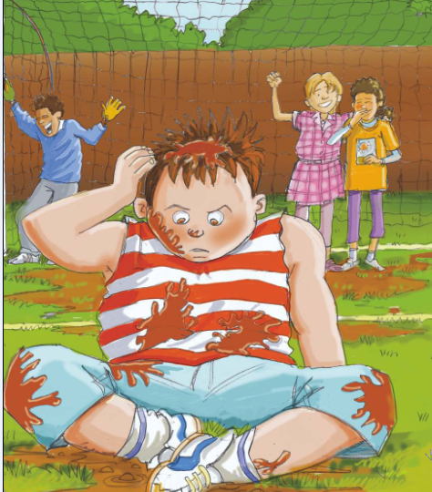
Retell the story

Slide 8
Choose your role
Discussion Leader
Character Captain
Creative Connector
Cultural Collector
Moral Master

Slide 9
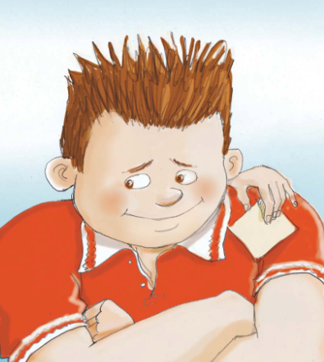
Imagine…
Imagine after Jake left, what would Nick be like?

Slide 10
Homework
●Write down what we should do if we
want to get on well with others in school.
●Write down what we should do if we find
our classmates are too mean to others in
class.

