Slide 1
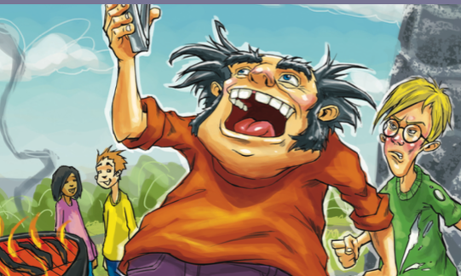
Uncle Al Goes Camping with Us
多维阅读第13级

Slide 2
Look at the cover of the book, what can we see?
2. What do you think might be going on?
3. What does it make you wonder about this book?

Slide 3
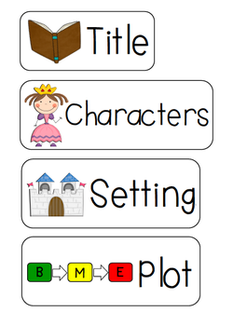
Read and Find out

Slide 4
What are characters in a story?

Slide 5
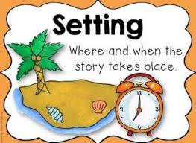
What is the setting in a story?

Slide 6
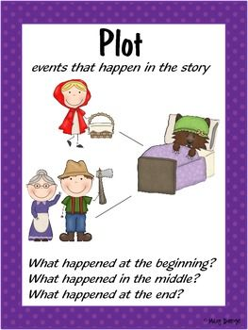
What is the plot of a story?
What happened at the beginning?
What happened in the middle?
What happened in the end?

Slide 7
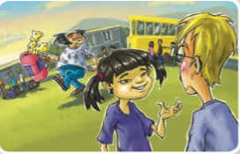
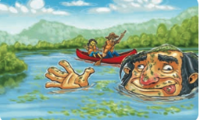
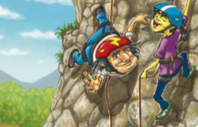
Read and Find out
Who are the main characters in the book?
2. What are the 3 settings in the book?
3. What happened before, during and after the camp?

Slide 8
Read and Find out
Who are the main
characters in the book?
Uncle Al and “I”.
What are the 3 settings in the book?
At home, at camp, at school.
3. What happened before,
during and after the camp?
… (Answers can be general or
detailed.)

Slide 9
Read again and Find out
What do “I” think of Uncle Al before, during and after the camp? Find out the adjectives.
Before the camp: Uncle Al was silly.
During the camp：Uncle Al was silly, funny and crazy, and “I ” was cross.
After the camp: Uncle Al
was great, and “I” was lucky
to have him.

Slide 10
Retell the Story
Work in pairs, and retell the story. Try to use the adjectives in the book to describe “my” feelings towards Uncle Al.

Slide 11
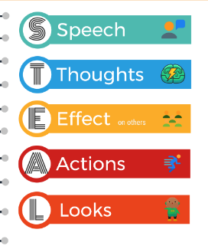
STEAL
We can try to analyze a character with the help of STEAL method.

Slide 12
STEAL
What did Uncle Al say/do? What can you know about him from that?
What did Uncle Al look like? What can you know about him from his appearance?

Slide 13
STEAL
✔
— “No worries, we’ll see how
far we can throw them.”
— “I’ll fix it.”
— “It’s fixed.”
childlike
Warm-hearted
capable
…

Slide 14
STEAL
— But he made them (sausage) so black…
— Uncle Al climbed up to get her. But his
foot got stuck in a hole.
— Uncle Al fell out of the canoe.
—Uncle Al was already looking in the
motor.
—He did a silly dance right there in the
bus.
✔
careless
clumsy
warm-hearted
…

Slide 15
STEAL
— He had duckweed on his head and he
was making silly faces.
— He had black oil all over his face and
hands and clothes.
✔
He doesn’t care about his looking.
…

Slide 16
Group Work
Did the boy’s attitude towards Uncle Al change? What makes you say that?
What did the boy say or think about Uncle Al?
What did the boy do when he was with Uncle Al?
Why do you think the boy’s attitude changed?

Slide 17
Group Discussion
Do you have similar experience as the boy in
the story?
2. Have you read about the changing attitudes
towards someone before?
3. What effects may misunderstanding have
in our real life?
4. What have you learnt from the text?

Slide 18
Summary

Slide 19
Homework
Write about what might happen between Uncle Al and the boy afterwards.
Write about your own experience if you have ever changed opinion towards someone, or someone has ever changed opinion to you.

