Slide 1

KC Miggins
猫王不见了
选自《多维阅读第12级》

Slide 2
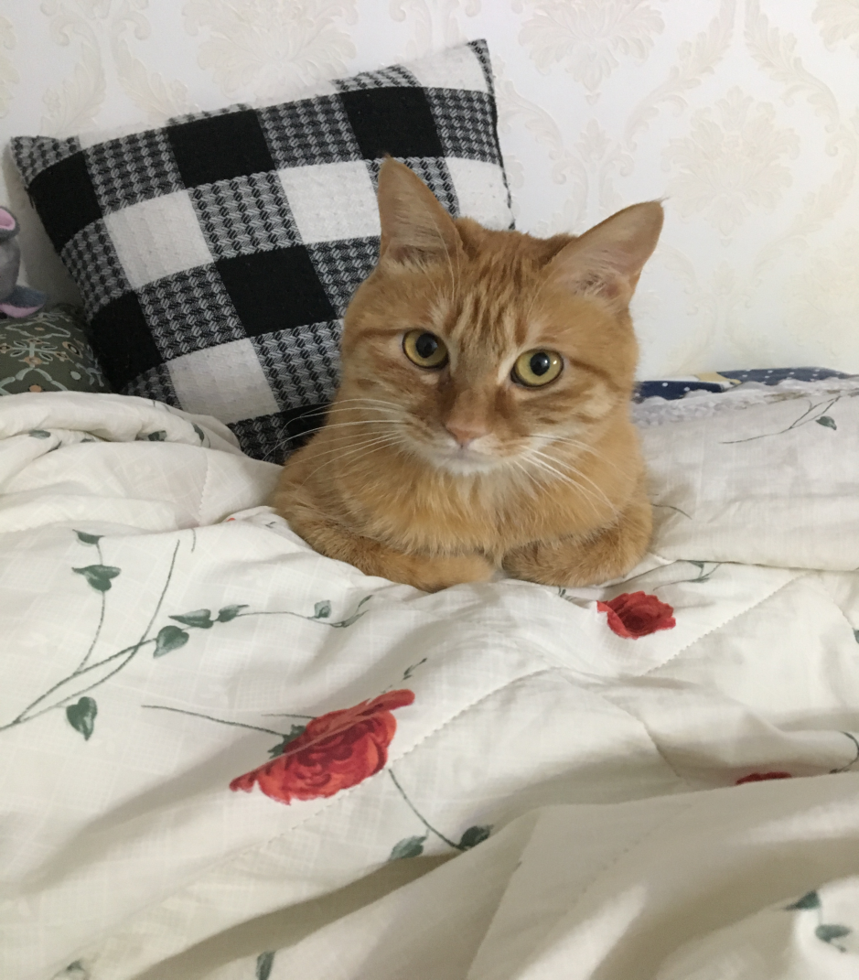
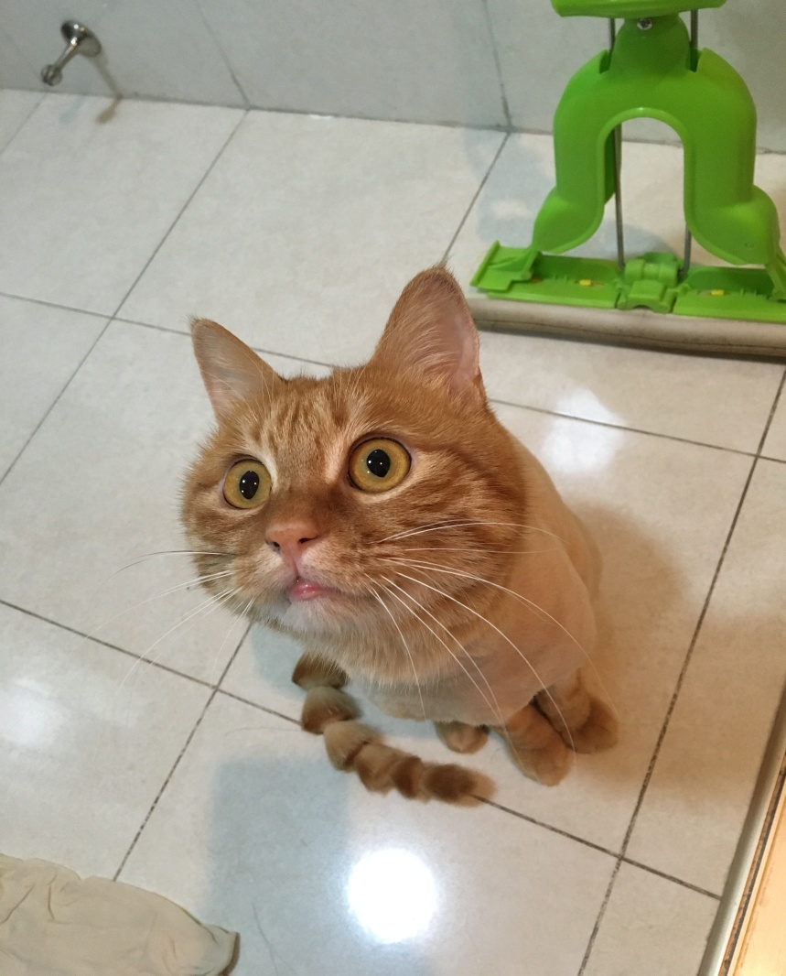
My pet-Bubble
Notes:
图片为制作PPT的教师家里的猫

Slide 3
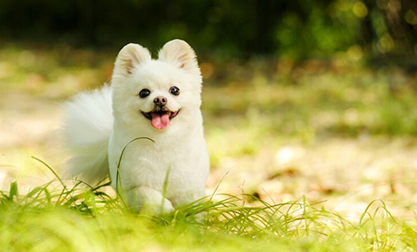
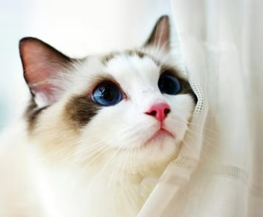
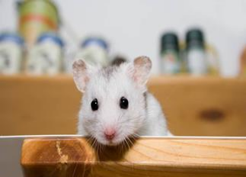
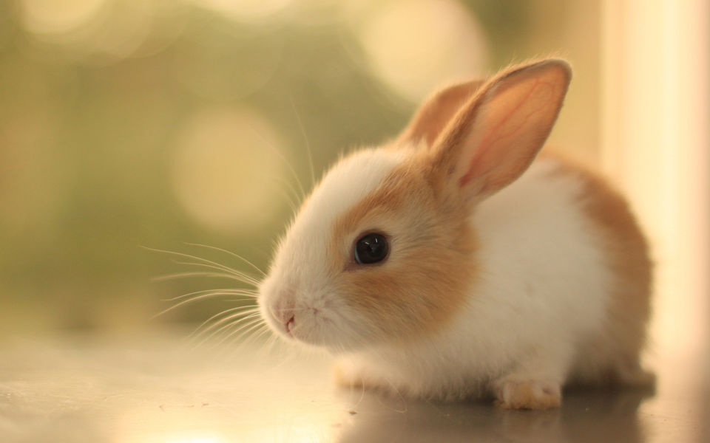
Do you have a pet cat or some other animals?
What does it look like?
Can you say something about it?

Slide 4
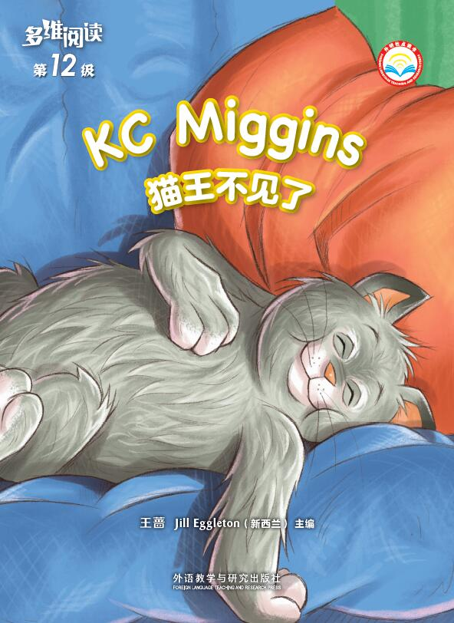
What’s the title?
What do you think the story is going to be about?
What do you want to know from the story?

Slide 5

Reading Time
Is your prediction right?
Can you find what you want to know in the book?

Slide 6
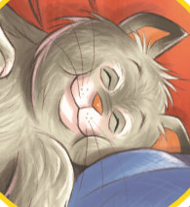
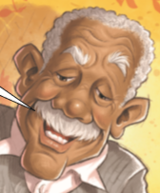


The Main Characters
KC Miggins
Papa
Momsy
Hugo
Setting: At home In the rain Back home

Slide 7
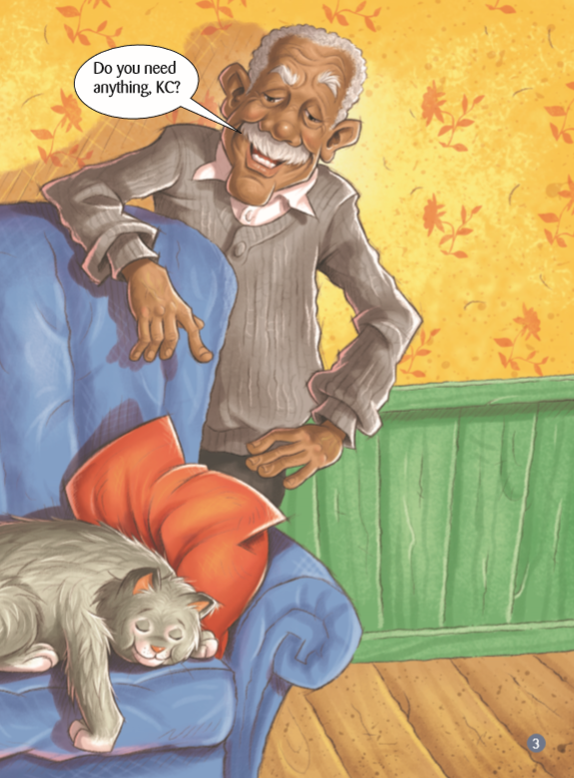
Papa and Momsy found a stray cat.
They took good care of it.
Why do you think the cat was called KC and not his full name?
How do you know KC was well cared for?

Slide 8
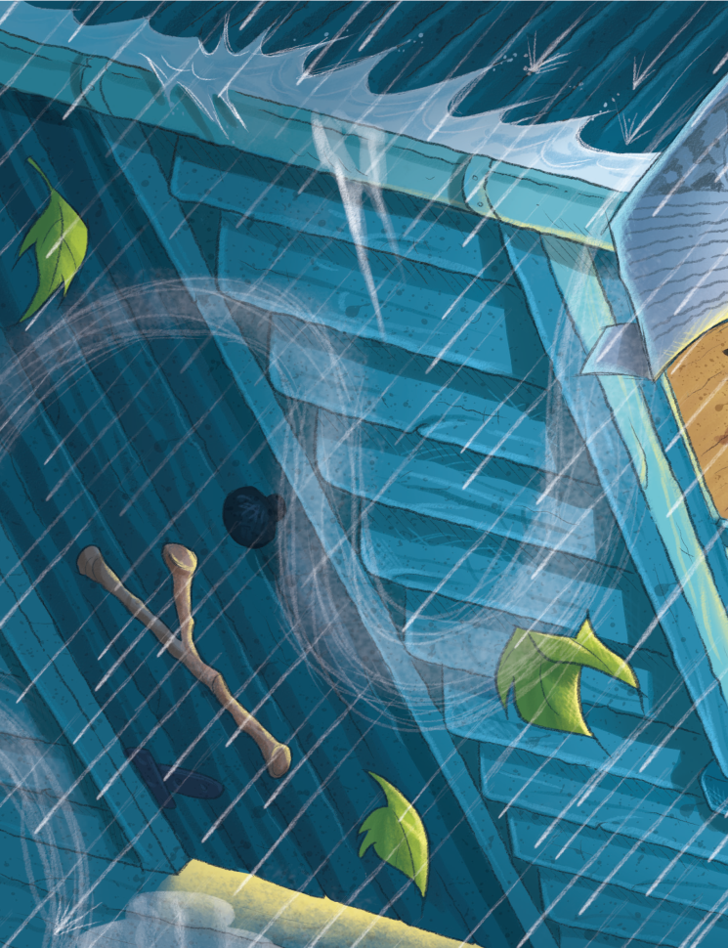
One weekend, there was storm. Papa and Momsy and Hugo found that KC disappeared.
How was weather like on the weekend?
How do you know this was a big storm? Which words tell you?
What do you think made Papa say “He can smell a storm”?
How would you feel in a storm like this? Why?

Slide 9
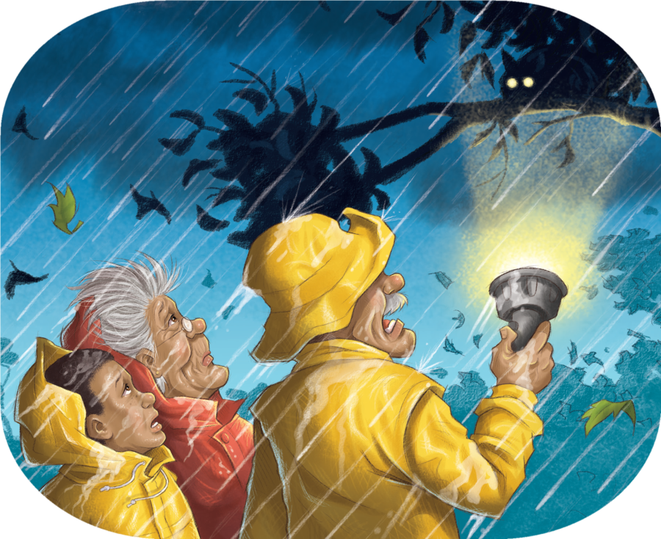
Whole family came out to look for and rescue KC.
Do you think they should have gone out in the storm? Why?
How do you think they might solve the problem?
Is it easy for them to rescue KC? How do you know that?

Slide 10
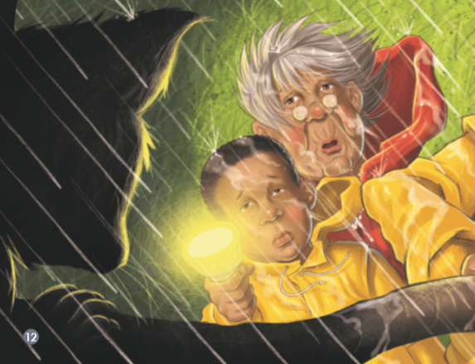
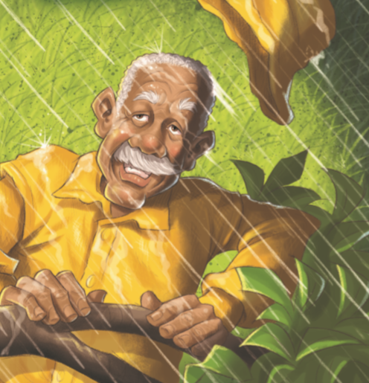
How did they rescue KC? What was the result?
Cause Effect
What Papa did? What happened because of this?

Slide 11
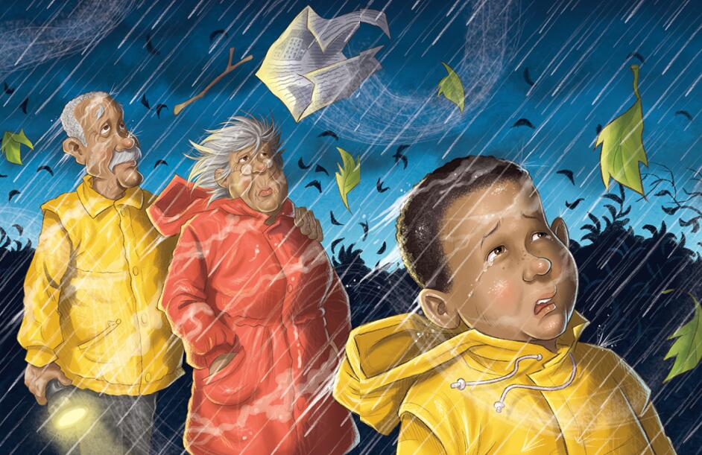
Which words would you use to describe how they might be feeling?
Has anything like this ever happened to you?

Slide 12
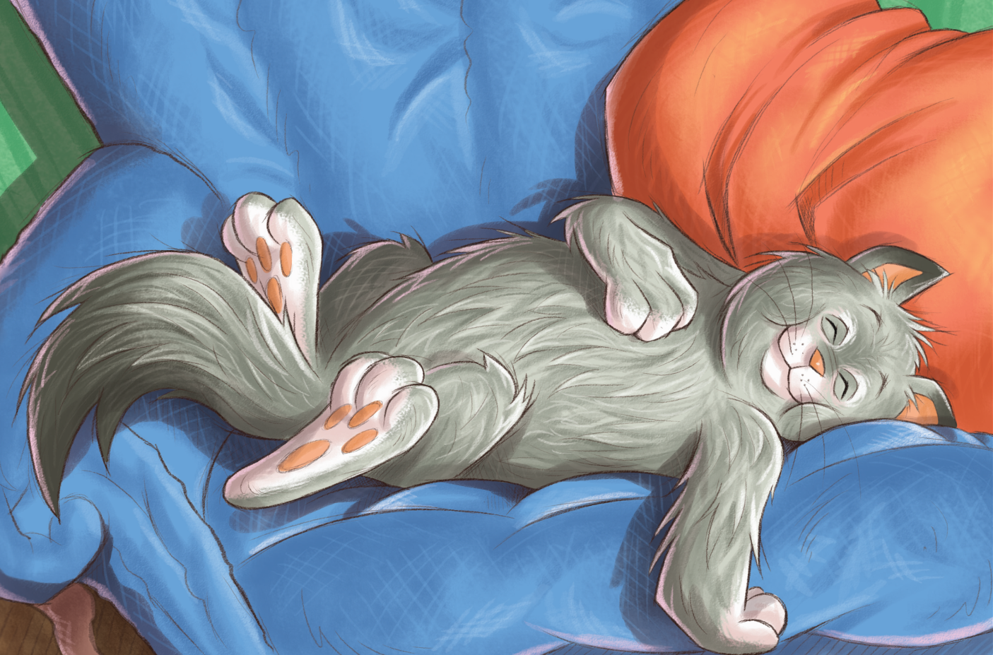
When they came back home. They found KC was there!
If the illustrator was to draw Papa, Momsy and Hugo here, how do you think he would show their faces?
What do you think is meant by “Ah yes, life was good for KC Miggins”?

Slide 13
Finish the Diagram
palace
throne
Papa and Momsy found a stray cat.
They took good care of it and treated it like “King Cat”.

Slide 14
Story Time
Let’s share the story together.
Learning tips:
Tell the story with the help of your diagram.

Slide 15

Work in Groups
Please choose your favourite episode and act it out with your group members. First, do scriptwriting cooperatively like this …
Example:
PP14-16
Setting：Outside/In the rain
Characters：Papa, Momsy, Hugo
Script：
Narrator: Papa and Momsy and Hugo stood there, the wind circling them like a pack of angry wolves. They were wet and cold. But they stood there in silence, thinking about KC …
Papa: We are going to miss that silly cat …
Momsy: He was part of the family …
Hugo: There’ll never be another KC …
……

Slide 16

Discussion
If you were KC and you can speak, how would you feel and what would you do/ say?
If you were Papa, would you choose other ways to solve the problem?

Slide 17
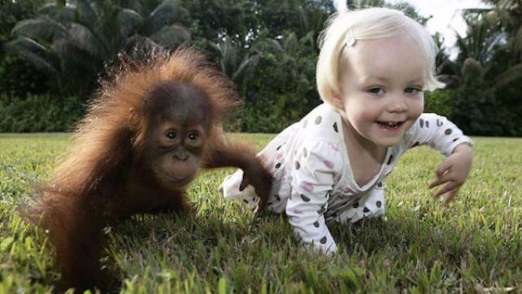
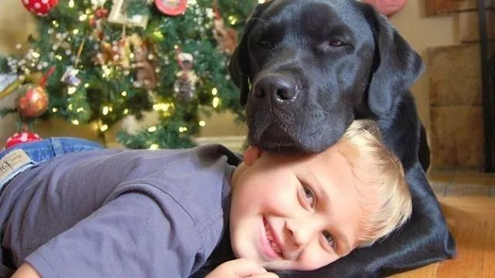
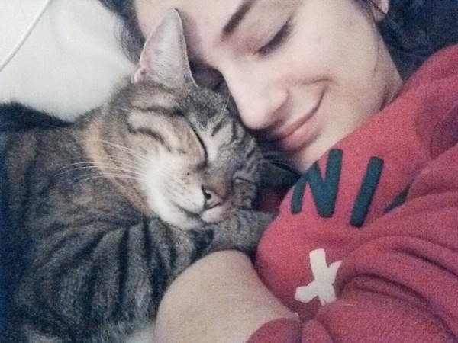
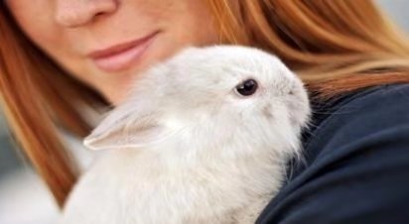
We should treat animals as our family members and never abandon them.
Notes:
图片均取自百度图库

Slide 18

Homework
1. Tell the story “KC Miggins” to your parents.
2. Tell another story about an animal friend you have read or heard or composed to your classmates.

