Slide 1
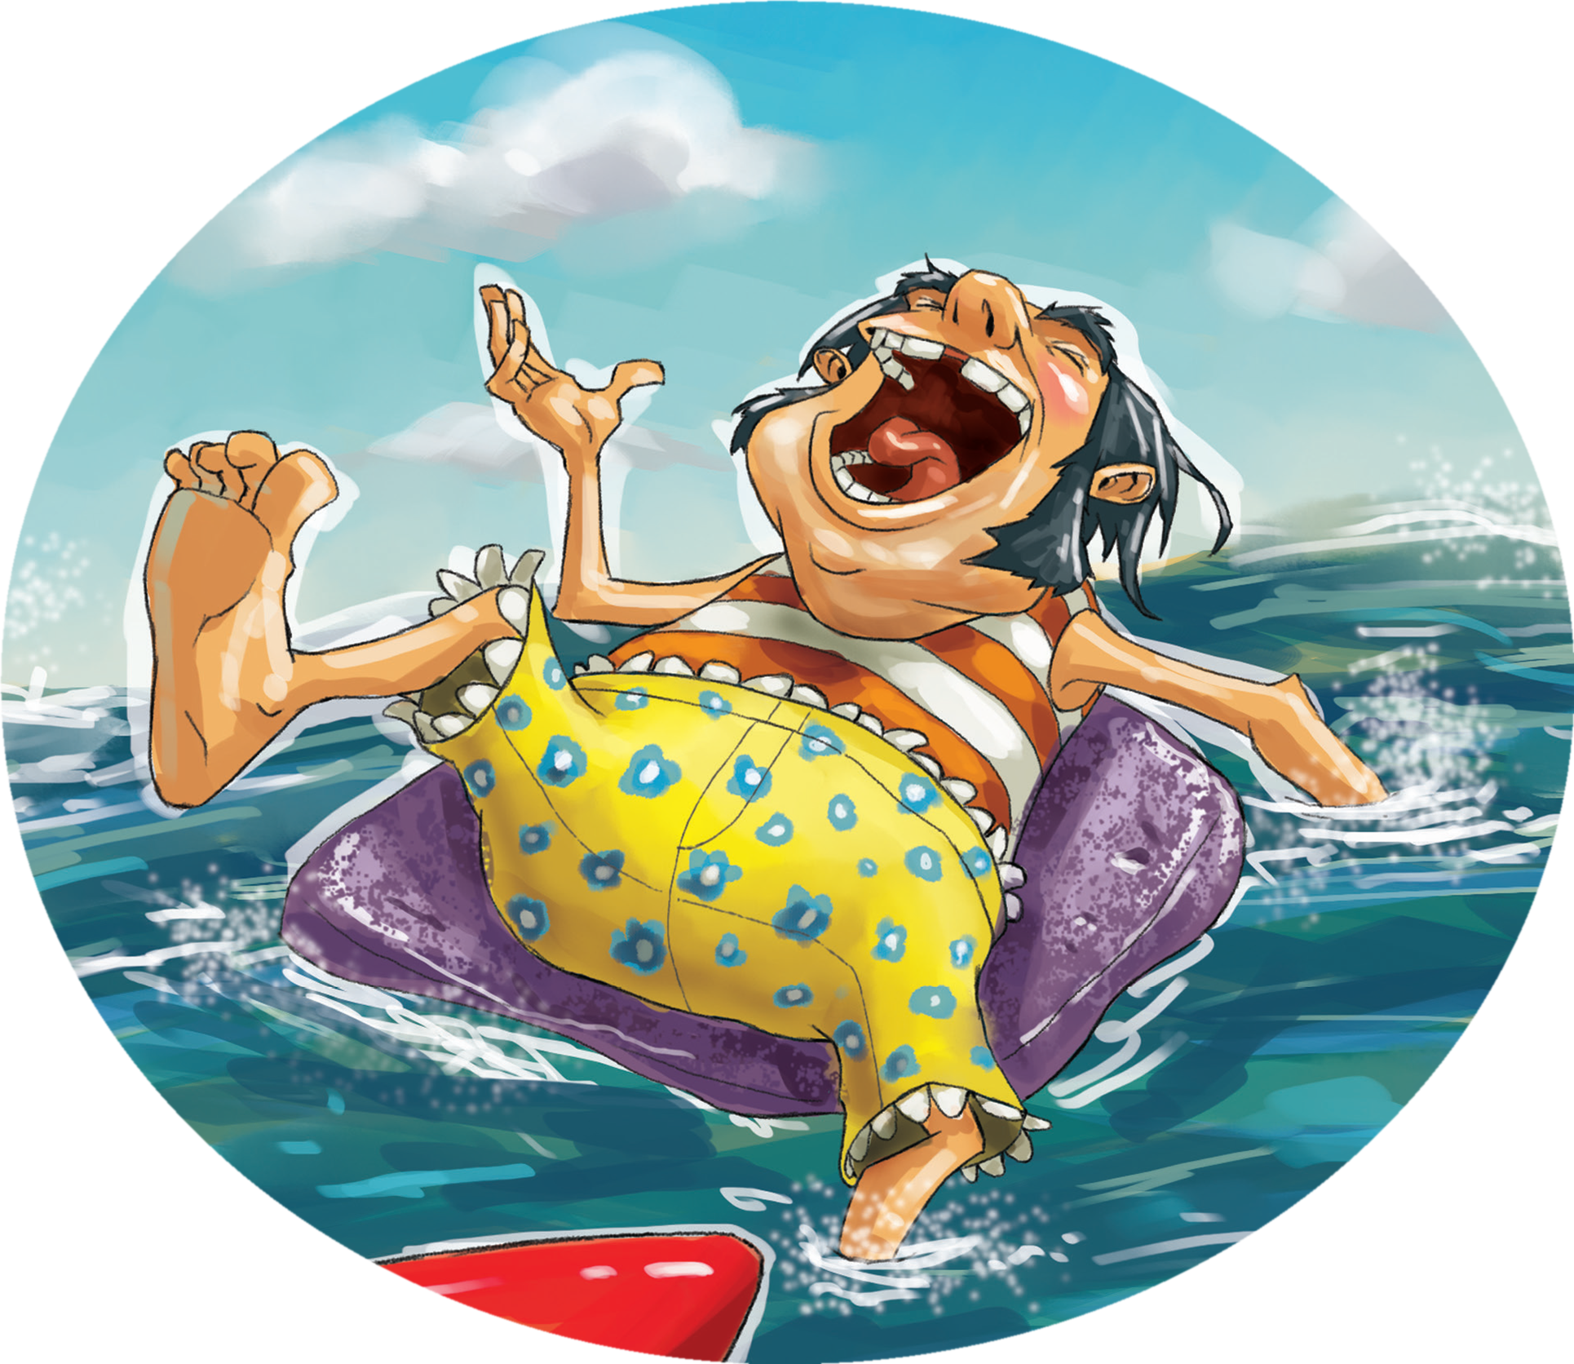
Uncle Al - Surfer
阿尔叔叔上头条
选自《多维阅读第12级》

Slide 2

Where is it?
What can you do here?
2. Usually what do people take to the beach?
Will you take a sofa to the beach? Why or why not?
3. If someone else does it, how would you think of him?
4. Have you ever surfed? What do you need when you are surfing?
Lead-in

Slide 3
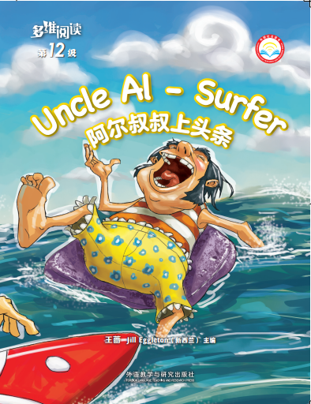
Look at the cover page.
What can you see from the front cover?
Where did the story happen?
3. What is the title?

Slide 4
Guess: What do you think the story is going to be about?

Slide 5
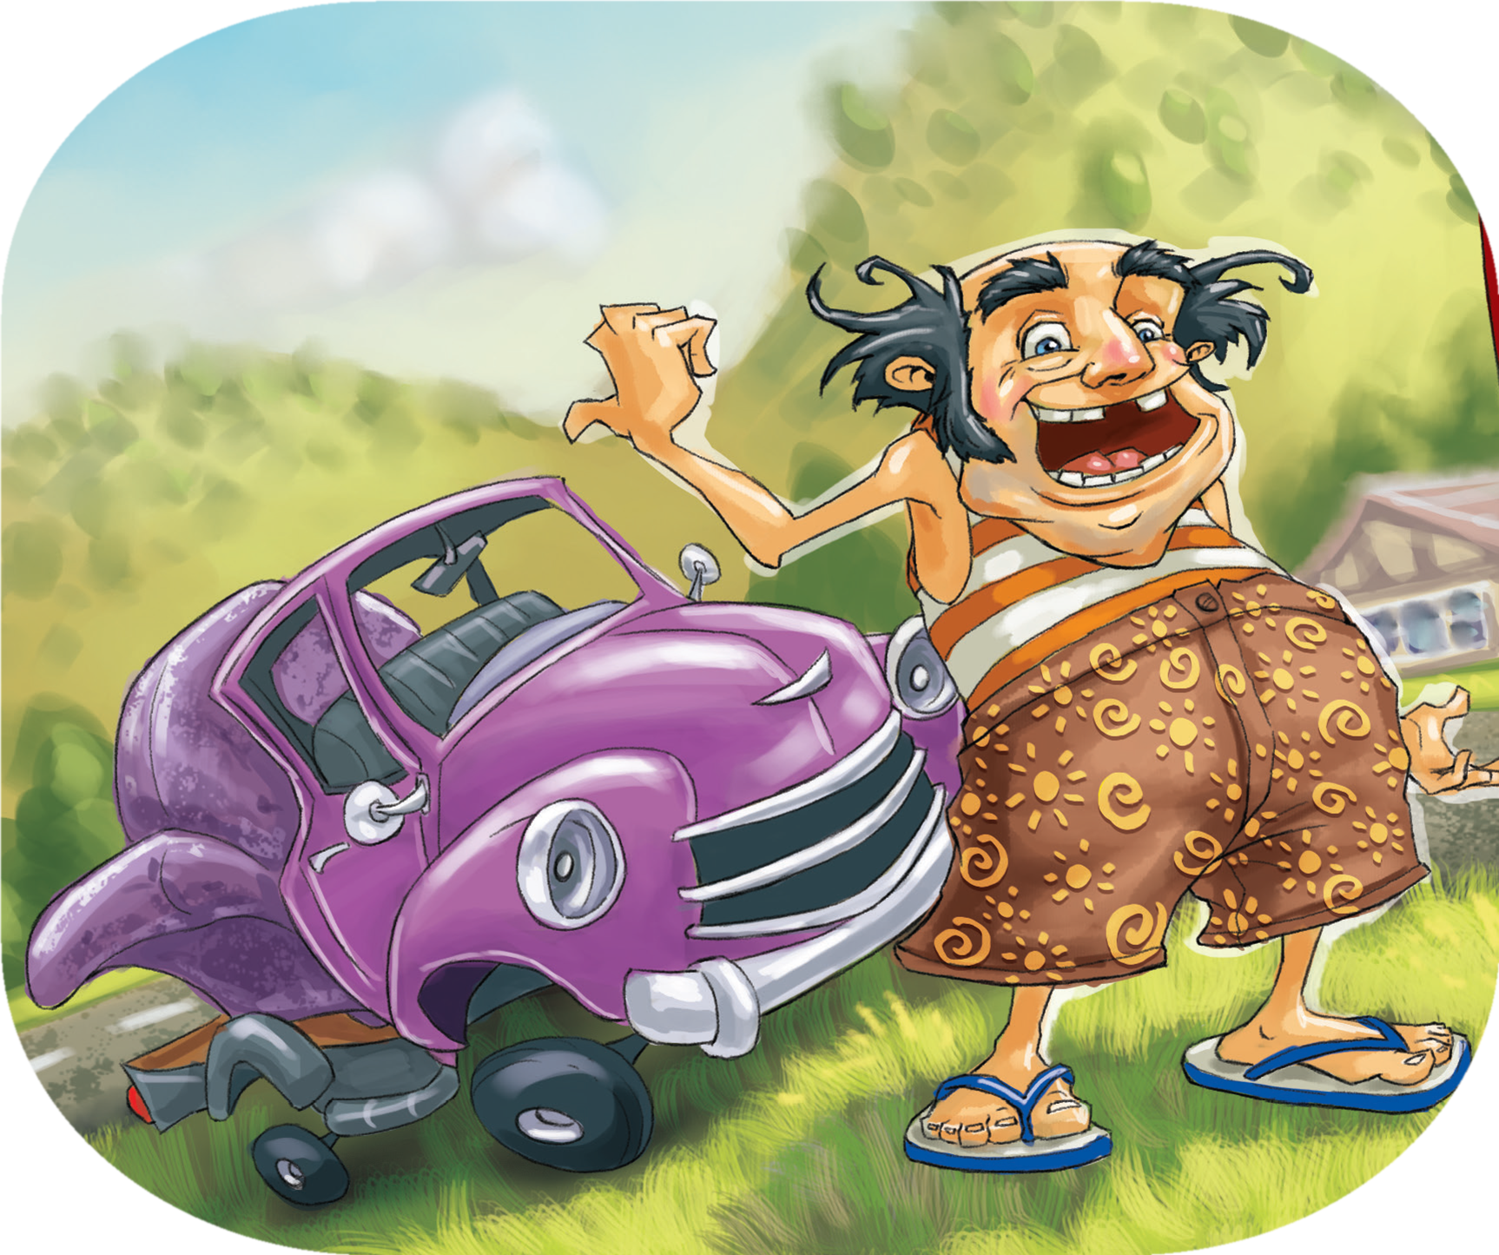
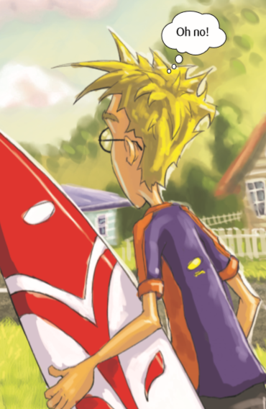
Read and Answer (PP2-3)
1. Where was the boy going?
What was the boy going to do?
  2. Who did the boy meet on his way to the beach?
  3. Why do you think he didn’t want to go to the beach with Uncle Al?

Slide 6
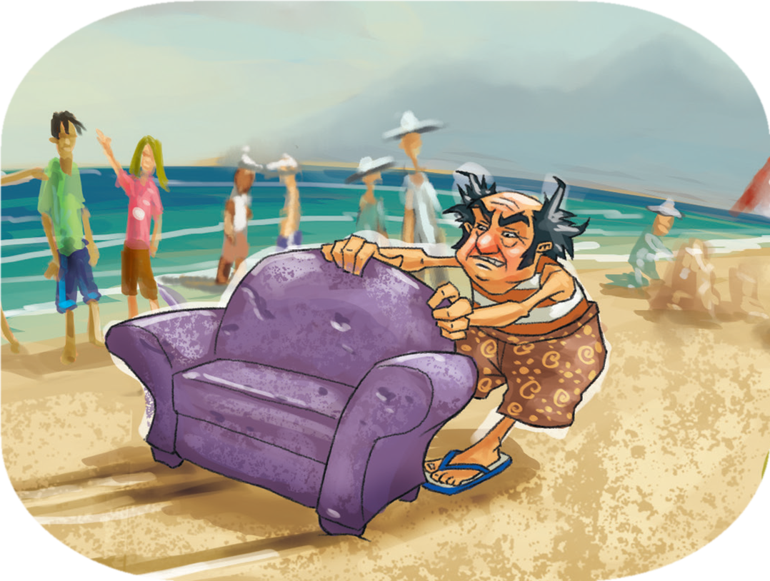
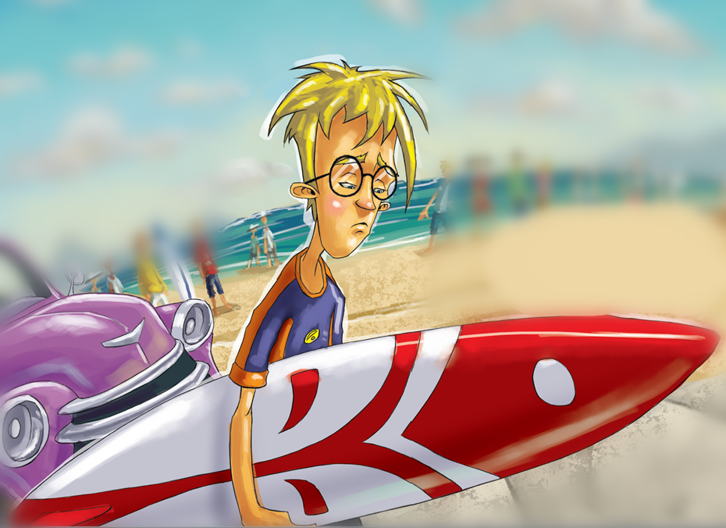
Read and Answer (PP4-12)
What do you think made Uncle Al different?
  2. Why do you think Jack was so embarrassed?

Slide 7
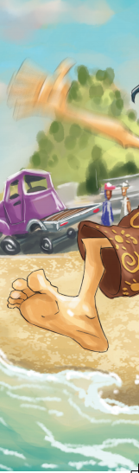
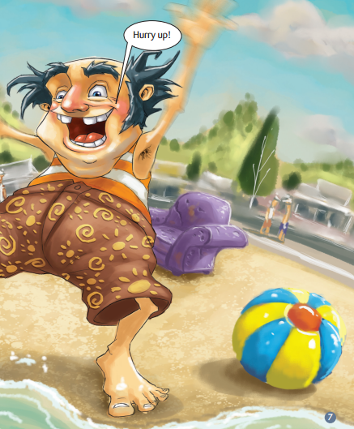
Read and Answer (PP4-12)
  3. How do you know the boy really cared about Uncle Al?
  4. What did Uncle Al want to do?

Slide 8
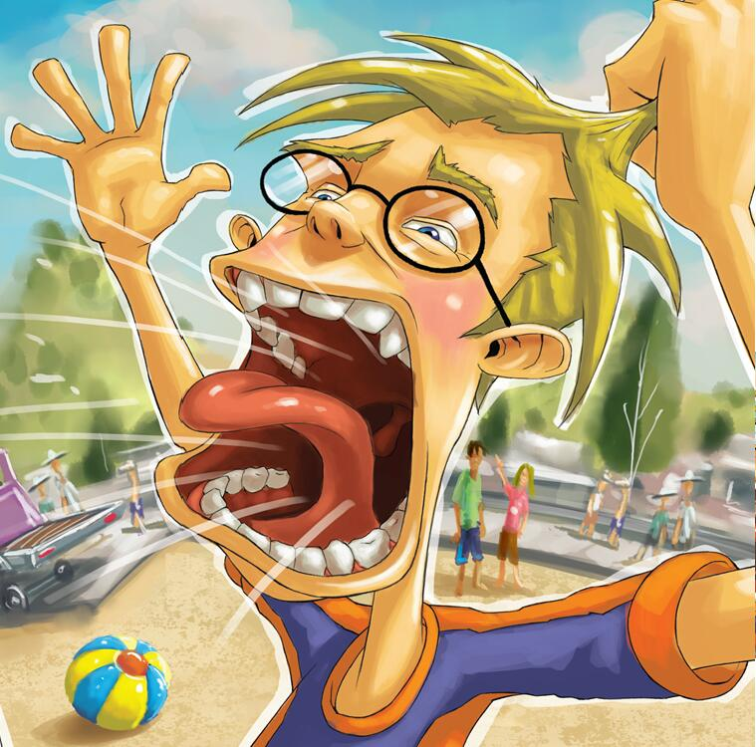
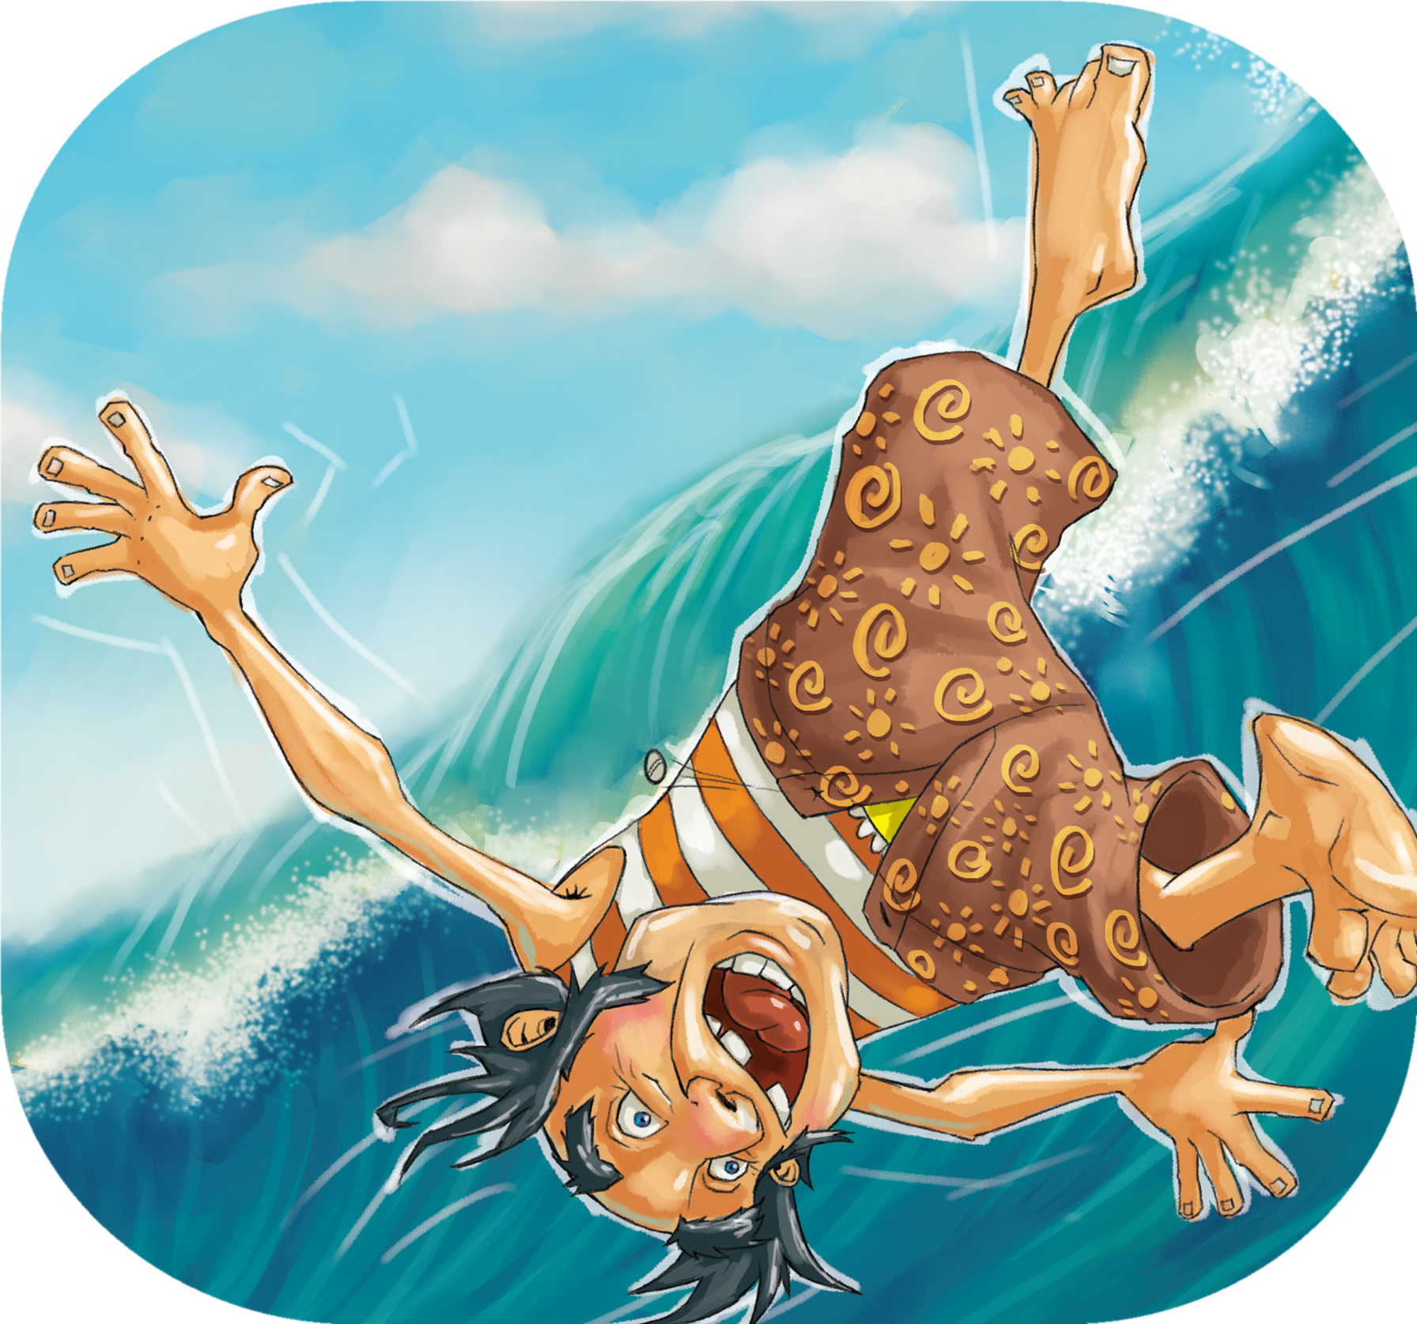
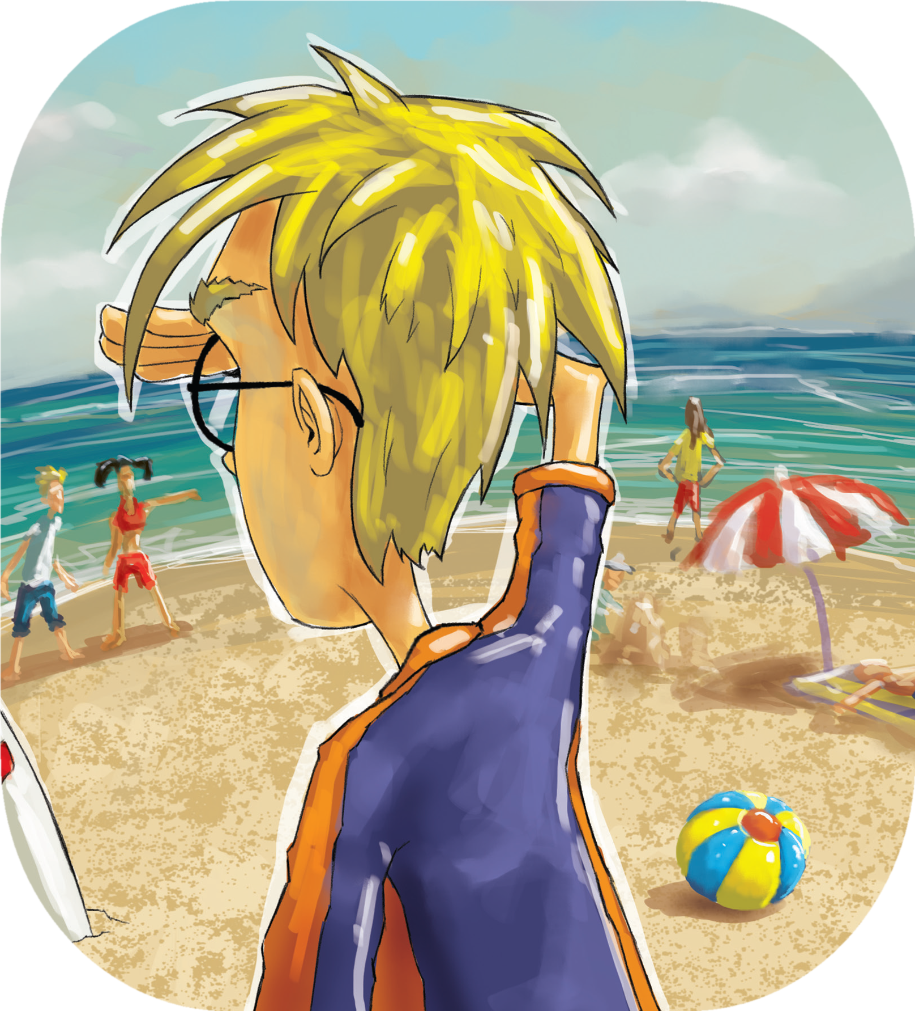
Read and Answer (PP4-12)
  5. What do you think might be a consequence of Uncle Al being sucked into the churning water?
  6. What do you think Jack meant by “I should have been stronger”?
  7. Why do you think Jack couldn’t move his legs?

Slide 9
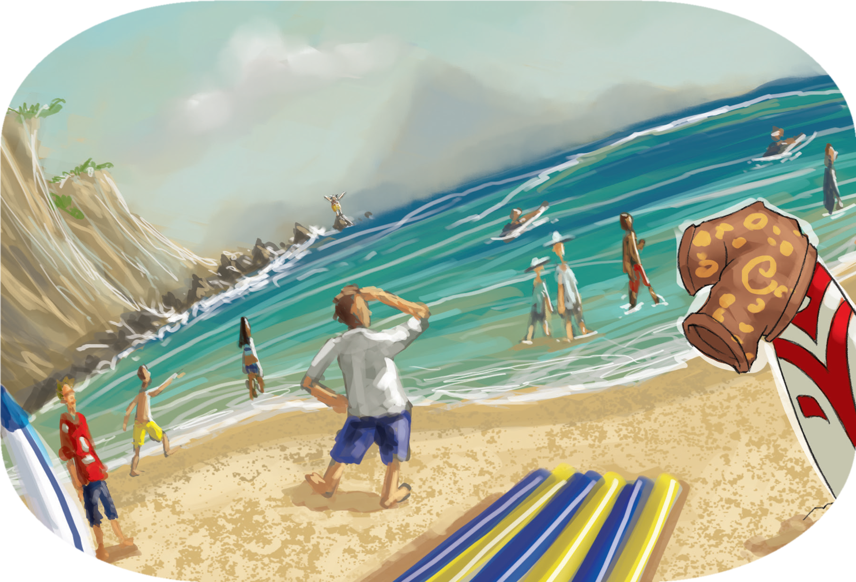
Read and Answer (PP12-17)
1. How do you know the people cared?

Slide 10
Read and Answer (PP12-17)
2. How do you know Uncle Al was a long way away?

Slide 11
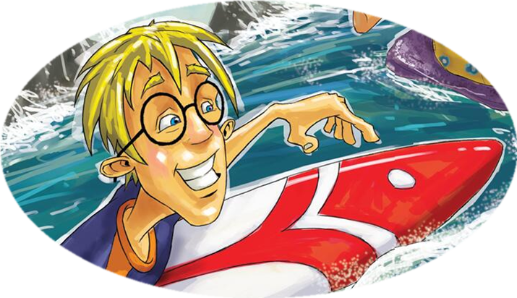
Read and Answer (PP12-17)
3. Why do you think Uncle Al wanted the seat off the chair?
4. Why do you think Jack’s expression has changed now?

Slide 12
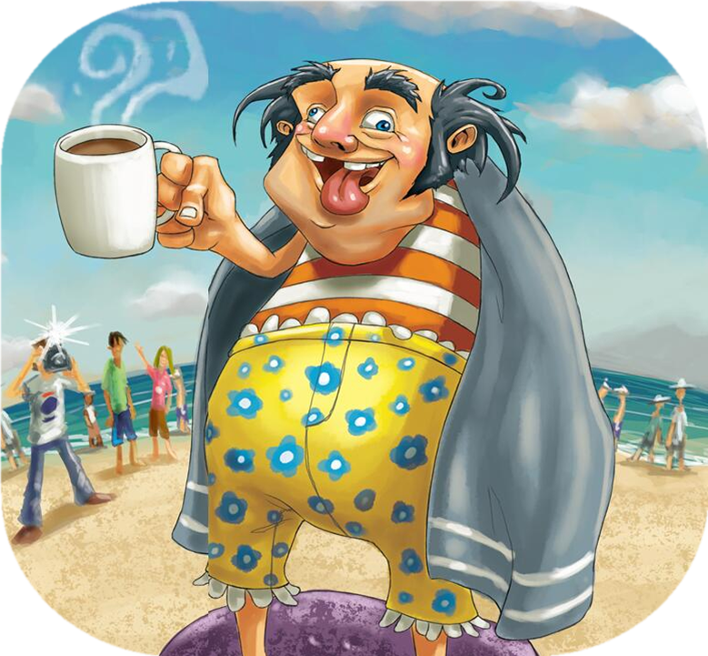
Read and Answer (PP12-17)
  5. Do you think Uncle Al was a hero? Why do you think that?

Slide 13
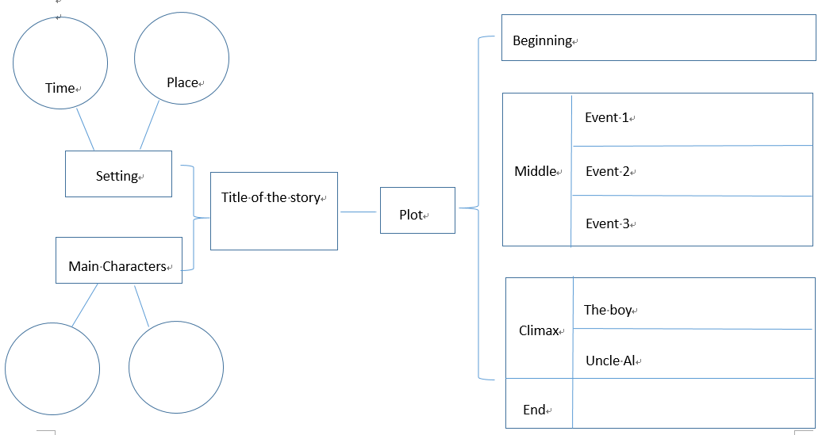
Activity 1
  Please complete the story map and try to retell it.

Slide 14
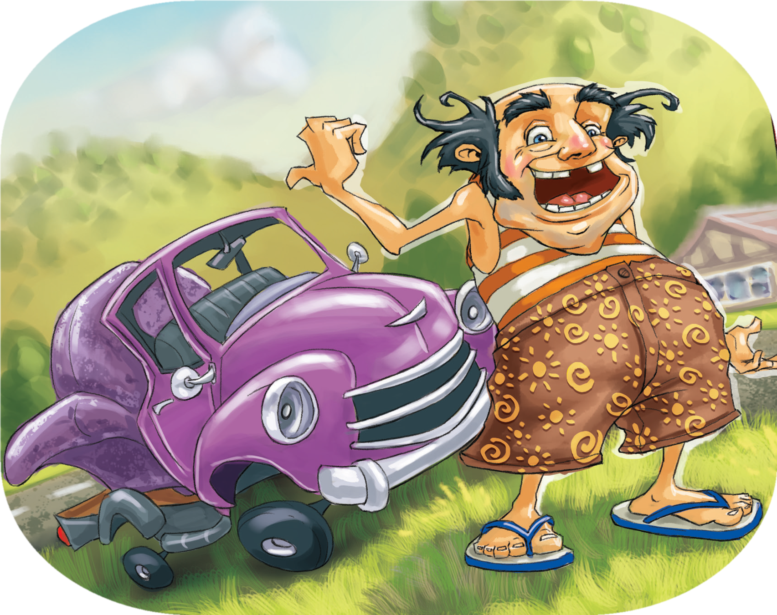
Read for the 2nd time ---Think and Answer
PP2-3
What do you think the narrator meant by “There he was, grinning like a fat cat” and “No one could argue with Uncle Al”?

Slide 15
Read for the 2nd time ---Think and Answer
PP4-5
How was the boy feeling when they got to the beach?
What did the boy compare his feeling of embarrassment to?

Slide 16
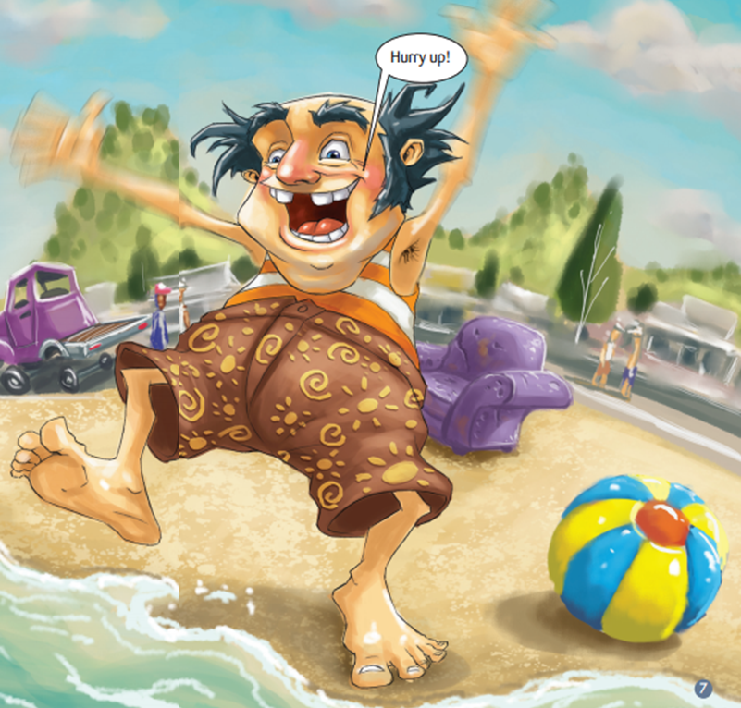
Read for the 2nd time ---Think and Answer
  PP6-7
  1.What made the boy think there was something wrong with Uncle Al?
  2. Why do you think Uncle Al might be compared to King Canute?

Slide 17
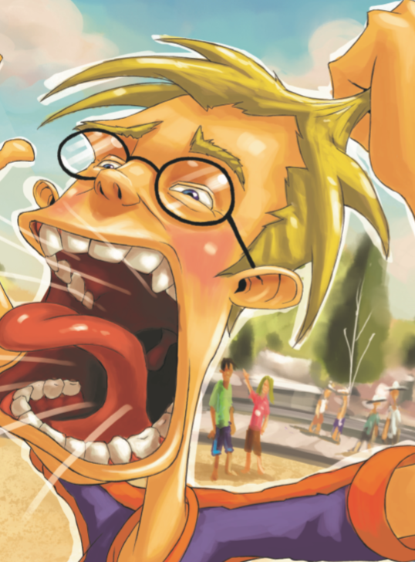
Read for the 2nd time ---Think and Answer
PP10-11
1. What has the illustrator done to show the boy’s feeling?
2. What do you notice in the illustration?
3. How was the boy feeling at the moment?

Slide 18
Read for the 2nd time ---Think and Answer
PP14-15
  1. How do you know the boy was very happy at that time?
  2. What words would you use to describe how the boy might be feeling?

Slide 19
Read for the 3rd time ---Think and Answer
PP16-17
  1. Which sentence tells you that the boy would be embarrassed again by Uncle Al?
  2. Do you think the headline was right? Why? Why not?

Slide 20
Activity 2
Imagine you are Uncle Al, tell the story from his perspective. Or imagine you are the boy, continue to tell the story.

Slide 21
Discussion
  1. What would the boy say to Uncle Al after he came back to the beach?
  2. Do you think there would have been another way to get Uncle Al off the rock? How?

Slide 22
Homework
Tell the story “Uncle Al - Surfer” to your parents.
Try to write another story about a person who has given you a deep impression. You can write your PERSONAL NARRATIVE with one or some special events.

