Slide 1
Fussy Ferret
洁癖老妈邋遢娃
选自《多维阅读第12级》

Slide 2
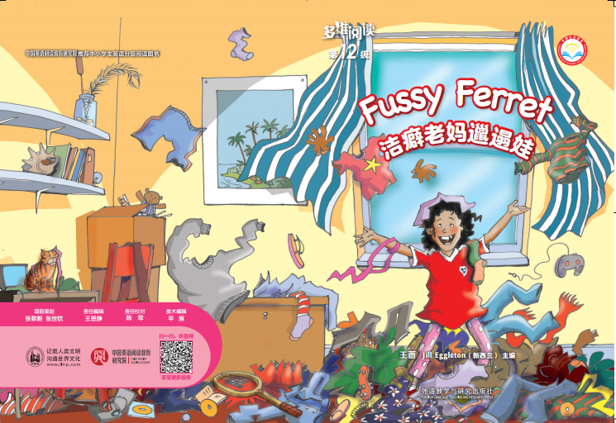
Look at the cover and guess.
1. Where is the girl?
2. What is on her head / arm / shoulder?
3. What do you think of her and her room?

Slide 3

Look at the title and guess.
Fussy Ferret
1. What does “fussy ferret” mean?
2. What do you think the story is going to be about?

Slide 4
Read the story and answer.
1. How many main characters are there?
2. Who are they?
3. Who was a “fussy ferret” in the story?
4. Why did the girl describe her mum as a “fussy ferret” ?
Four.
The girl, Mum, Dad and Tom.
The girl’s mum.
She liked everything to be tidy and couldn’t stand it when it wasn’t.

Slide 5
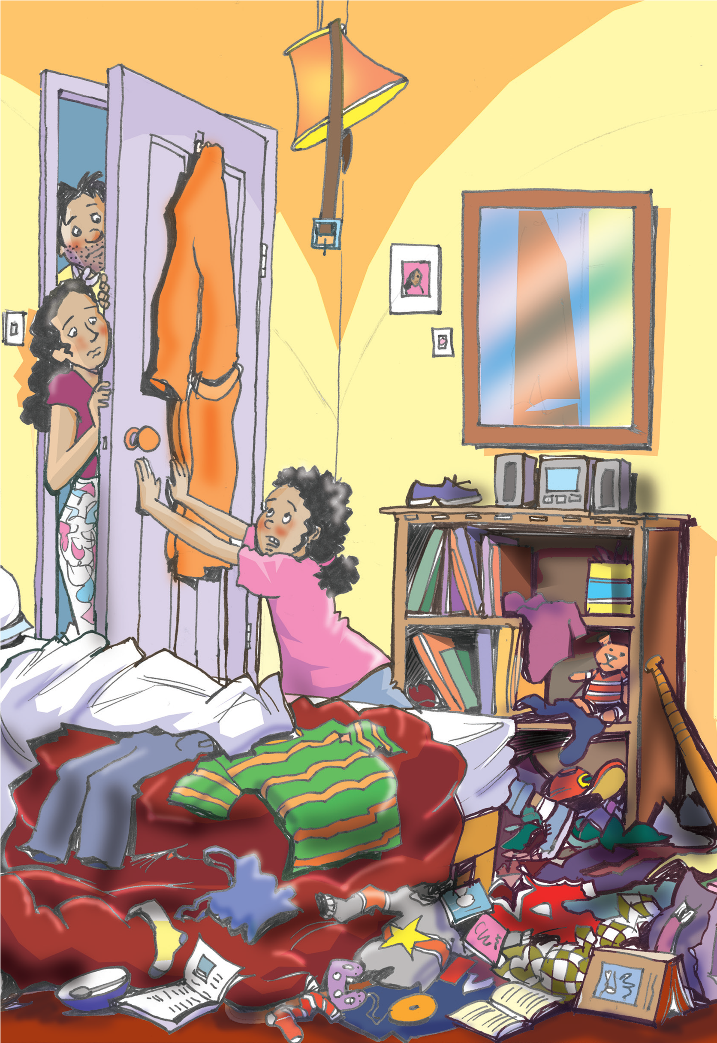
Read pages 2-7 and answer.
1. How did the girl feel when her room was messy?
2. What did Tom think of his sister’s habit?
She felt as cosy as a cat in a cupboard.
He thought it was bad.
What’s your opinion then?

Slide 6
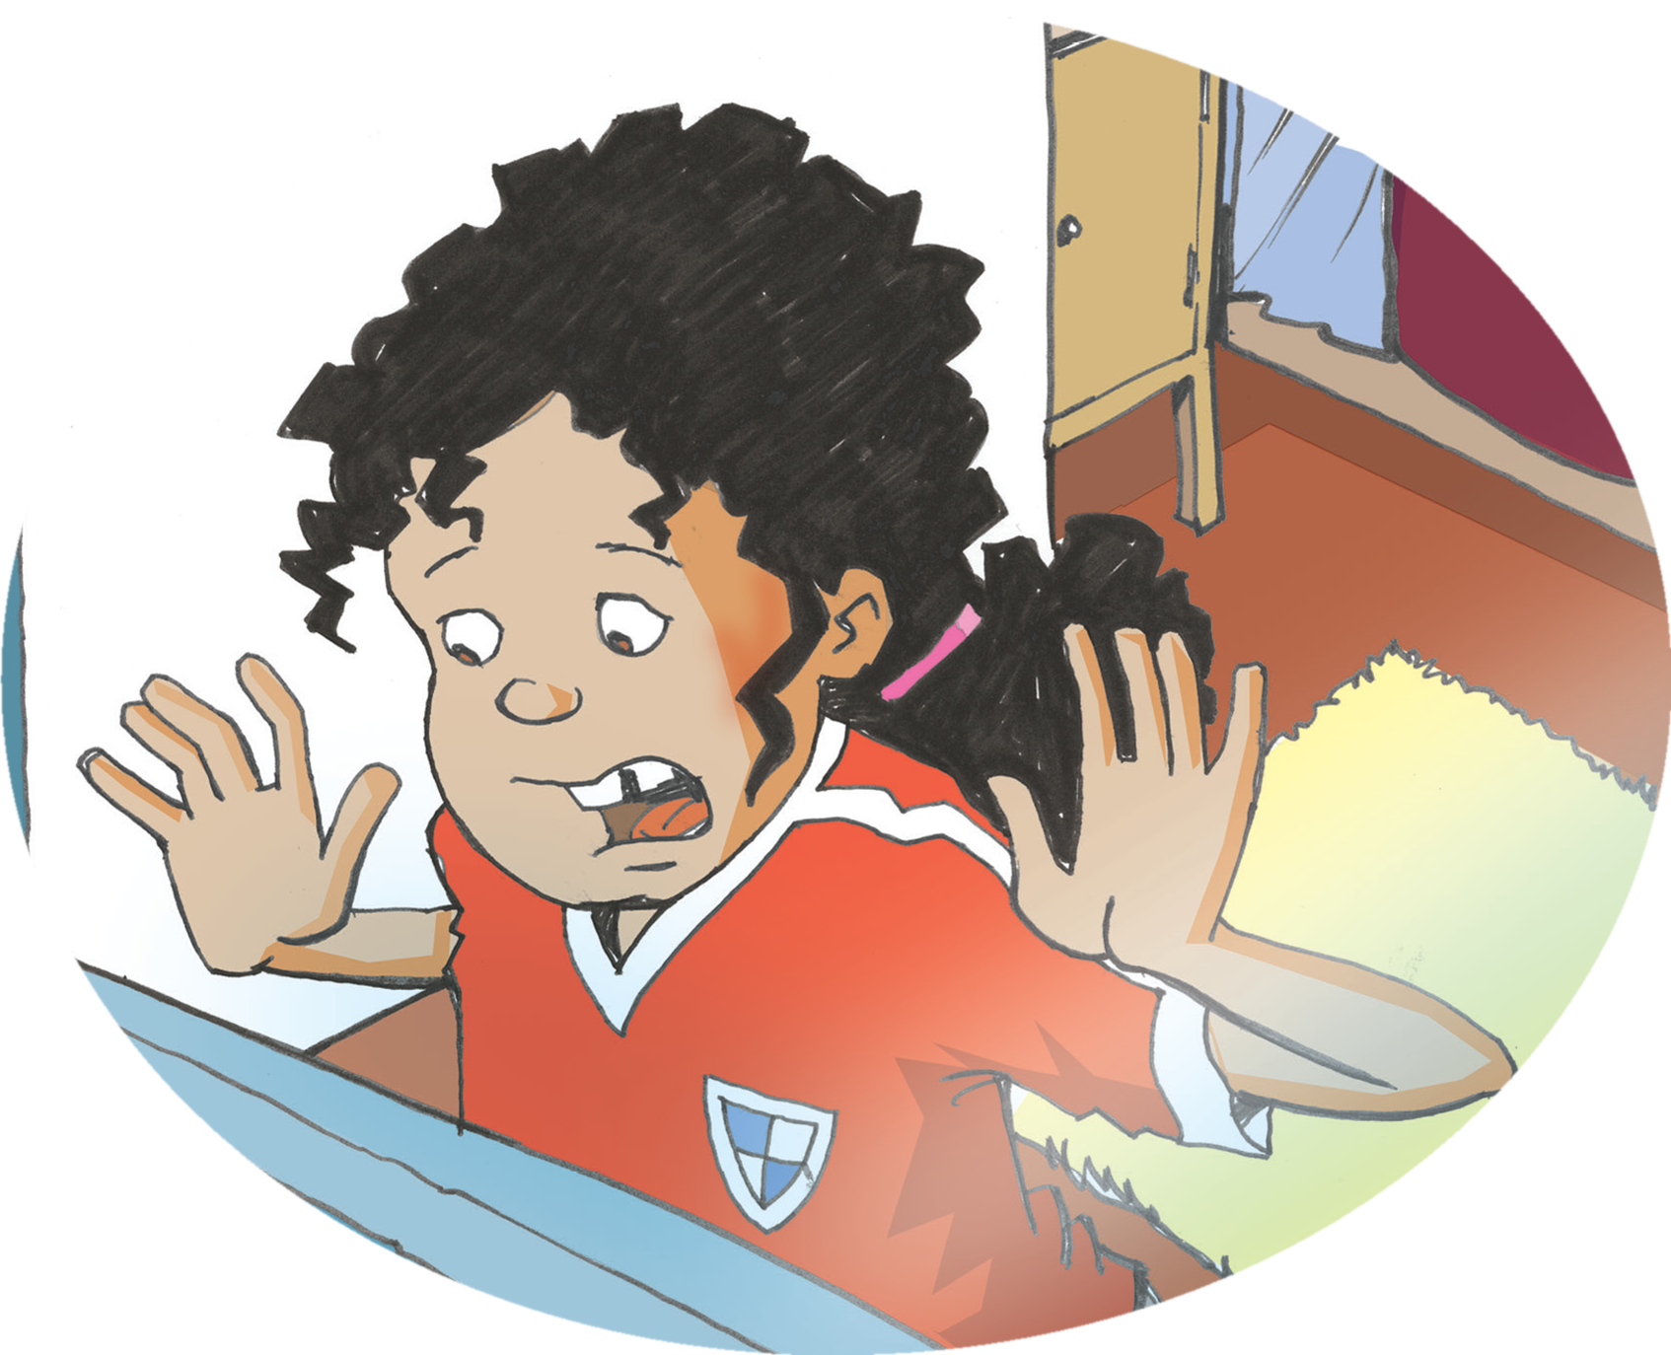
Read pages 8-15 and answer.
1. What did Mum do with the girl’s things on the floor?
2. What did Tom do with them then?
3. What did the girl do when she came back home?
She threw everything that was on the floor out the window.
He made a garage sale and sold almost everything.
She shouted and screamed.

Slide 7
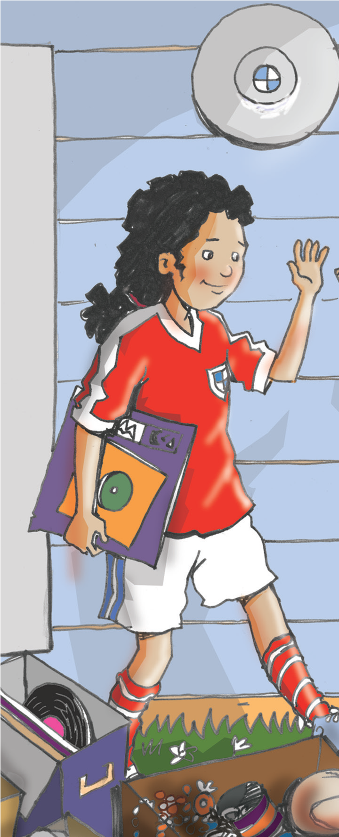
Read pages 16-17 and answer.
What happened to the girl at last?
She became a fussy ferret just like her mum.
She was never so untidy again.

Slide 8
Discuss in groups
Do you think the idea of the garage sale worked well?
Why?

Slide 9
Word Master
The words
we would like to remember!
The page of the word on.
The pronunciation of the word.
The meaning of the word.
Show us an example.

Slide 10
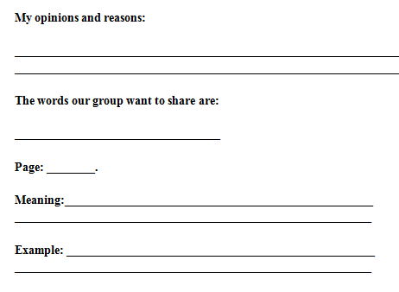
Choose one word and share it with others.
Word Master
Notes:
此环节选做，教师可将本PPT页面中的文字图片打印给学生使用。

Slide 11
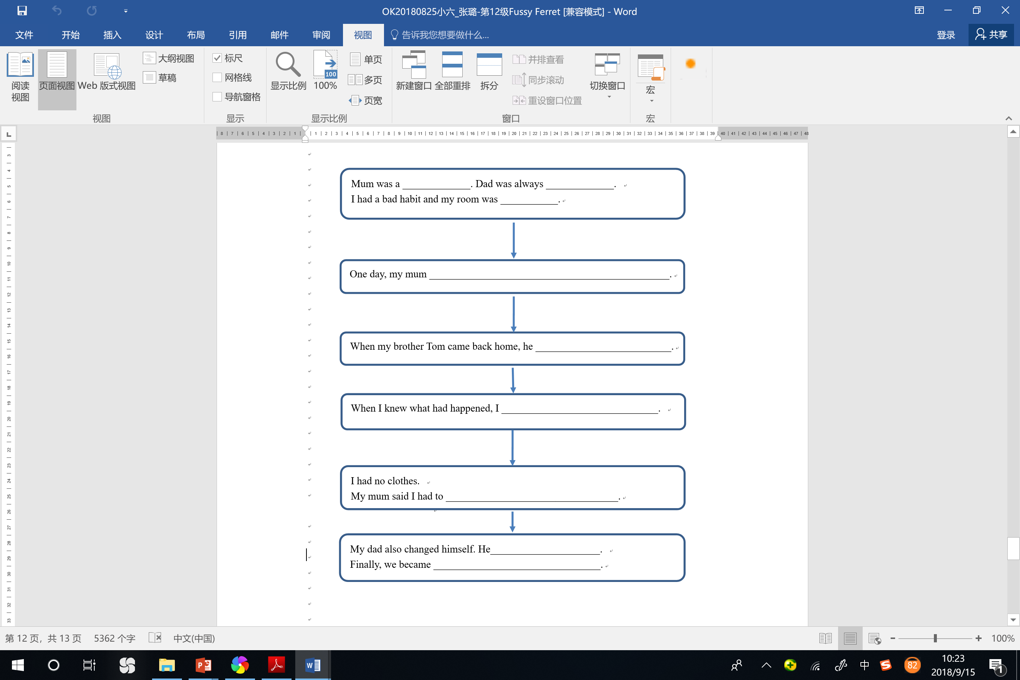
Complete the flow diagram and try to tell the story according to it.
Notes:
此环节选做，教师可将本PPT页面中的文字图片打印给学生使用。

Slide 12

Choose one part of the story that you are interested in,
and read it in the class.
使用故事书封面清晰大图

Slide 13
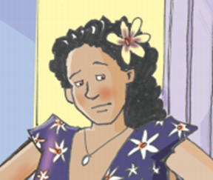

Think and say
 | Imagine you were the mum, please tell the story to your classmates. You can begin like this: My daughter’s room was always untidy. One day, I came back home and saw her things on the floor. I …

Slide 14


Think and say
 | Imagine you were Tom, please tell the story to your classmates. You can begin like this: One day, I came back home and found a lot of my sister’s clothes were on the lawn…

Slide 15
Discuss in groups
Imagine you were Tom. Would you have a better way to help your sister?
I have a good idea. I …

Slide 16
Assignment (Choose one)
Option 1 Tell the story “Fussy Ferret” to your parents.
Option 2 Think about some good ways to keep your house tidy and clean. Share them with your classmates.
Option 3 Write a story about how you keep a good habit or change a bad habit.

Slide 17

Thank you!

