Slide 1
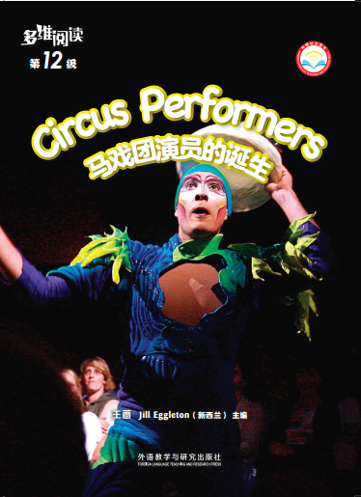
Circus Performers
马戏团演员的诞生
选自《多维阅读第12级》

Slide 2
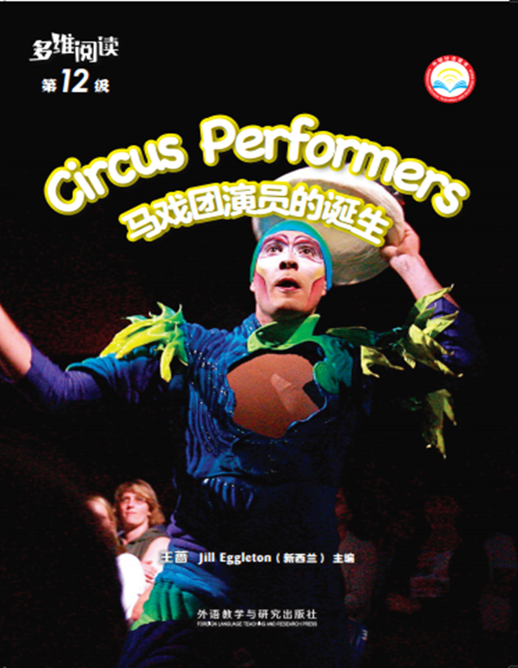
Look at the cover of the book.
1. What can you see from the cover?
2. Do you like watching circus performances?

Slide 3
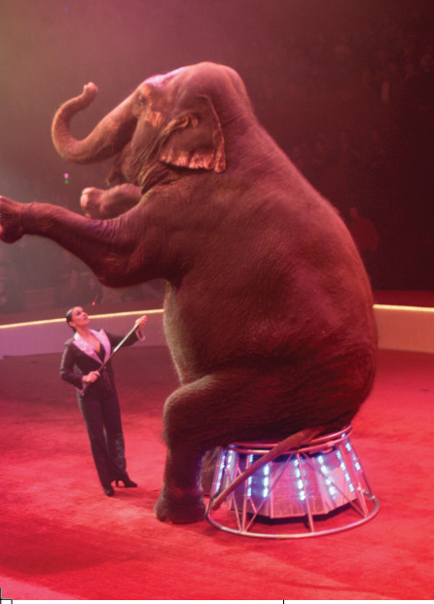
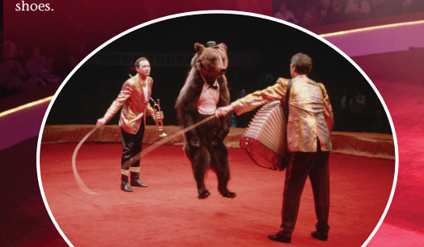
Read pages 2-3 and answer the questions.
1. Who do you think these people might be?
2. What are they doing?
3. Have you ever seen circus performers?
4. How do you think circuses have changed?

Slide 4
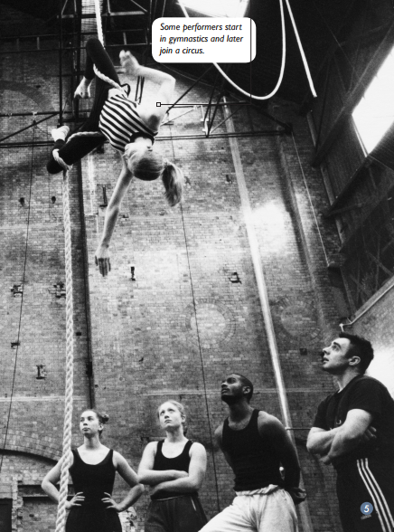
Read pages 4-7 and answer the questions.
  1. Look at the photograph. What are the performers doing?
  2. What do you think is meant by “they learn a lot of different acts”?
  3. What is meant by “backstage helpers”? Why would these people be important?

Slide 5
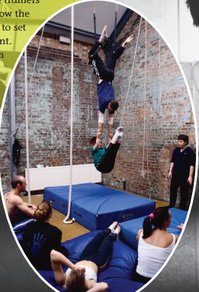
Read pages 4-7 and answer the questions.
  4. What do you think would be important to do with the equipment?
  5. Why do you think a person needs to be strong to do circus tricks?

Slide 6
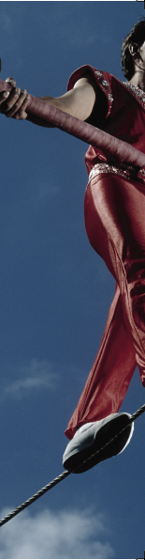
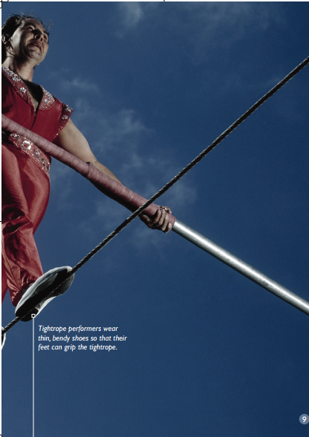
Read pages 8-9 and answer the questions.
  1. What do you think would be difficult about these tricks?
  2. What did you learn about balancing from this?

Slide 7
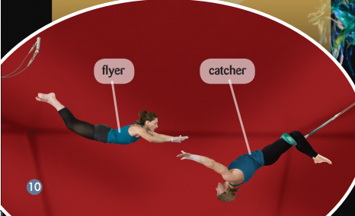
Read pages 10-13 and answer the questions.
  1. What do you think these performers are doing?
  2. Why is timing important?

Slide 8
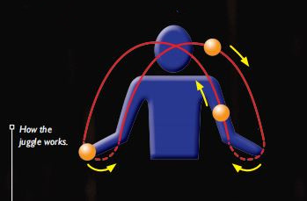
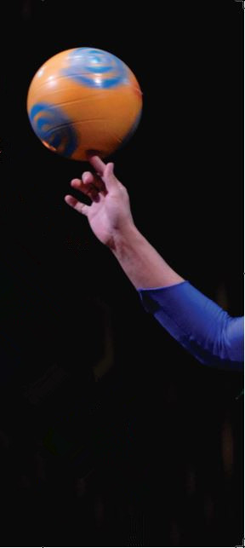
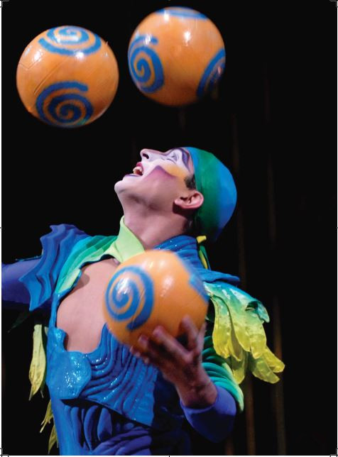
Read pages 10-13 and answer the questions.
3. Look at the diagram. What does it show you?
4. Have you ever tried to juggle? Why is it difficult?
5. What did you learn about juggling from this information that you didn’t know before?

Slide 9
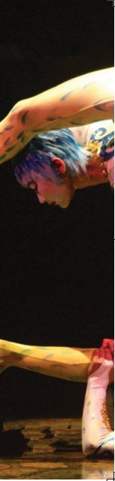
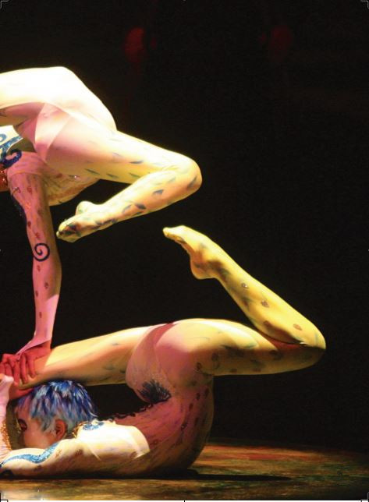
Read pages 14-15 and answer the questions.
  1. Look at the photograph. How do you think these performers are able to do this?
  2. What is something you know that is flexible?

Slide 10
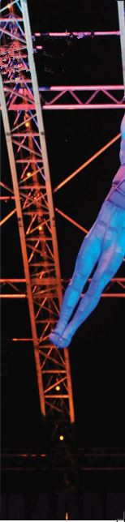
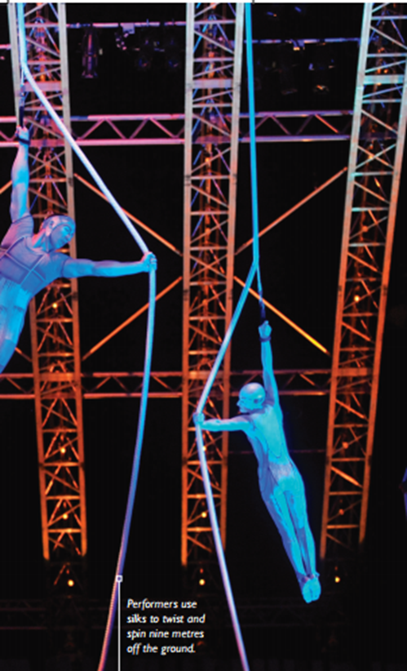
Read pages 16-17 and answer the question.
Why do you think some tricks might be extra dangerous?

Slide 11
Today, circuses are a mix of dance, acting, street entertainment and _______________.
Circuses have ______________________ all the time.
How circuses have changed
Activity 1:
Acting can be ______________, dangerous and takes a long _________ to learn.
The circus school teaches performers everything, among which "___________________" is the most important.
How performers learn their tricks
Try to use the mind map to introduce the important facts of circus performers.
In the acts of balancing and spinning plates, and tightrope walking, performers are always ______________ things. It is very important.
Why balance is important
Circus Performers
Why timing is important
In the acts of flying trapeze, juggling, ________________is important.
Some performers need to be able to bend, twist and stretch their body into many strange and ______________ shapes.
They train hard to make their bodies strong and ____________.
Why some performers need to be flexible
Being a human cannonball or using silks are _______________.
Performers not only need to be clever, but also _________.
Why some tricks are extra dangerous

Slide 12
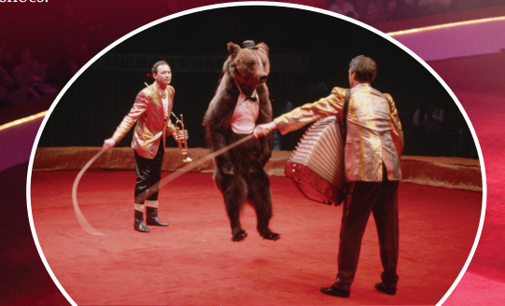
Read again.
Why do many people believe it is cruel to make wild animals perform tricks?

Slide 13
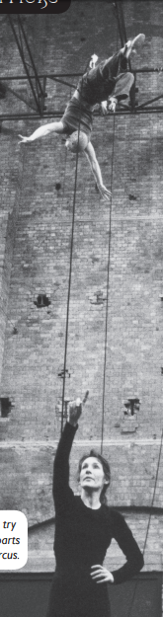
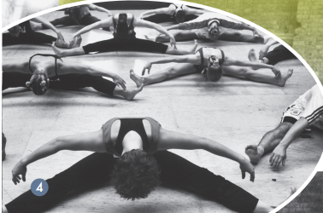
Read again.
How do you know that some tricks are difficult?
Find the words that make you think that.

Slide 14
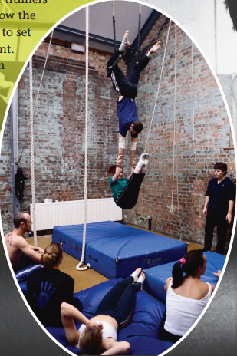
Read again.
What is the most important thing that a circus school teaches?

Slide 15
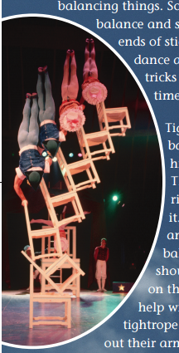
Read again.
1. Have you ever tried to balance on something?
2. What did you do to try and keep your balance?

Slide 16
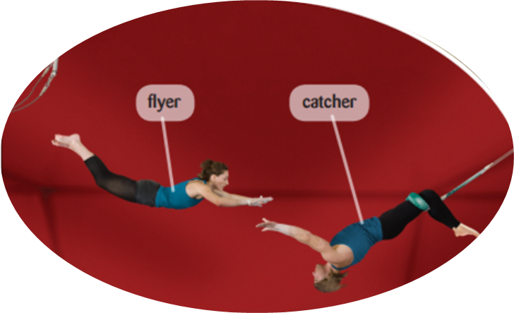
Read again.
  1. How do you know this act would have been very dangerous in the past?
2. What would you need to be a catcher?

Slide 17
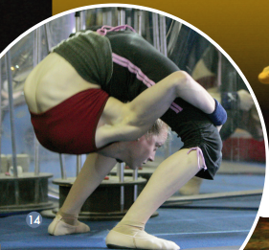
Read again.
What do you think would be an unnatural shape for your body to be in?

Slide 18
Read again.
  1. What part of cannonball trick would be the scariest for you? Why?
  2.What is the main idea in this book?

Slide 19
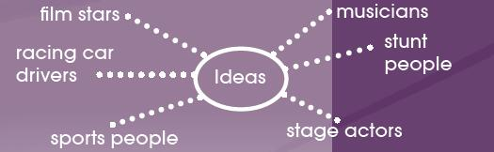
Activity 2:
Choose a topic and try to give an explanation on it. Tell your partner what your explanation is about and some facts you know about your topic. Use words like so or because when you explain. Then complete the following introduction.
I am going to talk about ____________________.
As a/an ____________________, ____________________is important. And ____________________ is also necessary for them.
They can learn ____________________ at / in ____________________.
I want to be a/an ____________________ in the future because ____________________.

Slide 20
Discussion
Have you ever had to train for something? What was it? What did you have to do? What do you think of it?
Have you read any other books about circus performers or people who do dangerous tricks to entertain others? What were they about?
What do you think of them?

Slide 21
Homework
    1. 完善并运用思维导图，向全班介绍马戏团演员诞生的要素，可以通过查阅资料丰富介绍内容。
    2. 阅读另一篇关于马戏团演员或其他靠危险技能来娱乐人们的演员的书籍或故事，并给大家讲一讲。

