Slide 1
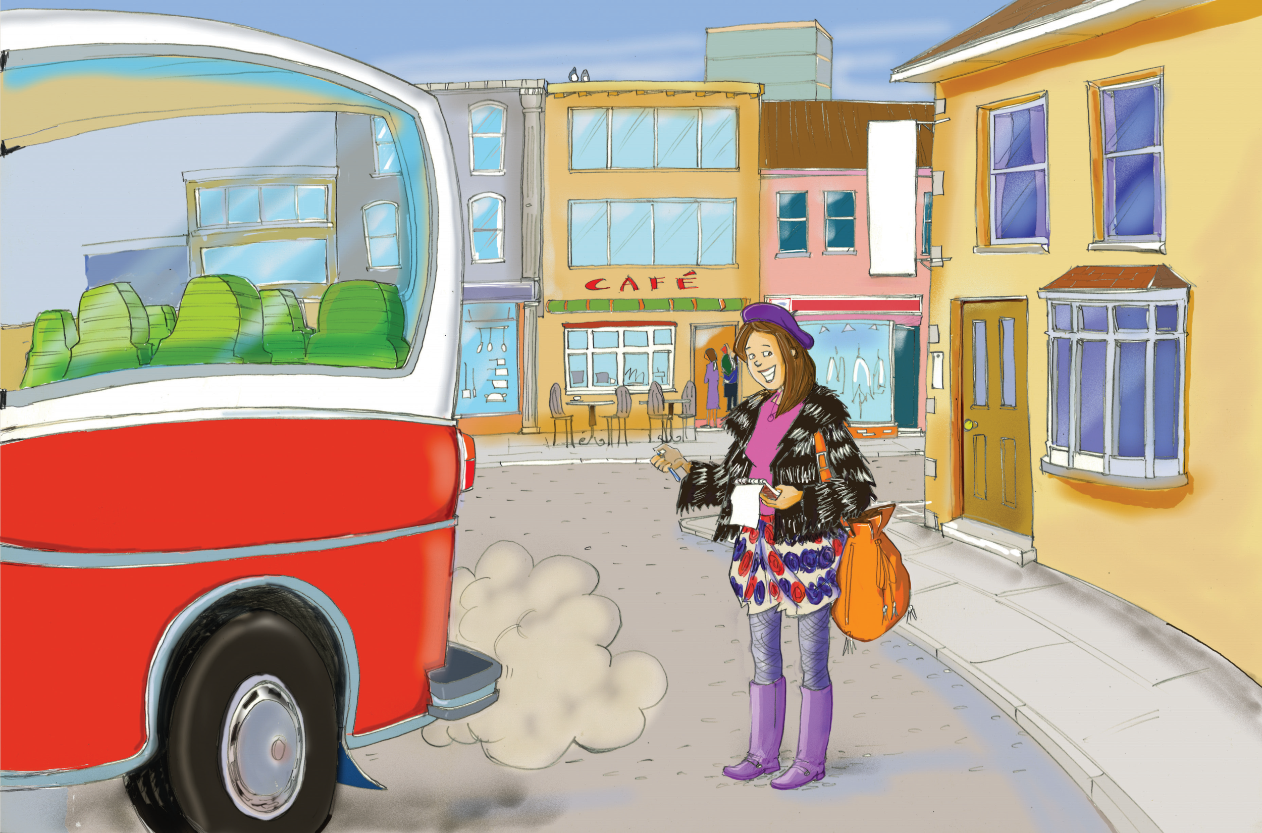
Spotlight on the People
小镇采访记
选自《多维阅读第12级》

Slide 2

Activity 1
What can you see from the cover?
2. What’s the title and what do you think the story is going to be about?
3. What do you want to know about the story?

Slide 3

Activity 2
Read and get the general idea.
Have you got the answers to some of the questions in Activity 1? Would you please share them with your classmates?
How many parts can you divide the book into? Why?

Slide 4
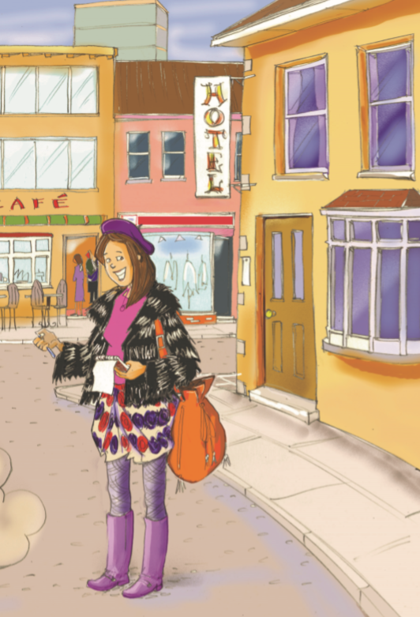
PP2-3
What type of job do you think Molly McGinty does?
2. What can you tell about the climate in Kimberly from the description of Molly McGinty?

Slide 5
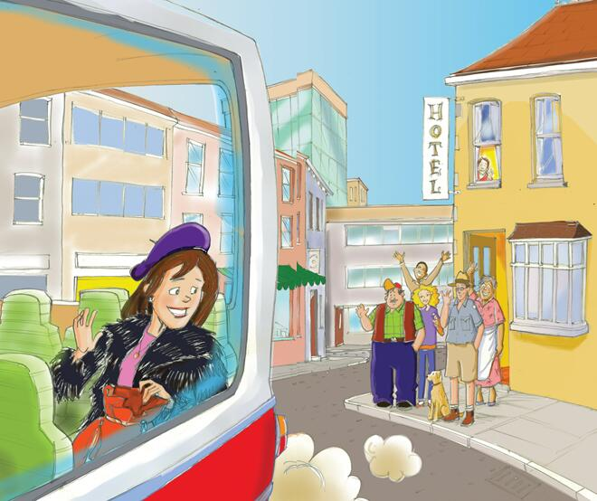
PP16-17
1.Why do you think Molly McGinty is leaving Kimberly?
2.What does “Mag” mean?
3 Do you know what Molly McGinty does?

Slide 6
Activity 3
• Read
• Match the names with the proper subheadings
• Complete the bubble diagram.

Slide 7
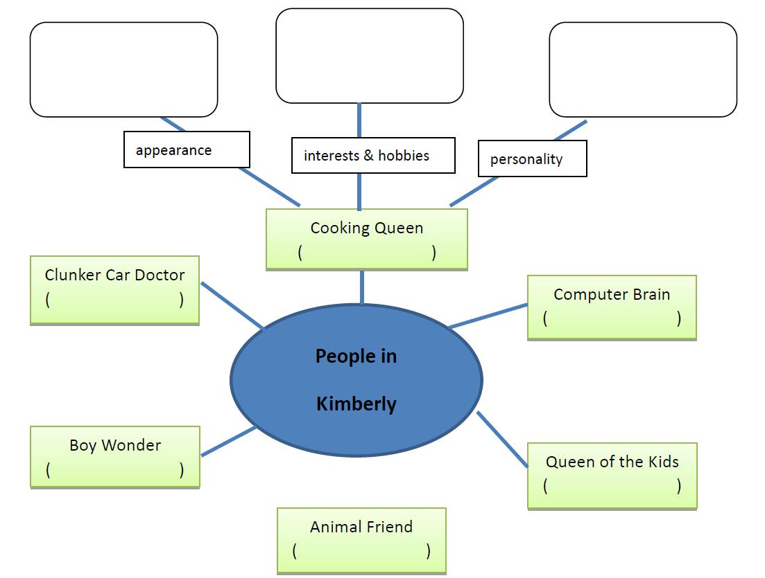

Slide 8

Activity 4
Let’s retell.

Slide 9
Activity 5
Answer and share.
P2
How did Molly McGinty get information about the people in Kimberly?
Do you think Molly McGinty really “sniffed out people”?

Slide 10
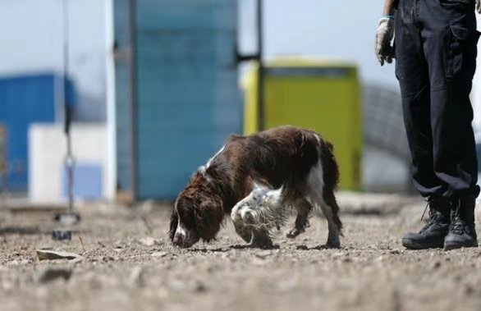
sniff out
The dog is sniffing out the missing person.

Slide 11
Answer and share.
P4
What does Harry McFarr’s hair look like?
What does “bristles on a broom” mean? Can you try to draw his hair?

Slide 12
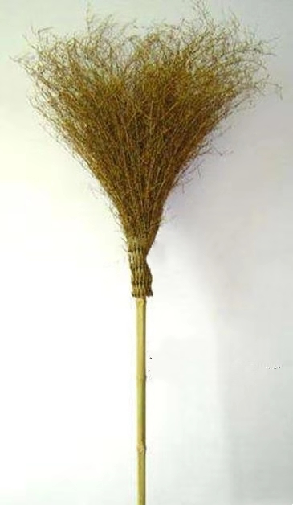
bristles on a broom

Slide 13
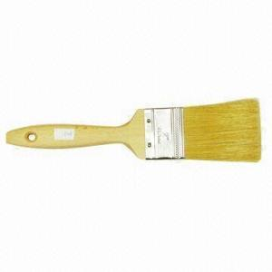
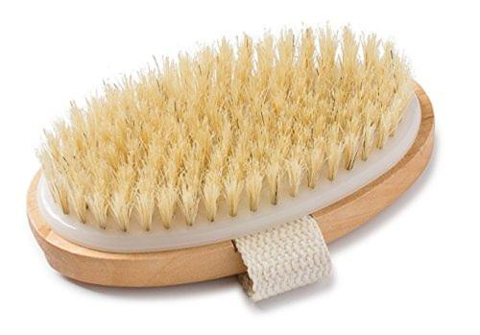

bristles on a brush

Slide 14
Answer and share.
P8
Do people like Barnaby B.?
How do you know that?
What does “feel it in their toes” mean?

Slide 15
Answer and share.
P10
How do Bart Henry’s eyes look like? How do you think of them?
Do you think that kind of eyes are very important to a teacher? Why?

Slide 16
Answer and share.
P14
Who stays with him when Jacob is sitting on a log?
What does the dog look like?
Why does the dog want to stay with Jacob?
Do you have a pet like this? Please use “like” or “as if” to describe one of your pets or the animal you like best.

Slide 17
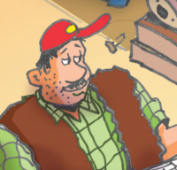
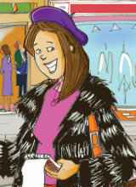
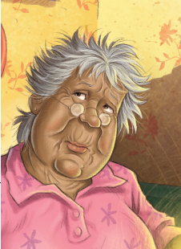
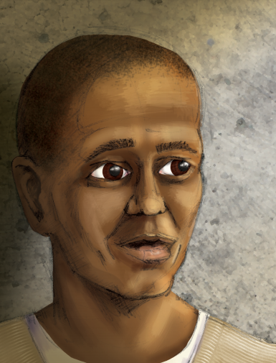
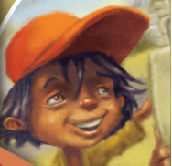
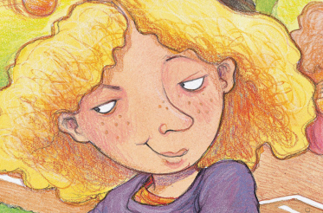
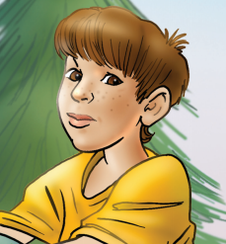
Activity 6
Choose and say.
Hello. I am… I have … I like…

Slide 18

Activity 7
If you were one of the people in Kimberly and read “Spotlight on the People in Kimberly”, how would you think of it? What would you do?

Slide 19
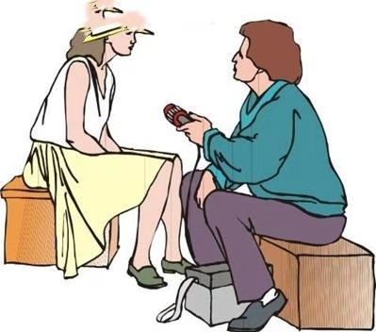
Activity 8
Imagine you were Molly McGinty, how would you interview people?
Please act that out with your partner.
Notes:
图片来自百度图片

Slide 20
Discussion
• Can you tell what kind of person someone is by just looking at him/her?
• Why? Why not?

Slide 21
Further Study
1. Tell the story “Spotlight on the People” to your parents.
2. Introduce your mom or dad to your classmates.
Learning tips:
Choose one task. Finish it with the help of what you learnt from the book.

Slide 22


