Slide 1
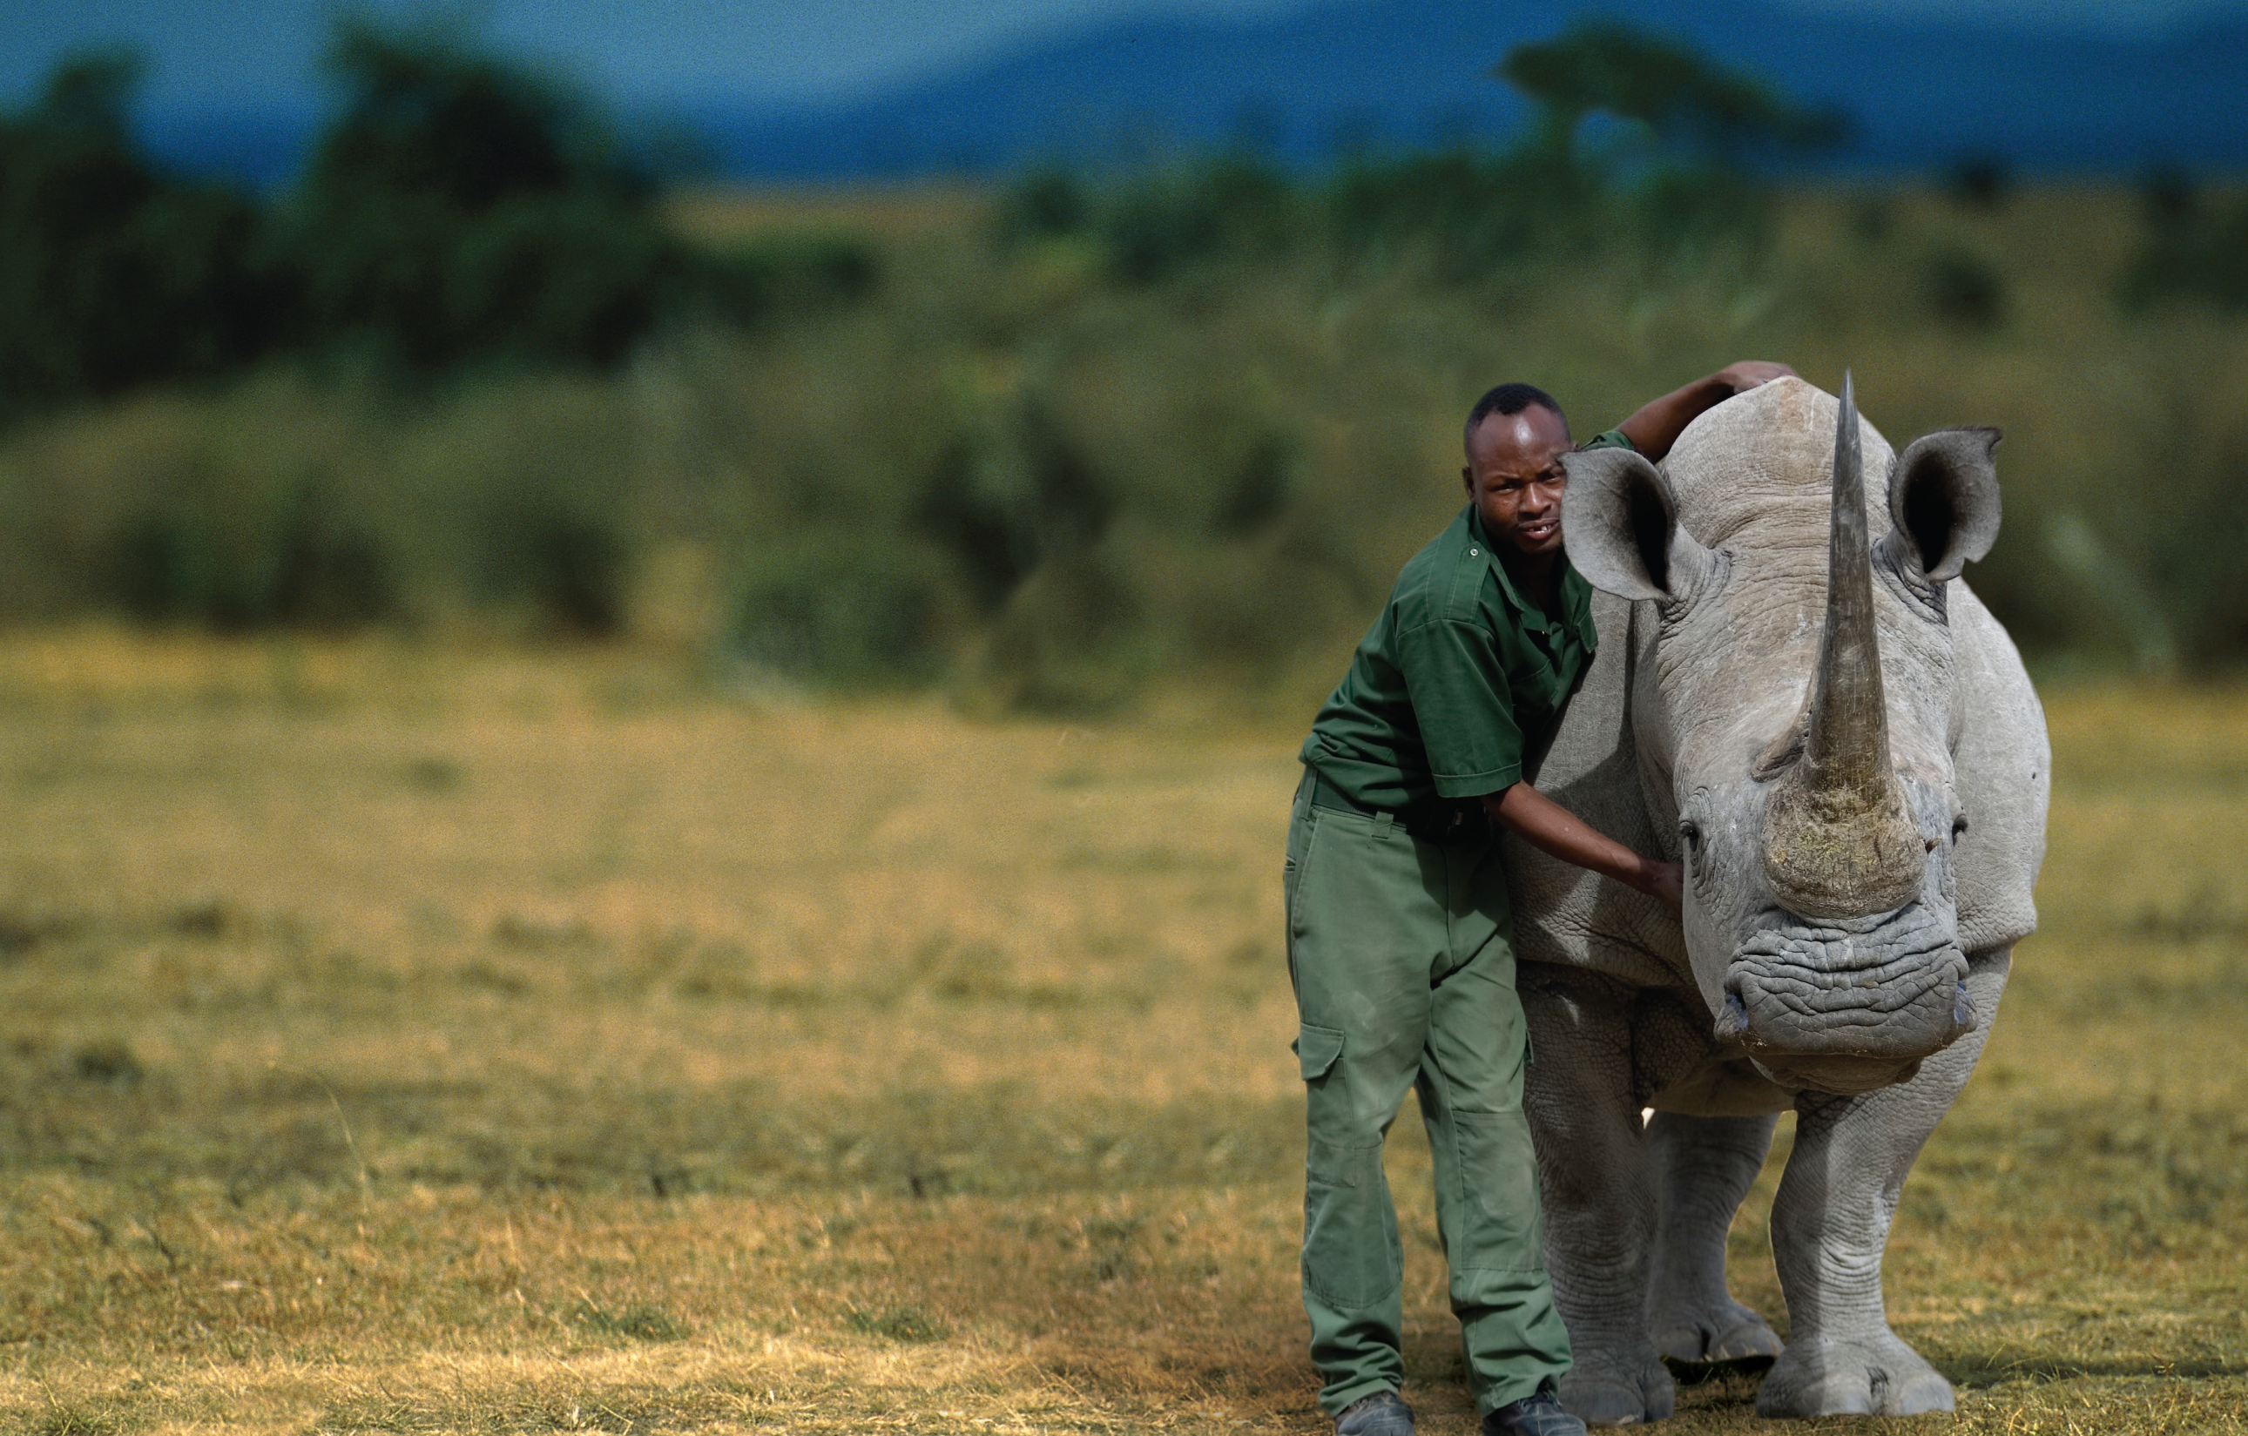
Wildlife Detective
侦探日记
选自《多维阅读第12级》

Slide 2
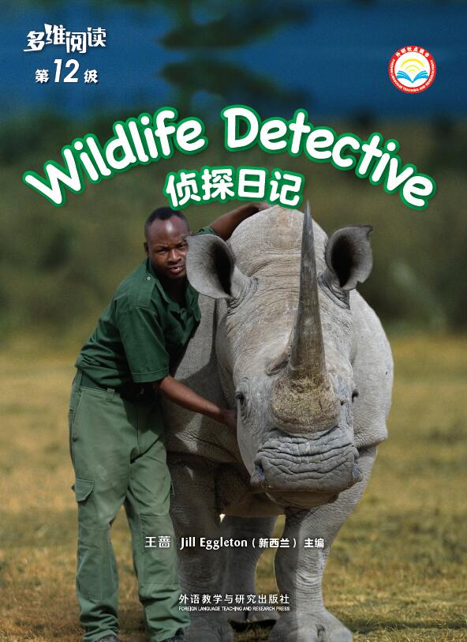
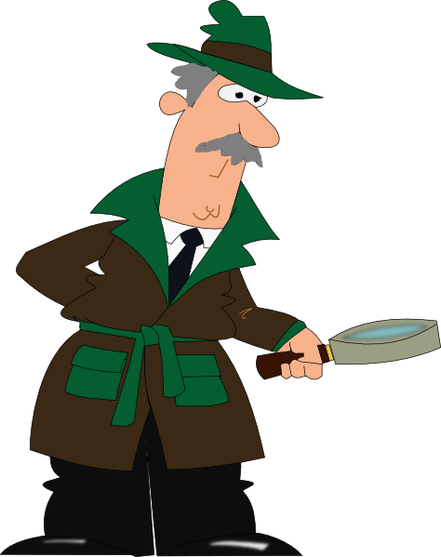
What can you see from the cover?
2. What’s the title? And have you heard about any famous detectives?

Slide 3
What words can you think of relating to “detective”?
dangerous

Slide 4
1. What does a wildlife detective usually do at work?
2. What do you think of this job?

Slide 5
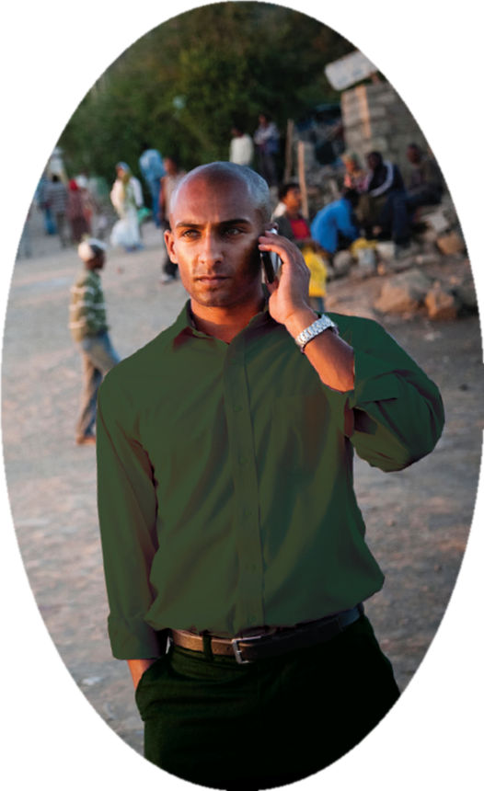
1. What did the detective do?
2. Why did he pretend to be a criminal?
3. Did he like that? How did he feel?
4. Do you think the detective should do this?

Slide 6
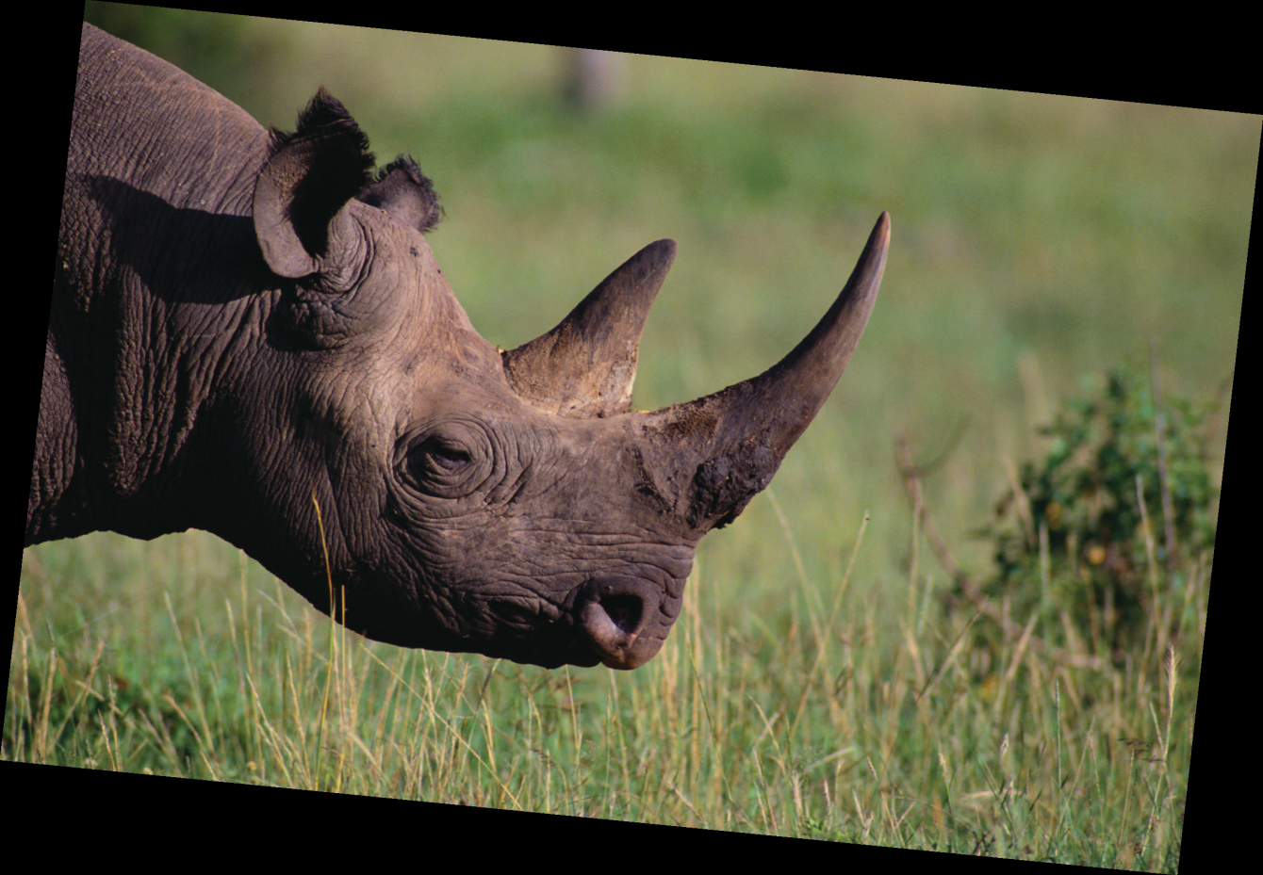
Rhino horn

Slide 7
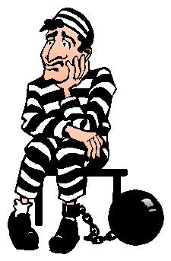
criminal

Slide 8
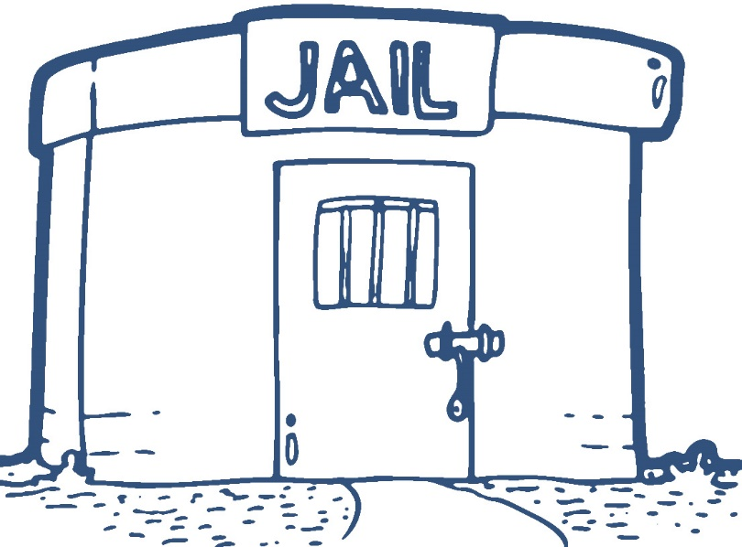
jail

Slide 9
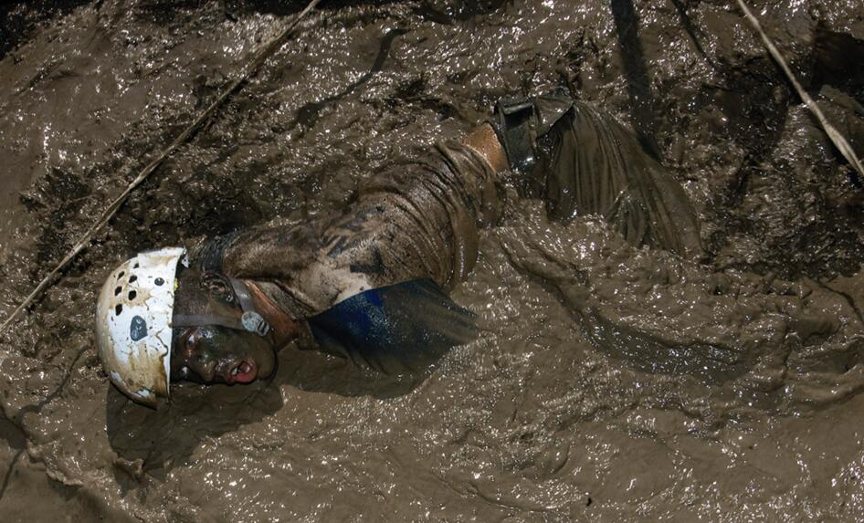
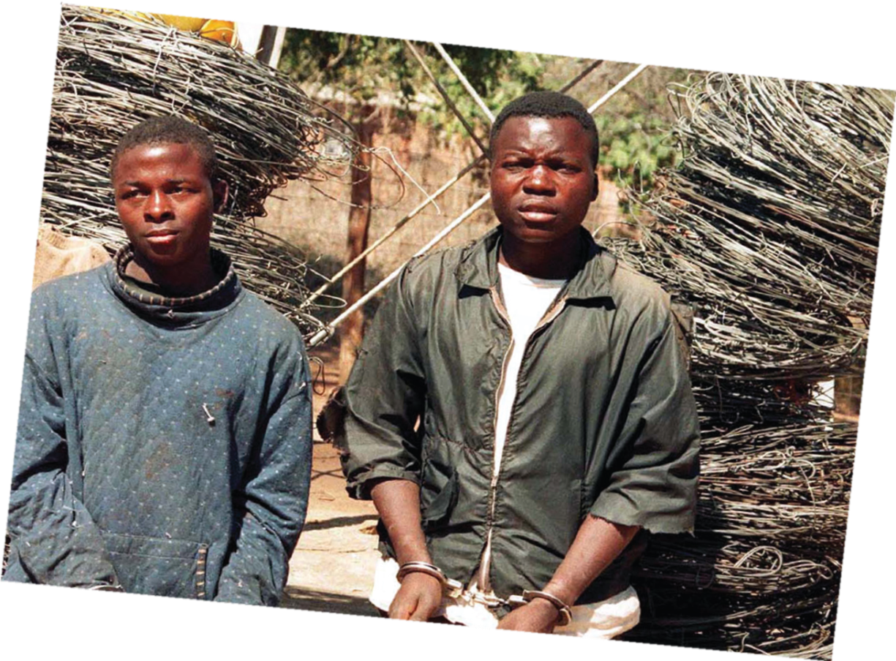
1. How did the detective and his colleague catch the duck hunters? Was it easy?
2. What did the detective think of crawling in the mud/catching the duck hunters?
3. What do you think of the detective and his colleague?

Slide 10
allow: V-T If someone is allowed to do something, it is all right for them to do it and they will not get into trouble. 允许

Slide 11
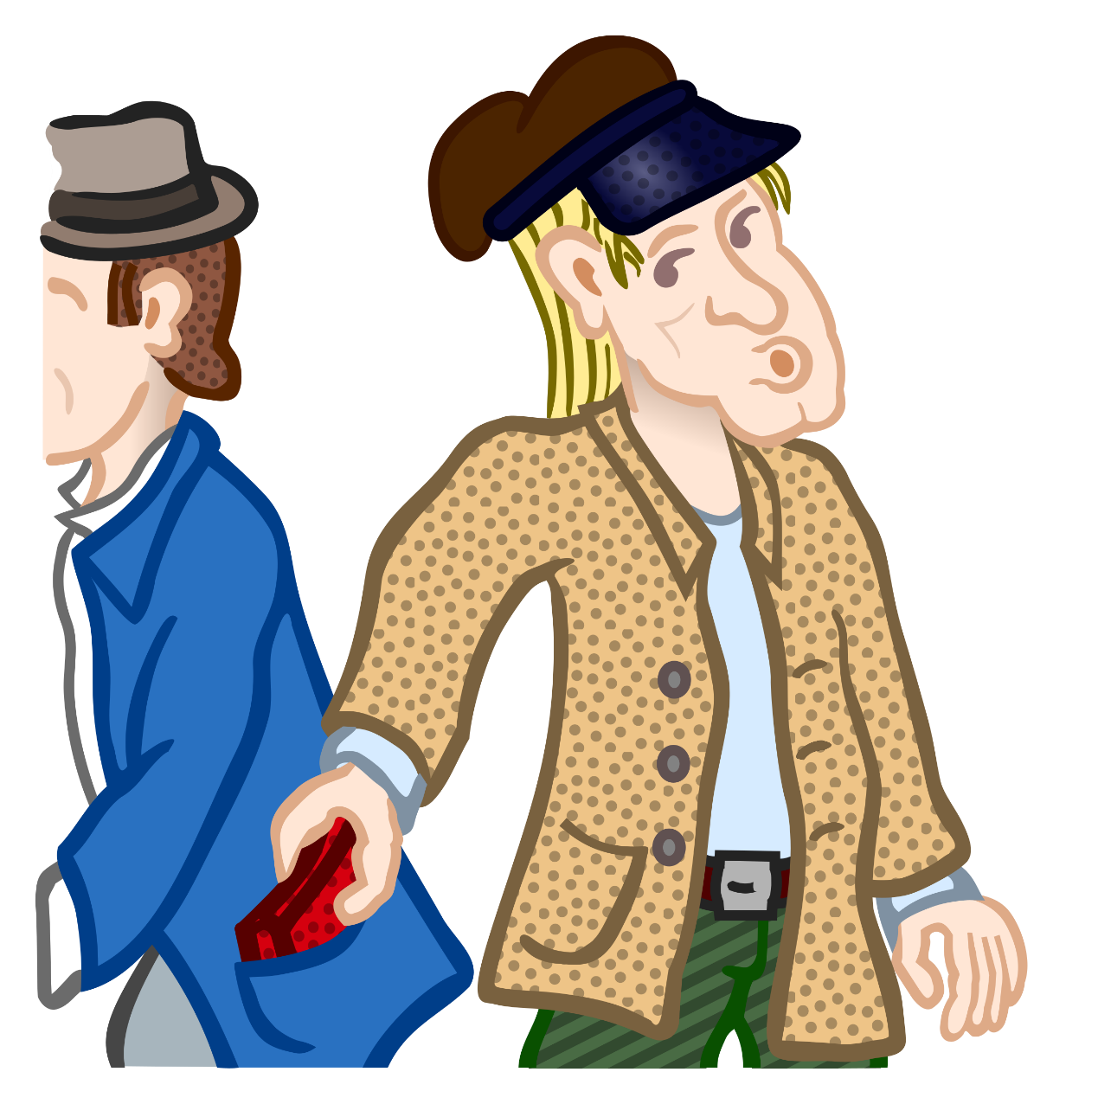
steal

Slide 12
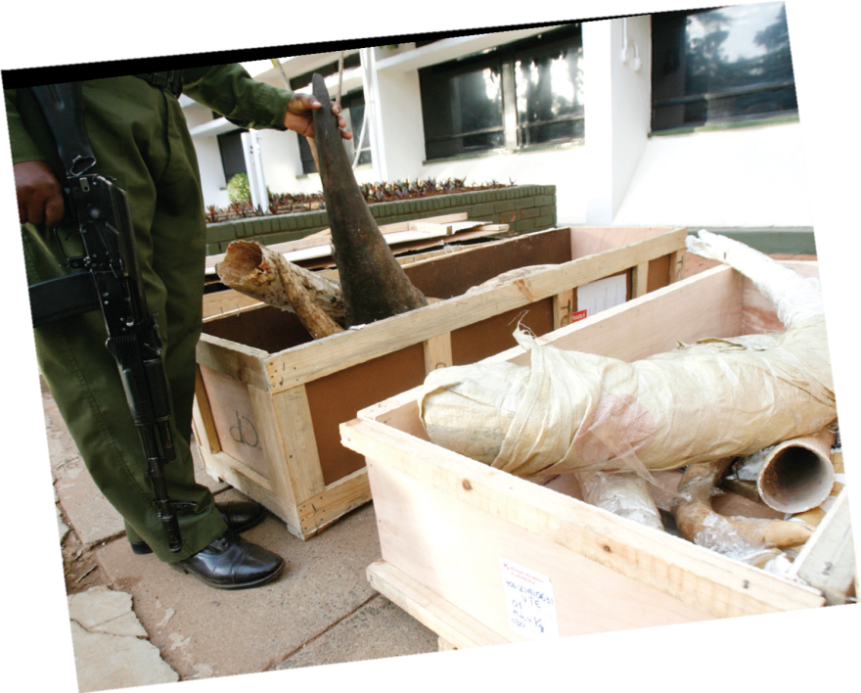
What happened on June 7th?
2. Why did the detective say that he couldn't wait to catch Jones? How did he feel when he said so?

Slide 13
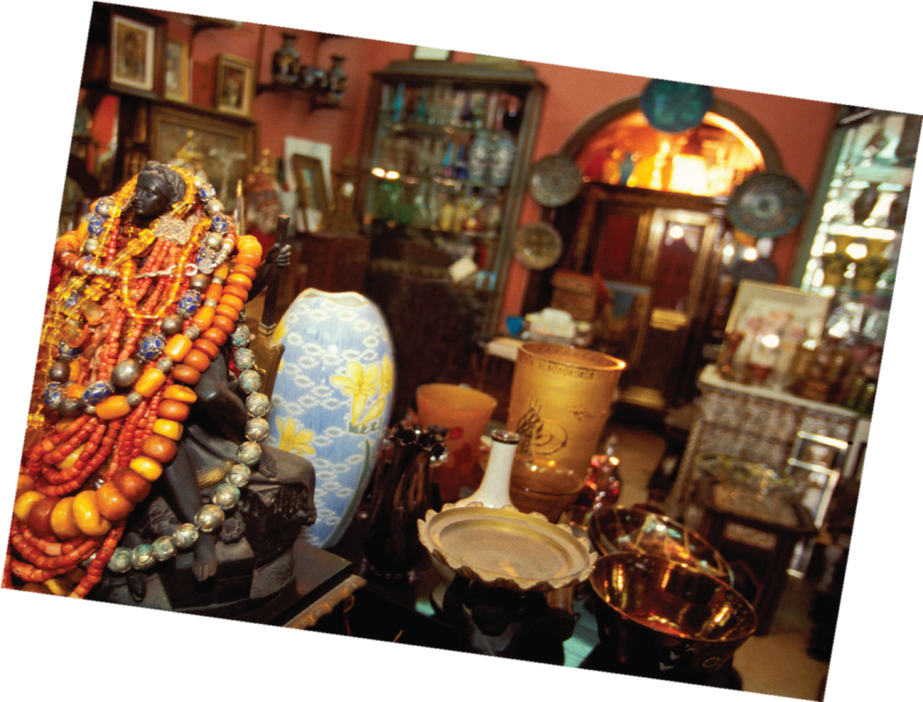
1. What makes you think the owner didn’t know that a wildlife detective was in her shop?
2. Why do you think someone would want a golden eagle fan?

Slide 14

badge

Slide 15
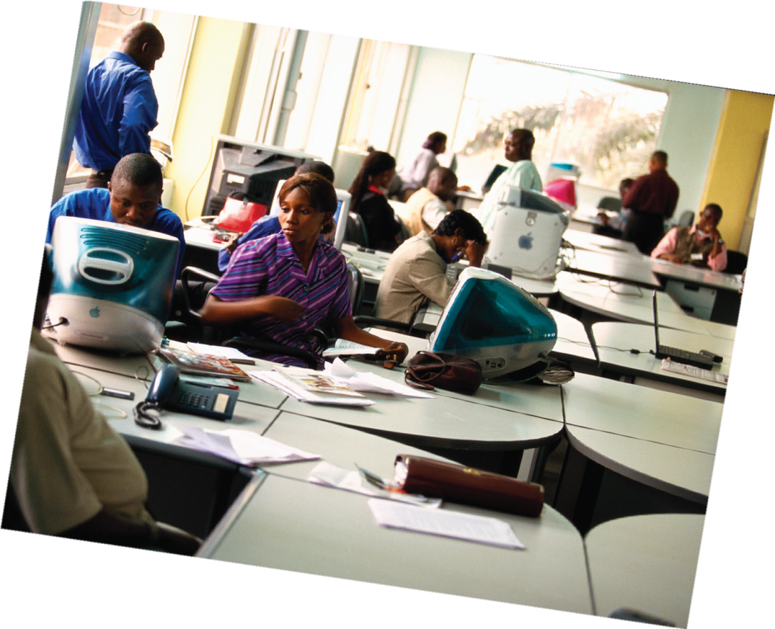
1. Who helped to catch bird smugglers? How do you know that?
2. What does the detective think of the bird smugglers?

Slide 16
smuggler: N-COUNT Smugglers are people who take goods into or out of a country illegally. 走私者 investigate: V-T/V-I If someone, especially an official, investigates an event, situation, or claim, they try to find out what happened or what is the truth. 调查

Slide 17
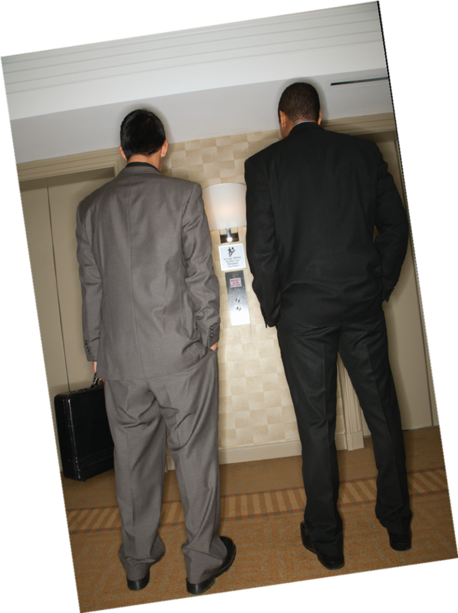
1. What did the detective and his colleague do on June 10th?
2. What does the detective think of insect smuggling? How do you know that?

Slide 18
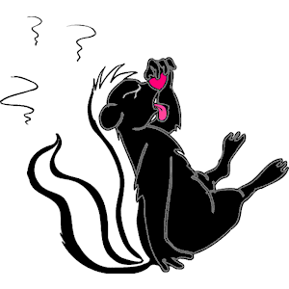
skunk

Slide 19
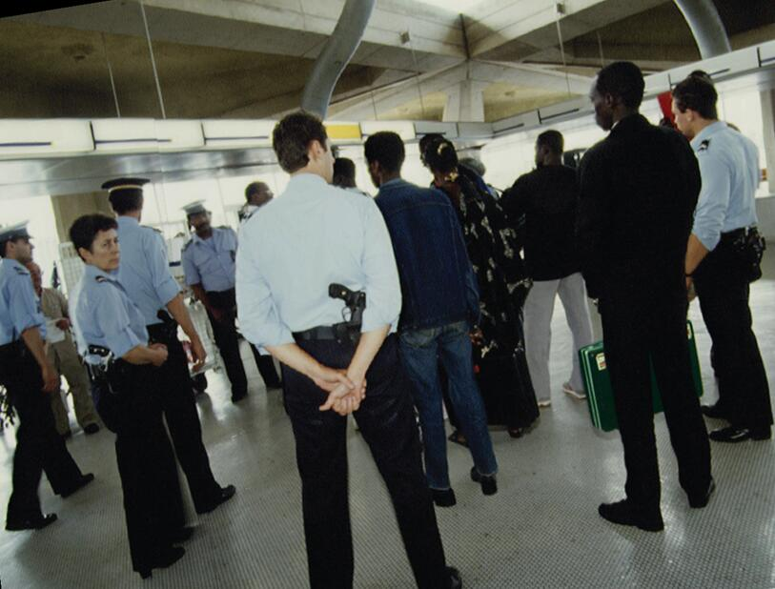
1. Did the detective catch Jones alone? Who helped him?
2. Where and how did they catch Jones?
3. How does the detective feel when he thinks of the wild animals which are killed or trapped every year?
4. What do you think the detective meant by “What’s the use of all that money then?”?

Slide 20
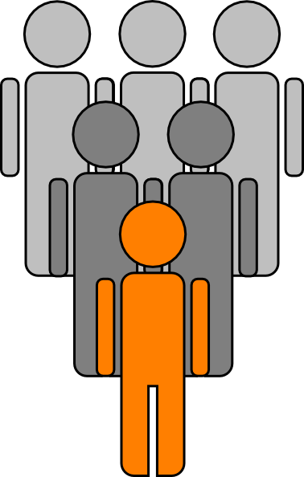
back-up team

Slide 21
surround: V-T If you are surrounded by soldiers or police, they spread out so that they are in positions all the way around you. 包围

Slide 22
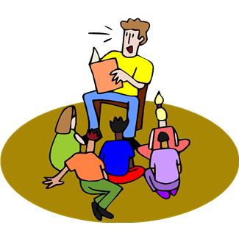
Read aloud:
1. Choose 1 or 2 diaries you like best to read aloud.
2. Underline well-written or interesting sentences while you are reading and think of why you like them.
3. Read the sentences you like aloud and tell why you like them.

Slide 23
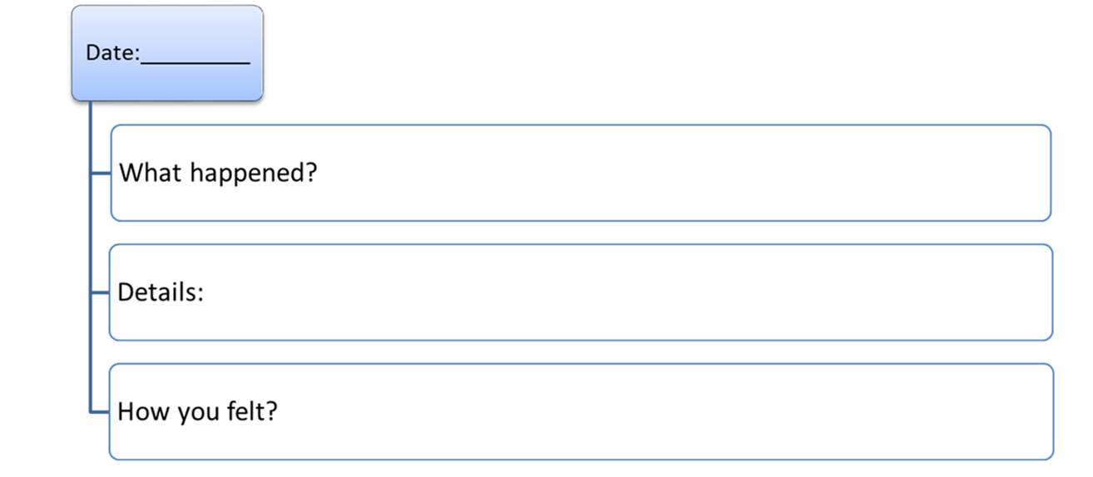
Think of a thing impressed you and complete the diagram.

Slide 24

Talk about the thing that impressed you:

Slide 25
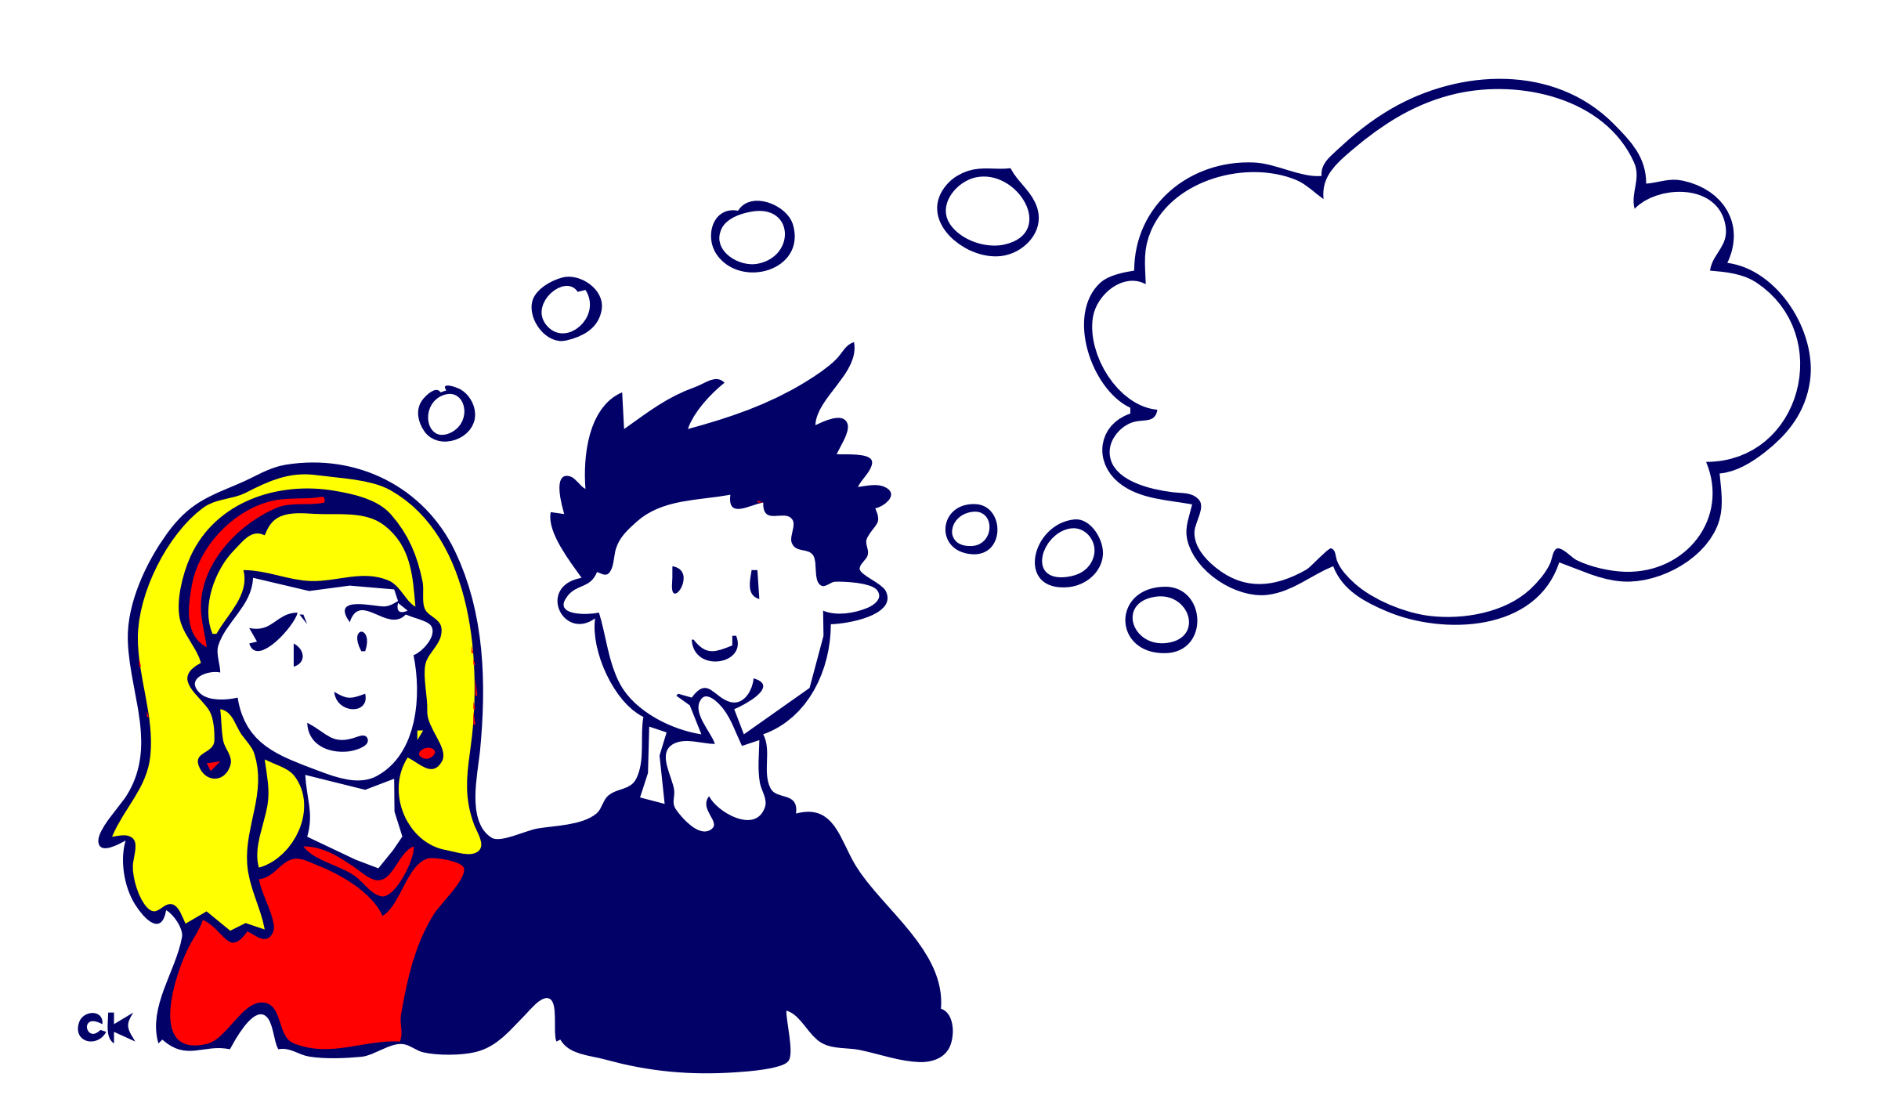
Summary:
What cases did you read about today?
Do you like the book?
What do you think of the book / the detective?

Slide 26
Choose one of the assignments to finish:
Write a diary and share it with your friends.
Tell the detective story you read today to your friends.

