Slide 1

Yes, No, or Maybe So
是对是错
选自《多维阅读第11级》

Slide 2
Activity 1
What is a“book”?
What do you know about a book?
Do you think reading a book is always a good experience? Why?

Slide 3
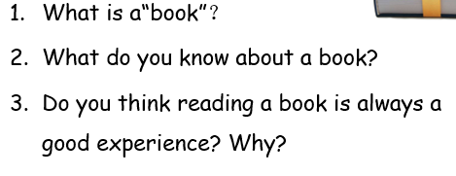
Activity 1
Why do we all agree with that this is a book, while have different ideas on the third question?
Usually, how many kinds of opinions are there for one topic?
What can you see on the front cover?

Slide 4
Activity 1
Fact
Something that is consistent with objective reality or can be proven with evidence.
Opinion
A judgment, viewpoint, or statement that is not conclusive.
People give their opinions about all sorts of things.
Not everyone has the same opinion.

Slide 5

Activity 2
• What reasons were given for kids having a GPS?
What reasons were given for not having a GPS for kids?
What could be done for kids not having a GPS?
GPS For All Kids

Slide 6
Activity 3
Read, fill in the chart and answer the questions
What is the problem?
What are the opinions?
What are the facts?
What could be done?

Slide 7
Problem | Opinion | Reason

Slide 8
Problem | Opinion | Reason
 | There should be a GPS for all kids, like the GPS used for tracking animals. | Monitoring safety
GPS For All Kids

Slide 9
Problem | Opinion | Reason
 | I don’t think kids should have a GPS. | Learning to be responsible. Being trusted.
GPS For All Kids

Slide 10
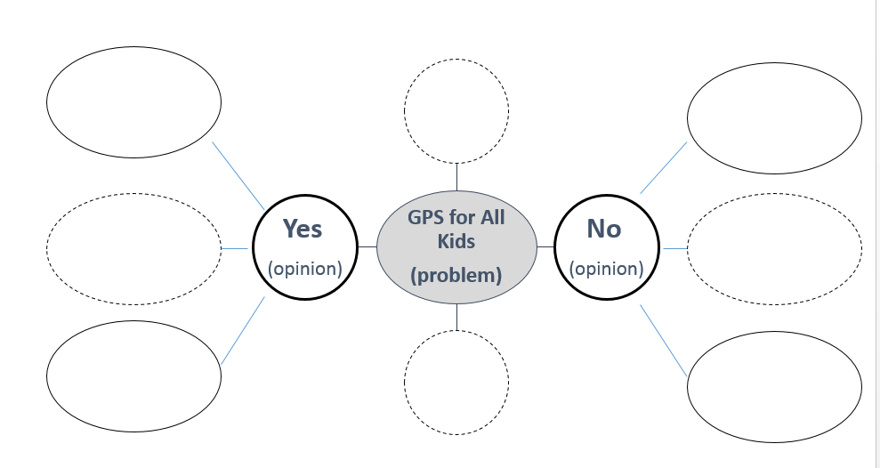
Activity 3
Read PP2-5 and fill in the mind map.

Slide 11
Activity 4
Do you agree that parents or caregivers should know where their kids are when they are not at home?
What do you have to do if you are away from home without your parents or caregivers?
Which opinion do you agree with? Why or why not?
What are the useful structures for showing our ideas?
Notes:
3. 参考： I (don’t) think … In my opinion …

Slide 12
Discuss and Report
Activity 4

Slide 13

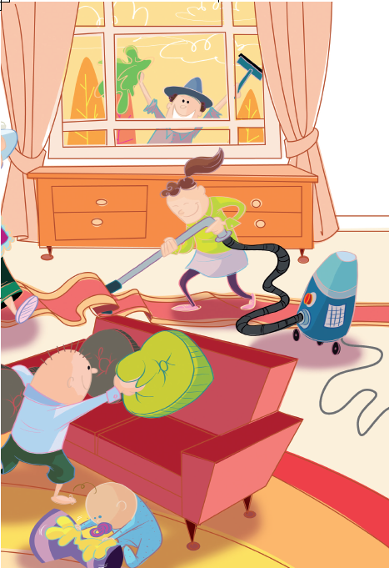
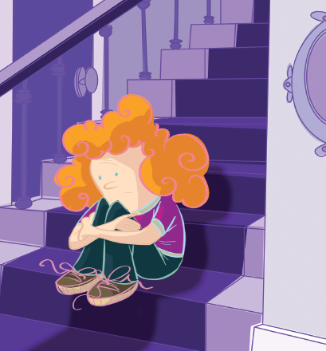

Activity 5
Choose one of the topics to read.
Work in pairs.
A：All Kids Should Have Jobs
B：Time Out for Kids
C：Robot Teachers
Notes:
教材图片

Slide 14
Activity 5（1）
Please make your own mind-map according to the textbook.

Slide 15
All Kids Should Have Jobs
Problem | Opinion | Reason
 | In my opinion, all kids in the family should have jobs. | Learning responsibility.
All Kids Should Have Jobs

Slide 16
Problem | Opinion | Reason
 | I don’t think kids should have to do jobs every day. | Should have free time. Need a rest.
All Kids Should Have Jobs

Slide 17
Time out for Kids
Problem | Opinion | Reason
 | In my opinion, time out is good. It is a consequence for misbehaving. | Time to calm down
Time out for Kids

Slide 18
Problem | Opinion | Reason
 | I don’t think giving kids time out as a consequence works at all. | Waste of time.
Time out for Kids

Slide 19
Robot Teachers
Problem | Opinion | Reason
 | In my opinion, robots would be good teachers. | They are patient and fair, and know a lot more than a teacher can know.
Robot Teachers

Slide 20
Problem | Opinion | Reason
 | I don’t think having robot teachers is a good idea at all. | Not real. Boring.
Robot Teachers

Slide 21
Activity 5（2）
The words
we would like to
remember!
My opinions and reasons:
__________________________________
The words our group want to share are:
__________________________________
Page: ________
Meaning:__________________________
Example: __________________________

Slide 22
Activity 5（2）
Are there any words you didn’t/don’t know the meaning of or the pronunciation?
What clues can you use to work out the meaning or the pronunciation of a word you do not know?
Do you have any other questions?
My opinions and reasons:
__________________________________
The words our group want to share are:
__________________________________
Page: ________
Meaning:__________________________
Example: __________________________

Slide 23
Activity 5（3）
How can we make persuasive arguments?
State what the problem is. (Find the problem)
Give opinions. (Find the opinions.)
Give reasons for the opinion (Find the reasons.)
Say what could be done. (Find what this writer thinks could be done. )

Slide 24
Activity 6
Do a report with your mind map.

Slide 25
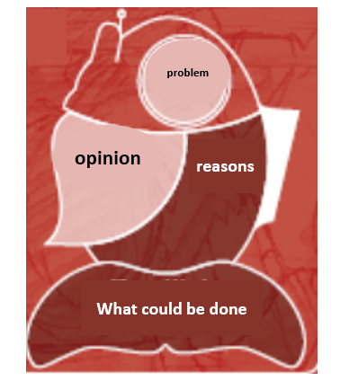
Choose one of the topics from the book and make a mind-map to show your own opinion.
Activity 7
This is an example of how you can show the persuasive argument you have chosen.

Slide 26
Activity 8
Debate time.
YES VS NO VS MAYBE SO

Slide 27
Homework
Do a research for your debate.
Make a poster and show your points about your principal concern.
YES VS NO VS MAYBE SO

