Slide 1
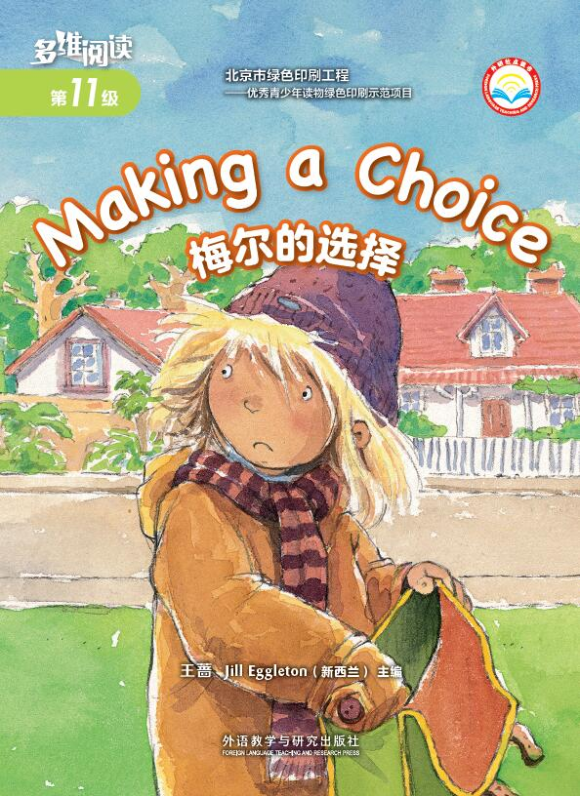
Making a Choice
梅尔的选择
选自《多维阅读第11级》

Slide 2
Predict
1. What can you see on the front cover? What is the title of the book?
2. Who makes the choice?
3. Look at the girl. What does she put in her bag? Look at her face. How does she feel? Why?

Slide 3
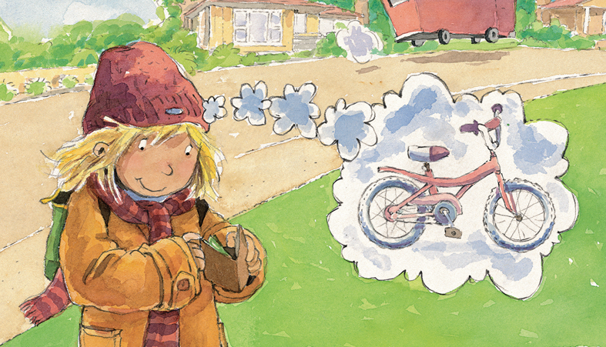
Fast Reading
Part 1
1. What did Mel find? Where did she find it?
2. What did she want to do?
3. Do you think Mel’s family have a lot of money? How do you know it? Underline the words.

Slide 4
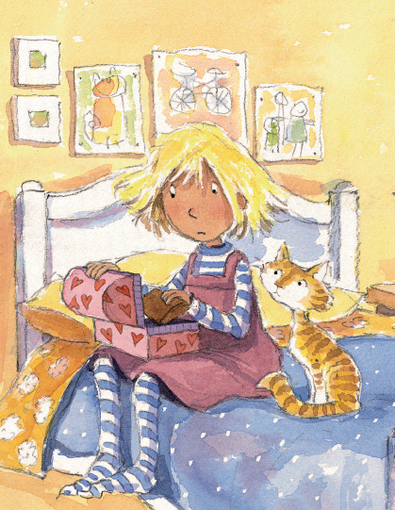
Fast Reading
Part 2
1. What did Mel do with the money?
How did she feel?
2. Do you think Mel did the right thing?

Slide 5
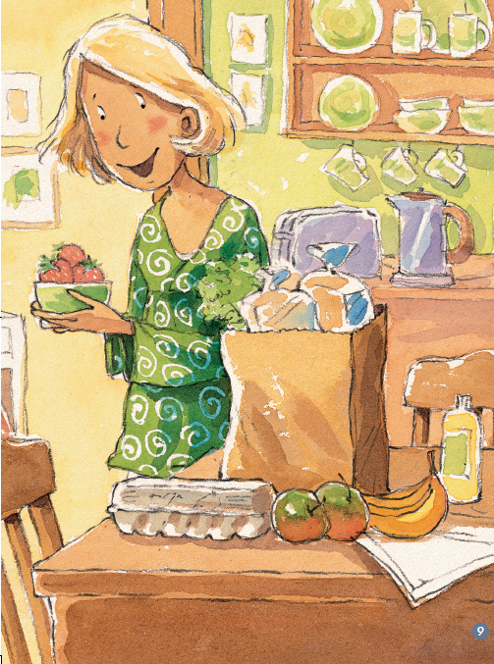
Fast Reading
Part 2
3. What made Mel really think about the money again?

Slide 6
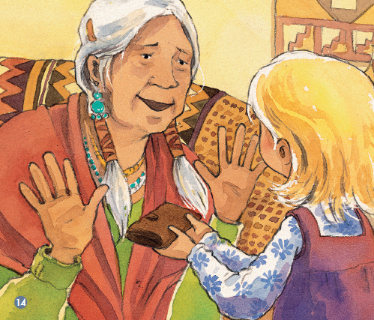
Fast Reading
Part 3
1. How do you feel when you read about Mrs Maka? Why did you feel like that?

Slide 7
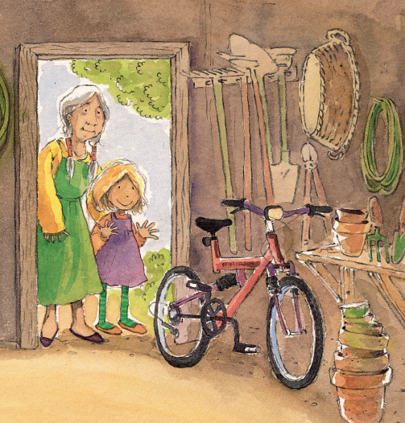
Fast Reading
Part 3
2. How do you think Mel felt at the end of the story? Why do you think that?

Slide 8
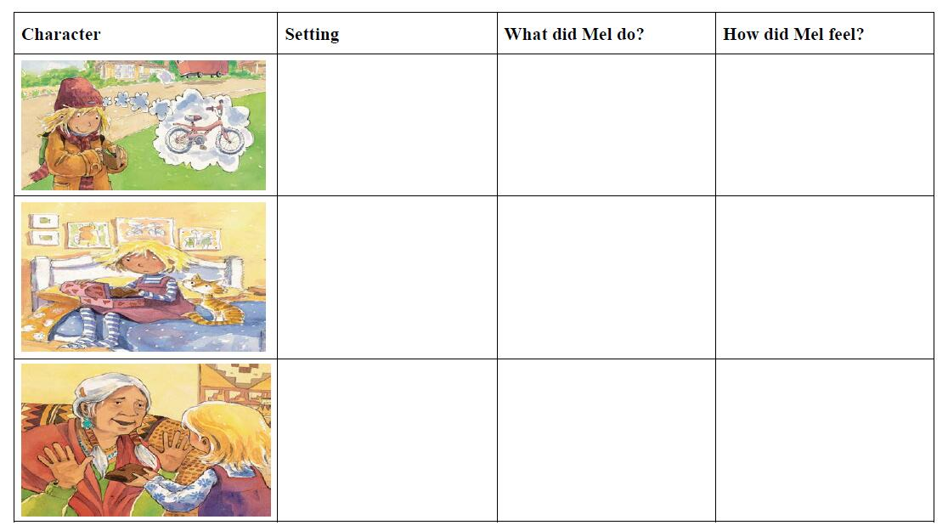
Can you recall some details of Mel in the story? Try to complete the table.

Slide 9
Read for Details
1. How did Mel feel when she found the wallet?
2. What was she thinking about?
Notes:
(Happy/Surprised. Because she wanted to buy a bike with the money.)

Slide 10
Read for Details
1. Why did Mel look around?
2. How do you know Mel didn’t want anyone to find about the wallet? Find out the words that could tell you.
Notes:
(She wanted to make sure that no one saw it.
She put the wallet in her treasure box. Then she locked it and hid the key.)

Slide 11
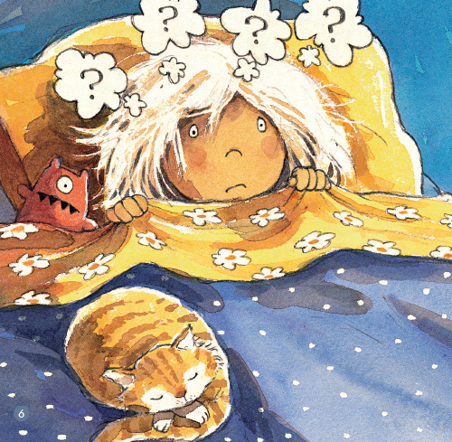
Read for Details
How did Mel feel at night?
2. What problem did she have? How did she solve the problem?
Notes:
(Worried. She didn’t know how to tell her parents about the money. She would tell her parents she won the science competition.)

Slide 12
Read for Details
Why do you think strawberries are a treat?
Notes:
(Mel’s family was not rich. They seldom had money for strawberries.)

Slide 13
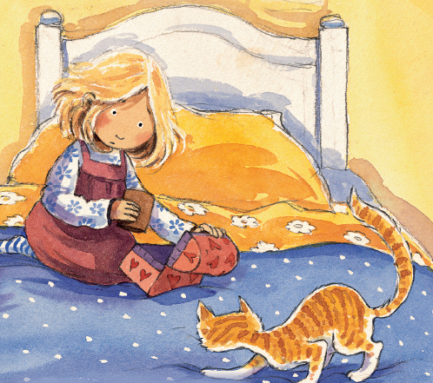
Read for Details
1. What picture did you get in your head when you read “Mel’s news darted back inside her, like a moth into a dark corner?”
2. What do you think it means?
Notes:
(Mel wanted to say something but the words were choked in her mouth. It means she was speechless at that time and felt a little ashamed )

Slide 14
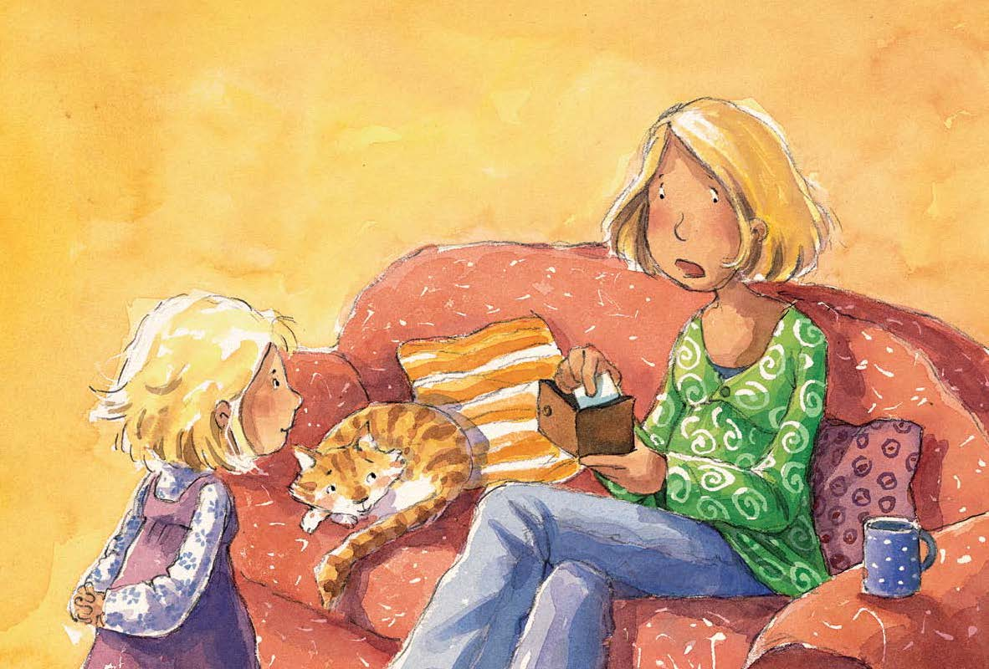
Read for Details
1. Why do you think her mother said “Wow”?
2. How do you think she know it was Mrs Maka’s wallet?

Slide 15
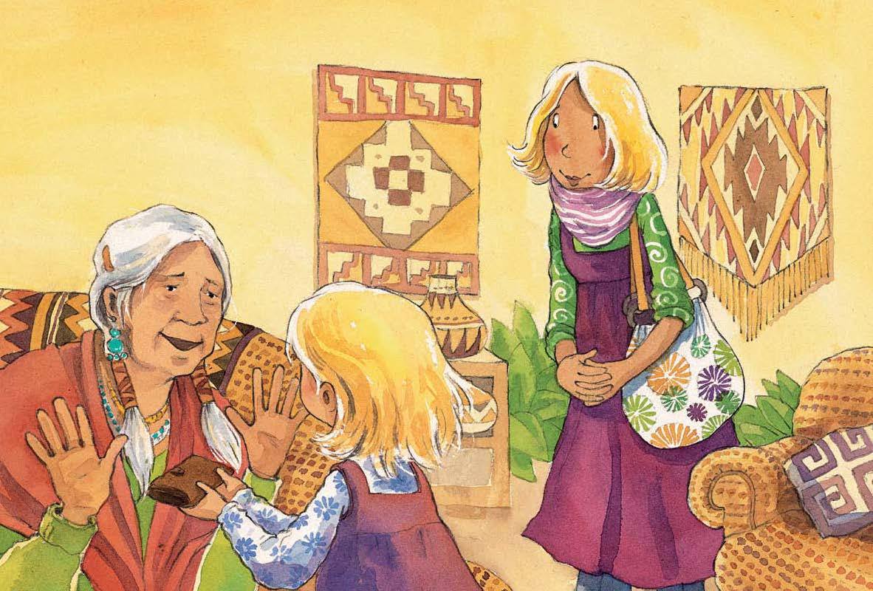
Read for Details
1. How do you know Mrs Maka was very thankful to Mel for giving the wallet back?
2. How do you think the story might end?

Slide 16
Read for Details
Did Mel get a bike in the end?
How did she get it?
Notes:
(Yes. Mrs Maka gave her as a gift.)

Slide 17
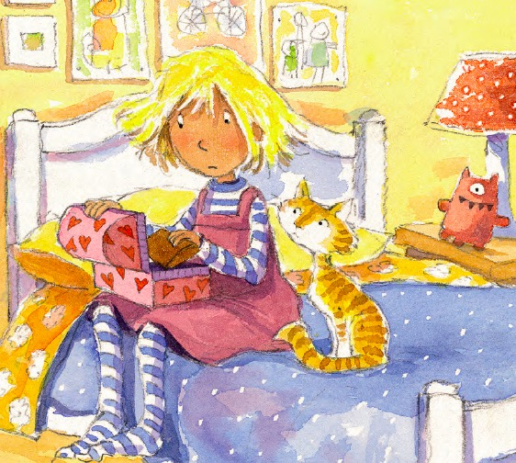
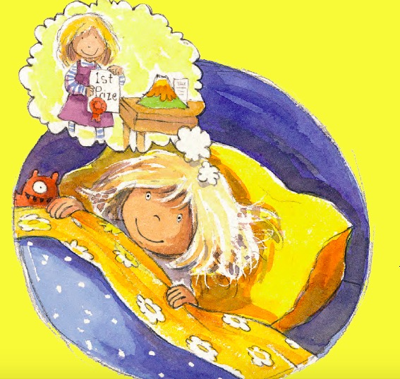
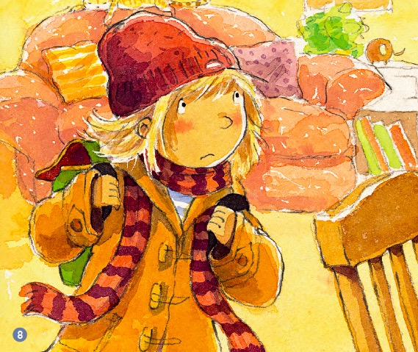
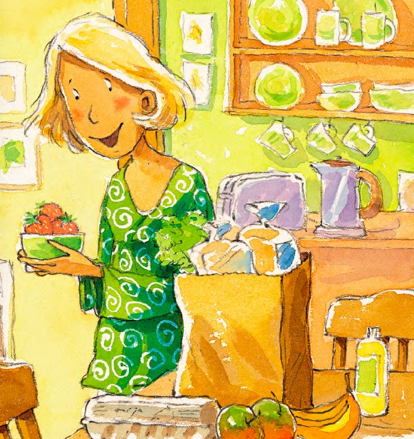
Retell the Story

Slide 18
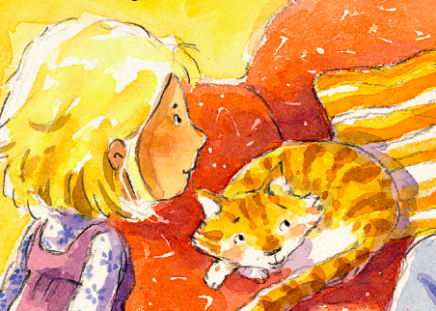
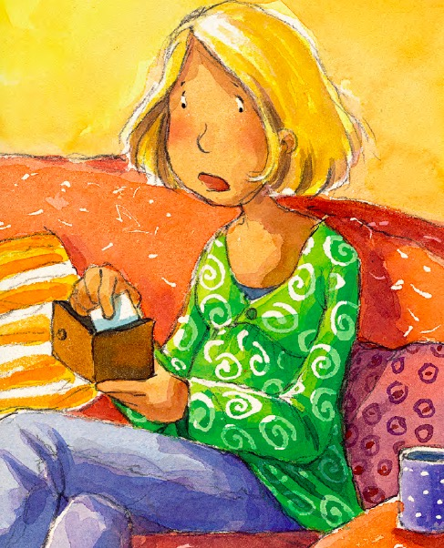
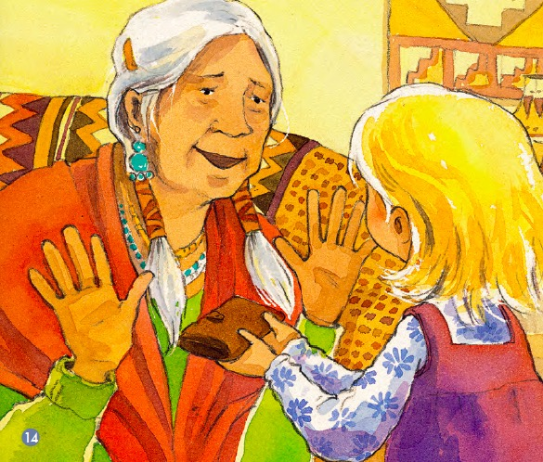
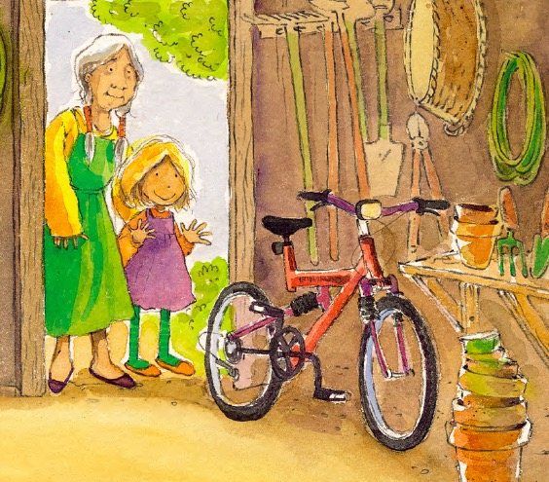
Retell the Story

Slide 19
Imagination and Creation
If you were Mel, what would you do with the money?

Slide 20
Extension and Discussion
Have you ever had to make a choice between doing something right or wrong?
Have you ever done something like Mel? What did you do? How did you feel?

Slide 21
Homework
Tell the story “Making a Choice” to your parents.
Have you lost something, or found something that does not belong to you before? Can you tell your parents what did you do and how did you feel then?

