Slide 1

Adventure in the Desert
沙漠惊魂
选自《多维阅读第11级》

Slide 2
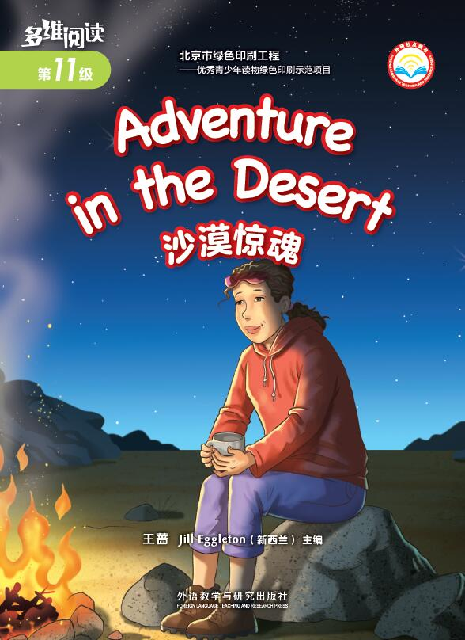
What can you see on the front cover?
What’s the title?
Where did the story happen?

Slide 3
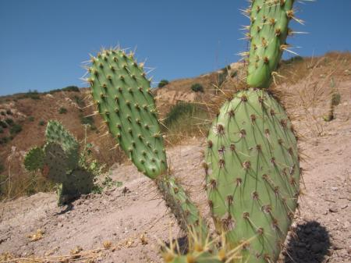
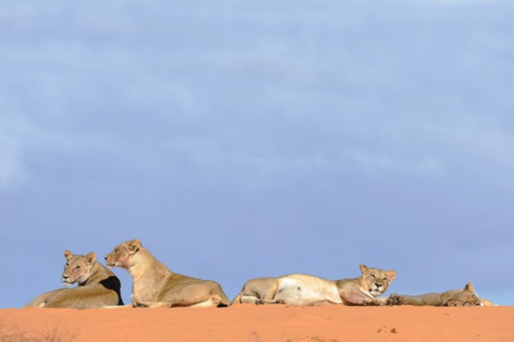
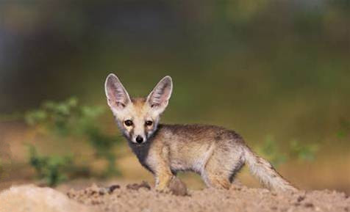
What would they see in the desert?

Slide 4
Reading Time
Read the story and underline the facts.
who
when
where
what

Slide 5
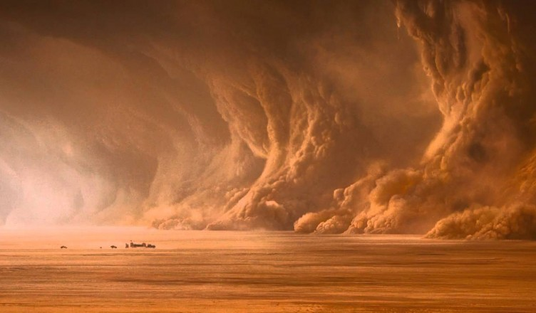
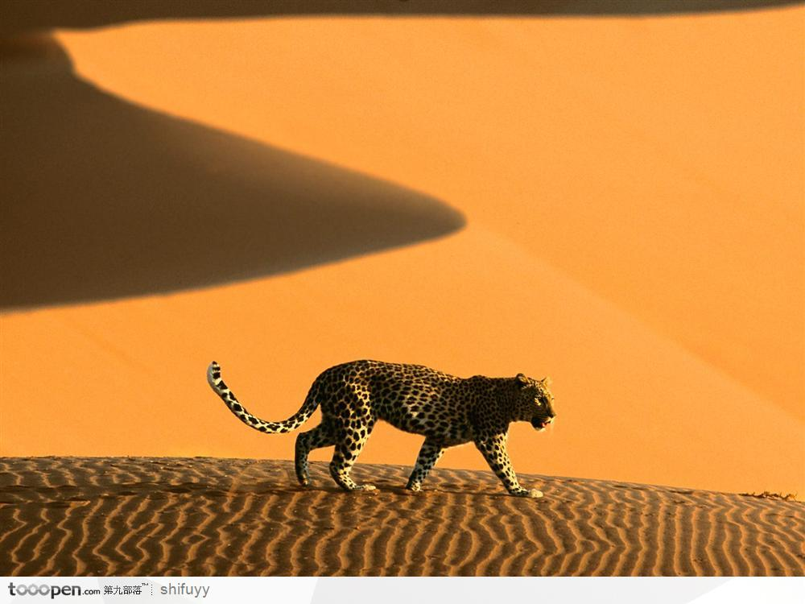
Reading Time
Read PP2-5 and answer the questions.
Why do you think Jack and Ally had to be careful not to go far from each other?
What might be dangerous for them in a place like the desert?

Slide 6
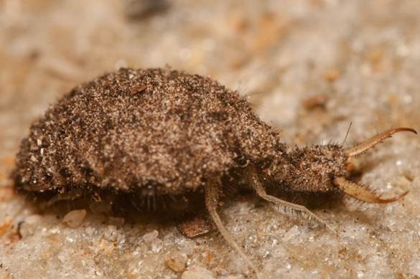
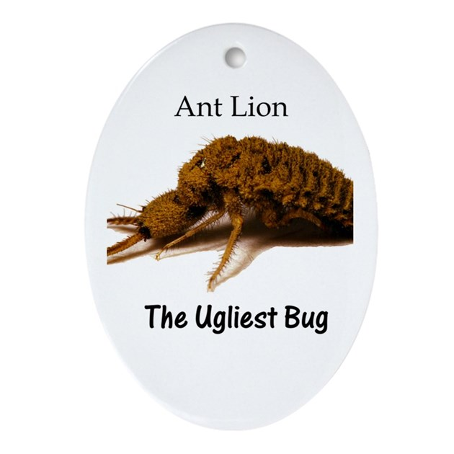
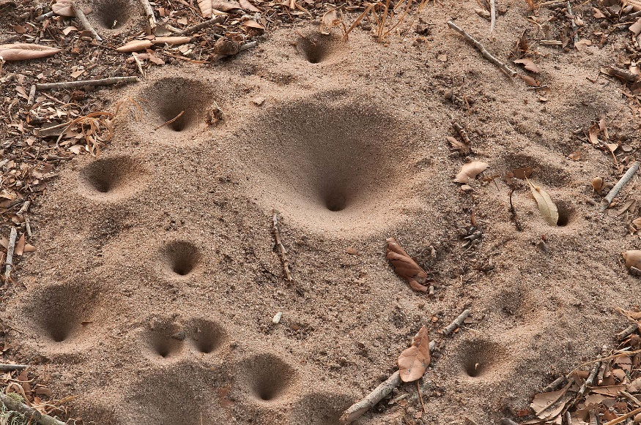
What animal is it? Where can you see it?
ant lion

Slide 7
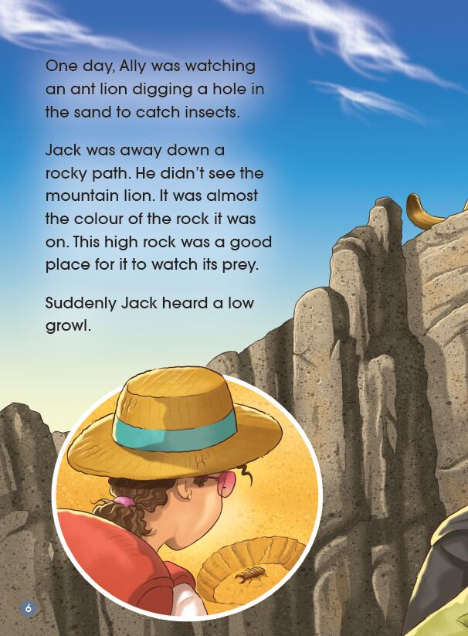
Reading Time
Read P6 and discuss in groups.
How do you know Jack and Ally weren’t together? Underline the sentences.

Slide 8
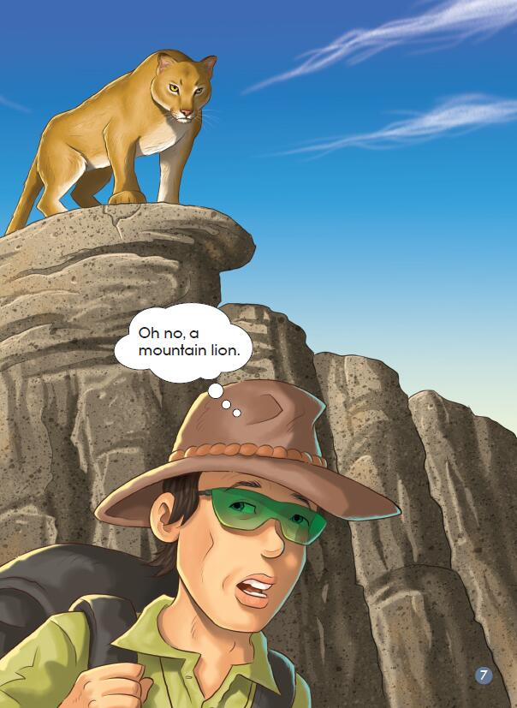
Reading Time
Read P6 and discuss in groups.
2. Why do you think Jack didn’t see the mountain lion?
3. Do you think the rock was a good place for the lion to watch its prey? Why?

Slide 9
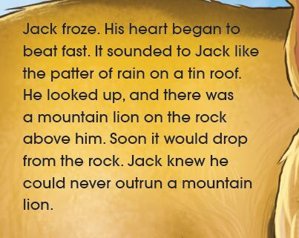
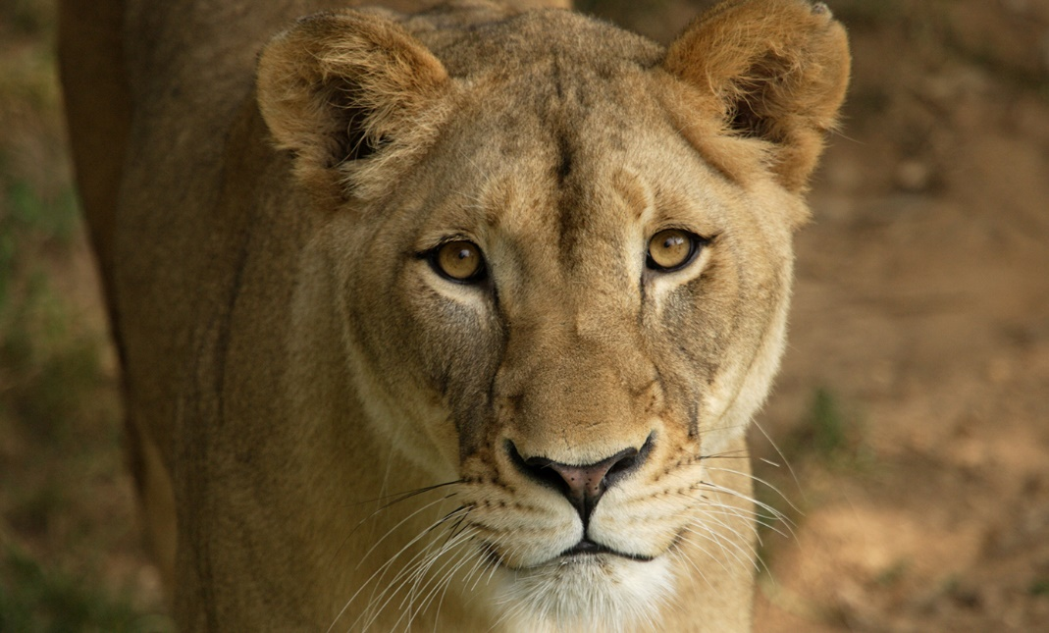
Reading Time
Read PP8-15 and discuss in groups.
How do you know Jack was really scared?
If you were Jack, what would you do?(P8)
Do you think you would run away from a mountain lion? Why?

Slide 10
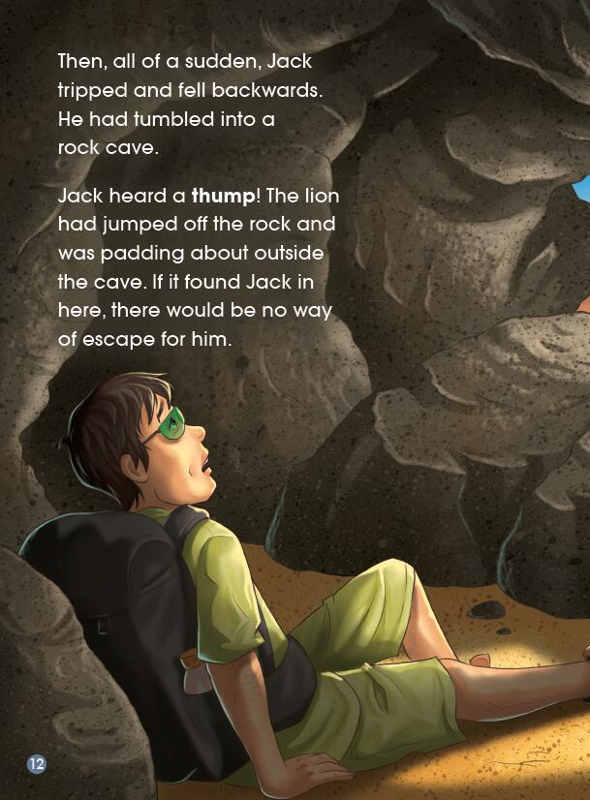
Reading Time
Read PP8-15 and discuss in groups.
4. How do you think Jack was feeling when he tumbled into a rock cave? What makes you think that?

Slide 11
Reading Time
5. If you were Jack, what would you do? (P12)

Slide 12
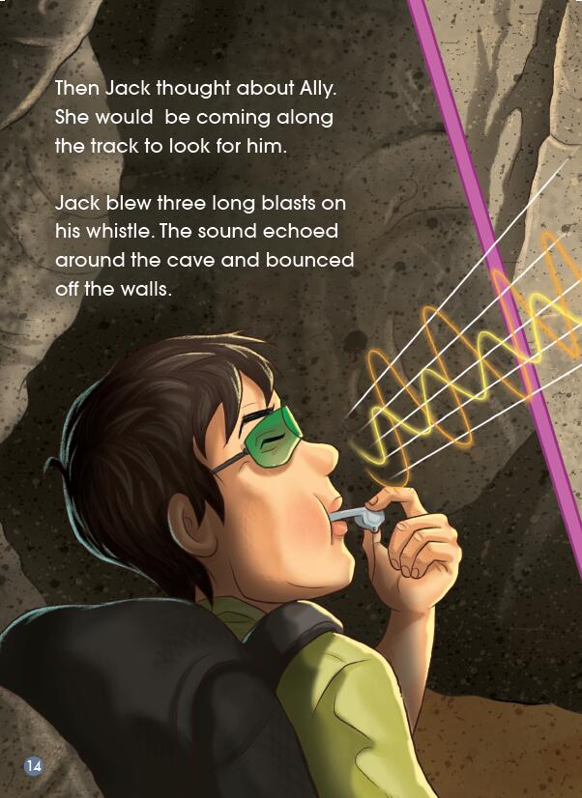
Reading Time
6. How do you know Jack was caring?

Slide 13
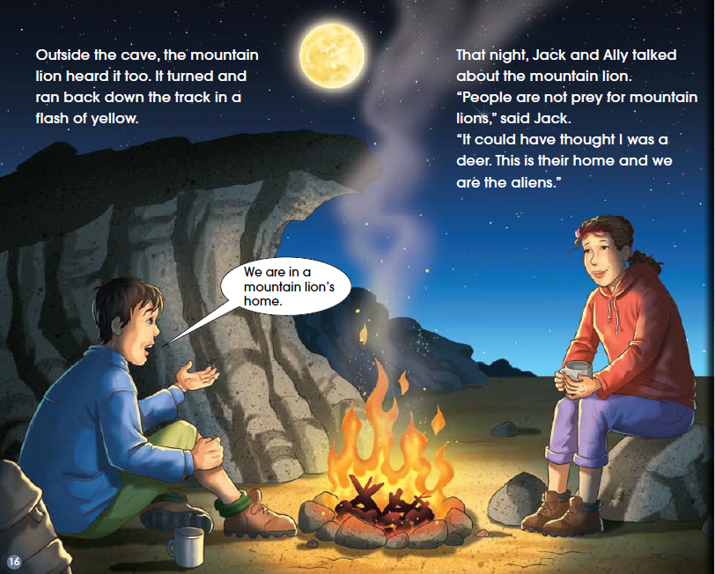
Reading Time
Look at the picture and read the text (PP16-17).

Slide 14
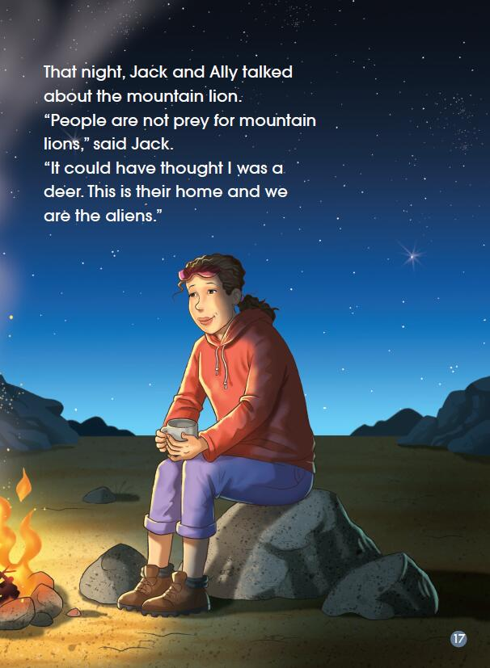
Discuss and share your ideas.
Why do you think the mountain lion would run when it heard the sounds of the whistle?
What did Jack mean by saying, “we are the aliens”?

Slide 15
Please complete the flow diagram and try to retell the story.
Plot:
Beginning:
Middle:
Climax:
Ending:

Slide 16
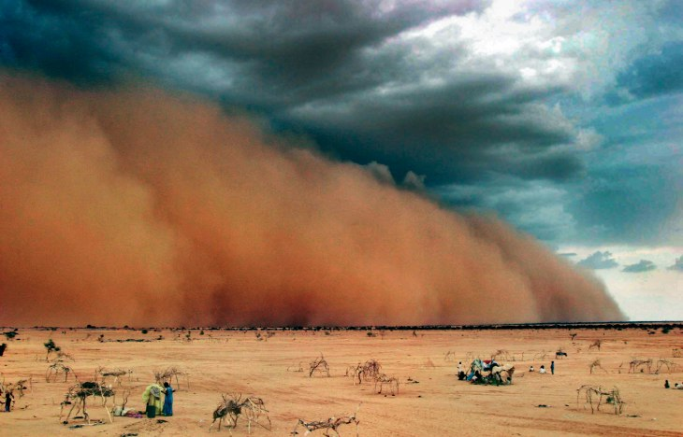
Details of the story
What is a sandstorm?

Slide 17
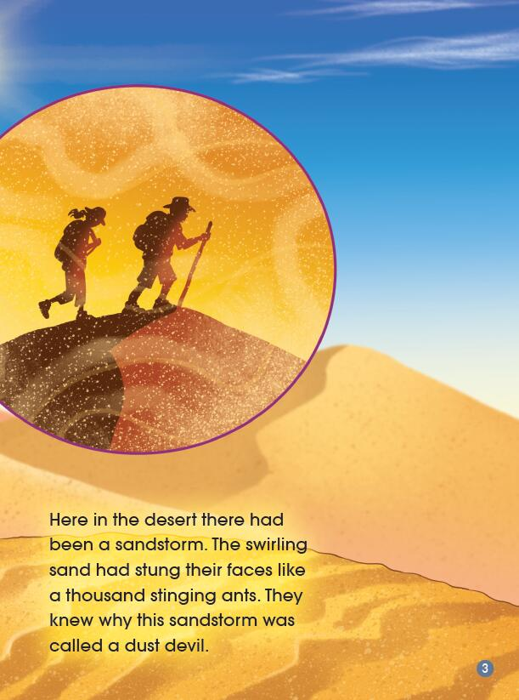
Details of the story
The swirling sand had stung their faces like a thousand stinging ants.
Why was this sandstorm called a dust devil?

Slide 18
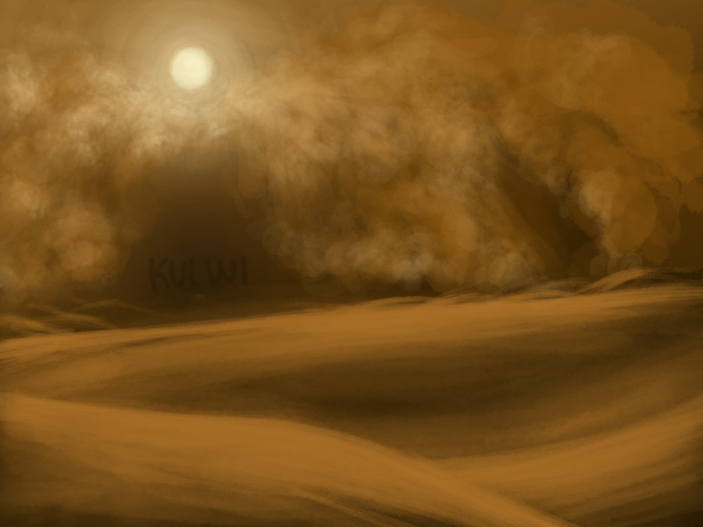
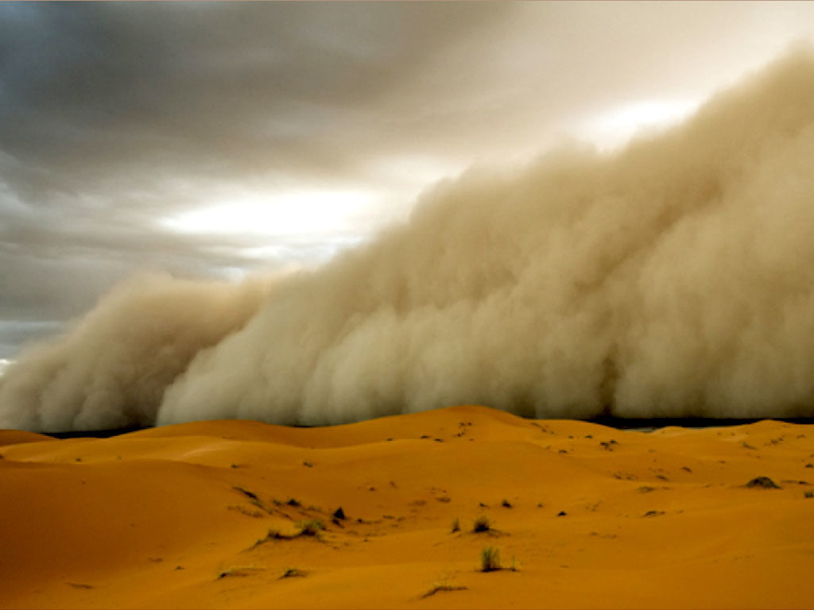
Details of the story
The swirling sand had stung their faces like _________.

Slide 19
Details of the story
• What does “froze” mean? Would you like to act it out?
• What picture did you get in your head when you read “It sounded ... like the patter of rain on a tin roof ”?

Slide 20
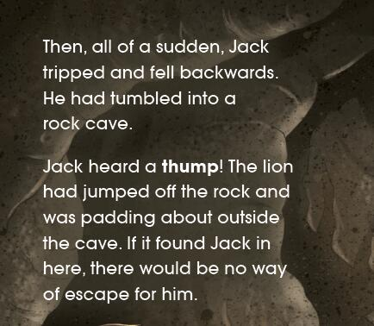
Details of the story
• How do you think Jack was feeling?
• What makes you think that?
• Read in your group and try to act it out. Pay attention to the verbs.

Slide 21
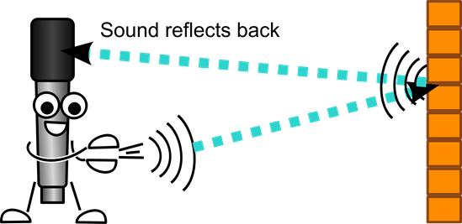
Details of the story
How has the illustrator shown that the sound is travelling?
echo

Slide 22
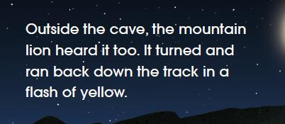
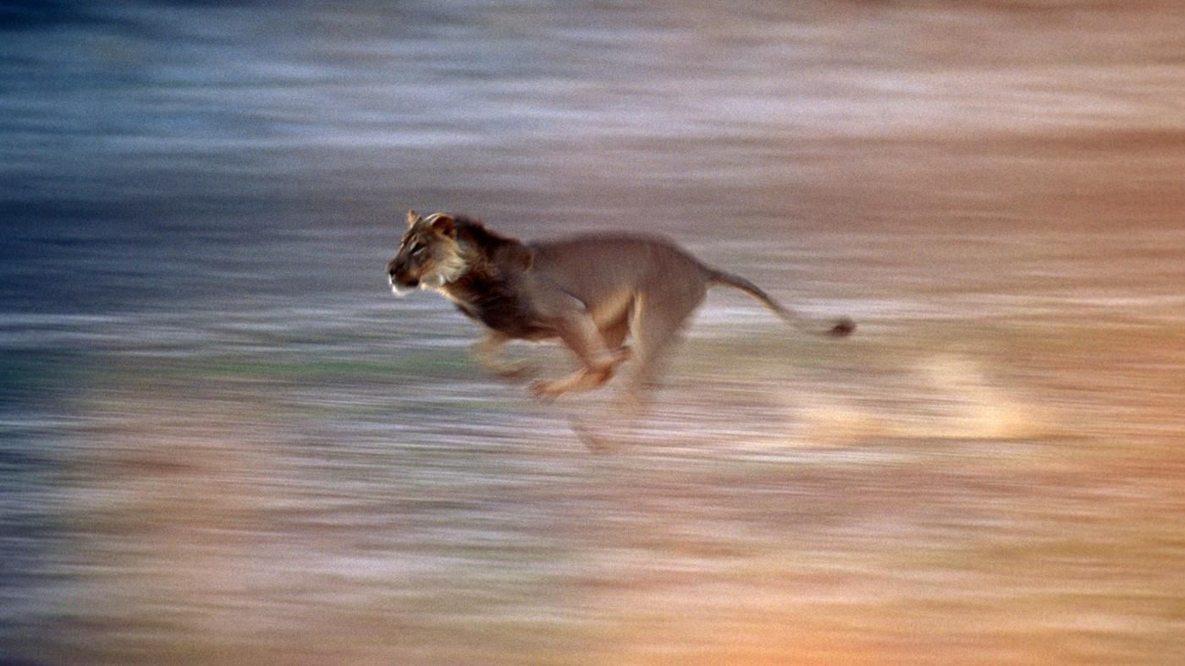
Details of the story
What do you think is meant by “a flash of yellow”?

Slide 23
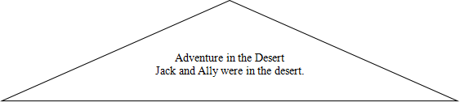
List out important facts and fill in the chart.
Problem | Solution in the book | Alternative idea of yours
There was a mountain lion on the rock and watched Jack as its prey.
Jack thought about Ally. He was worried about her.
…
…

Slide 24
Group discussion
Let’s share.
• If you were Jack, do you have different solutions?
• If you were Ally, what would you do?

Slide 25
Something to think about
• Desert is home to many animals. What desert animals do you know about?
• What can you do to make their living environment better?

Slide 26
Homework
Option One: Tell the story to your parents.
Option Two: Share another adventure story with your classmates.

