Slide 1
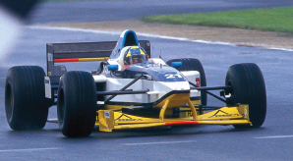
Race to the Finish
冲向终点
选自《多维阅读第11级》

Slide 2
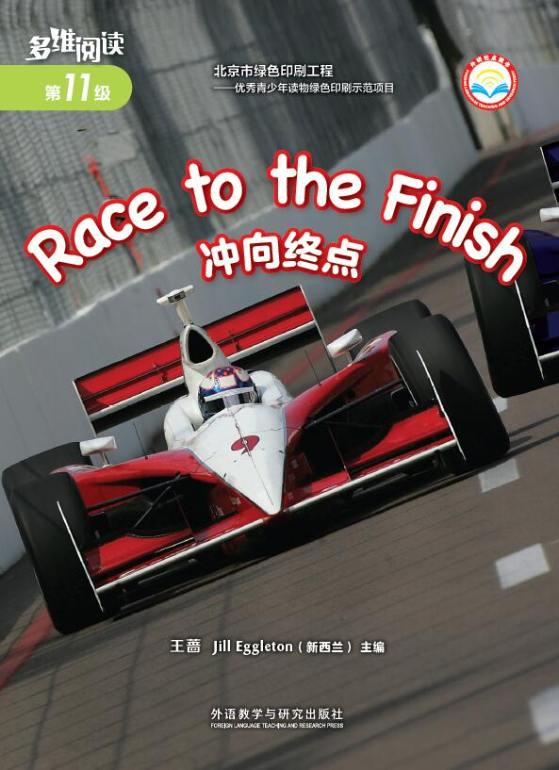
Look at the cover of the book.
1. What’s this in the picture?
What’s the name of it?
2. What do racing cars look like?
Where do people have the race?
What do you think of the race?
Are there anything else you know about it?
3. Why is the book titled Race to the Finish? Can you guess how to be the winner of the race?

Slide 3
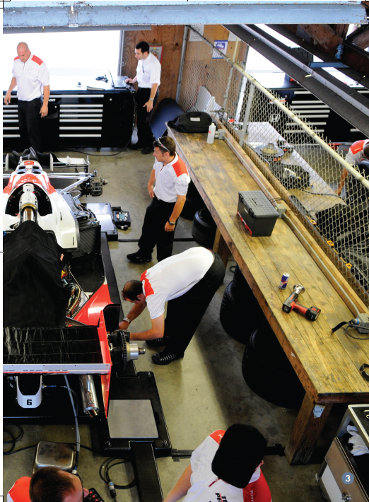
Read and answer the questions.
The Day Before the Race
1.Who do you think these people might be?
2.What do you think they are doing?
3. What do you think would be the most important thing to do before a race?

Slide 4
Read and answer the questions.
The Day Before the Race
1.Who do you think these people might be?
Notes:
请学生观察图片回答问题，答案可以是drivers, mechanics, workers等，只要意思正确均可。

Slide 5
Read and answer the questions.
The Day Before the Race
2.What do you think they are doing?
They are testing the car.

Slide 6
Read and answer the questions.
The Day Before the Race
3. What do you think would be the most important thing to do before a race?
It is to test the car.

Slide 7
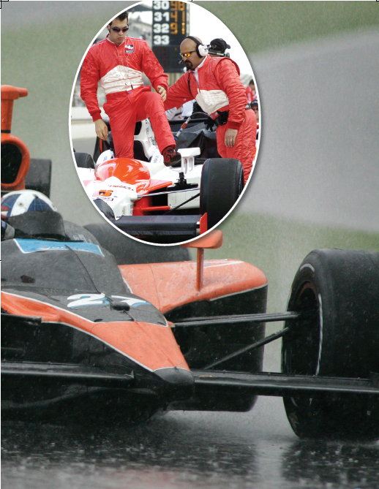
Read and answer the questions.
The Day of the Race
1.What do you think the men are doing in the inset photograph?
2.What do you know that is smooth? What would be the opposite to smooth?

Slide 8
Read and answer the questions.
The Day of the Race
1.What do you think the men are doing in the inset photograph?
They are getting ready for the race.
dry
smooth tyres
weather
tyres with a
deep tread
wet
test their cars
drivers
practise the tight turns and bends

Slide 9
Read and answer the questions.
The Day of the Race
2. What do you know that is smooth? What would be the opposite to smooth?
______ is /are smooth.
VS
smooth
?
rough

Slide 10
Read and answer the questions.
Racing
1. How does the car keep the driver safe?
2. How do the drivers keep safe?
3. How do people help if there is a crash?
4. Why are there different race flags?
5. Why do cars need pit stops?
6. Why don’t some cars finish a race?
7. Which team will win the race?

Slide 11
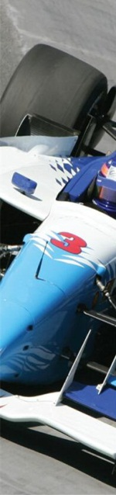
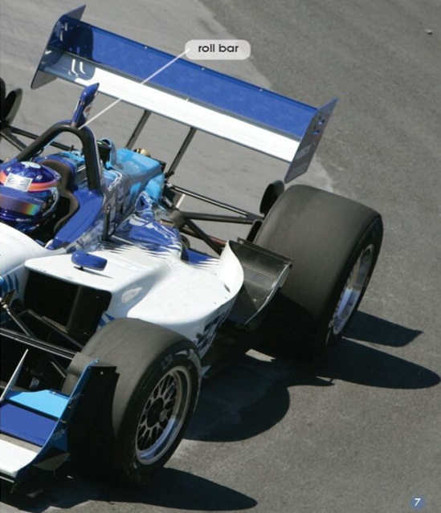
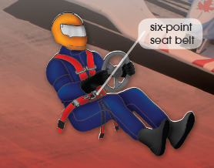
Read and answer the questions.
Racing
1. How does the car keep the driver safe?
steering wheel
the seat belt is special
stop the driver
from getting crushed
make a quick escape

Slide 12
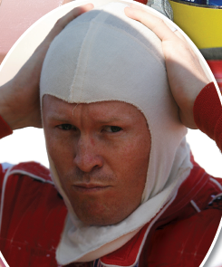
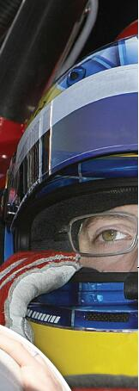
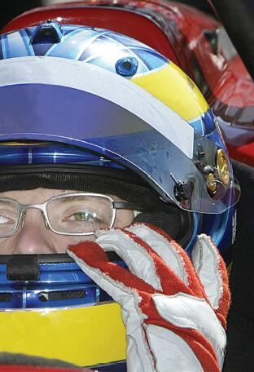
Read and answer the questions.
Racing
2. How do the drivers keep safe?
fireproof underwear and caps
crash helmet
protect them
if there is a fire
light and tough; protect them if there is a hit

Slide 13
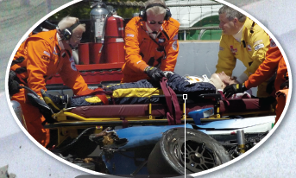
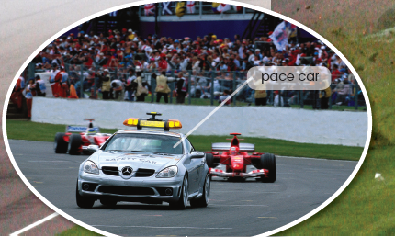
Read and answer the questions.
Racing
3. How do people help if there is a crash?
some people
pace car
put out the fire
come to the track; all cars must slow down
help rescue the driver
Notes:
图片请调换，以更清晰

Slide 14
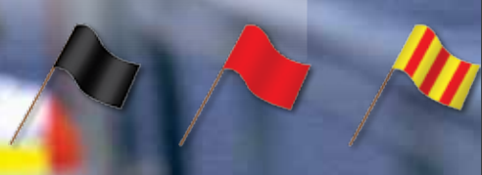
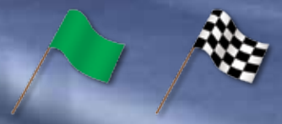
Read and answer the questions.
Racing
4. Why are there different race flags?
The car
has to stop.
The race has been stopped.
The track
is slippery.
Cars start racing.
The car wins the race.

Slide 15
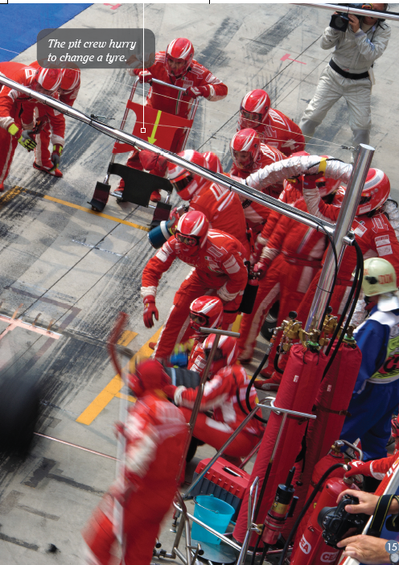
Read and answer the questions.
Racing
5. Why do cars need pit stops?
burn up fuel
A good pit crew
have the car
back on the track
in about 7 seconds.
cars
wear out tyres
make up of about 20
people
the
pit
crew
get the car ready
for racing again
Notes:
图片清晰

Slide 16
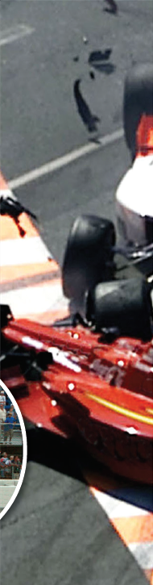
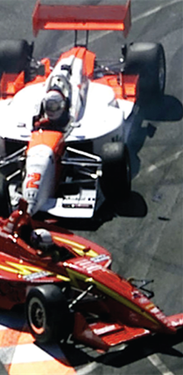
Read and answer the questions.
Racing
6.Why don’t some cars finish a race?
crash
cars
spin off the track
tyres
blow out
engines
break down

Slide 17
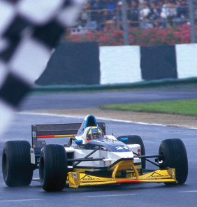

Read and answer the questions.
Racing
7. Which team will win the race?
the best car
The team with
the best driver
the best pit crew
see the first!

Slide 18
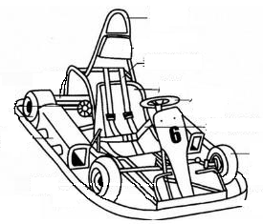
Group Work
1. Label the parts of a racing car.

Slide 19
Group Work
2. Fill in the blanks and talk about the car racing.
The Days before the Race The days are __________. Drivers practise on the __________. They __________ their cars.
The Day of the Race The teams __________ for the race ________ in the morning. They check the __________. The drivers test their cars on the __________. They practise the __________ and __________.

Slide 20
Racing
The cars have _______ to stop the driver from getting ____________.
Drivers have to wear _________, _________ and ________ to protect them.
Many people come to _____if there is a crash.
There are different ______ to tell the drivers different things.
A good pit crew will have the car back on the _______in ­_____ seconds.
The team with the best _____, the best _____, and the best ______ usually sees the __________flag first.
Group Work

Slide 21
Group Work
3. Talk about the race from the perspectives of different people.
Imagine you are a car driver.
Imagine you are a mechanic in the pit crew.
Car Racing
Now, you are yourself.

Slide 22
Group Work
4. Choose a topic to give an explanation on.
mountain bike race
running race
?
Ideas
speed boat race
yacht race
bike race

Slide 23
Homework
建议：
（1）与小组成员合作，制作一幅海报，介绍一种体育赛事，包括该赛事的简介、需要重视的安全事项以及如何更好地参加这一赛事。在全班进行展示。
（2）课后和小组成员一起利用网络或者图书馆查询资料。看看是否有其他的体育赛事没有同学提到。在全班汇报调查结果。

Slide 24
Thank you!

