Slide 1
Different Villages
形形色色的村庄
选自《多维阅读第11级》

Slide 2
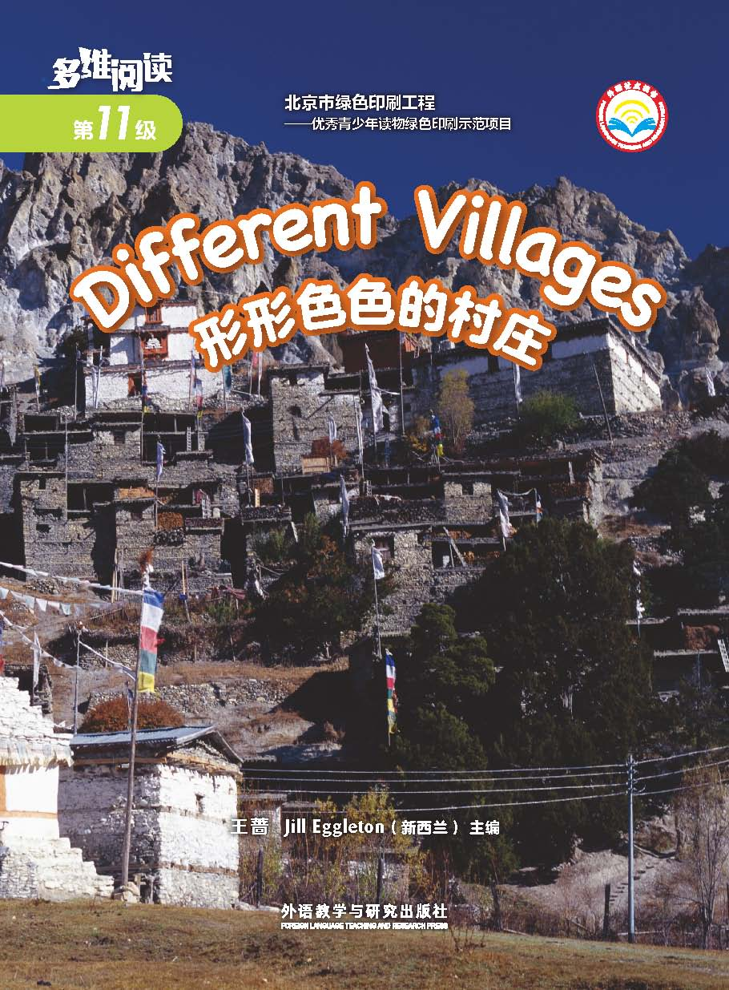
Look at the cover of the book
What can you see from the picture?
Have you ever seen houses like these?
Where did you see them?
What’s the name of the book?
2. What do you know about villages?
What do you want to know about villages?
3. What is the same or different about what the people who live in villages have and what you have?

Slide 3
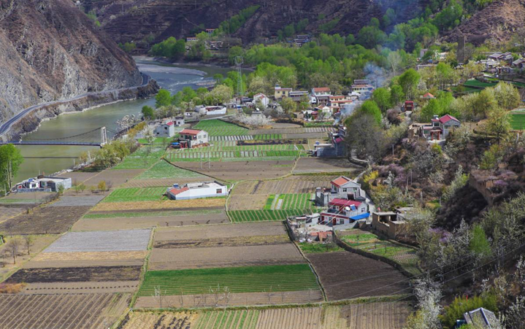
Read and answer the questions
What Is a Village?
1. What do you know about a village now?
2. How are they different from a town or a city?
3. Why do you think people might live in a village?

Slide 4
Read and answer the questions
Weather
A Village
Far from the Sea
1. What information about Burkina Faso do you know from the internet?
Location
Burkina
Faso
Houses
2. Why do you think houses here would be made with mud bricks and straw roofs?
…

Slide 5
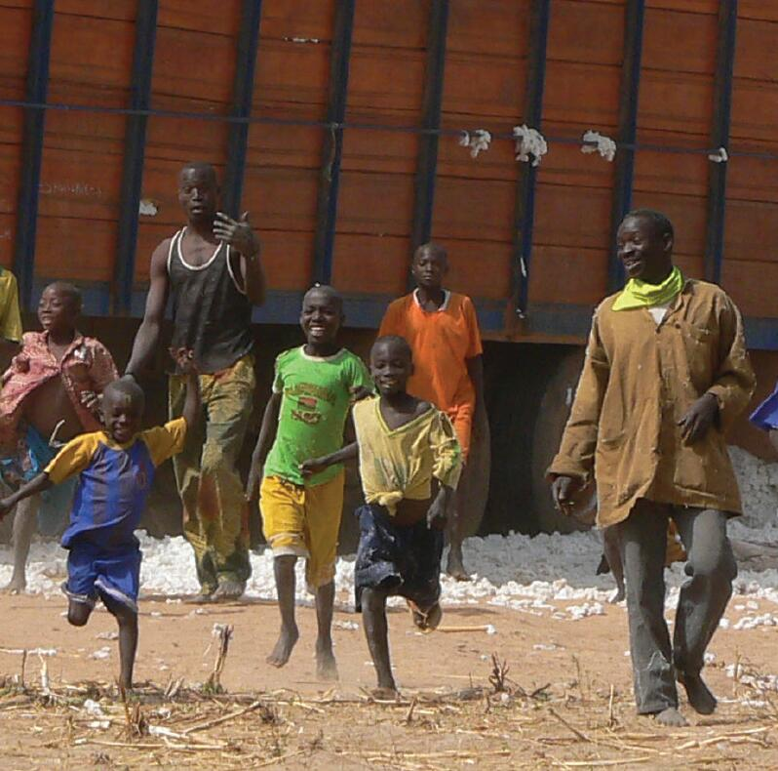
Read and answer the questions
A Village
Far from the Sea
3. Look at the people. How do you think they are feeling?
Why do you think that?

Slide 6
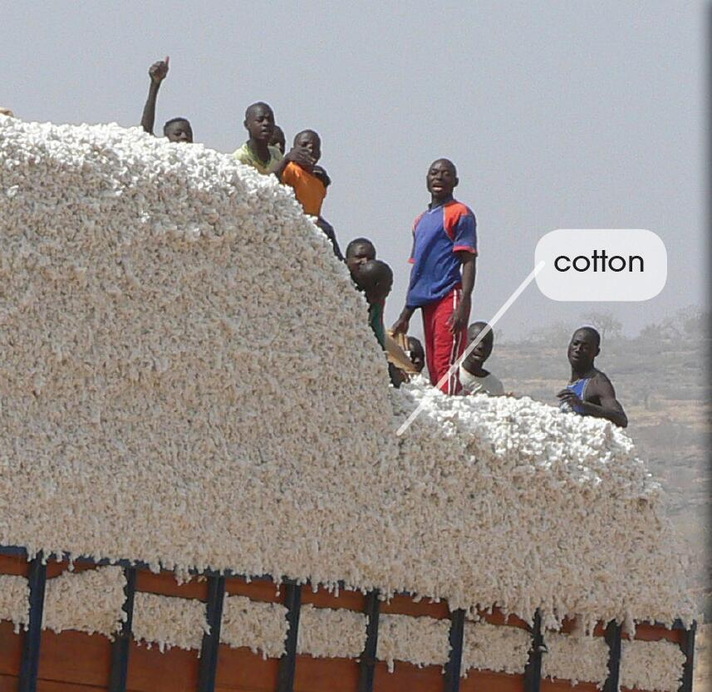
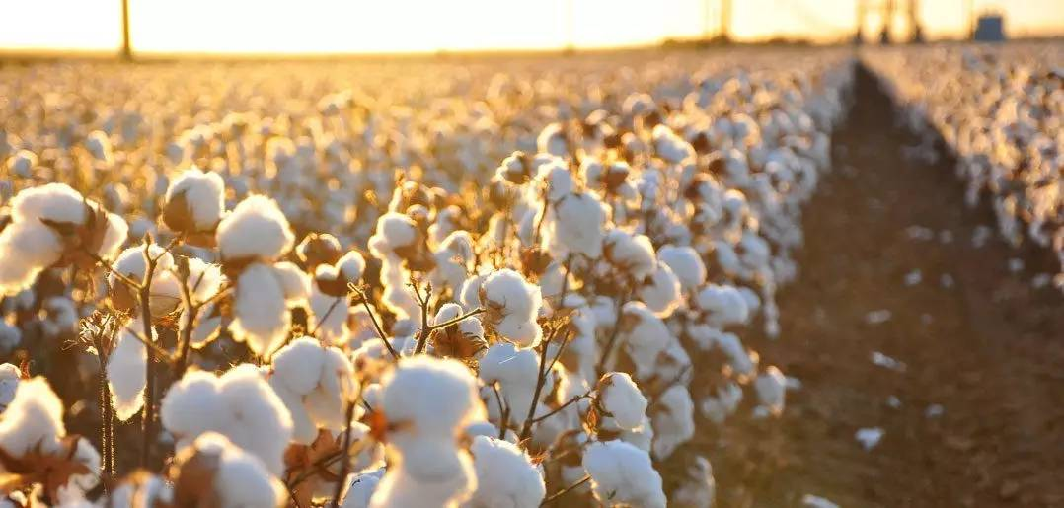
Read and answer the questions
A Village
Far from the Sea
4. Why do you think cotton is very important to these people?

Slide 7
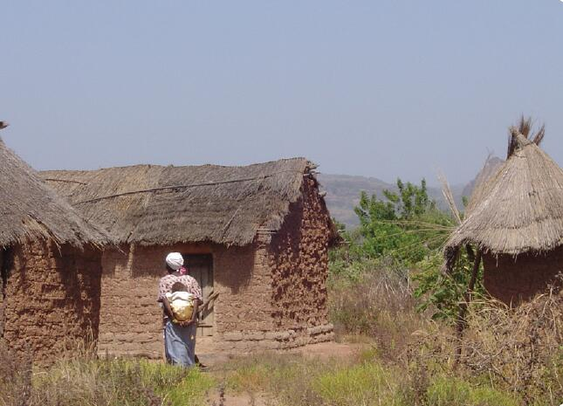
Read and answer the questions
A Village
Far from the Sea—Village houses
5. How do the men know which houses to live in?

Slide 8
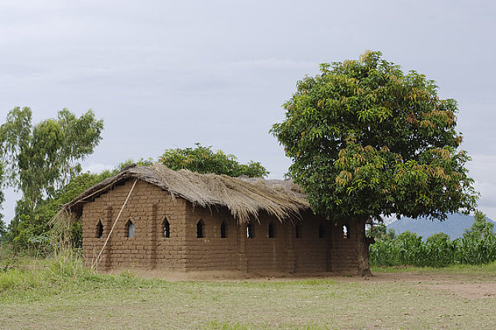
Read and answer the questions
A Village Far from the Sea—Village houses
rectangle
rectangular house
Notes:
图片来源：全景网 www.quanjing.com

Slide 9
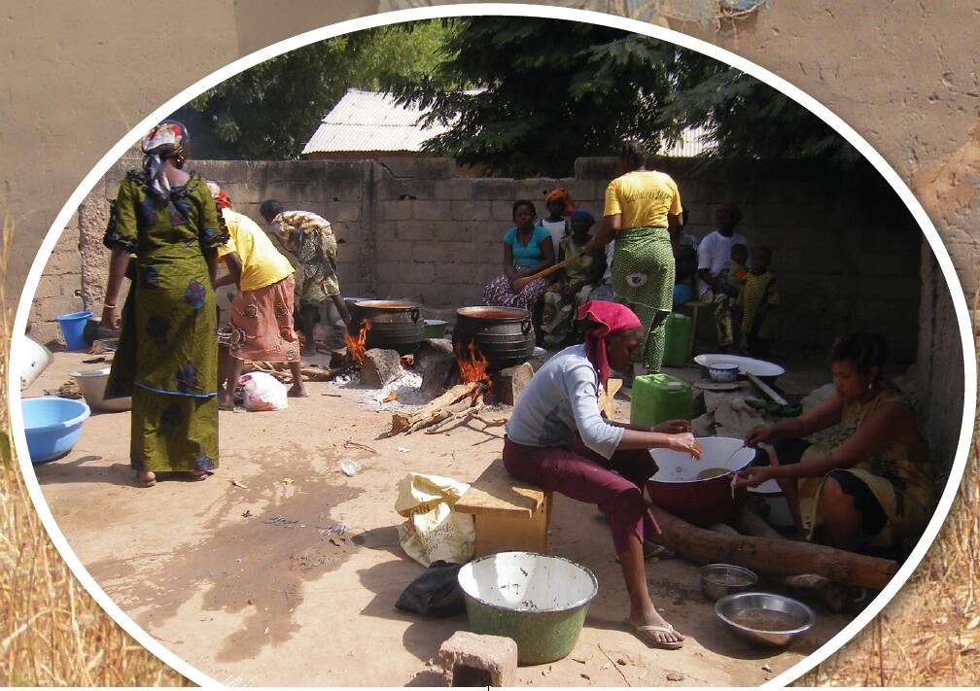
Read and answer the questions
A Village Far from the Sea—Village houses
6. Where do the people cook?
Why?

Slide 10
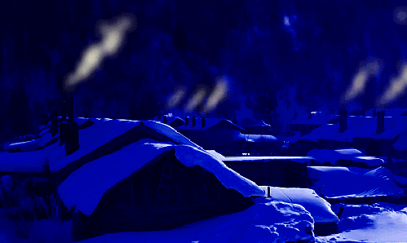
Read and answer the questions
A Village Far from the Sea—Village houses
The smoke drifts away
Notes:
图片来源：blog.sina.com.cn/s/blog_66d0c7060100nn88.html

Slide 11
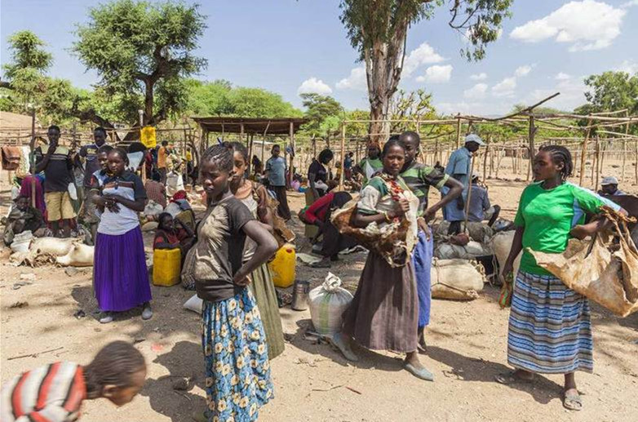
Read and answer the questions
A Village Far from the Sea—In the village
7. What words tell you the market is a very important place for this village?
buy food and other things
meet people
share news
Notes:
图片来源：paixin.com

Slide 12
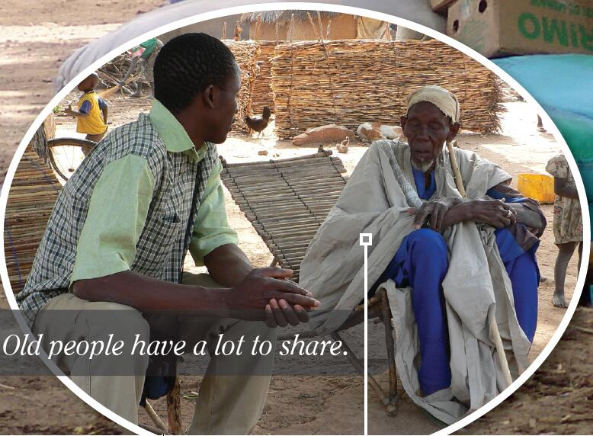
Read and answer the questions
A Village Far from the Sea—In the village
8. Why do you think the old people are important in the village?

Slide 13
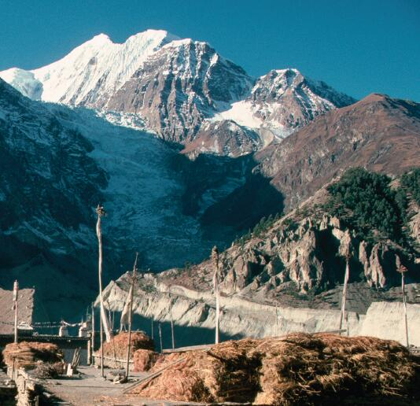
Read and answer the questions
A Village High in the Mountains
1. What is different about this village from the village in Burkina Faso?

Slide 14
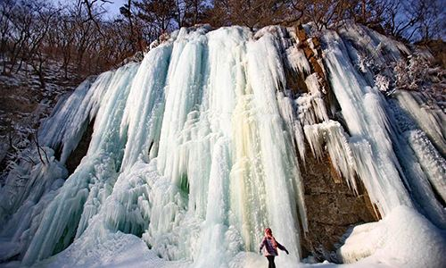
Read and answer the questions
A Village High in the Mountains
2. What two words can you see in icefall?
ice+fall

Slide 15
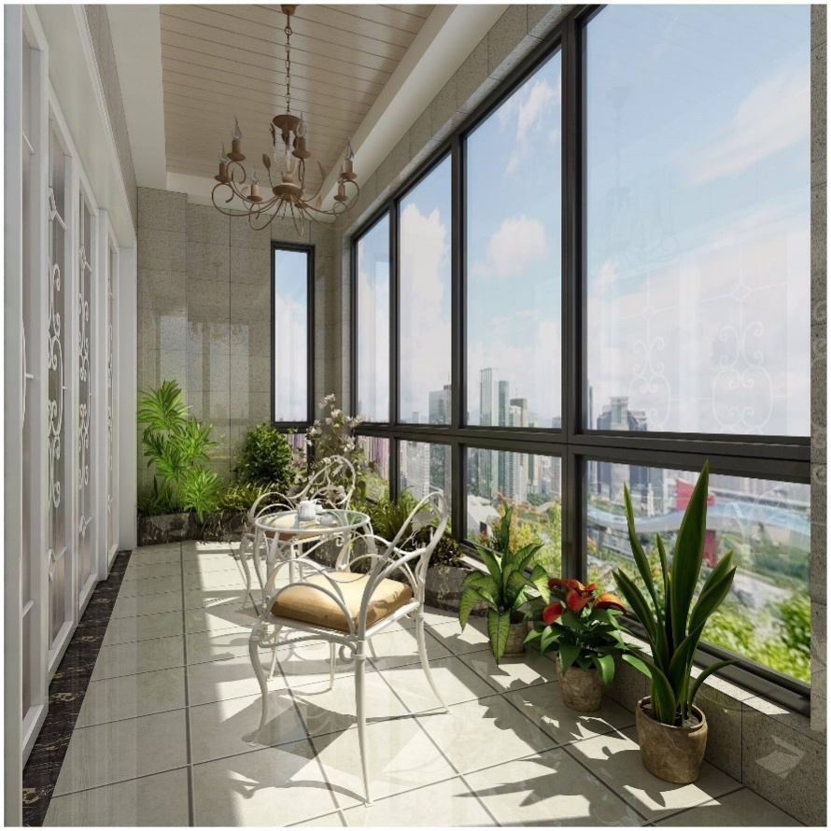
Read and answer the questions
A Village High in the Mountains—Village houses
3. Were there any words you didn’t know the meaning of or how to say?
veranda

Slide 16
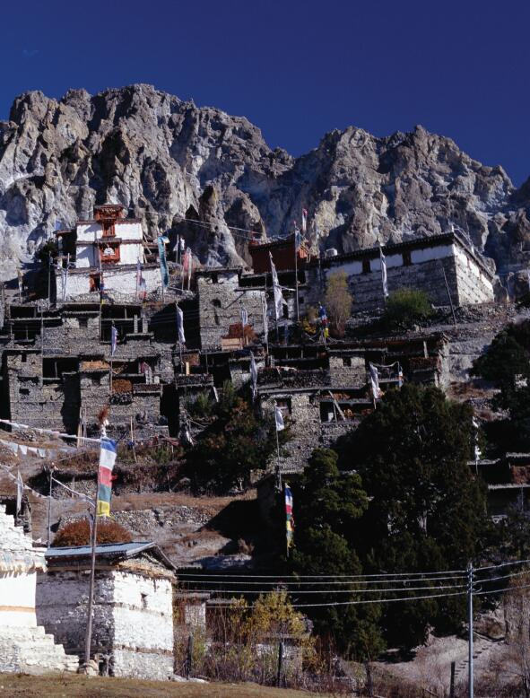
Read and answer the questions
A Village High in the Mountains
—Village houses
4. Why do you think the houses are built on top of each other?

Slide 17
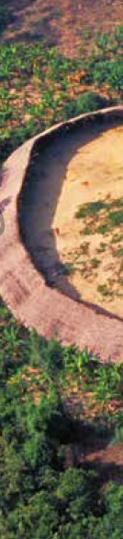
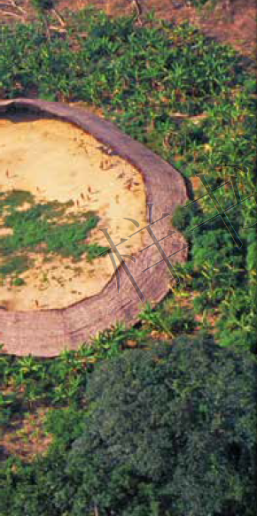
Read and answer the questions
A Village in the Rain Forest
1. What is different about this village from the village in Burkina Faso?
2. Why is the rain forest important to these people?

Slide 18
Read and answer the questions
Different but the Same
1. In what ways are these villages in this book the same? In what ways are they different?
2. What do you think you would like about living in a village?
3. What can the people share in these villages?

Slide 19
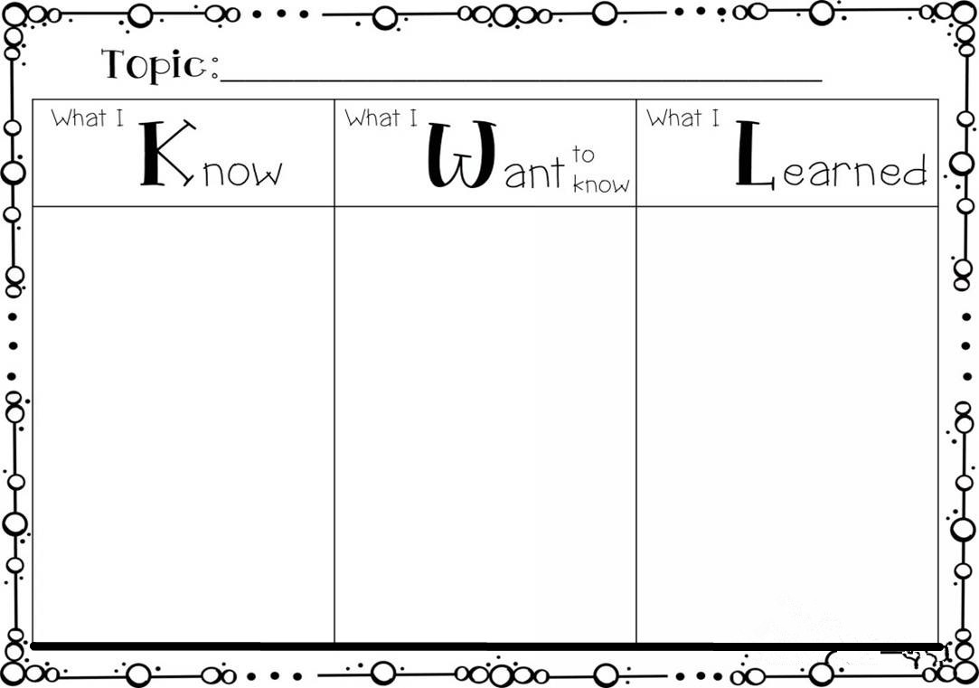
Group work
Complete KWL Chart please.

Slide 20
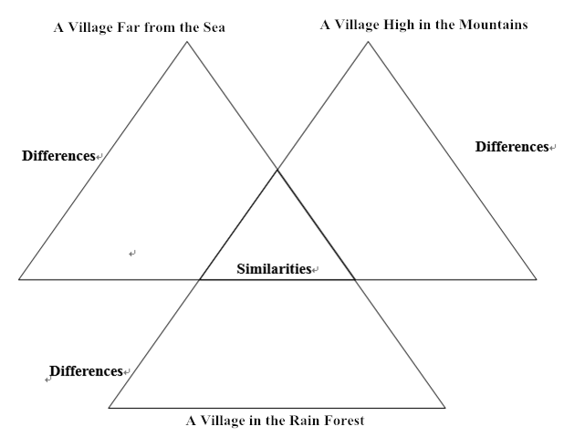
Group work
From the book you have read, find out the differences and similarities of the villages.

Slide 21
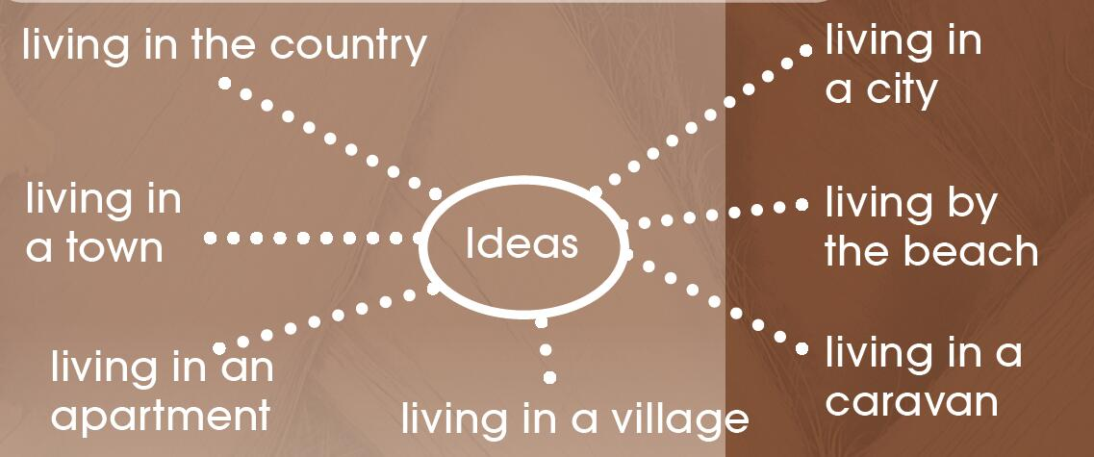
Group work
Choose a topic and talk about it with your partner.

Slide 22
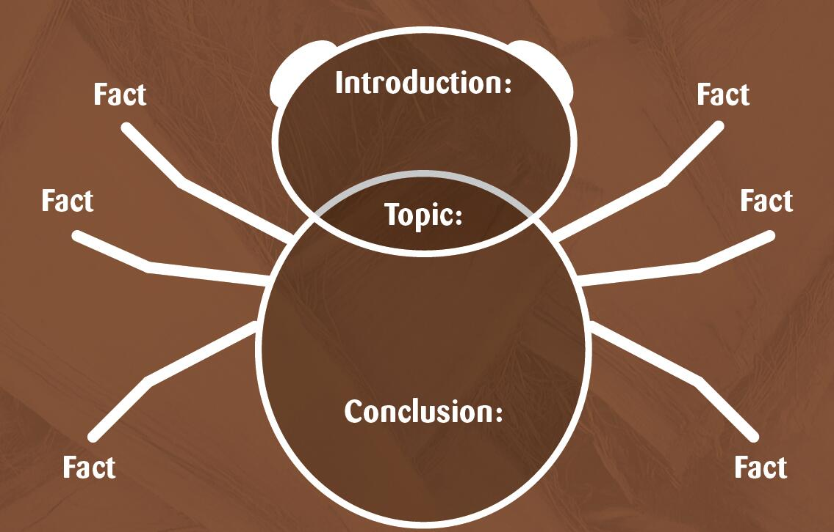
Group work
Find the topic of the report, and make a bug graphic like this. Then give your partner an oral report about your topic.

Slide 23
Discussion
1. Now could you tell me more about the differences between what the people who live in villages have and what you have?
2. Why does the author write the book?
3. What do you usually share with the people in your hometown?

Slide 24

Homework
与小组成员合作，制作一幅海报，介绍自己的家乡，包括地理环境、房屋结构、人们的生活方式等。在全班进行展示。
课后和小组成员一起利用网络查询资料并展开想象。如果人类到太空或是去其他星球居住，会是什么样子的？在全班汇报结果。

Slide 25
Thank you!

