Slide 1
Word Pictures
身临其境
选自《多维阅读第11级》

Slide 2
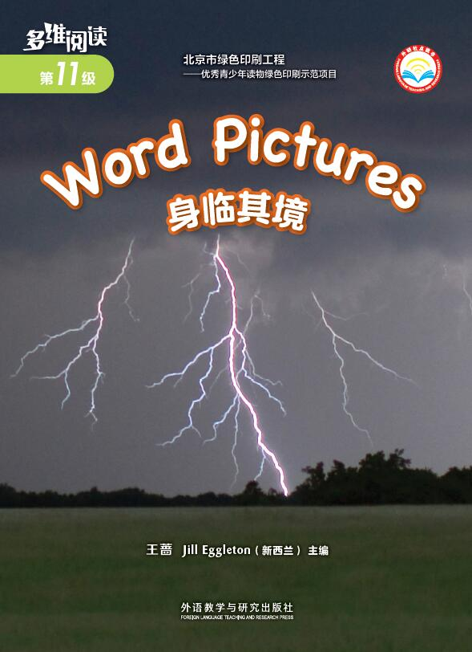
Activity 1 Look at the cover of the book and answer.
What’s the picture about?
2. What’s the title of the book?
3. Do you know anything about
“Word Pictures” ?
Notes:
样书封面

Slide 3
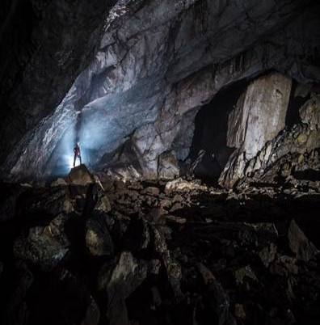
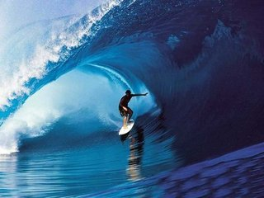
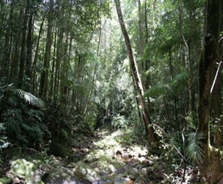
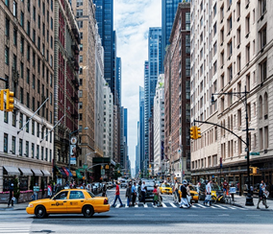
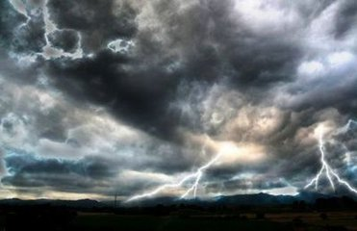
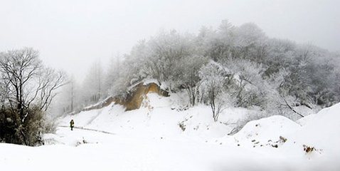
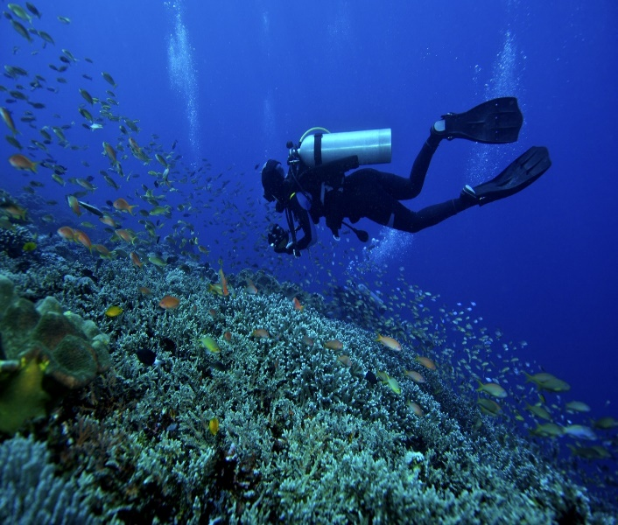
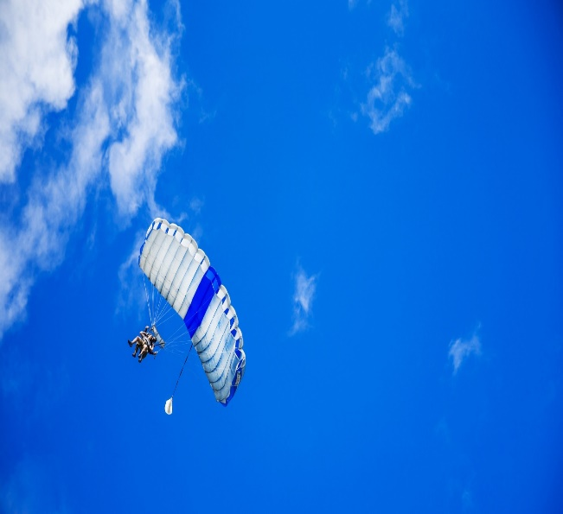
Activity 2 Watch and say.
In a cave
On a surfboard
In the rain forest
In a busy city street
In the storm
High up on a mountain
Deep under the sea
In the sky
Notes:
学案1

Slide 4
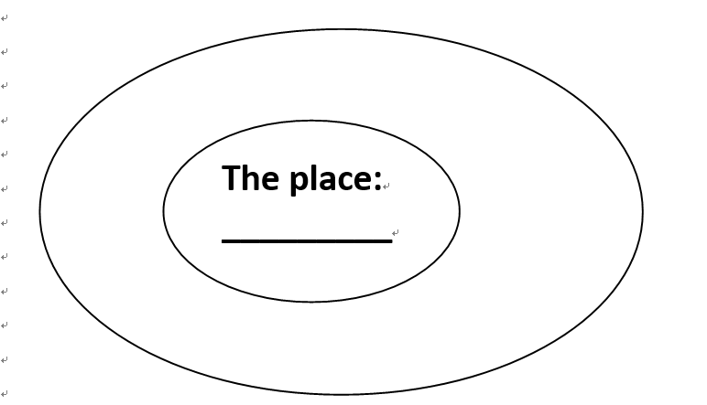
Students brainstorm with the teacher.
1. Think about “Where am I? Have I ever been to these places? What can I say about it?”
2. Describe it to your partner and listen to his/her description.
Notes:
学案1

Slide 5
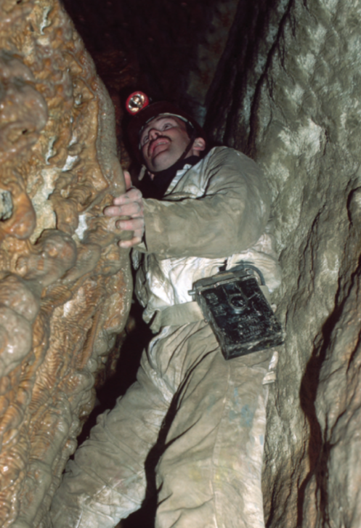
Activity 3 Read and answer.
Where am I? (In the cave)
What do you know about a cave?
Have you ever been in a cave? How would you describe what it was like?
What words (adjectives) describe the cave?
What words describe a sound?
What words (verbs) describe how this man is moving?
Notes:
图片来源：
www.baidu.com

Slide 6
Activity 3 Read and answer.
Where am I? (In the storm)
Have you ever been in a storm? How would you describe it? What did you see, hear and feel?
What words are used to describe the cloud?
What picture did you get in your head when you read “The wind howls like a lone wolf”? Draw it.
What words helped you most to get a picture in your head? Why?
Notes:
图片来源：
www.baidu.com

Slide 7
Activity 3 Read and answer.
Where am I? (On a surfboard)
What do you think about this person?
How might you feel if you were this person?
What words are used to describe the waves?
Which descriptions gave you a picture in your head?
How would you describe what the boy might do after the wave has left him on the sand?

Slide 8
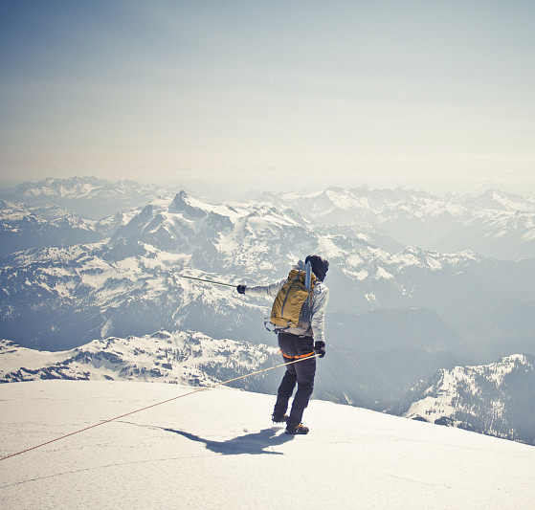
Activity 3 Read and answer.
Where am I? (High up on a mountain)
Where is this person?
Have you ever been high up on a mountain?
What did you see/feel/hear?
Why do you think the river would look like a thin ribbon?

Slide 9
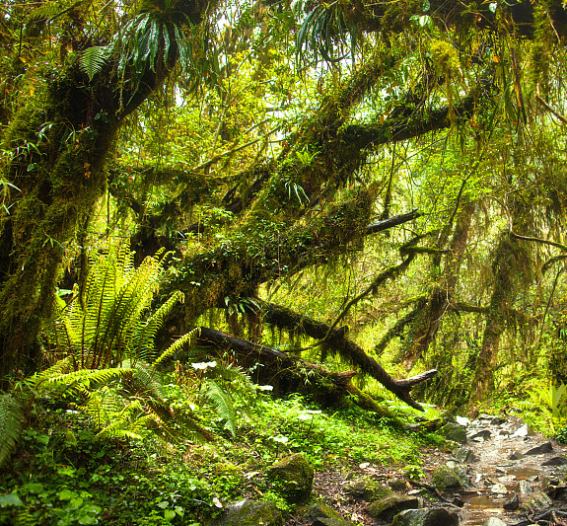
Activity 3 Read and answer.
Where am I? (In the rain forest)
What words describe the rain forest? What words describe the trees? What other words could you use to describe the trees?
What picture did you get in your head when you read about the roots? Draw it.
Do you think this is a good description of roots? Why?
What else could you compare the roots with?

Slide 10
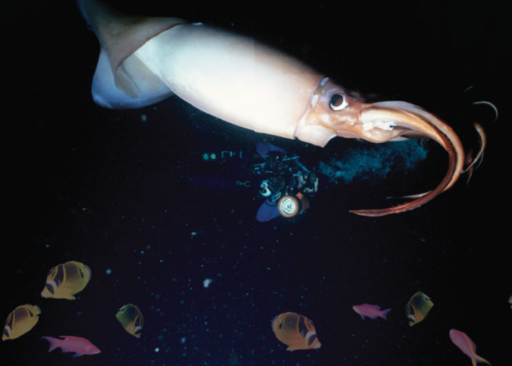
Activity 3 Read and answer.
Where am I? (Deep under the sea)
How do you know it is very quiet under the water? Find the words that tell you.
What other words might you use to describe the squid’s eye?
Why do you think the fish disappear?
How could you describe what might happen next?

Slide 11
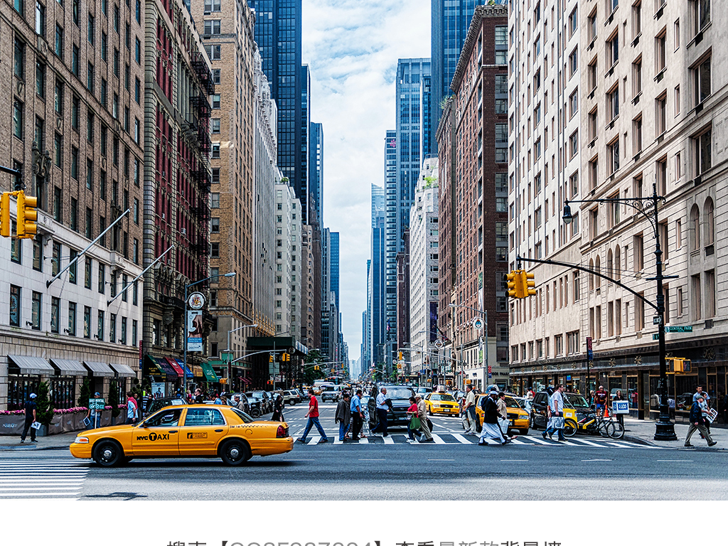
Activity 3 Read and answer.
Where am I? (In a busy city street)
How could you describe these buildings?
Do you like being in a big city? Why? Why not?
What do you think it means by “Only a small patch of blue sky can be seen like a lid over them”?

Slide 12
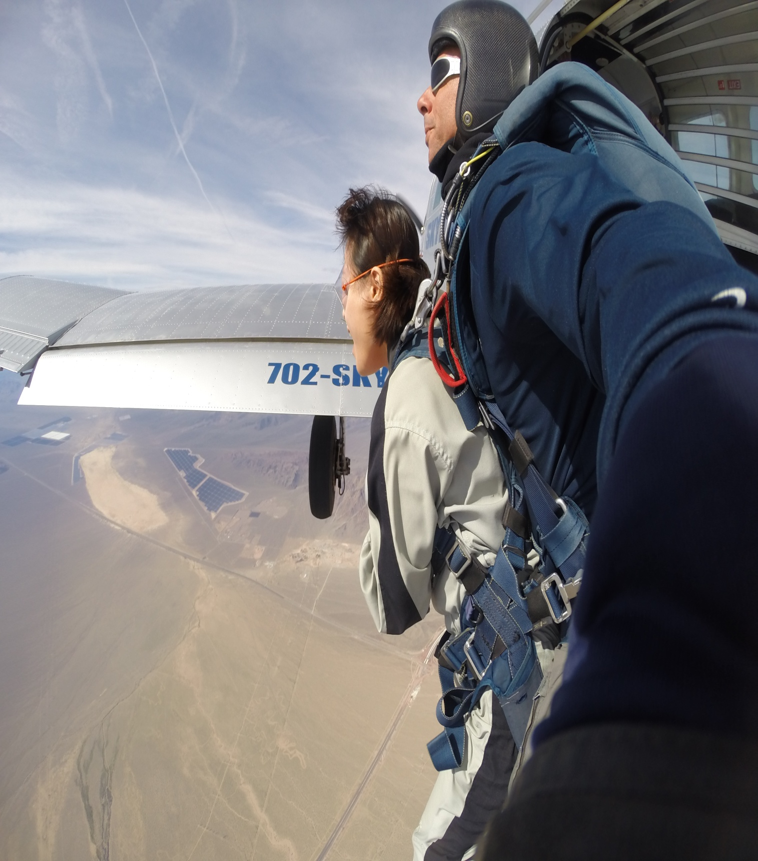
Activity 3 Read and answer.
Where am I? (High up in the sky)
What do you think this description might be about? Why do you think that?
Which words describe what the skydiver does?
Which words describe the feelings?
Why do you think the skydiver is both scared and excited?
Notes:
图片来源：
www.baidu.com

Slide 13
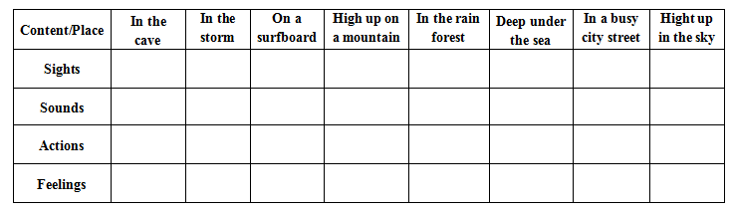
Activity 4 Fill in the chart according to the book.
Notes:
学案3

Slide 14
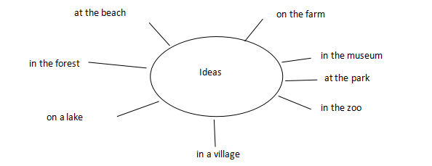
Activity 5 Choose a topic to talk about it with your partner.

Slide 15
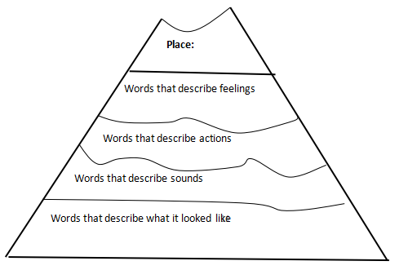
Activity 6 Make a mountain graphic and write a report.

Slide 16
Activity 7 Think deeply and answer the questions.
Why does the author write the book?
How do you feel and what do you get after reading?
How would you use words to paint a picture for the reader?

Slide 17
Activity 8 Homework.
Make a poster and use words to paint a picture for it, and make a report if you like.
Draw a picture for your mountain graphic.

Slide 18
Thank you!

