Slide 1

The People of Hickory Street
希科里街的邻居们
Look & Guess : What do you think the story is going to be about?
选自《多维阅读第11级》

Slide 2
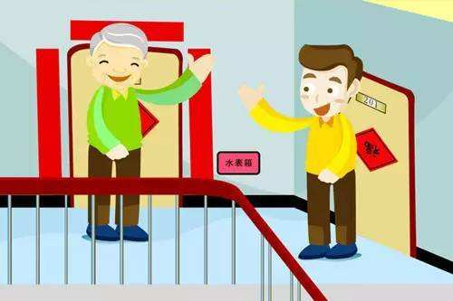
Can you think of a neighbour that impresses you most?

Slide 3
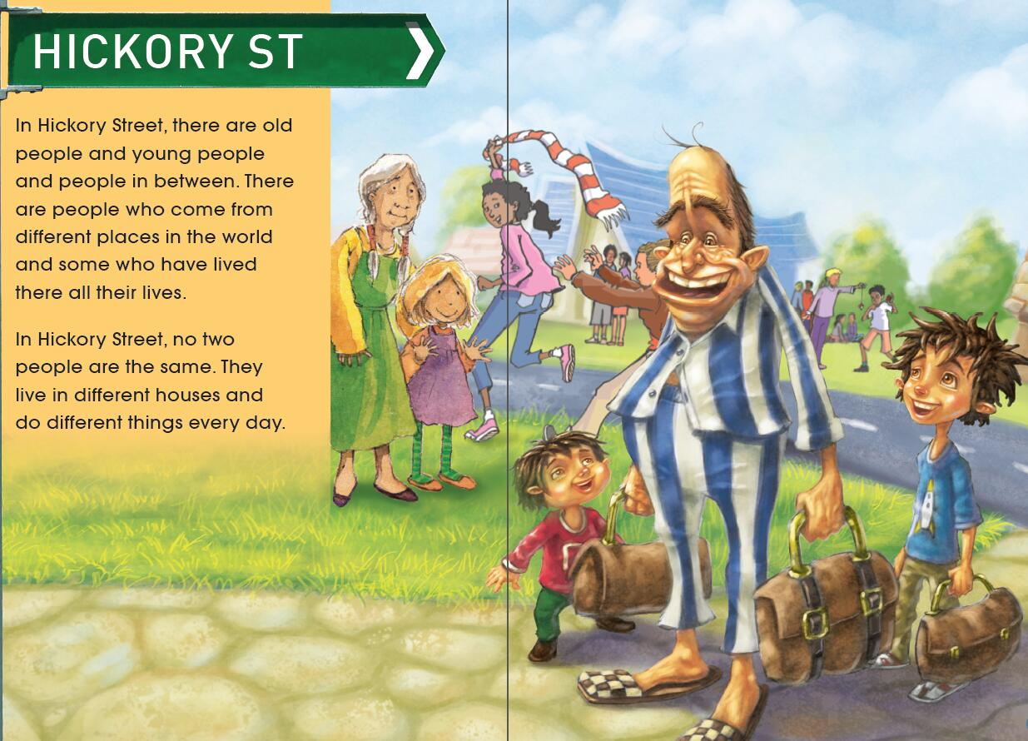
Where do the people in the picture live? Where do they come from?
What is ST short for?

Slide 4
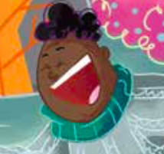
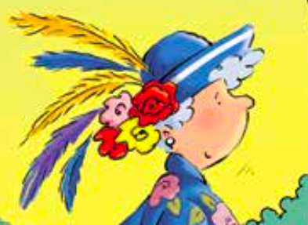
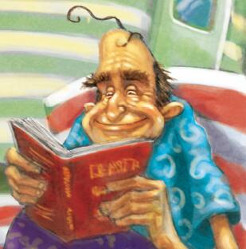
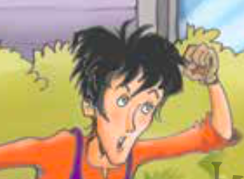
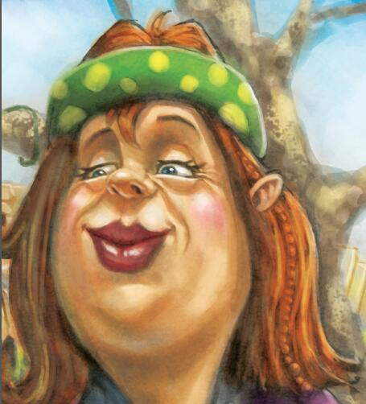
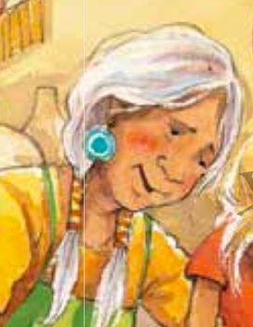
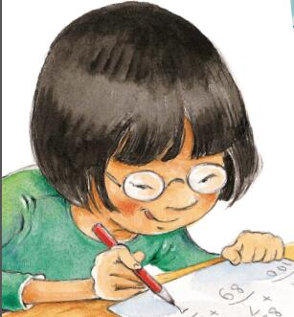
Read & answer: Who are the people of Hickory Street?
Mr Nelson
Mrs McFee
The People of Hickory Street
Louise East
Pop Painter
Mrs May
Mrs Maka
Suzi Chang

Slide 5
Read & Fill
Character | How the character looks like | What his / her personality is like | What he/she likes or dislikes | What he/she does
Mr Nelson
Mrs McFee
Pop Painter
Louise East
Mrs Maka
Mrs May
Suzi Chang

Slide 6
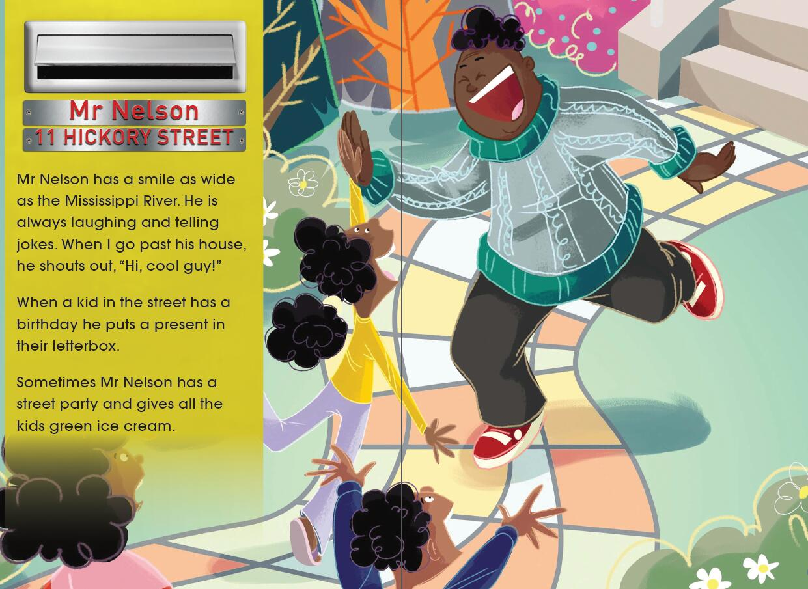
1. What sort of person do you think Mr Nelson might be?
2. Would you like Mr Nelson to live in your street? Why?

Slide 7
Read & Fill
Character | How the character looks like | What his / her personality is like | What he/she likes or dislikes | What he/she does
Mr Nelson | has a smile as wide as the Mississippi River | kind and outgoing | laughing and telling jokes | sometimes has a street party…
Mrs McFee
Pop Painter
Louise East
Mrs Maka
Mrs May
Suzi Chang

Slide 8
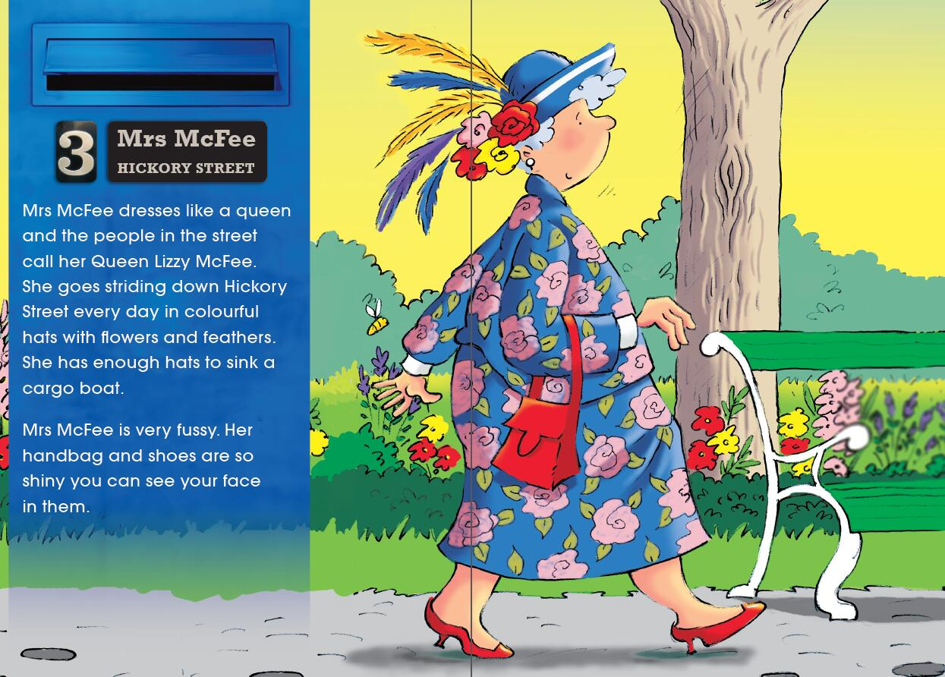
1. What can you tell from the illustration about Mrs McFee?
2. What do you know about Mrs McFee’s personality?

Slide 9
Read & Fill
Character | How the character looks like | What his / her personality is like | What he/she likes or dislikes | What he/she does
Mr Nelson | has a smile as wide as the Mississippi River | kind and outgoing | laughing and telling jokes | sometimes has a street party…
Mrs McFee | dresses like a queen; shiny handbag and shoes; colorful hats | fussy |  | goes striding down the street every day
Pop Painter
Louise East
Mrs Maka
Mrs May
Suzi Chang

Slide 10
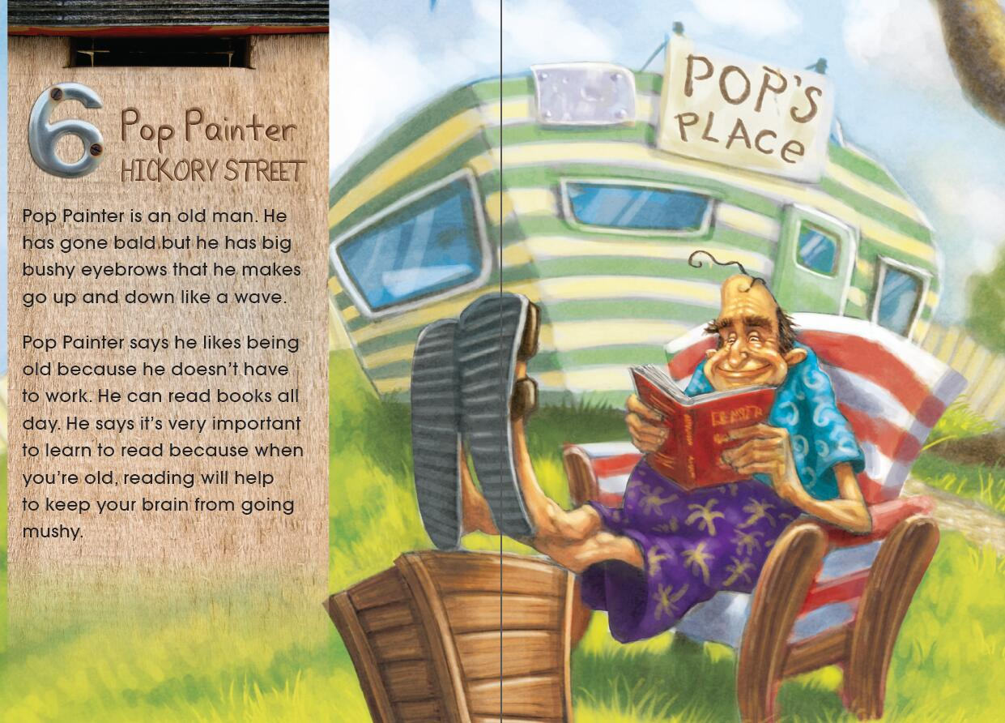
1. What words would you use to describe Pop Painter?
2. Do you agree with what Pop Painter says? Why? Why not?

Slide 11
Read & Fill
Character | How the character looks like | What his / her personality is like | What he/she likes or dislikes | What he/she does
Mr Nelson | has a smile as wide as the Mississippi River | kind and outgoing | laughing and telling jokes | sometimes has a street party…
Mrs McFee | dresses like a queen; shiny handbag and shoes; colorful hats | fussy |  | goes striding down the street every day
Pop Painter | an old man who has gone bald; has big bushy eyebrows |  | being old and reading books | reads books all day
Louise East
Mrs Maka
Mrs May
Suzi Chang

Slide 12
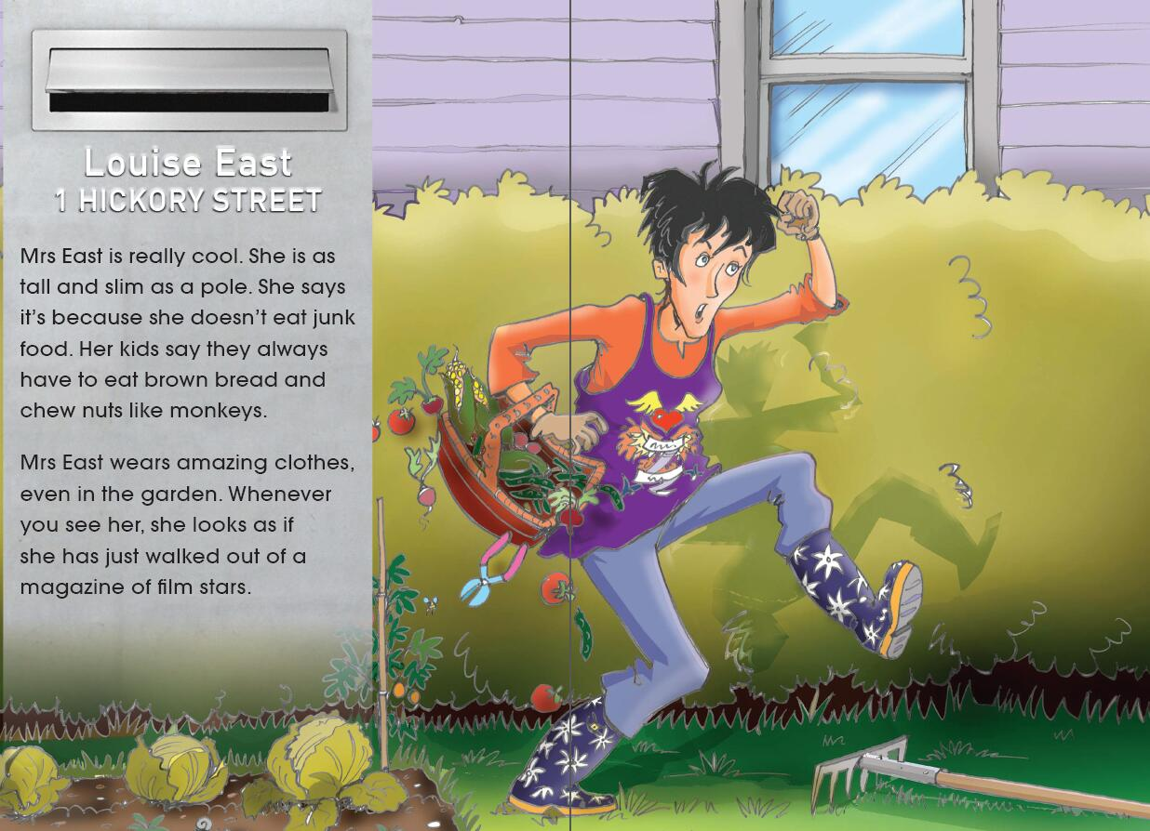
1. By looking at the illustration, how would you describe Mrs East?
2. Why is Mrs East as tall and slim as a pole?

Slide 13
Read & Fill
Character | How the character looks like | What his / her personality is like | What he/she likes or dislikes | What he/she does
Mr Nelson | has a smile as wide as the Mississippi River | kind and outgoing | laughing and telling jokes | sometimes has a street party…
Mrs McFee | dresses like a queen; shiny handbag and shoes; colorful hats | fussy |  | goes striding down the street every day
Pop Painter | an old man who has gone bald; has big bushy eyebrows |  | being old and reading books | reads books all day
Louise East | tall and slim; wears amazing clothes | cool | doesn’t eat junk food
Mrs Maka
Mrs May
Suzi Chang

Slide 14
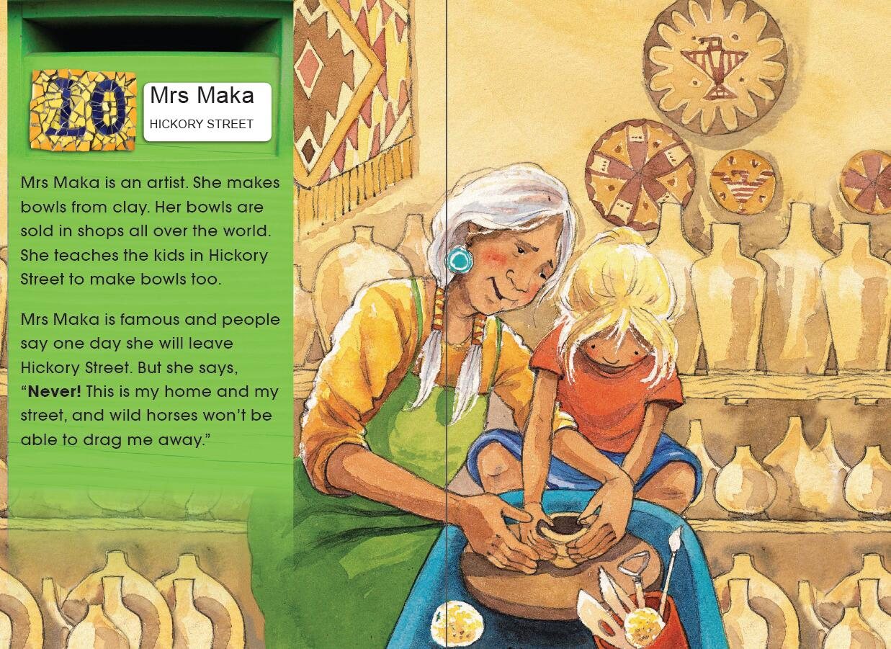
1. How would you describe Mrs Maka?
2. What do you think she might like doing?

Slide 15
Read & Fill
Character | How the character looks like | What his / her personality is like | What he/she likes or dislikes | What he/she does
Mr Nelson | has a smile as wide as the Mississippi River | kind and outgoing | laughing and telling jokes | sometimes has a street party…
Mrs McFee | dresses like a queen; shiny handbag and shoes; colorful hats | fussy |  | goes striding down the street every day
Pop Painter | an old man who has gone bald; has big bushy eyebrows |  | being old and reading books | reads books all day
Louise East | tall and slim; wears amazing clothes | cool | doesn’t eat junk food
Mrs Maka |  |  | loves her hometown and doesn’t want to leave it | makes bowls from clay
Mrs May
Suzi Chang

Slide 16
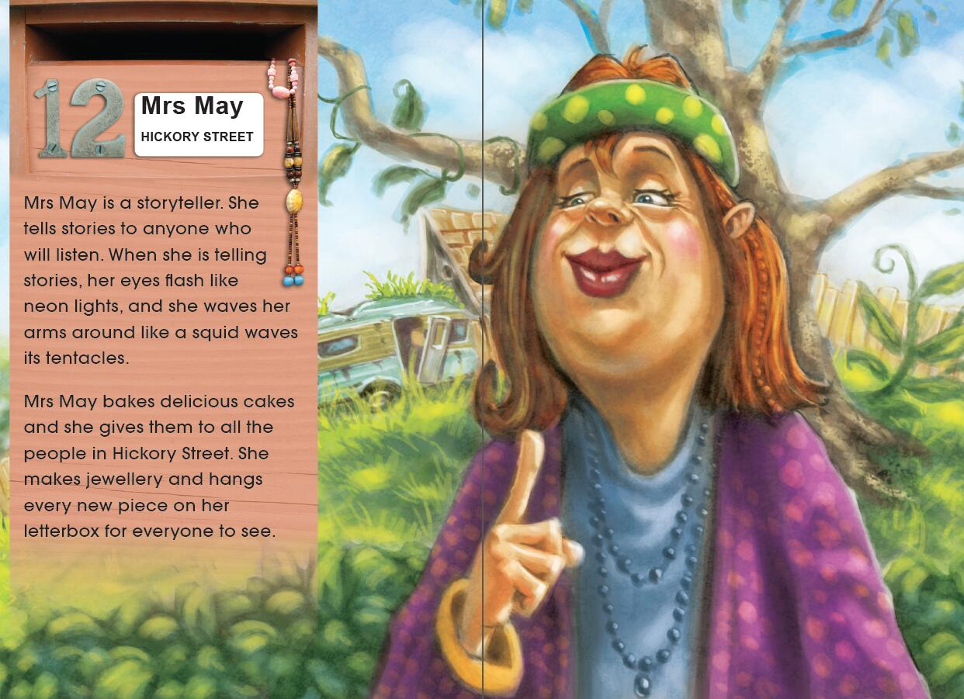
1. How would you describe Mrs May?
2. Why does Mrs May want everyone to see her new pieces of jewelry?

Slide 17
Read & Fill
Character | How the character looks like | What his / her personality is like | What he/she likes or dislikes | What he/she does
Mr Nelson | has a smile as wide as the Mississippi River | kind and outgoing | laughing and telling jokes | sometimes has a street party…
Mrs McFee | dresses like a queen; shiny handbag and shoes; colorful hats | fussy |  | goes striding down the street every day
Pop Painter | an old man who has gone bald; has big bushy eyebrows |  | being old and reading books | reads books all day
Louise East | tall and slim; wears amazing clothes | cool | doesn’t eat junk food
Mrs Maka |  |  | loves her hometown and doesn’t want to leave it | makes bowls from clay
Mrs May | eyes flash like neon lights |  | telling stories; baking cakes and giving them to all the people in the street; making jewellery … | tells stories; bakes cakes; makes jewellery
Suzi Chang

Slide 18
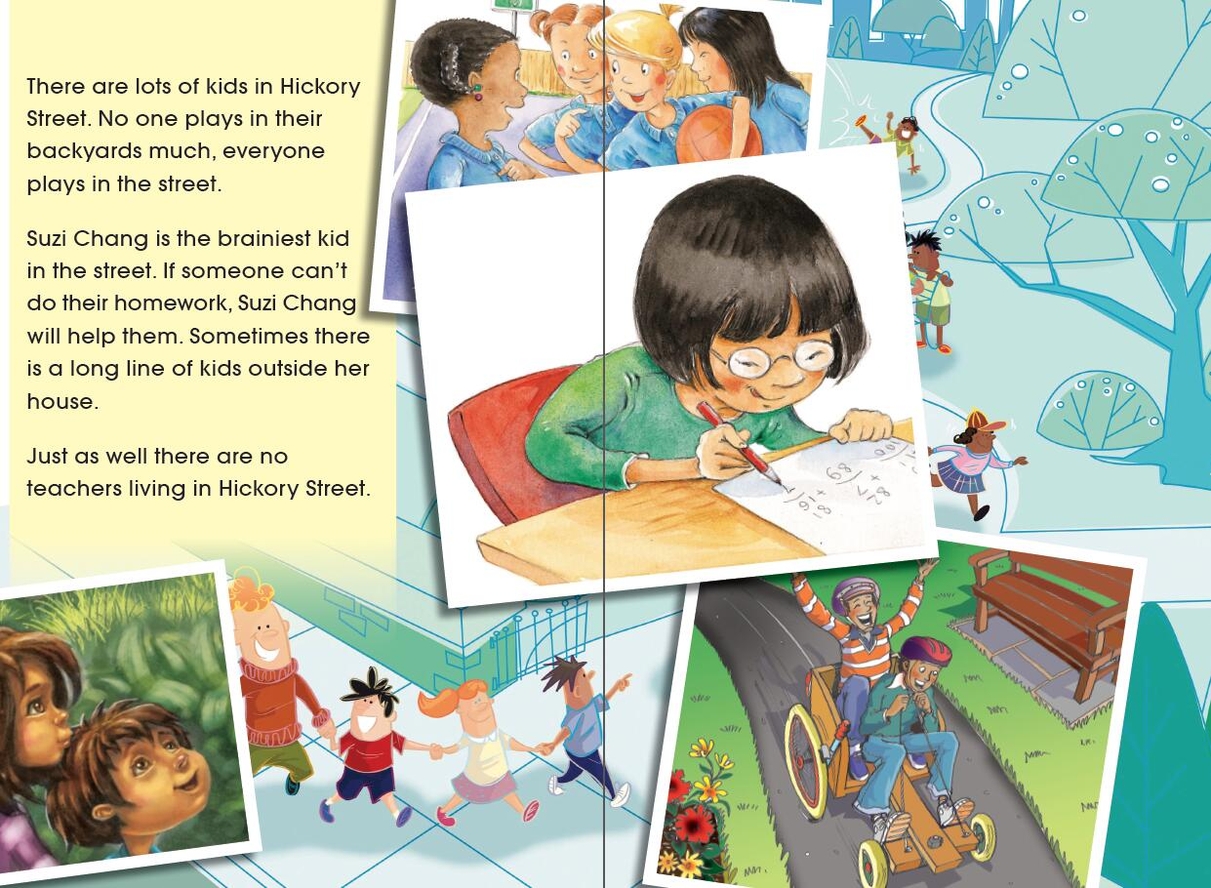
1. Why do you think the kids don’t play in their own backyards much?
2. How would you describe Suzi Chang?

Slide 19
Read & Fill
Character | How the character looks like | What his / her personality is like | What he/she likes or dislikes | What he/she does
Mr Nelson | has a smile as wide as the Mississippi River | kind and outgoing | laughing and telling jokes | sometimes has a street party…
Mrs McFee | dresses like a queen; shiny handbag and shoes; colorful hats | fussy |  | goes striding down the street every day
Pop Painter | an old man who has gone bald; has big bushy eyebrows |  | being old and reading books | reads books all day
Louise East | tall and slim; wears amazing clothes | cool | doesn’t eat junk food
Mrs Maka |  |  | loves her hometown and doesn’t want to leave it | makes bowls from clay
Mrs May | eyes flash like neon lights |  | telling stories; baking cakes and giving them to all the people in the street; making jewellery | tells stories; bakes cakes; makes jewellry
Suzi Chang | short hair; wears glasses | brainy and helpful |  | helps the kids in the street do homework

Slide 20
Read & discuss: detailed information
Mr Nelson
Mrs McFee
The People of Hickory Street
Louise East
Pop Painter
Mrs May
Mrs Maka
Suzi Chang

Slide 21
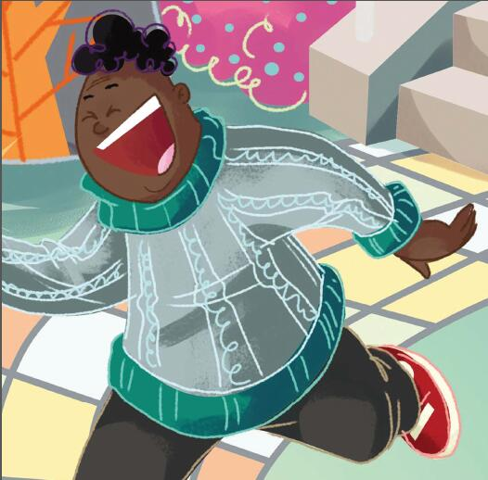
1. How does the author describe Mr Nelson’s smile?
2. Would you please act it out?
Notes:
Mr. Nelson’s smile is as wide as the Mississippi River.

Slide 22
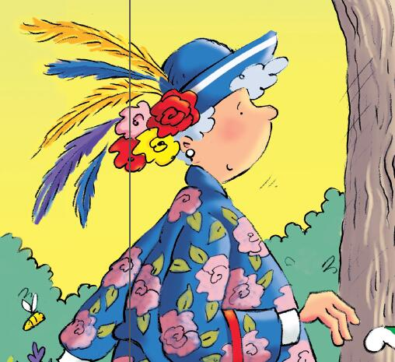
What is another word for striding?
2. What is another word for cargo?
3. How do you know Mrs McFee has a lot of hats?
4. How do you know it is an exaggeration?
Notes:
Walking
Boat
3. She has enough hats to sink a cargo boat.
4. Because even lots of hats cannot sink a cargo boat.

Slide 23
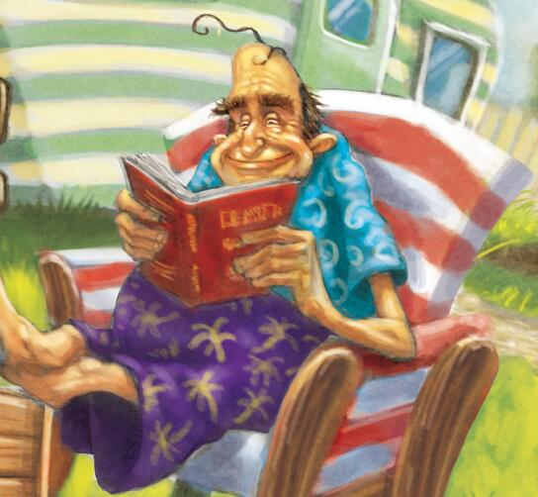
How do you think he makes his eyebrows go up and down?
2. What does Pop Painter mean by ”keep your brain from going mushy”?
Notes:
1. His eyebrows go up and down like a wave.
2. He wants to keep his brain working all the time.

Slide 24
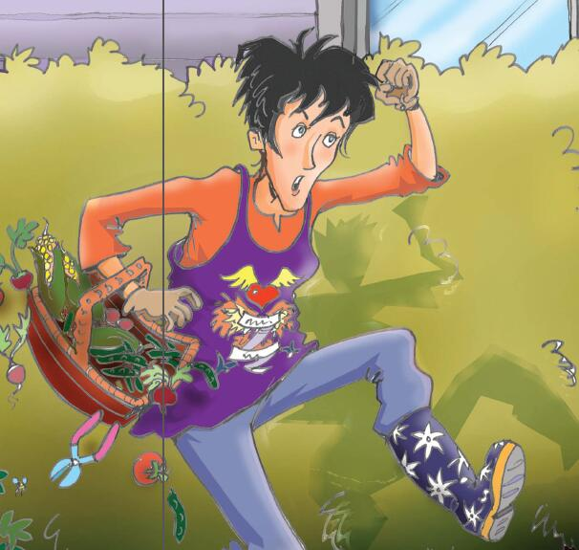
1.What is another word for slim?
2.What is another word for amazing?
3.Which sentence is an exaggeration? Why?
Notes:
Thin
Fantastic
Whenever you see her, she looks as if she has just walked out of a magazine of film stars. Because the sentence stretches what is true.

Slide 25
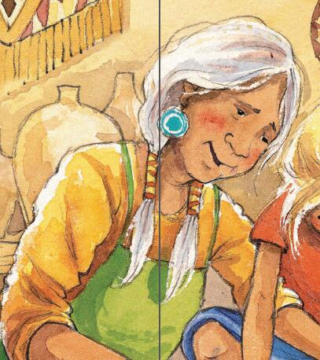
What word (adjective) could you use to describe something about Mrs Maka?
2. What is meant by “wild horses won’t be able to drag me away”?
Notes:
Famous
Mrs Maka loves her hometown very much and doesn’t want to leave it at all.

Slide 26
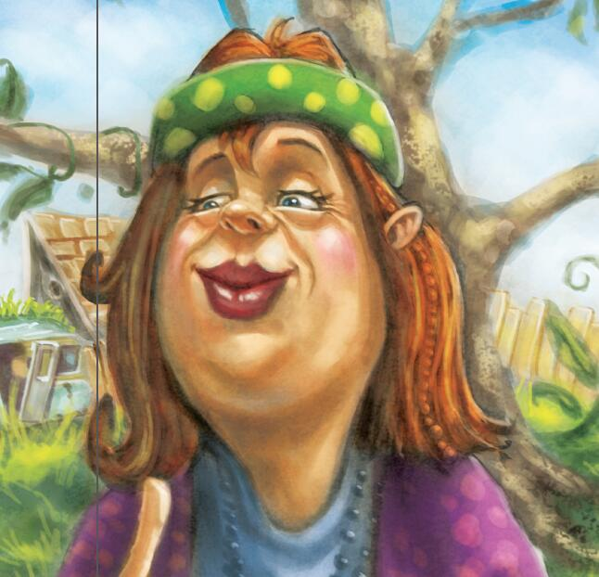
What else could “eyes flashing” be compared to?
Notes:
Shining stars

Slide 27
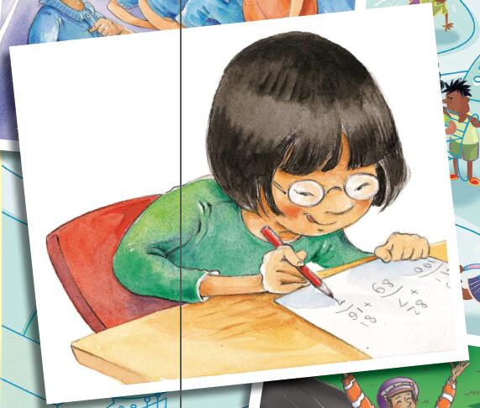
1. What is another word for brainiest?
2. Suzi Chang is brainy but how else might you describe her?
Notes:
Cleverest/ smartest
Helpful

Slide 28
Discussion
Do you think the people of Hickory Street are interesting? If your answer is yes, then what makes them interesting?
What do you think it means by “Just as well there are no teachers living in Hickory Street”?

Slide 29
Let’s interview.
Notes:
图片来自网络www.collegesisley.fr

Slide 30
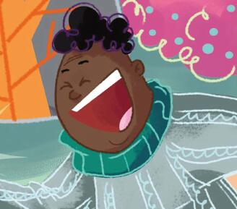
Interviewer: Hello, Mr Nelson.
I love your smile very much. Could you tell me something that you like to do in your spare time?
Mr Nelson: …
Interviewer: …
Mr Nelson: …

Slide 31
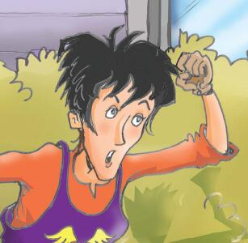
Imagine you are …
Please introduce yourself to the interviewer.

Slide 32
Reflection（反思）
After reading the story, what do you think of the people of Hickory Street?
Would you like to live in Hickory Street and why?
Notes:
In Hickory Street different people live in different houses and do different things every day.
They help each other and live a harmonious life.

Slide 33
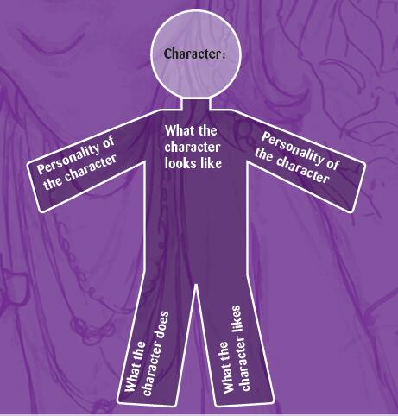
Homework
Tell the story “People of Hickory Street ” to your parents.
Choose a person you know or have read or heard about and try to describe him or her.
Notes:
图片出处

