Slide 1
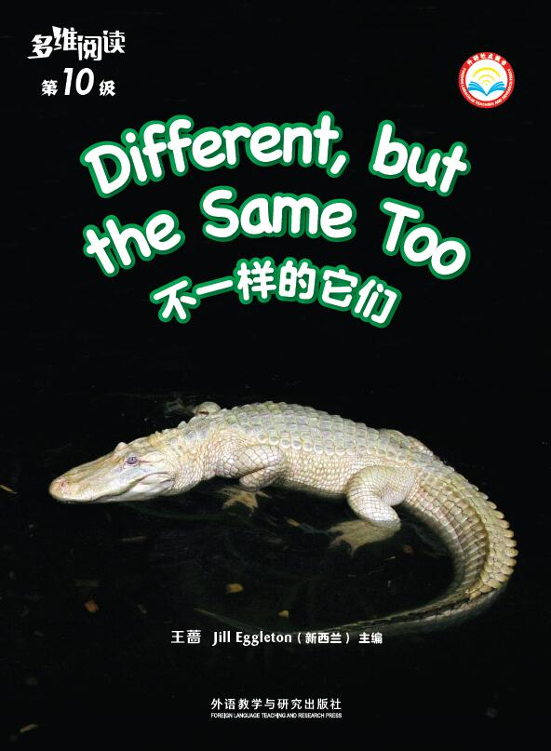
Different, but the Same Too
不一样的它们
选自《多维阅读第10级》

Slide 2
1. What can you see on the cover?
2. What’s the title and what information do you think the photograph is telling you?
3. What do you want to know from this book?

Slide 3
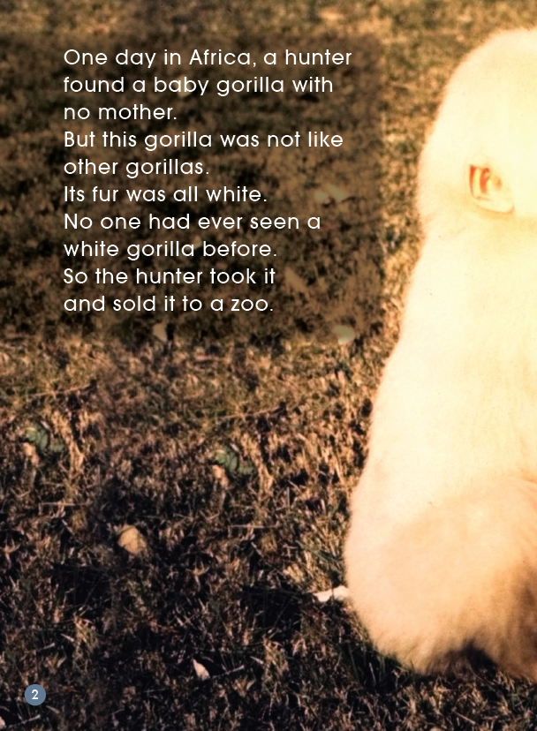
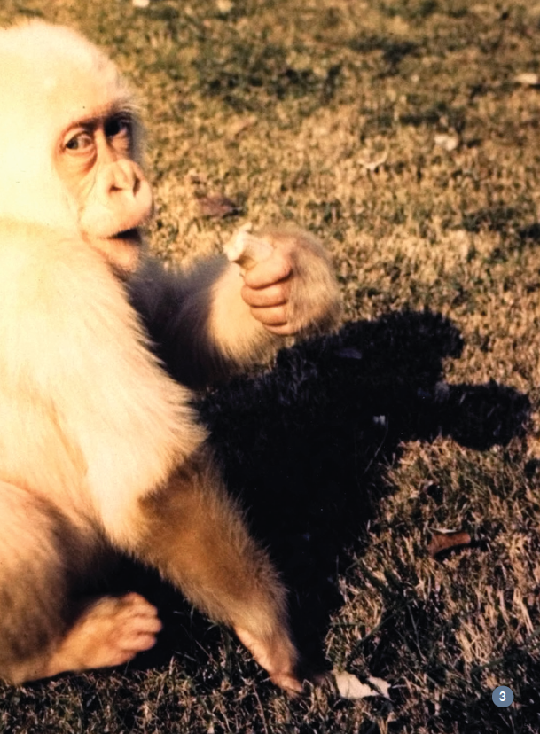
1. What do you notice about this baby gorilla?
2. Read the page by yourself and find out why this gorilla is different.
3. Why do you think the baby gorilla had no mother?
4. What did the hunter do to the gorilla?
5. Why do you think he took the baby gorilla to the zoo?
6. Do you think the hunter should take the baby gorilla to the zoo? Why/Why not?

Slide 4
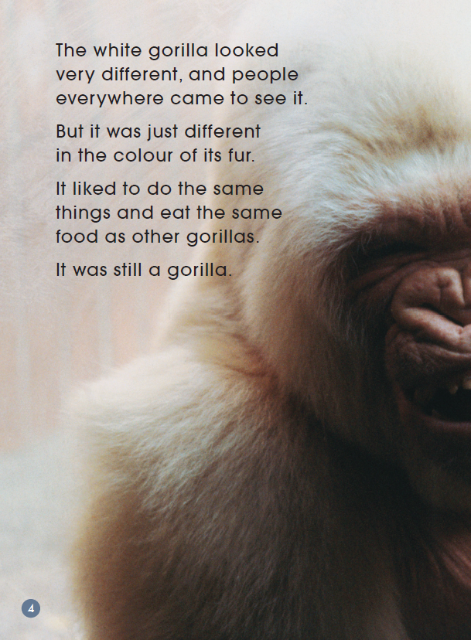
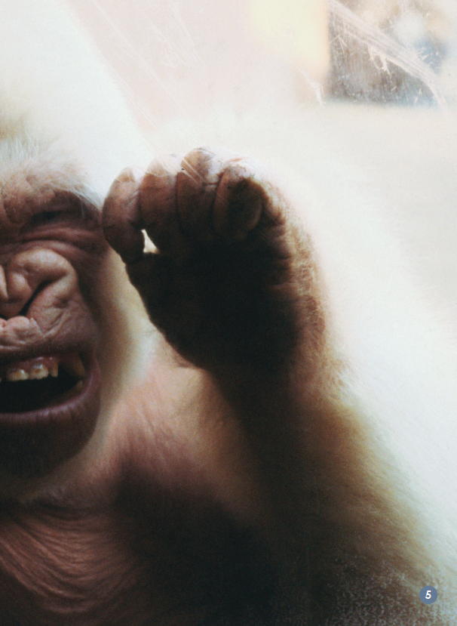
1. What was one thing different about this gorilla? Find the words that tell you.
2. What things about this gorilla were the same as other gorillas? Find the words that tell you.
3. Why do you think people from everywhere came to see it?
4. What do you think “It was still a gorilla” means?

Slide 5
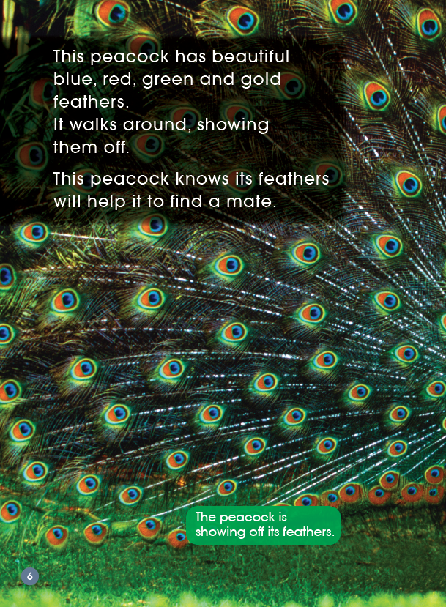
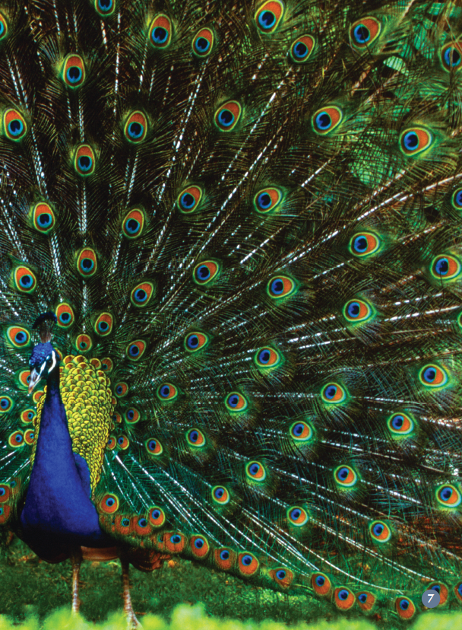
1. What do you know about peacocks?
2. What words might you use to describe its feathers? What colours can you see in the peacock’s feathers?
3. What does the peacock use its beautiful feathers for? Find the words that tell you.

Slide 6
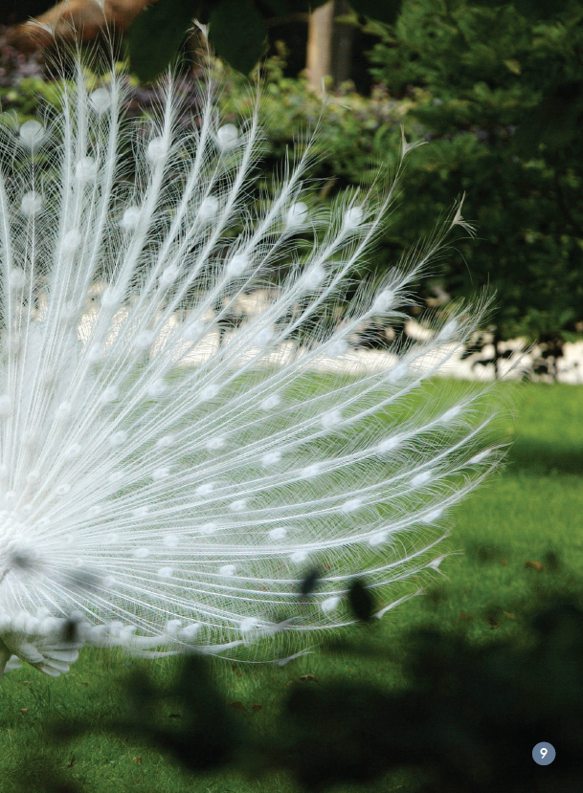
1. What is different about this peacock?
2. What words would you use to describe this peacock’s feathers?
3. Which words tell you how this peacock is the same as other peacocks?

Slide 7
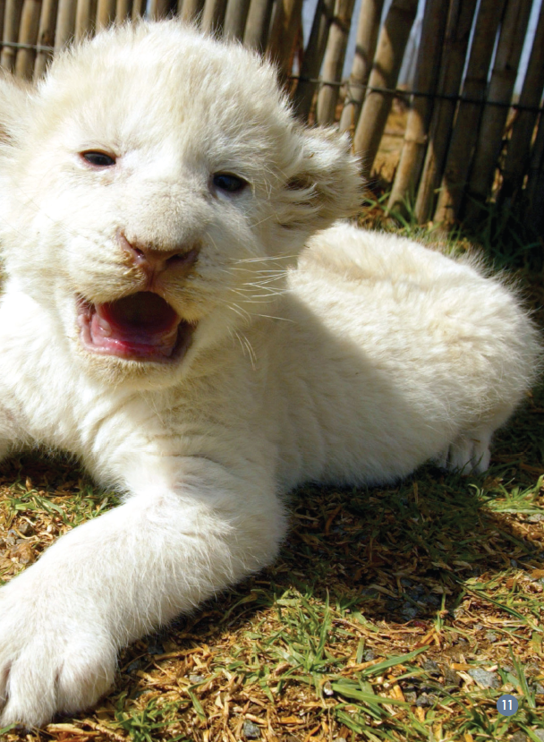
1. What do you notice about the lion in the left photograph?
2. What is different about the lion in the right photograph?
3. Do you think the colour of fur is important to lions? Find the words that tell why you think that.
4. Why would a lion not want to be seen? Do you think a lion with white fur is safe in the wild? Why/Why not?

Slide 8
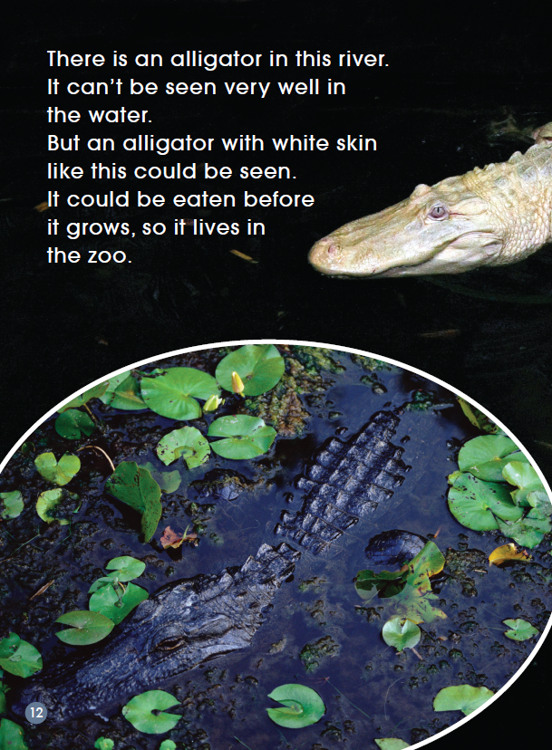
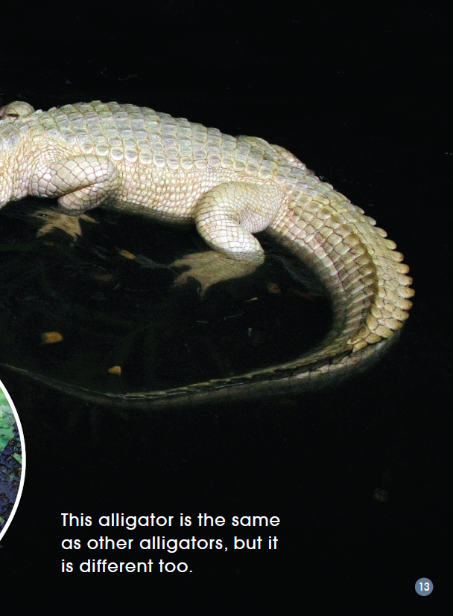
1. Look at the alligator in the inset photograph. What makes it hard to be seen? Do you think this is a good thing?
2. What is different about the alligator in the right photograph?
3. What is the problem this white alligator has? How can this problem be solved? Find the words that tell you.

Slide 9
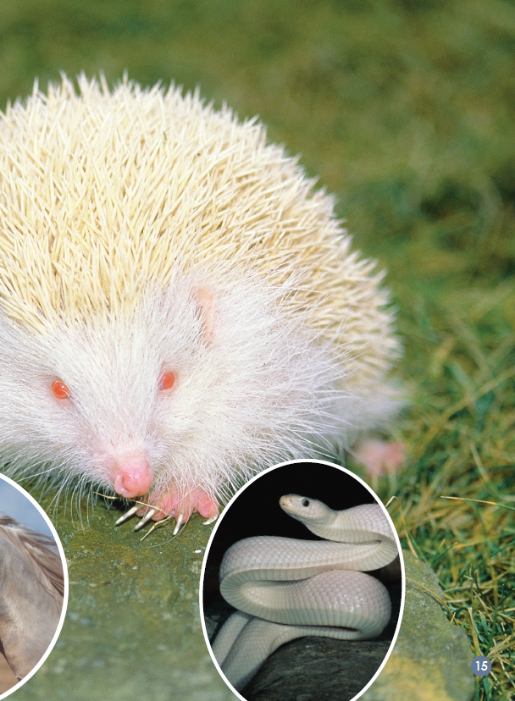
1. What do you notice about all these animals?
2. Which words describe how albinos look like?
3. Which words tell you there is not just one group of animals that have albinos?
4. What can be the problem for albinos? How to solve the problem?

Slide 10
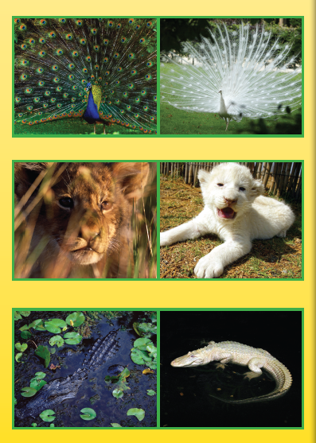
What have you learnt from this book?
1. What information does this book give you?
2. Why did the writer write this book?

Slide 11
请将下面的信息图填写完整，然后模仿该范例，选择一种自己感兴趣的动物，了解该种动物是否存在白化现象，将获得的信息通过图表呈现。

Slide 12
Thank you!

