Slide 1
The Stars Above
仰望星空
选自《多维阅读第10级》

Slide 2
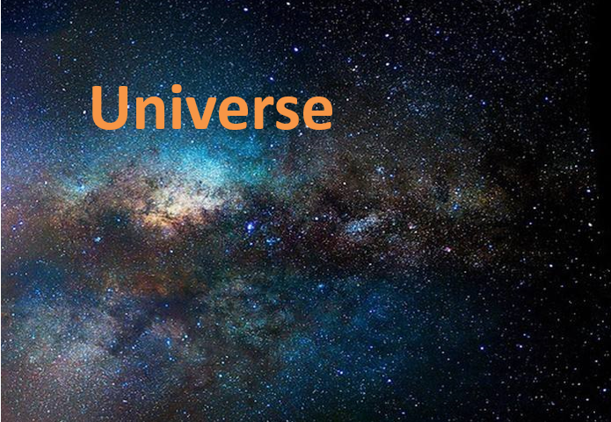
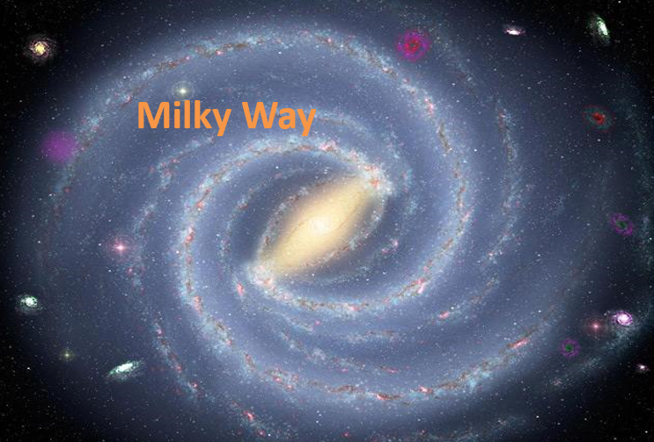
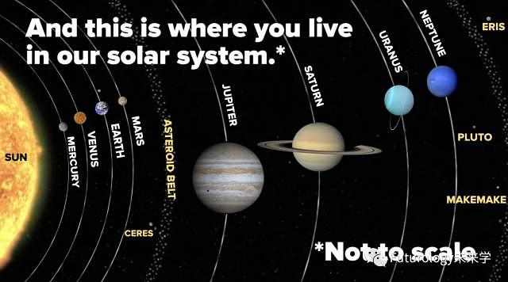
Earth
Notes:
T: We know the earth is the home for human. Look at the second picture, and this is where you live in our solar system. Beyond the solar system is the Milky Way Galaxy and then is Universe.

Slide 3
What can you know from the cover?
Notes:
T:1. What’s the name of the book？
2. What’s the title? Who’s the author?
3. What can we know from the cover?

Slide 4
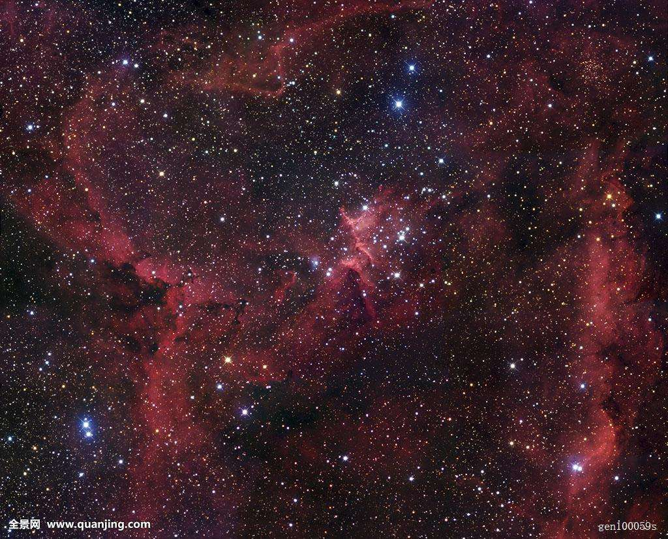
Put the stars in order according to how hot they are.
Notes:
T：We know that stars give light and that they can be blue, white, orange and red.

Slide 5
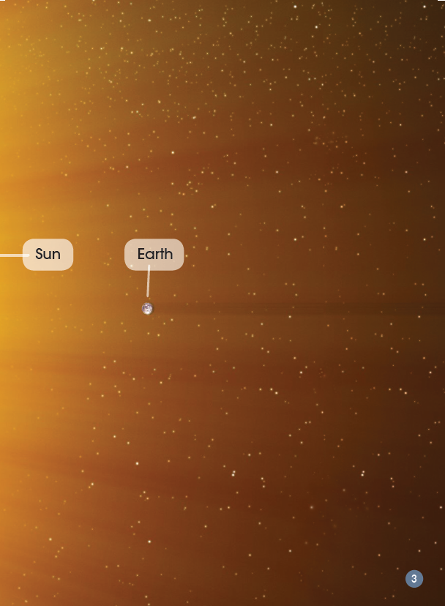
Notes:
Ok, let’s check the answer, maybe it’s different from your thinking… And in this book we will learn more interesting things. Now let’s read the book together.

Slide 6
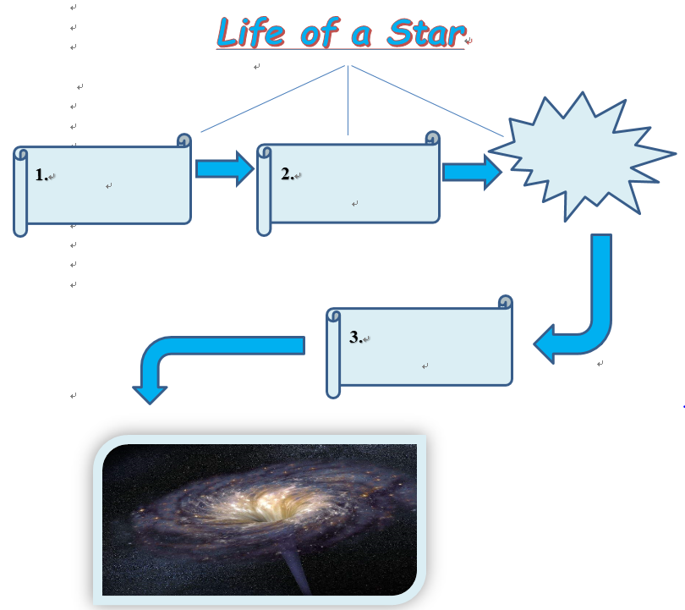
Read and Write
Notes:
Please read the book P4-9 and find out: What are the stages in a stars life? Finish the mind-map.

Slide 7
explode
born
get older
die

Slide 8
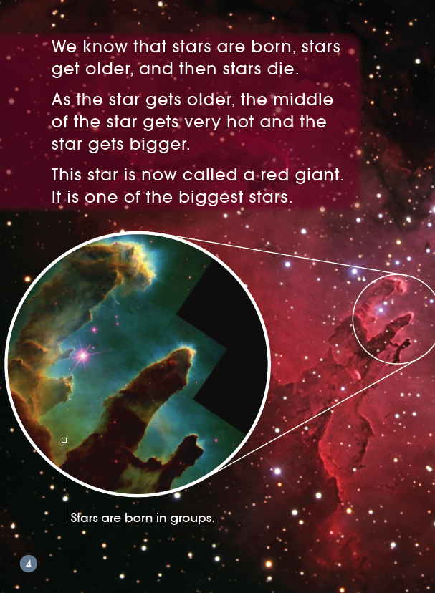
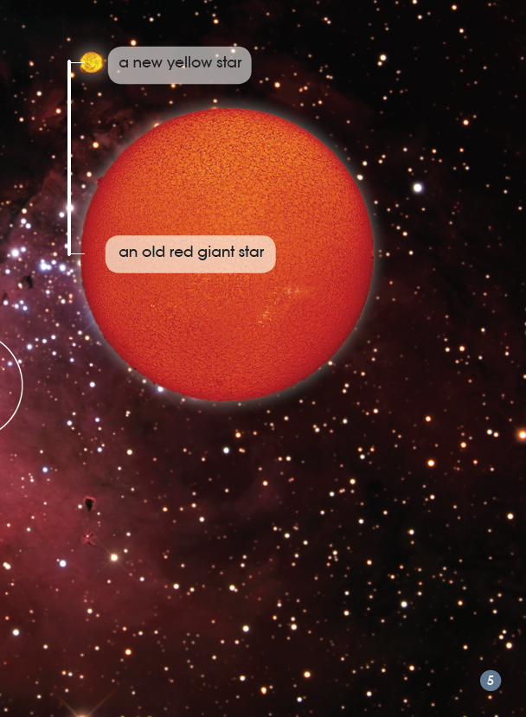
What will happen to the star as it gets older?
Notes:
What happens to the star as it gets older? Read the words that tell you?
Do you think the red giant is a good name for this star? Why?

Slide 9
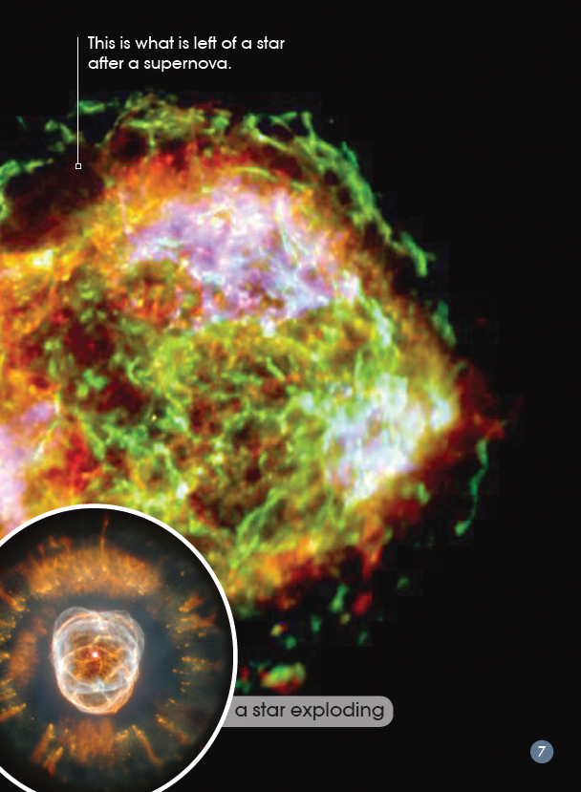
How do you know the explosion is the end of the star?
What is something you can guess about a supernova?
Notes:
What does explode mean? How do you know that?
In the word supernova there is the word super. What is something you can guess about a supernova?
What words tell you how bright the light from a supernova is?

Slide 10
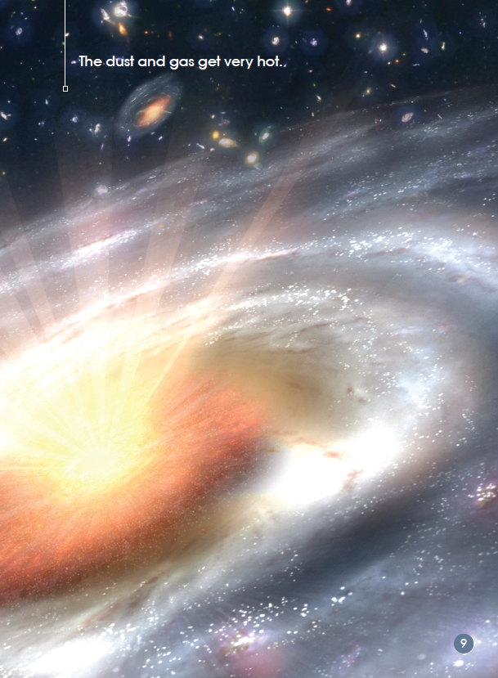
（explode）
Notes:
What makes the black hole? Read the words that tell you?
How do you know that if something goes into the black hole, it is gone forever? Please read the sentence out.
The first photograph shows dust and gas swirling around. What does swirl mean?

Slide 11
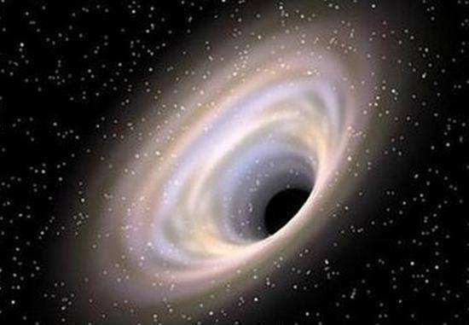
the black hole
Why do you think it is called a black hole?
Notes:
This photograph is showing a black hole and what happens around a black hole. Why do you think it might be called a black hole?

Slide 12
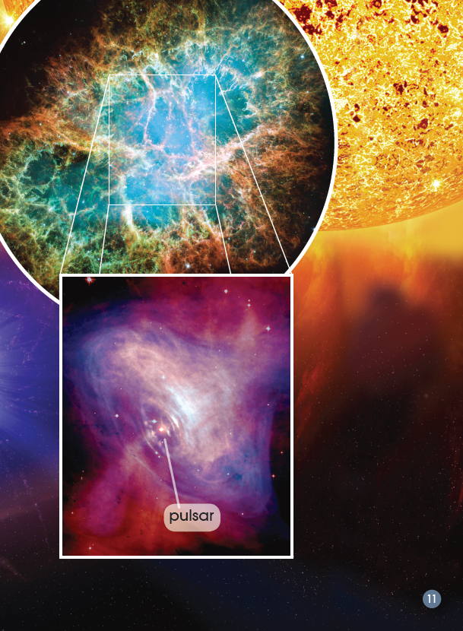
How do you know some people didn’t know about pulsars?
Notes:
How do you know some people didn’t know about pulsar? Read the words that make you think this?
Why do you think they might have thought they were aliens?

Slide 13
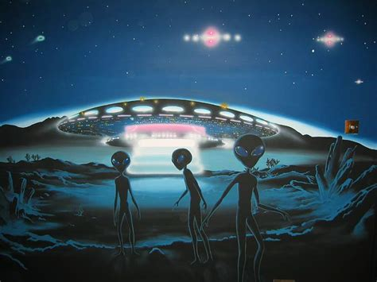
aliens

Slide 14
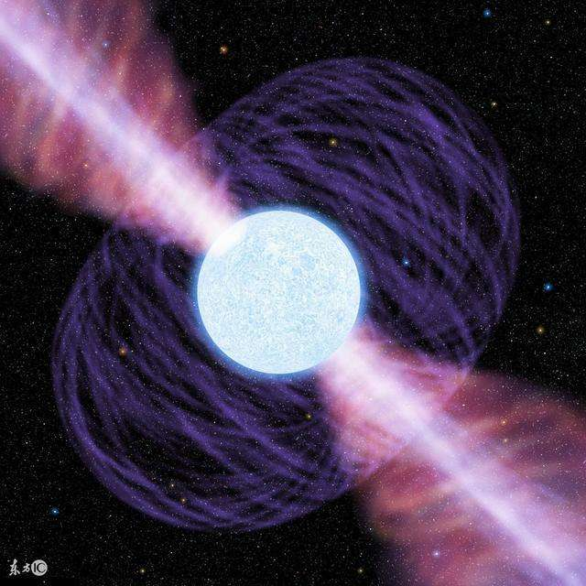
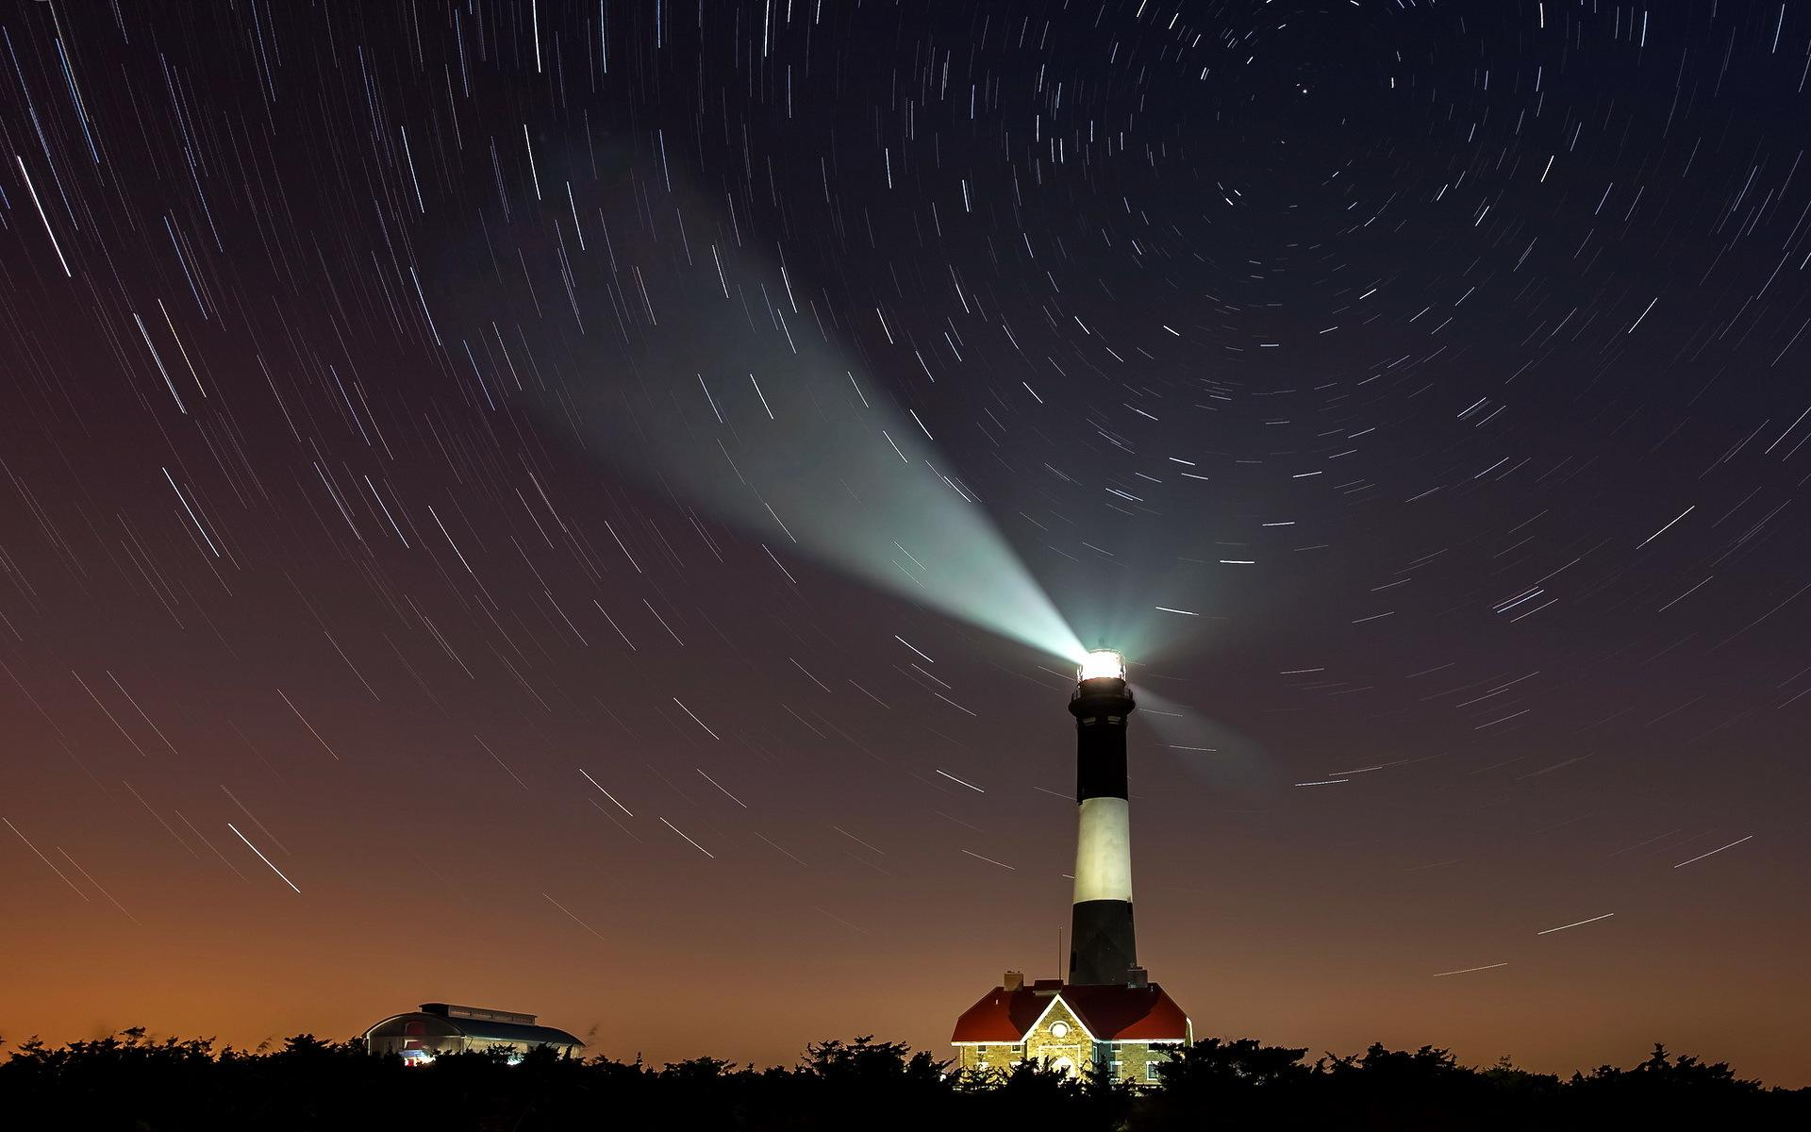
pulsar
lighthouse
Notes:
Small stars that spin fast and flash out light like a lighthouse are called pulsars.

Slide 15
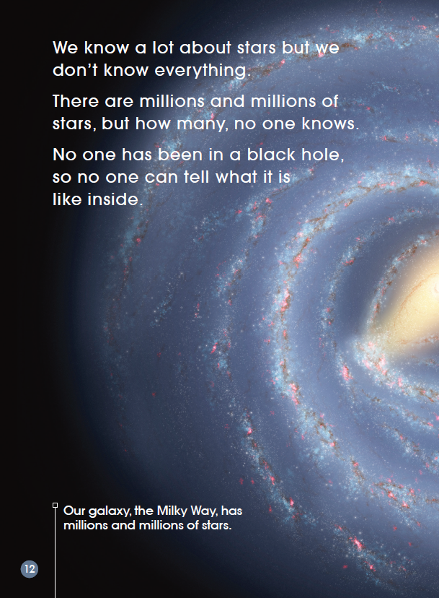
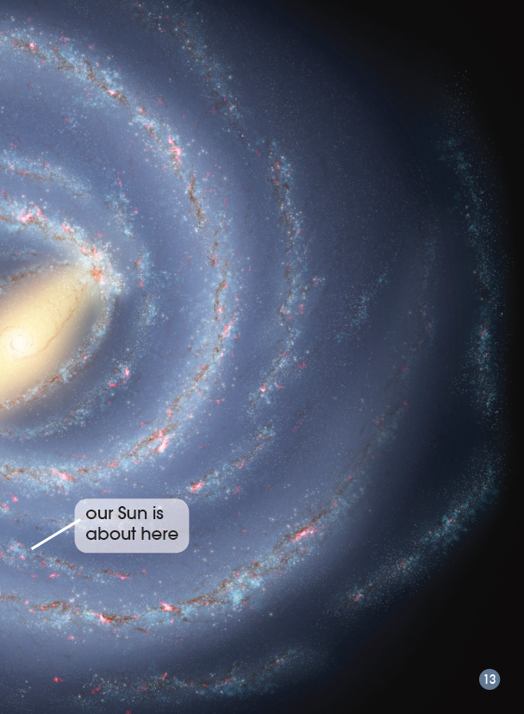
Milky Way
Why do you think it is called the Milky Way?
Why do you think no one knows how many stars there are?
Notes:
Who has seen the Milky Way at night or in other books?
Why do you think it might be called the Milky Way?
Why do you think no one knows how many stars there are? Find the words that might make you think this.

Slide 16
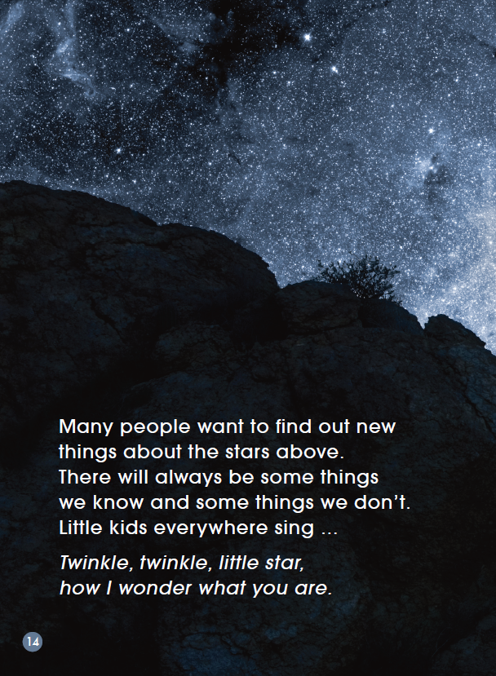
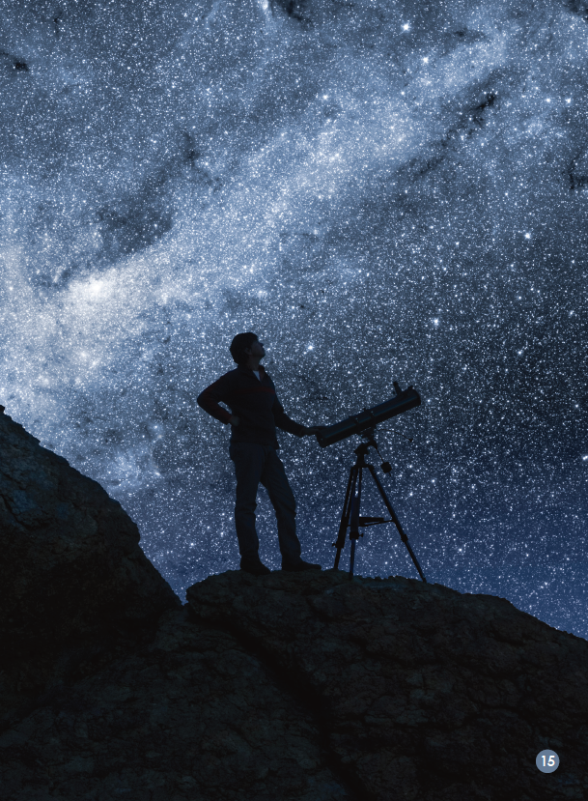
What do you think when you see this photograph?
?
Notes:
What do you think when you see this photograph?
Do you think one day people will know everything about the stars? Which words make you think of this?
What does the second sentence mean?
Read the nursery rhyme out loud together .Why do you think people wonder about the stars? What would you really like to know about stars that you don’t know now?

Slide 17
Listen & Repeat

Slide 18
Quiz Show
1. The hottest kind of star is red.
(F)

Slide 19
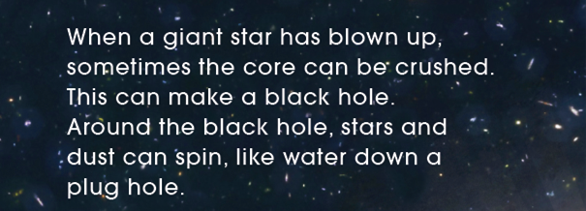
Quiz Show
2. When a star explodes, it always makes
a black hole.
(F)

Slide 20
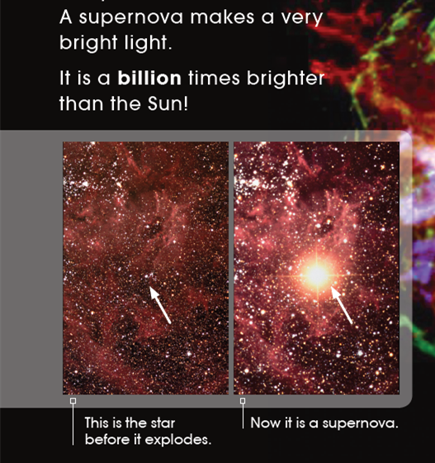
Quiz Show
3. A supernova makes a very bright light.
(T)

Slide 21
Quiz Show
4. What goes into the black hole cannot
come out again.
(T)

Slide 22
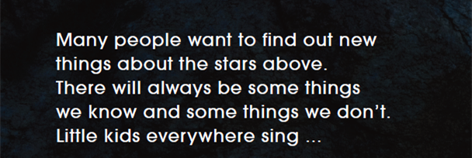
Quiz Show
5. We know everything about the stars above.
(F)

Slide 23
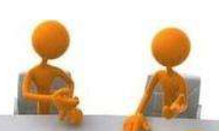
Choose one object in this book (e.g. black hole) you are interested in and introduce it to your partner.

Slide 24
Read the nursery rhyme out loud together.
Why do you think people wonder about the stars? What would you really like to know about the stars that you don’t know now?
If one day, the Earth was destroyed, where could we live? Why?
Notes:
延展思考：Read the nursery rhyme out loud together .Why do you think people wonder about the stars? What would you really like to know about stars that you don’t know now?
If one day, the Earth is destroyed, where could we live? Why?

Slide 25
Homework
Draw your favourite object in this book and write something about it. Then introduce it to your friends.

