Slide 1
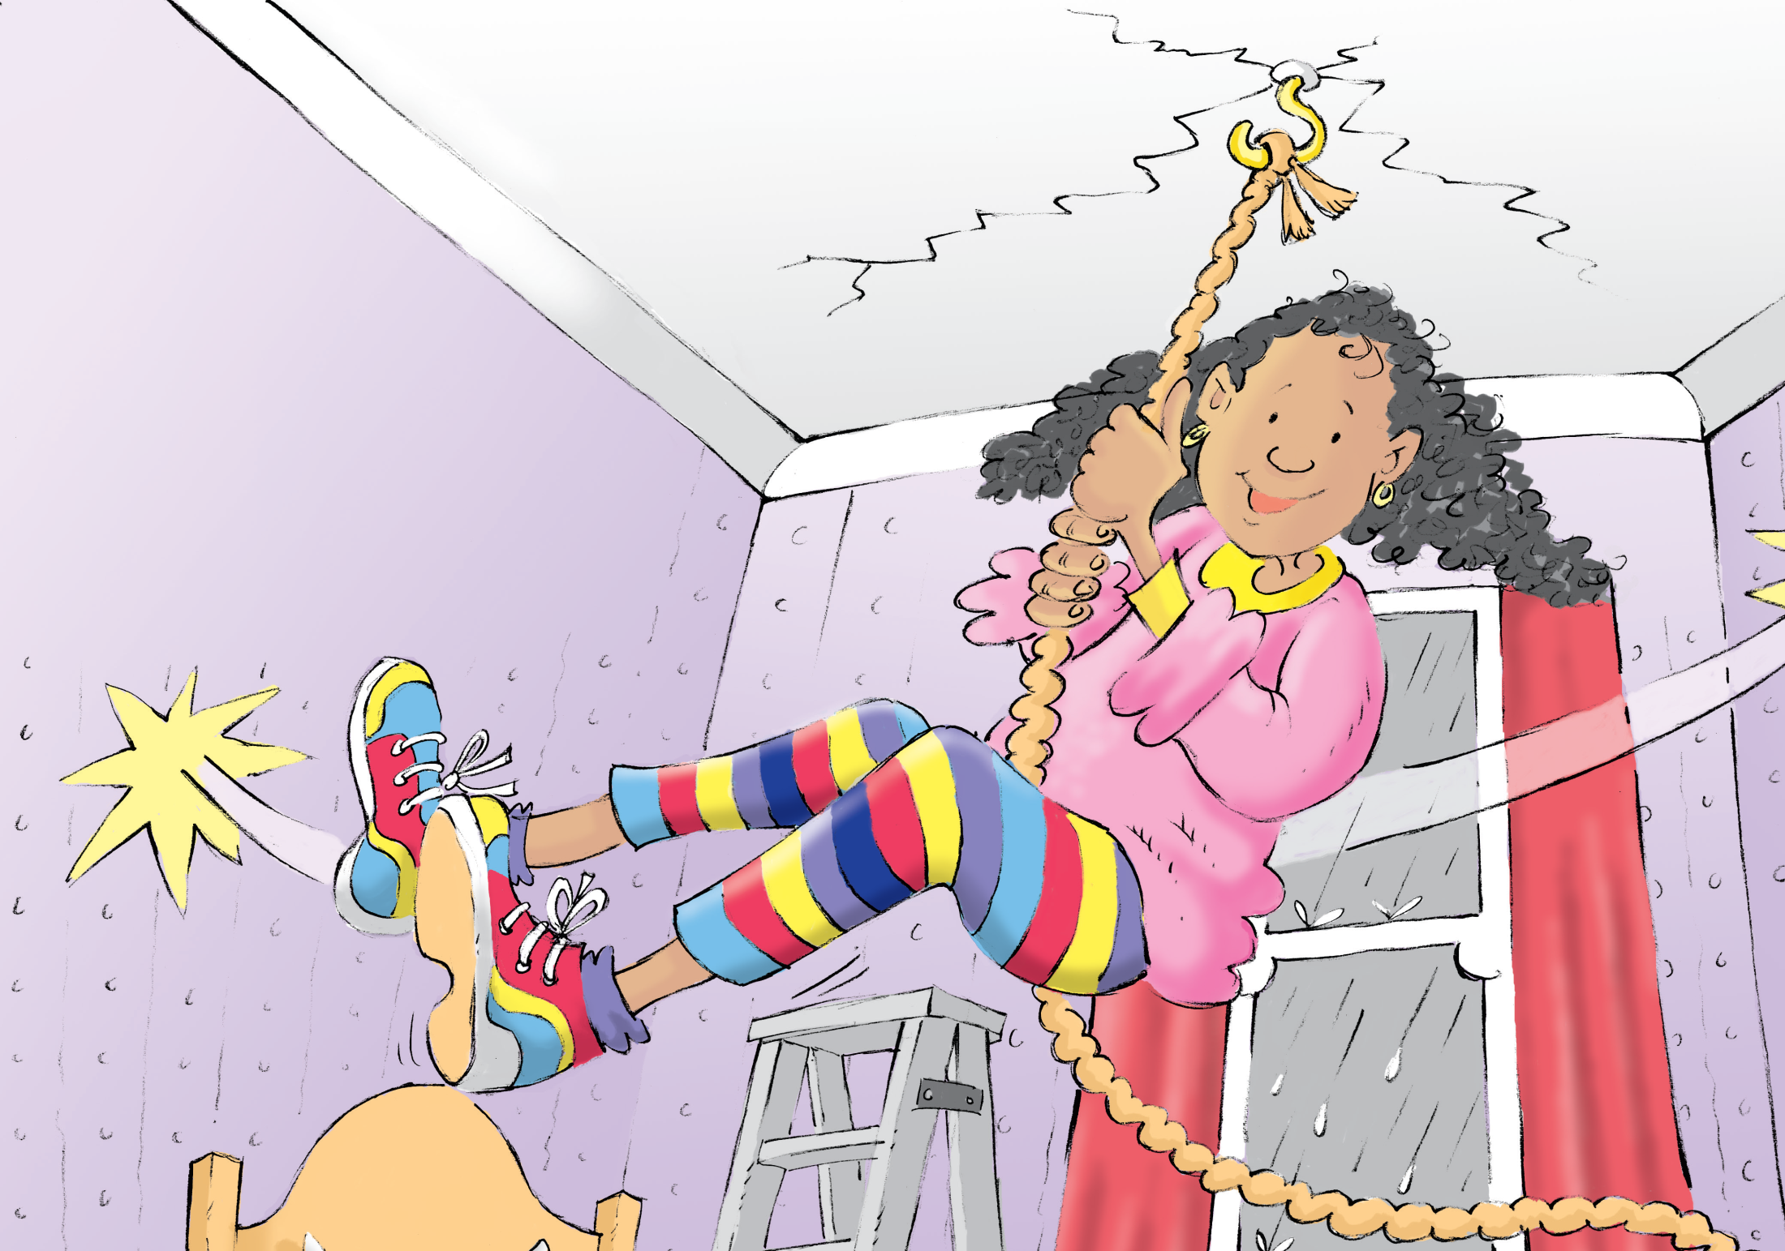
The Bedroom Swing
卧室里的秋千
选自《多维阅读第10级》

Slide 2
Read the Cover
What can you see from the cover?
What is the girl doing?
Why is she playing swing in her bedroom?
Notes:
学生阅读书图书封面并回答老师提出的问题。
提问建议：
1. What can you see on the cover?
2. What is the girl doing?
3. Why is she playing swing in her bedroom?

Slide 3
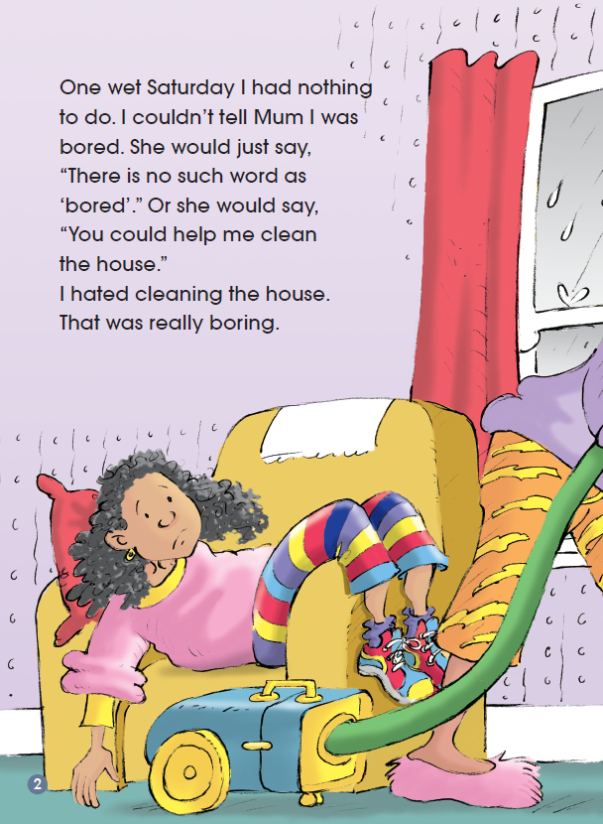
Read and Answer
What did the girl think of cleaning the house?
Can you guess what the girl would do later?

Slide 4
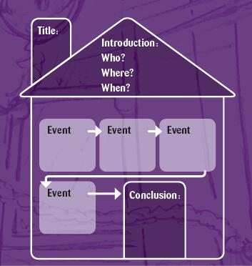
Read and Finish the House Graphic.
Notes:
学生自主阅读全书，完成表格。并在小组内交流所填表格。

Slide 5
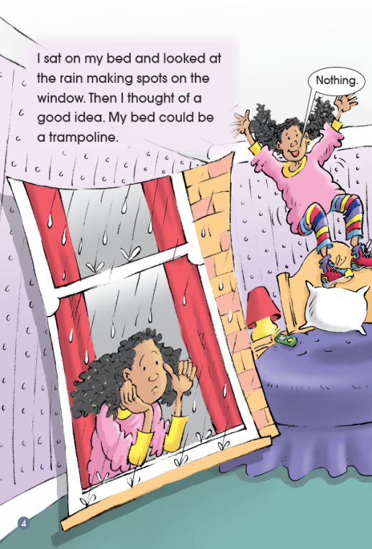
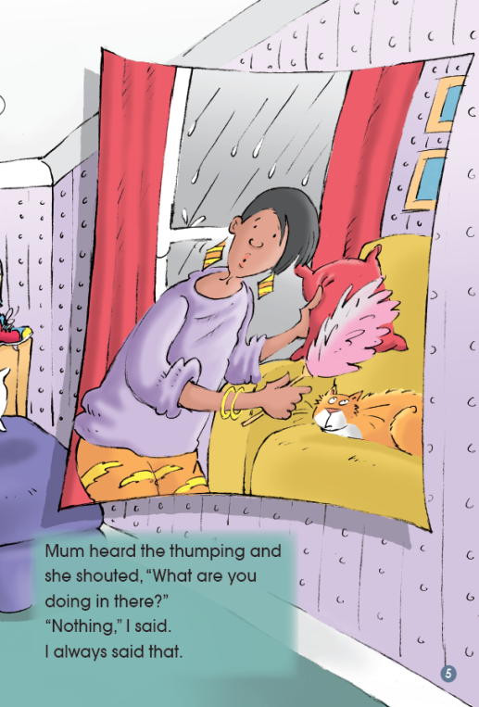
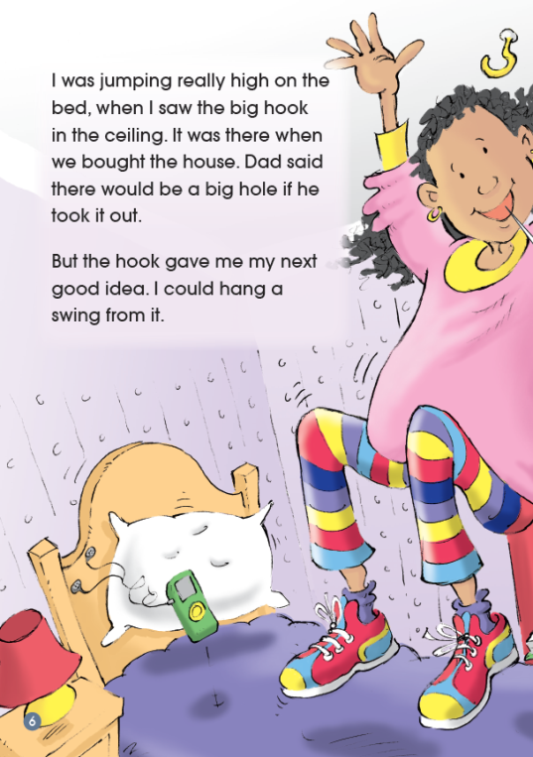
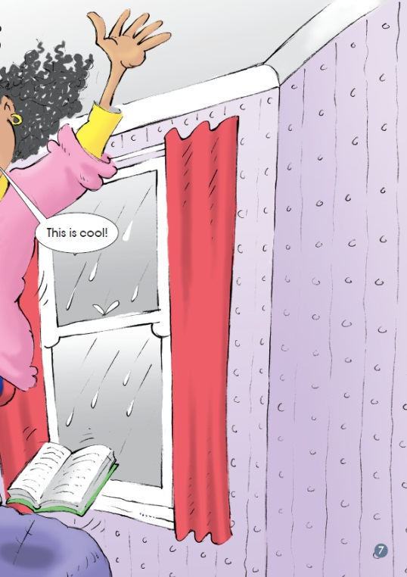
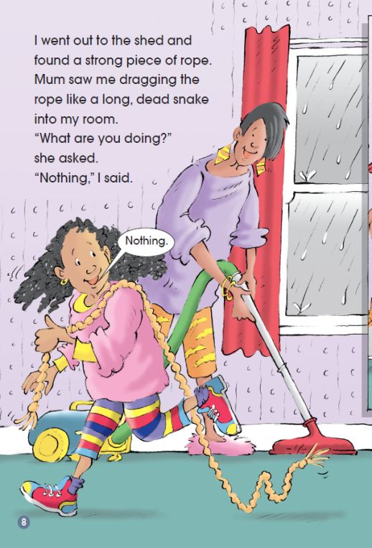
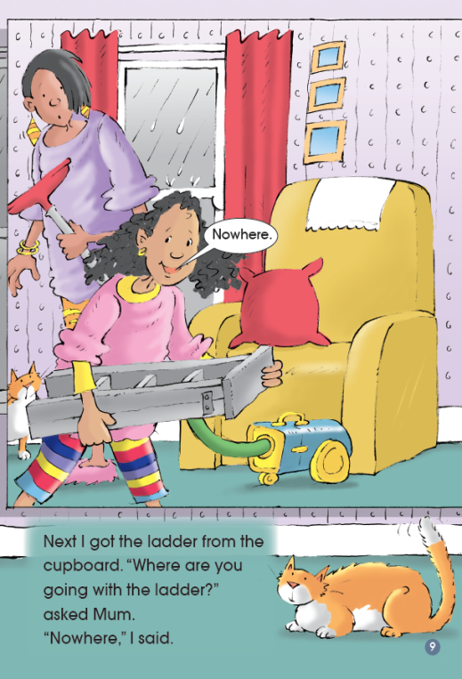
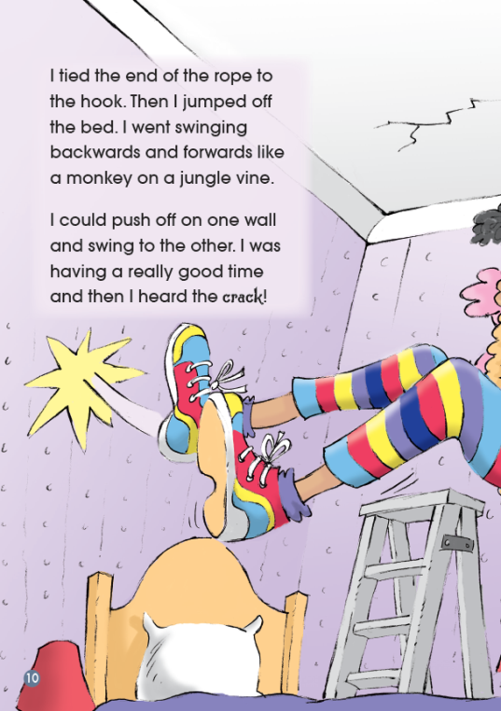
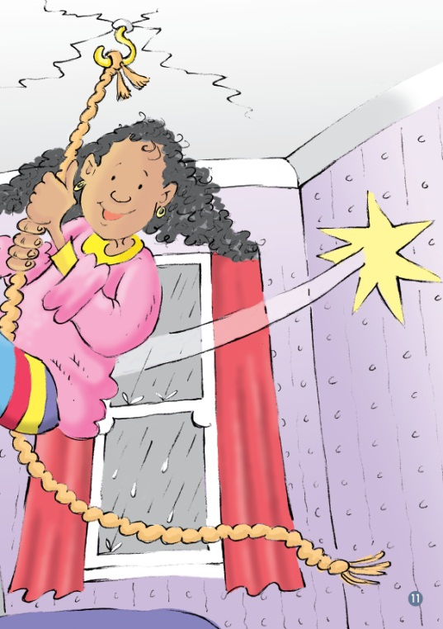

Slide 6
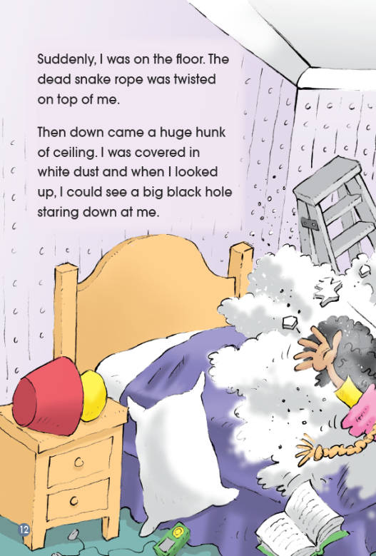
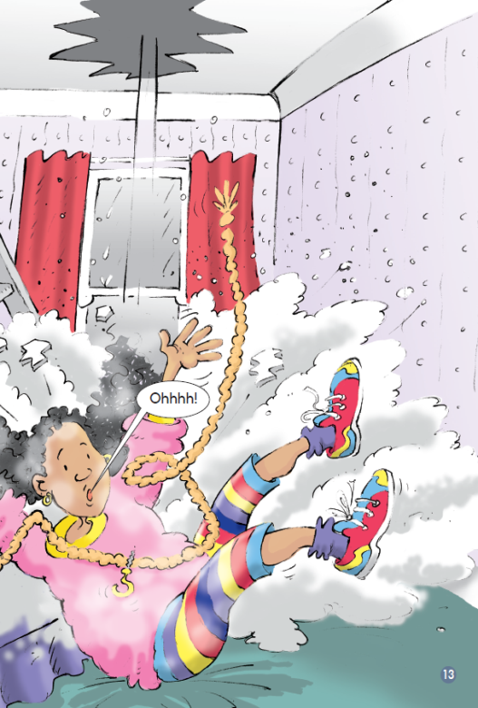
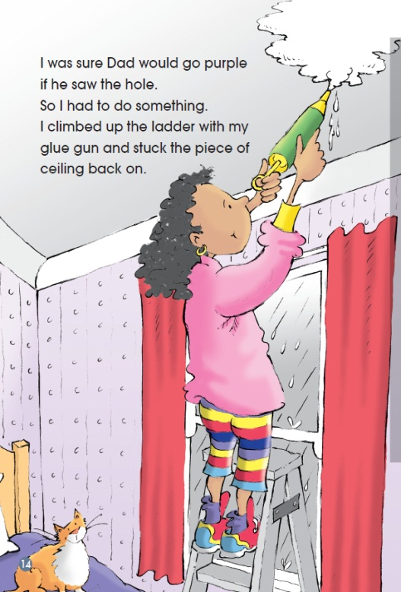
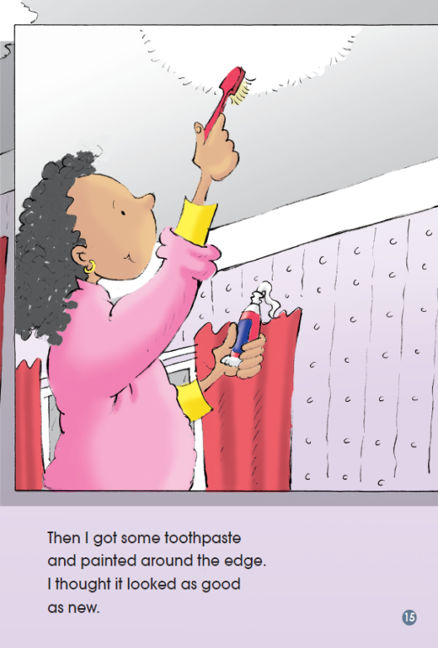
Discuss and Answer
1. What did the girl think after she fell down on the floor?
2. What did she do?
Notes:
引导学生推断和分析女孩心情有所变化的主要原因。

Slide 7
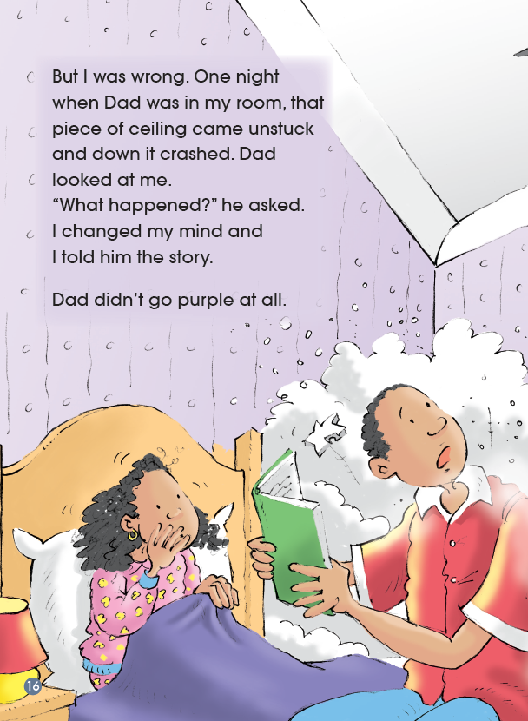
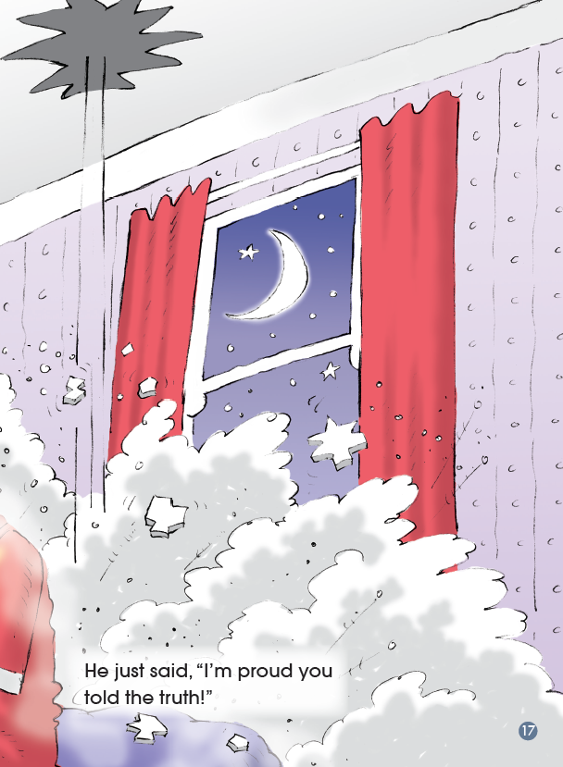
Discuss and Answer
Why did the girl decide to tell his father the truth?

Slide 8
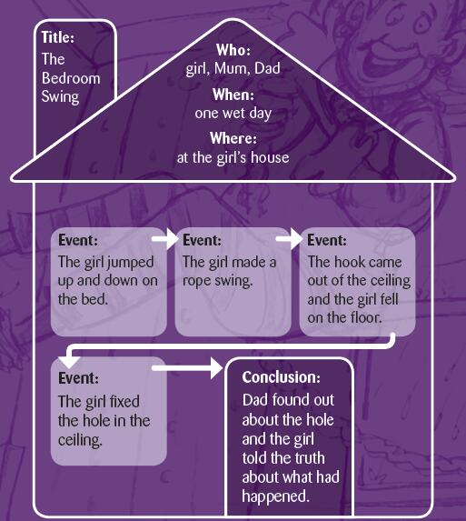
Retell the Story
Notes:
学生利用自己填的表格口头讲述故事。

Slide 9
Passage Person
Character Captain
Introduce the story
Ask detail questions
Analyse the girl’s personality
Reading Circle
Creative Connector
Moral Master
Share similar experiences
Provide solutions to the problem in the story
Notes:
学生根据教师创设的情境和任务选择自己在阅读圈活动中的角色和任务。
学生四人一组为单位，每个人承担阅读圈活动中的一个角色，在小组内进行交流；之后，所有同样角色的学生聚在一起，形成专家组进行讨论；最后进行阅读圈的小组展示。

Slide 10
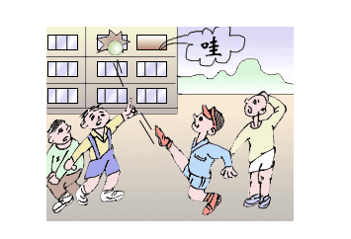
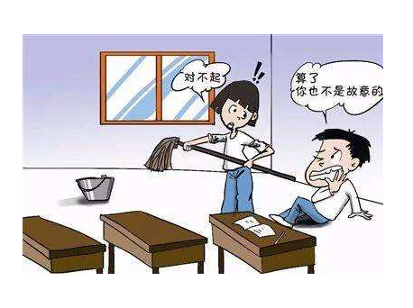
Discuss
How can you explain to your parents when you make troubles at school?
Notes:
学生在教师的引导下总结在学校生活中如果发现自己闯祸之后该如何向父母解释。

Slide 11
Homework
1. Write down what we should do if we cause troubles or make mistakes.
2. Find some sayings about HONSETY.

