Slide 1
Climbing a Rock Wall 攀岩
选自《多维阅读第10级》

Slide 2
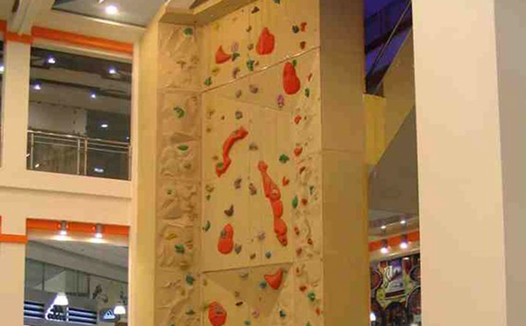
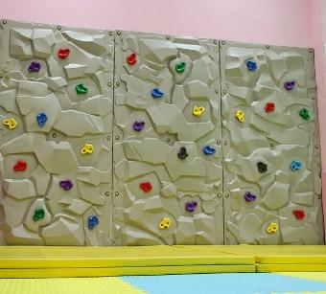
Have you ever gone rock climbing?
Notes:
1 感知注意 获取梳理
Activity 1 通过图片和问题，激活、补充有关攀岩的背景知识
学生观看老师展示的儿童室内攀岩照片，并回答老师的问题。
提问建议：
Have you ever been rock climbing? Where?

Slide 3
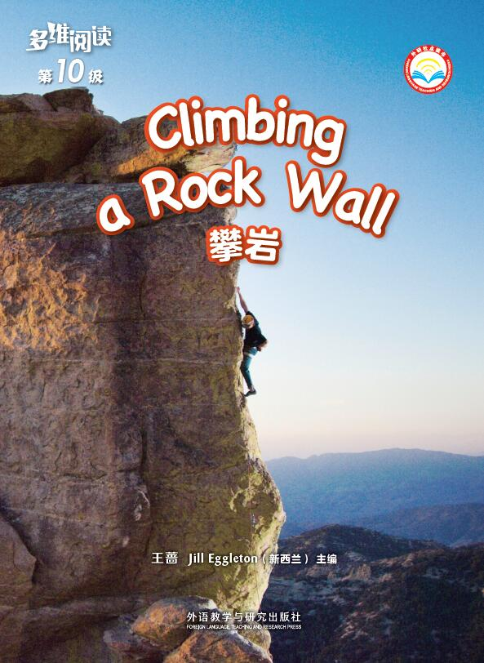
• What do you notice
in this photograph?
• What’s the title and what’s the meaning of the title？
• What do you want to know about climbing a rock wall?
Notes:
Activity 2 观察封面与目录，寻找感兴趣的问题
Step 1 关注封页与标题，熟悉主题
学生阅读书的封面，并回答老师提出的问题。
提问建议：
1. What do you notice in this photograph?
2. What’s the title and what’s the meaning of the title？ (T explains the word “rock”.)
3. What do you want to know about climbing a rock wall?

Slide 4
Why do rock climbers use special gear?
Notes:
Activity 3师生共读6—9页，提取关键信息，通过思维图进行梳理与概括
Step 1 学生阅读6—9页并回答问题，分享答案。
提问建议：
1. What special gear do rock climbers need? Why?
2. What do you think you will find out about a rock climber’s shoes and helmet?
3. What other word could be used instead of sticky? How do you know the shoes are not heavy?

Slide 5
Notes:
提问建议：
1.What makes you sweaty? What happens when you get sweaty?
2.What other gear do you think could be on the climber’s belt?

Slide 6
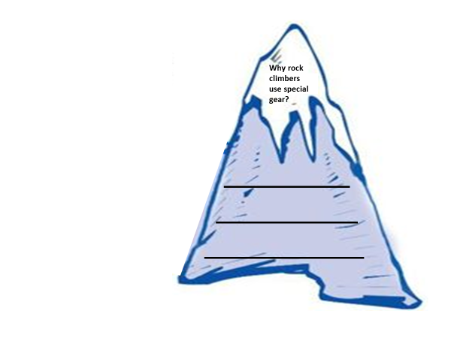
Answer the question according to what you have read.
Notes:
Step 2 梳理信息，完成思维图
在老师的帮助下，利用语境和图片猜测和学习相关生词。
学生基于对本部分文本的理解，填写为什么攀岩者需要穿戴特殊装备的思维图。

Slide 7
Let’s Do Jigsaw Reading!
Notes:
2 获取梳理 概括整合 描述阐释
Activity 1第一次分组阅读，通过思维图进行梳理与概括。

Slide 8
Questions
1. How do rock climbers climb?
2. Why do rock climbers use ropes?
3. Why do climbers need a partner?
4. How are climbing places different?
5. How can climbers keep themselves from getting hurt?
6. How can climbers get down?
Notes:
学生选择自己感兴趣的问题，组成阅读小组。小组共同阅读一个部分，提取信息，完成思维图。
第一组读2—3页“How Rock Climbers Climb”内容；
第二组读4—5页“Why Rock Climbers use Ropes”内容；
第三组读10—11页“Why Climbers Need a Partner”内容；
第四组读12—13页“How Climbing Places Are Different”内容；
第五组读14—15页“How Climbers Can Keep Themselves from Getting Hurt”内容；
第六组读16—17页“How Climbers Can Get Down”内容。

Slide 9
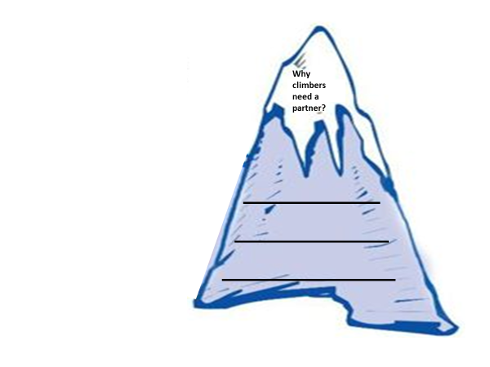
Complete one of the worksheets below according to what you have read.
Notes:
学生个体阅读后，组内交流阅读的收获，提取关键信息，完成各自的思维图。
如果有问题，学生可以问老师，也可以同学间相互讨论和帮助。
完成之后，小组内核对信息。
组内进行语言学习，保证每个学生对自己部分的语言都能够理解。

Slide 10
Let’s Do Jigsaw Reading!

Slide 11
Complete the worksheets below according to what your partner introduces.
Notes:
学生个体阅读后，组内交流阅读的收获，提取关键信息，完成各自的思维图。
如果有问题，学生可以问老师，也可以同学间相互讨论和帮助。
完成之后，小组内核对信息。
组内进行语言学习，保证每个学生对自己部分的语言都能够理解。

Slide 12
Notes:
Activity 3 阅读完整图画书，对文本进行排序
学生独立阅读完整图画书。

Slide 13
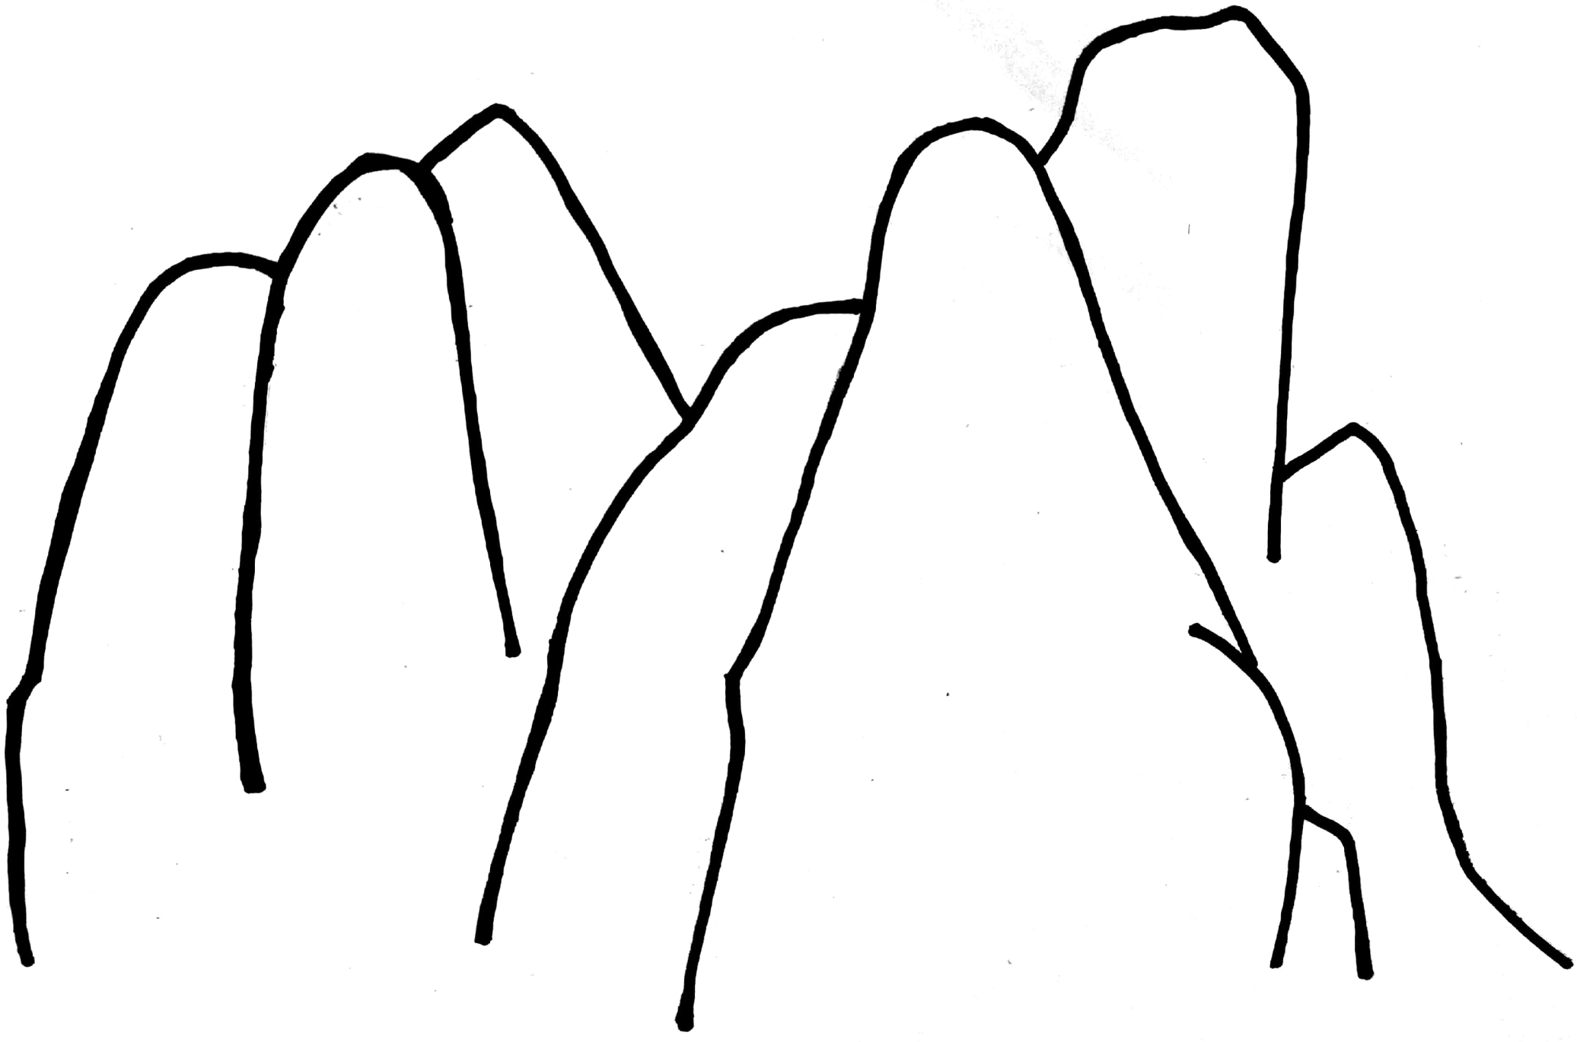
Order the seven parts and talk about your reasons. Write the numbers in.
How climbing places are different?
Why climbers need a partner?
Why rock climbers use special gear?
Why rock climbers use ropes?
How climbers can keep themselves from getting hurt?
How rock climbers climb?
How climbers can get down?

Slide 14
Let’s Say！
Choose one or more parts of Climbing a Rock Wall that you are interested in and retell.
Notes:
3 描述阐释 分析判断
Activity 1借助思维图，口头讲述攀岩活动的某一方面或几个方面
学生依据所梳理的思维图，运用所学习的词汇和表达方式，口头讲述攀岩活动的某一个方面或几个方面。
小组内复述后，选举代表在全班同学面前复述。
（学生选择哪部分进行复述，教师也相应点击PPT中相应部分）

Slide 15
How do rock climbers climb?

Slide 16
Why do rock climbers use ropes?

Slide 17
Why do climbers need a partner?

Slide 18
How are climbing places different?

Slide 19
How can climbers keep themselves from getting hurt?

Slide 20
How can climbers get down?

Slide 21
Why do people like to explore real rock places even though they are very steep?
Notes:
Activity 2 讨论攀岩活动吸引人的原因
提问建议:Why do people like to explore real rock faces even though they are very steep?

Slide 22
Think about the questions below.
Why does the author write this book?
2. What does the author intend to tell us?
3. What’s your opinion about the relationship between human beings and nature?
Notes:
4 分析判断 批判评价
Activity 1 分析作者的写作意图，探讨文本背后的信息。
学生小组讨论。
提问建议：
1.Why does the author write this book?
2.What does the author intend to tell us?
Activity 2 探讨人与自然的关系
提问建议：
What’s your opinion about the relationship between human beings and nature?

Slide 23
Homework
1. 课后和小组成员一起查询资料，看看是否可以对攀岩活动了解更多，并向全班汇报调查结果。
2. 学生与小组成员合作，从以下问题出发介绍骑行运动：
骑行能带来哪些益处？
骑行运动是否需要特殊装备？
如何在骑行中保护自己不受伤害？
学生个人或小组合作介绍后在全班进行展示。
Notes:
课堂小结：
学生在教师的引导下总结攀岩活动，并思考人类与自然的关系。
自主拓展建议：
学生从老师布置的两项作业中任选一项并完成。

