Slide 1
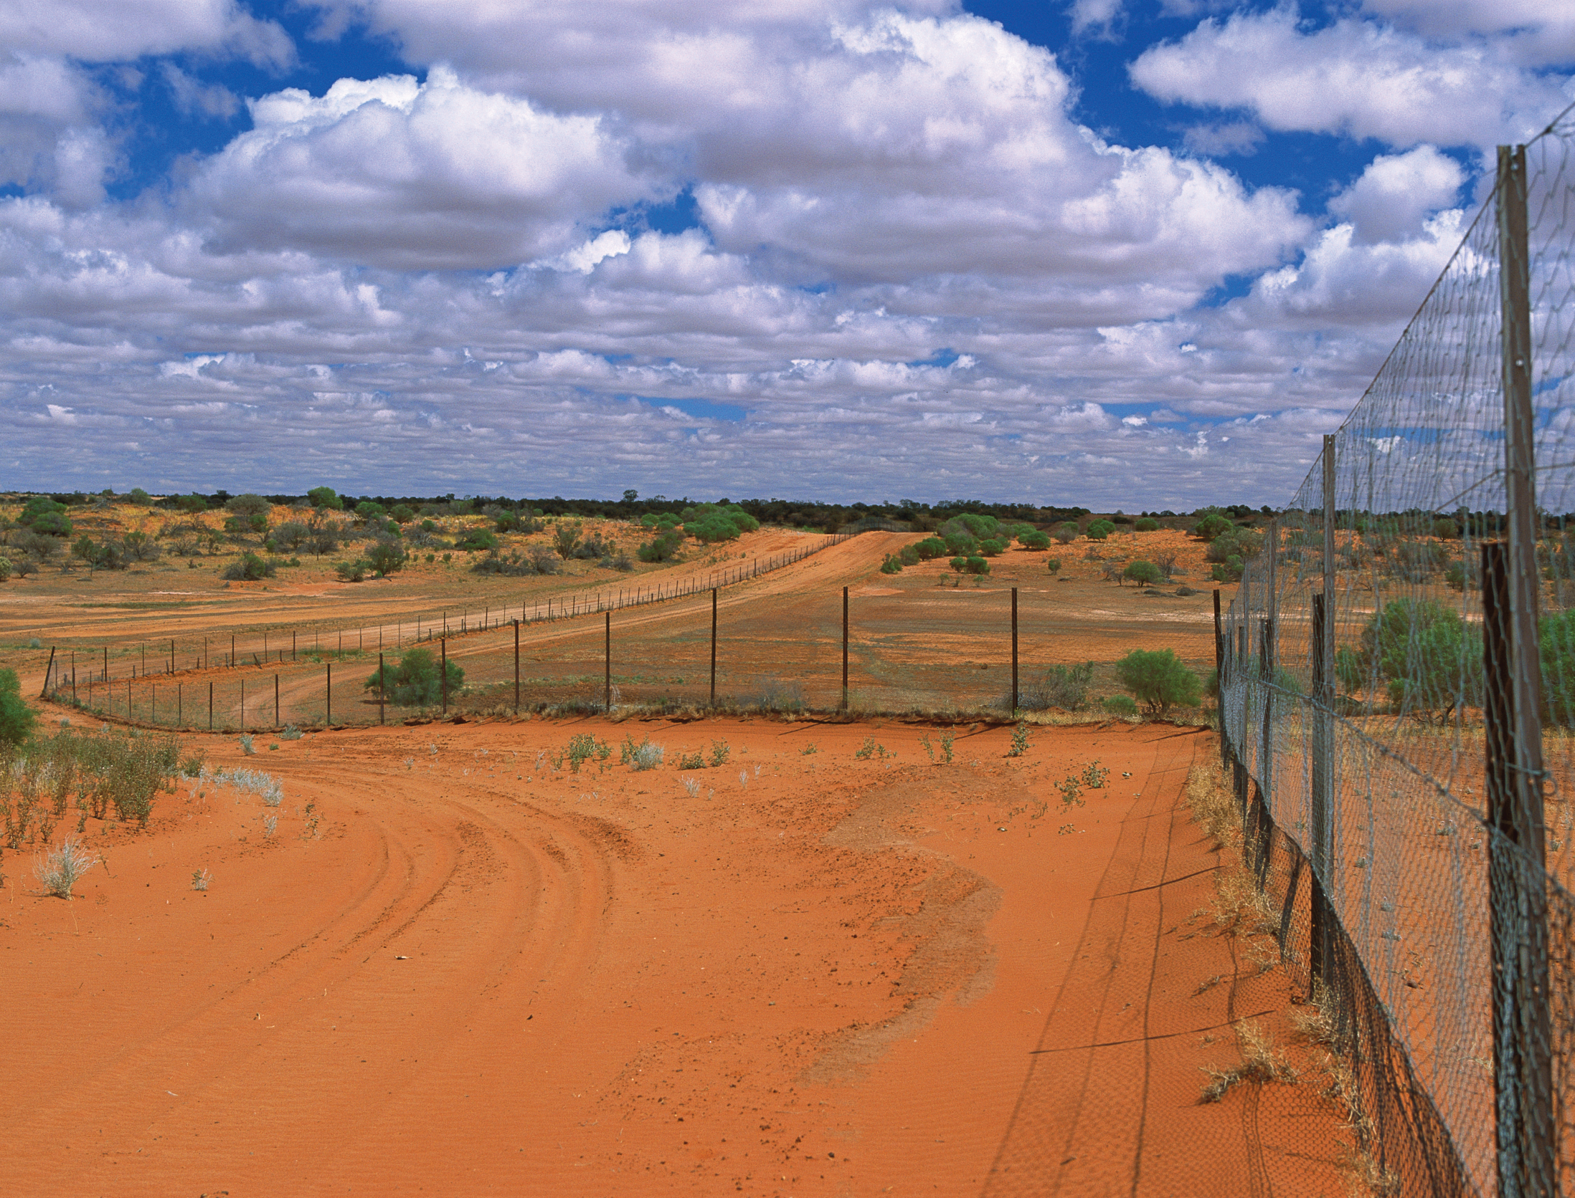
The Dingo Fence 防狗围栏
选自《多维阅读第10级》

Slide 2
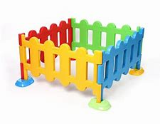
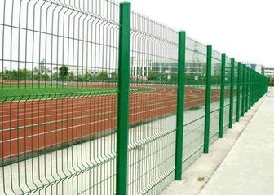
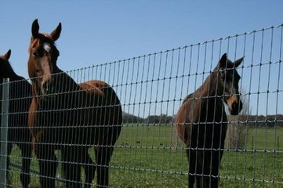
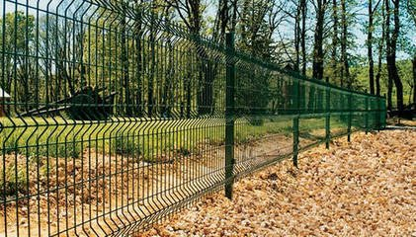
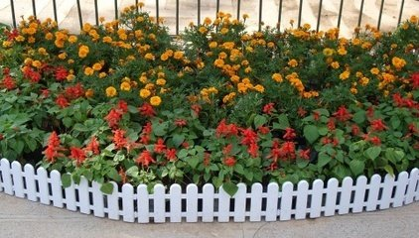
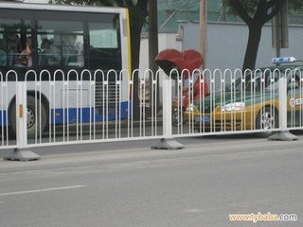
Pre-reading
A
B
C
D
E
F
1. Have you ever seen these fences? Where？
2. Why do people build these fences?
Notes:
阅读前活动
Activity 1 激活思维，引发思考
学生观察生活中不同围栏的图片并回答老师提出的问题。

Slide 3
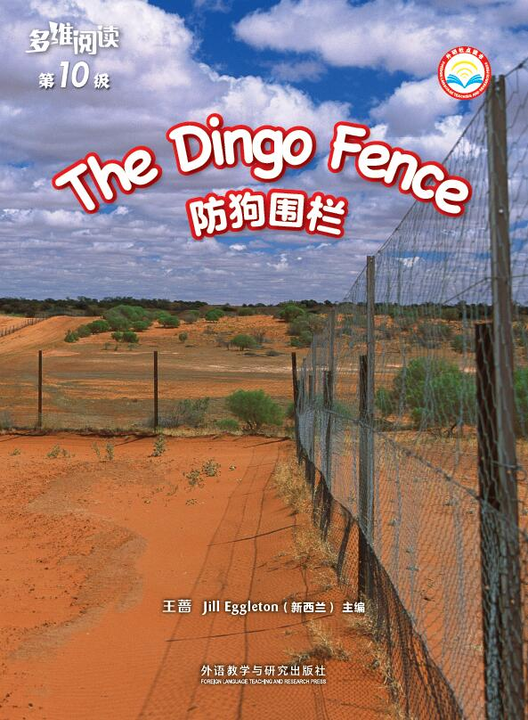
While-reading
Activity 1 Read the Cover
1. What can you tell about the dingo fence from the photograph?
2. How would you describe it?
3. What do you want to know about the dingo fence?
Notes:
阅读中活动
Acitivity 1 阅读封面，观察、预测
学生阅读书的封面并回答老师提出的问题。

Slide 4
Activity 2 Read and Answer
What information do you think might be on the sign?
Notes:
Activity 2 阅读第一部分 What Is the Dingo Fence? 了解防狗围栏
Step 1：阅读标志牌信息。
学生观察第一部分中的标志牌并回答老师的提问。

Slide 5
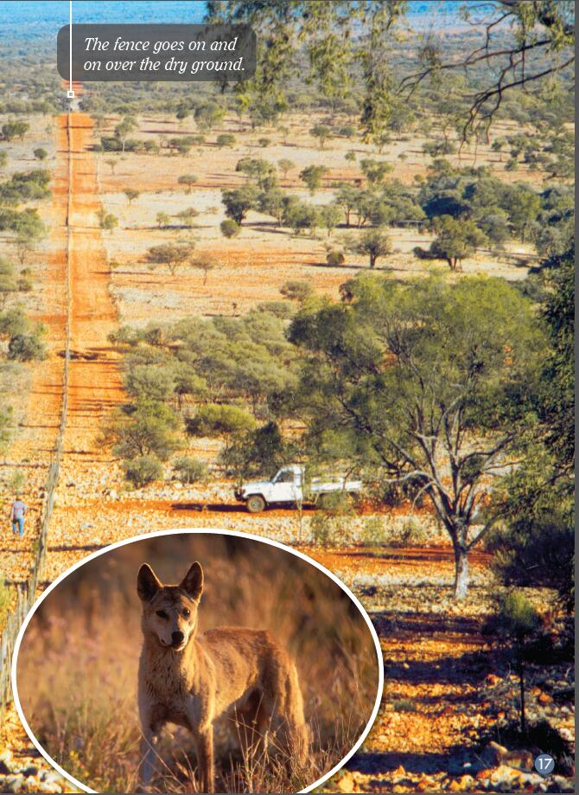
Activity 3
Step 1 Read and predict
1. What do you think that dingo want to do?
2. Why do you think that?
Notes:
Activity 3 阅读第7部分Hungry Dingoes，了解围栏防狗护羊的作用
Step 1：阅读标题、说明文字和图片，预测文本内容。
提问建议：
1. What do you think that dingo want to do?
2. Why do you think that?

Slide 6
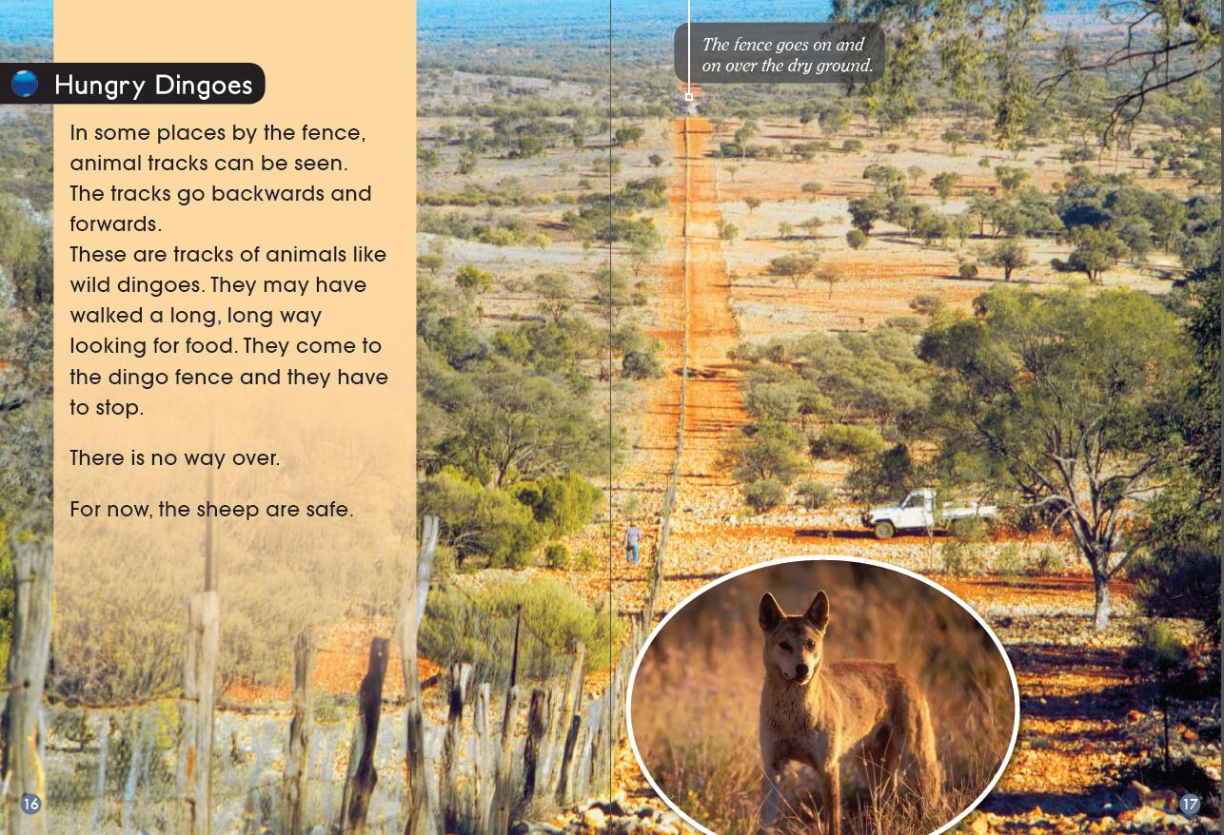
Activity 3
Step 2 Read and comprehension
1. How would people know that dingoes have been close to the fence line? Find words that tell you.
2. Why do you think the tracks go backwards and forwards?
3. What do you think “For now, the sheep are safe.” means?
Notes:
Step 2: 阅读第7部分Hungry Dingoes，捕捉细节信息，理解防狗围栏作用
提问建议：
1. How would people know that dingoes have been close to the fence line? Find words that tell you.
2. Why do you think the tracks go backwards and forwards?
3. What do you think “For now, the sheep are safe.” means?

Slide 7
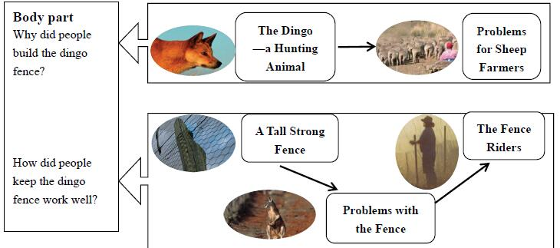
Introduction:
What is the dingo fence?
Body part:
Conclusion:
The Dingo Fence did work.
Notes:
理清小标题之间的关系，了解全文篇章结构。

Slide 8
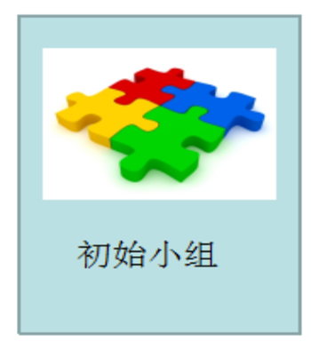
Activity 4
Jigsaw Reading from pp 4-15
Notes:
Activity 4 拼图阅读第2-6部分（From The Dingo—A Hunting Animal to The Fence Riders），探究“防狗围栏”（修建原因及维护方式）
学生用“拼图阅读”的方式阅读，从“建立防狗围栏的原因”和“保持防狗护羊的措施”两大方面，进行探究。

Slide 9
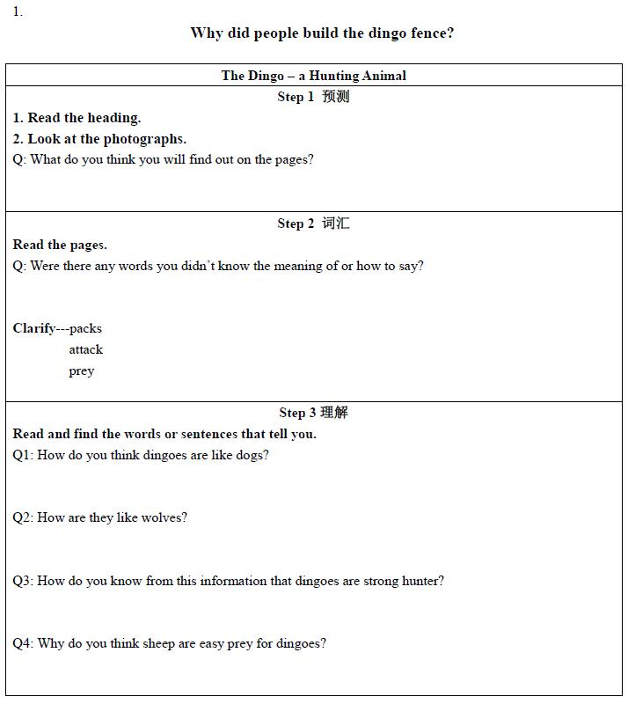
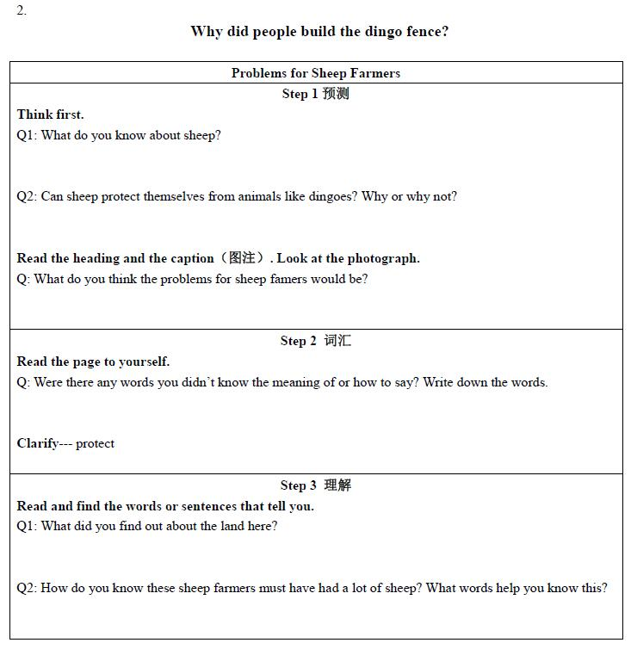
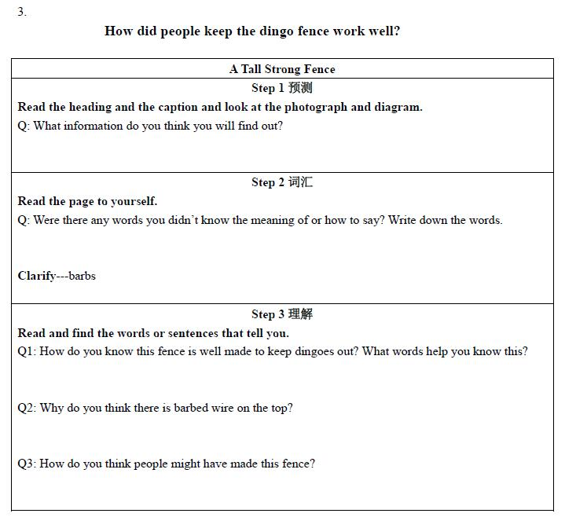
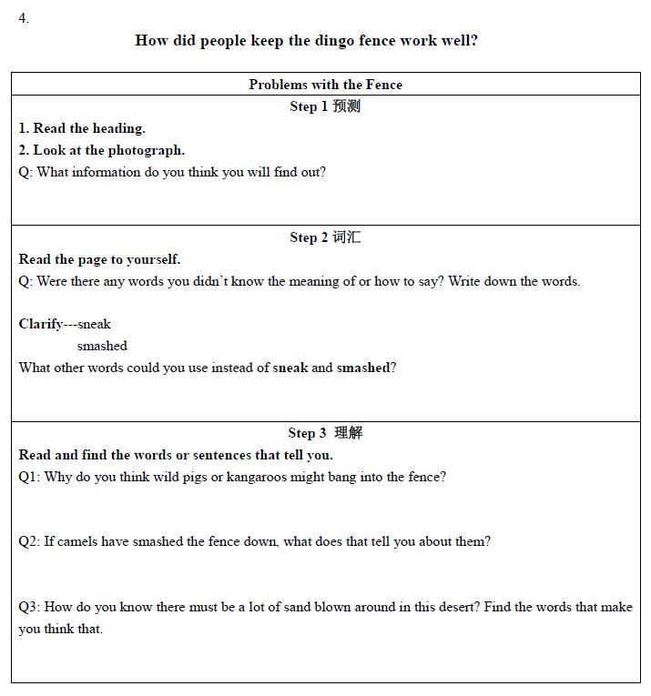
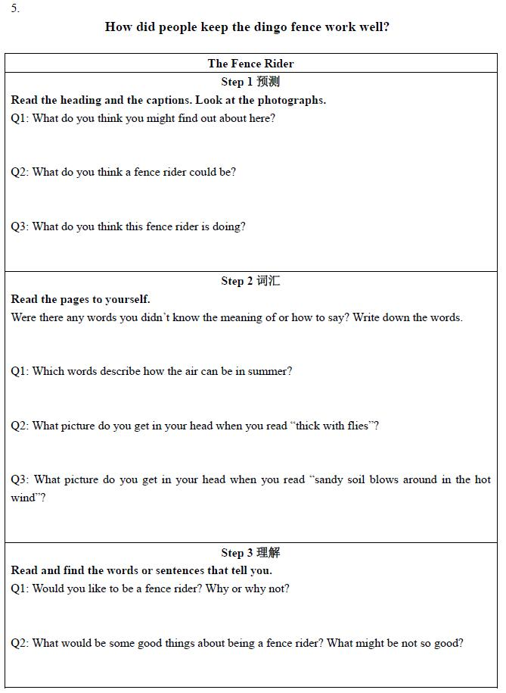
Step 1
Why did people build the fence?
How did people keep the fence work well?
初始小组
Notes:
Step 1明确阅读任务，分配阅读学习单。（使用学案1-5）
1.明确探究任务：探究防狗围栏修建原因及维护方式；
2.明确阅读章节：From From The Dingo—A Hunting Animal to The Fence Riders
3.建立初始小组，分配学习单。
五人一组，每人选择一章重点阅读，并领取相应章节的任务学习单。
Step 2 自主阅读，完成学习单上的任务。
小组内，每人根据任务学习单的提示，在问题的引领下，用阅读What Is the Dingo Fence和Hungry Dingoes的学习方式进行阅读，如先预测、学习词汇、理解文本。

Slide 10
Step 2
Notes:
Step 3 讨论并解决学习单上的问题。
重新分组：阅读相同章节的学生，3-4人一组，组成专家组，相互讨论并解决任务学习单上的问题。

Slide 11
Step 3
小组内汇报
Notes:
Step 4 回归初始小组，讨论并根据任务单汇报交流学习成果
Step 5 重新分配任务单，探究防狗围栏的“修建原因及维护方式”（使用学案6）
初始小组内，根据学案6，讨论并提出1-2个重要事实性信息，用以说明防狗围栏修建的原因及维护方式。

Slide 12
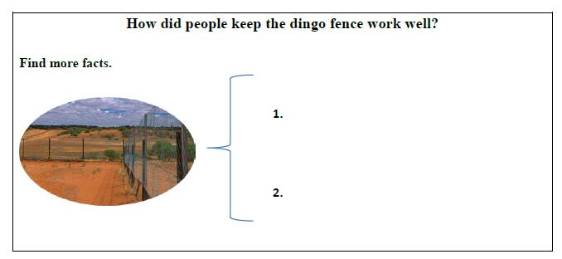
Step 4
Why did people build the dingo fence?
How did people keep the dingo fence work well?
Report
Notes:
Step5 班级内，以初始小组为单位汇报。（使用学案6）

Slide 13
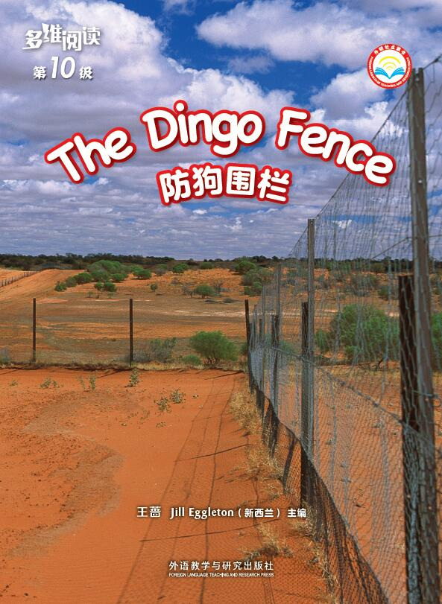
Post-reading
Activity 1
1. Why did the author write the book?
2. What did the author want to tell us?
3. What was the author’s idea about the dingo fence?
Notes:
阅读后活动
Activity 1 推测作者写作意图
学生根据书中陈述的事实，回答老师提出的问题。

Slide 14
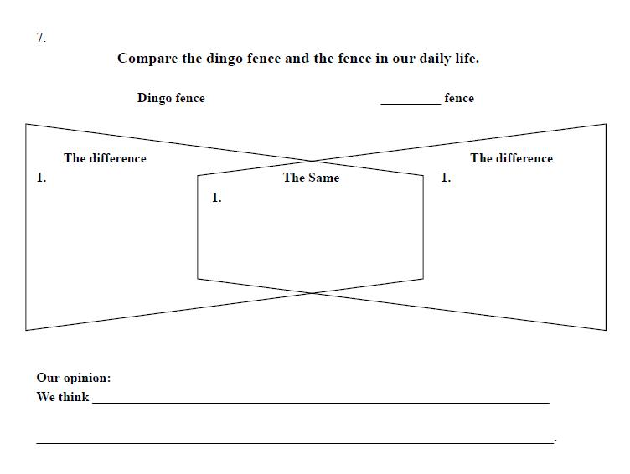
Activity 2
Notes:
Activity 2 从围栏外型和功用角度，对比围栏异同。
学生以小组为单位选择一个或几个生活中的围栏，与书中防狗围栏进行对比。通过思维导图的方式，呈现两者的异同。（使用学案7）

Slide 15
作业建议
1. 收集3—5个生活中成功使用围栏解决问题的案例，并用图或图示的方式进行事实的陈述说明。
2. 阅读有关澳洲野犬的新闻，提取事实性信息，陈述自己对新闻的观点，并制作有关防狗围栏的海报。
Notes:
作业建议

