Slide 1
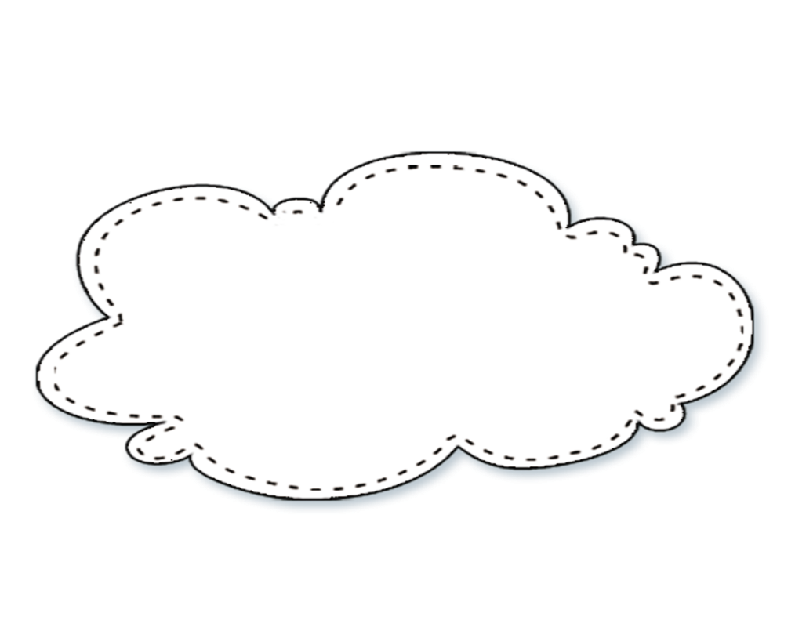
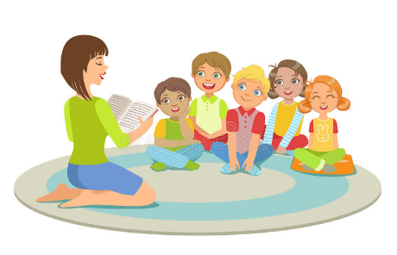
A Bag in the Jungle
丛林里的手提袋
Reading
Class
选自《多维阅读第9级》

Slide 2
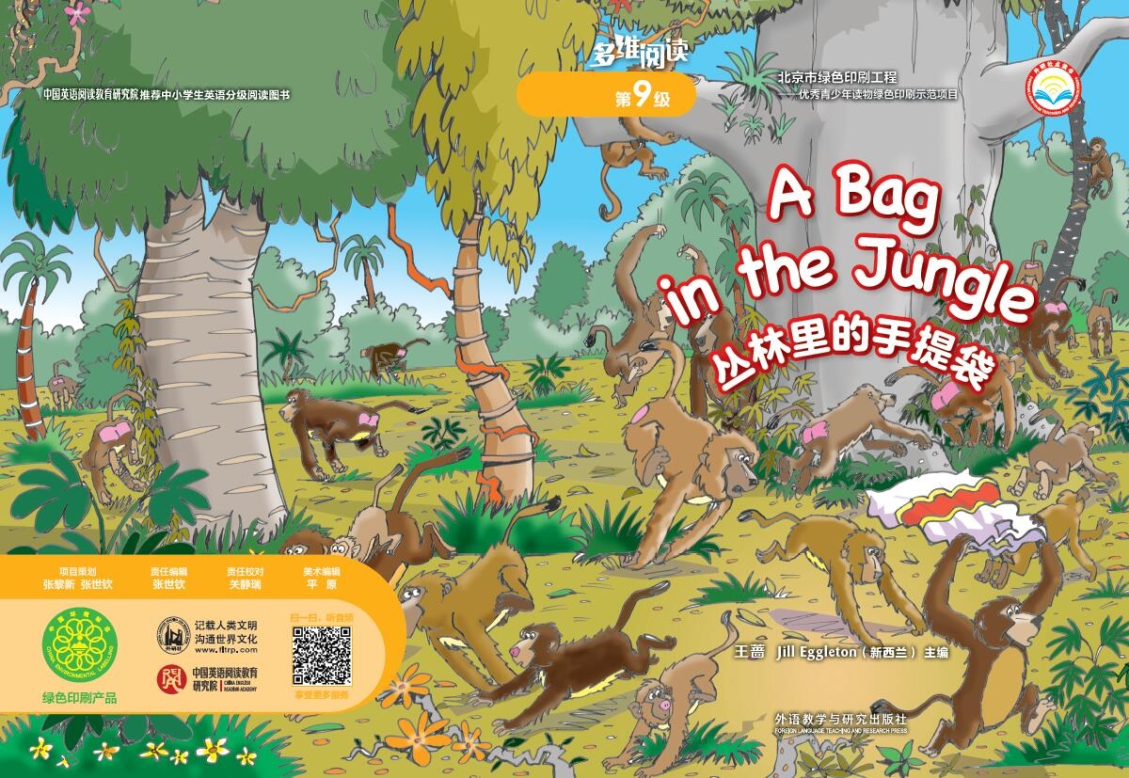
Activity 1 Talk about the cover

Slide 3

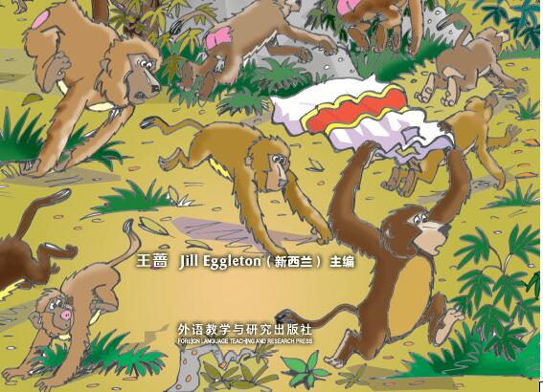
baboons
They live in Africa and Asia. They look like monkeys, but actually they are bigger than monkeys but smaller than gorillas. Their faces are a little special as they look like dogs’ faces. And they are social animals. They live with their family.

Slide 4
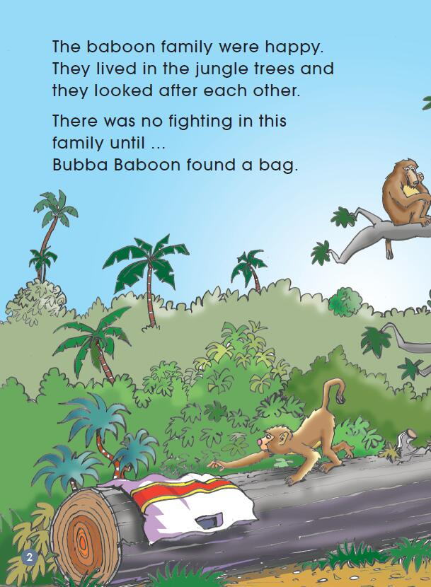
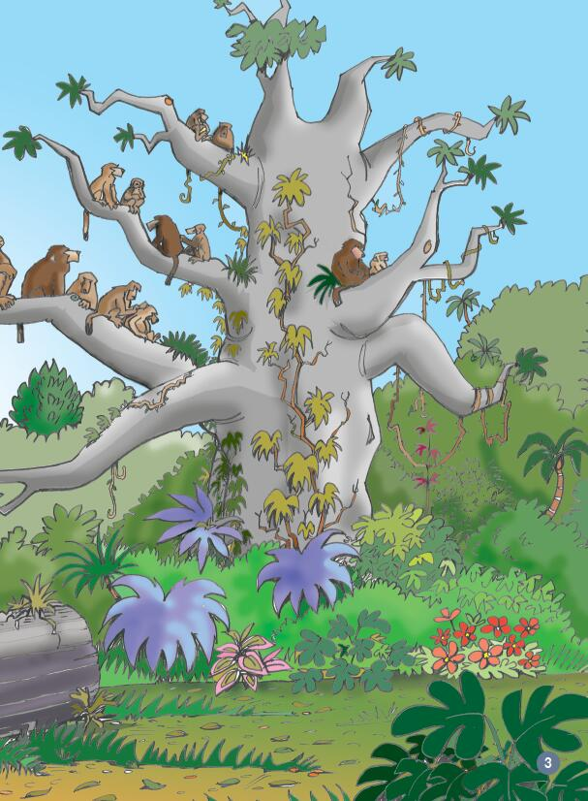
Activity 3 Read the story
Activity 2 What do you know about the baboon family?

Slide 5
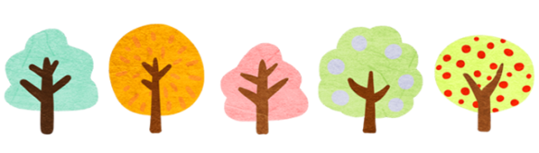


(1)Discuss in pairs
Guess: What might happen next?
Notes:
what might the family members do with the bag?

Slide 6
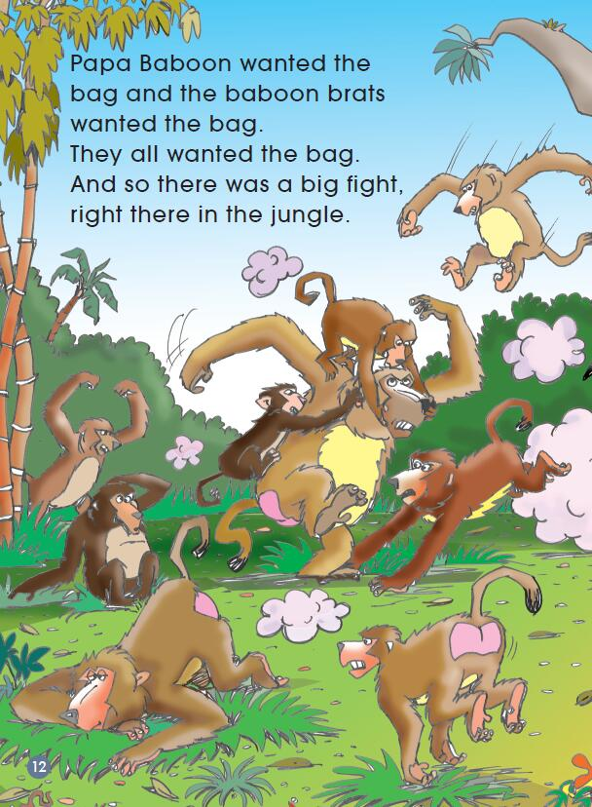
How was the baboon family ?
Why did they fight like this?

Slide 7
Guess: What might happen in the story?
Notes:
what might the family members do with the bag?

Slide 8
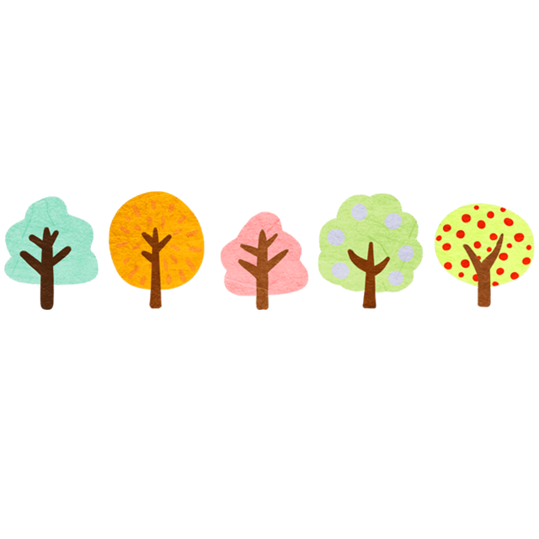
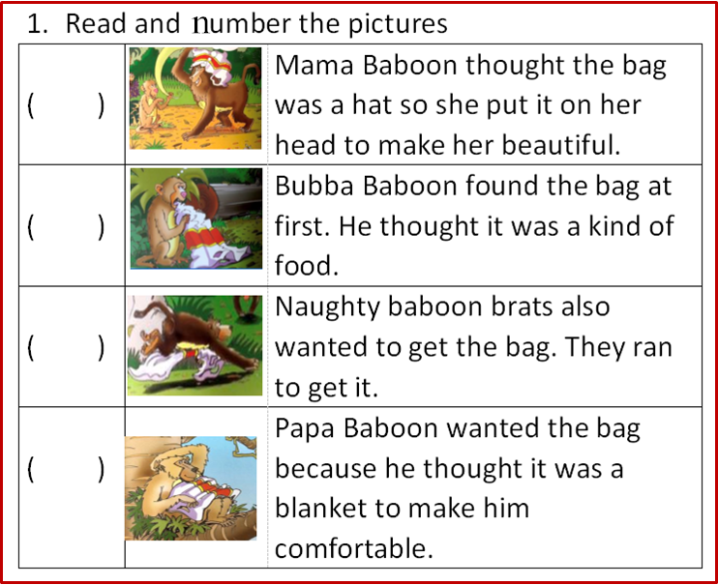
(2)Read and number
Worksheet
Exercise 1

Slide 9
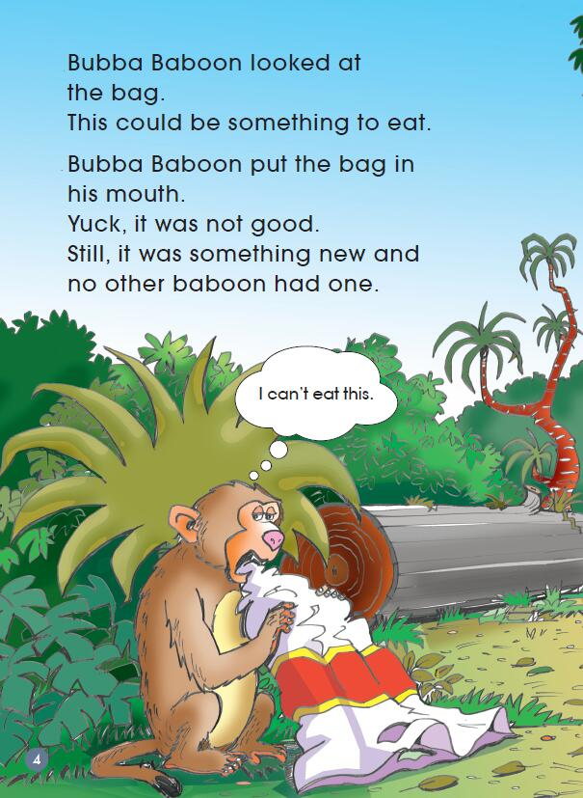
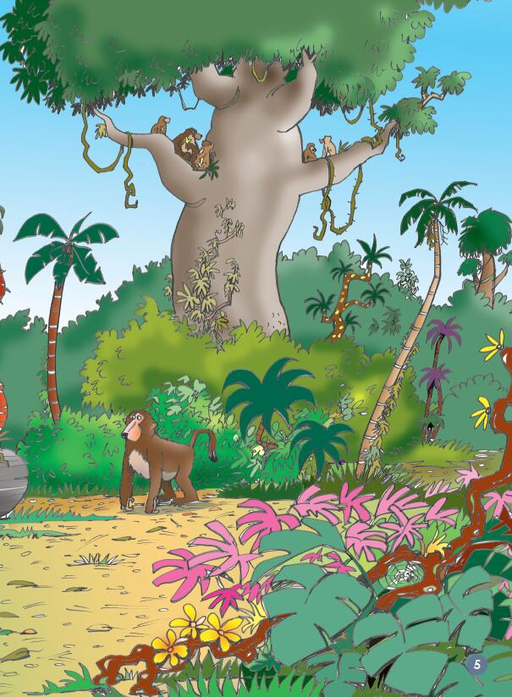

Slide 10
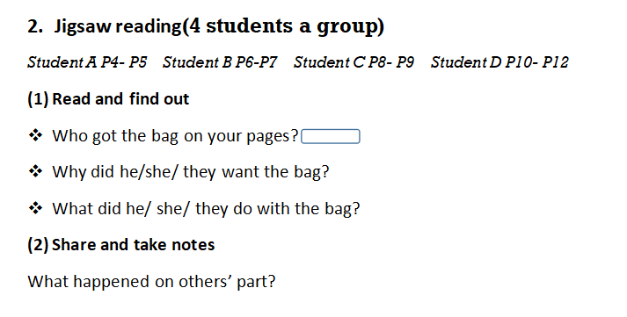
Activity 3 Jigsaw reading

Slide 11
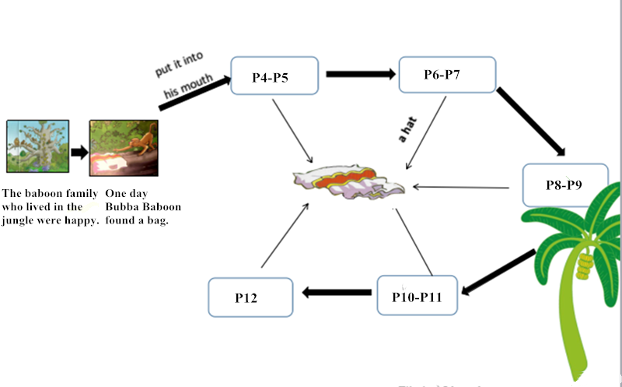

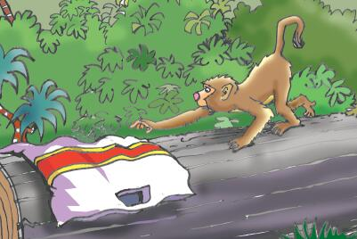
1. Read and finish your part.
2. Share and take notes.

Slide 12
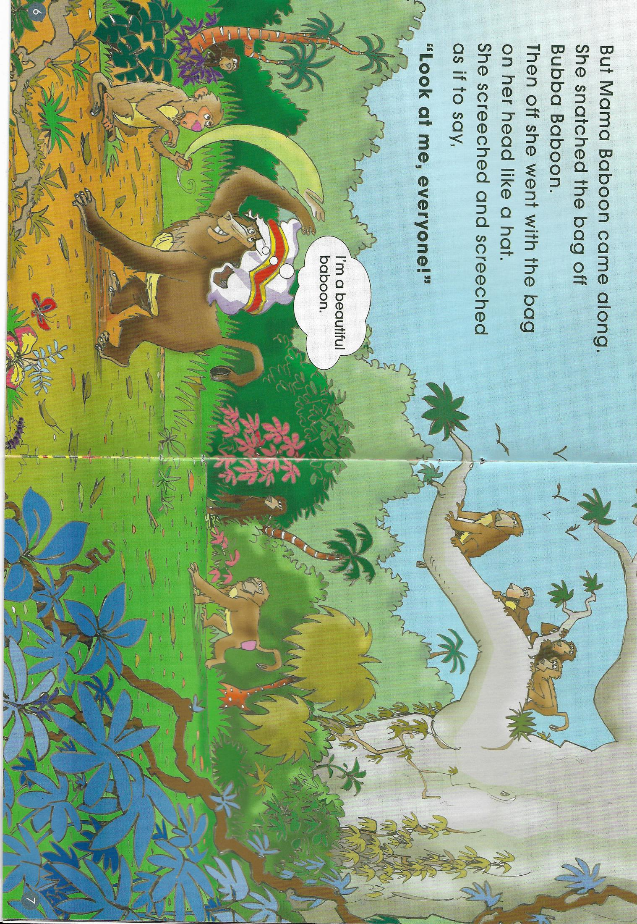

Slide 13
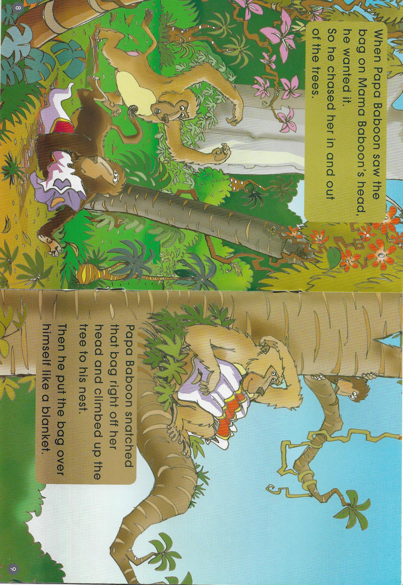

Slide 14
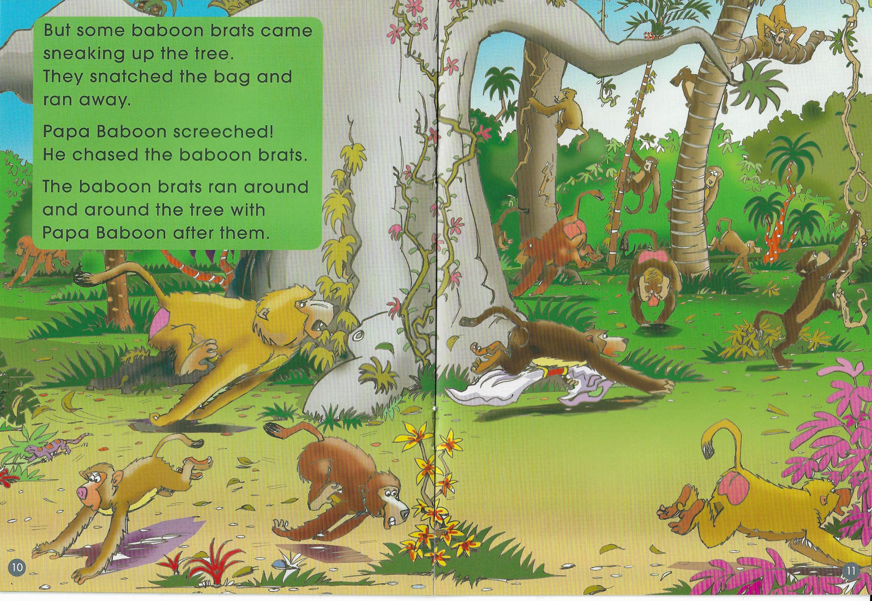

Slide 16
Check the answers.
2
Worksheet
Exercise 1
1
4
3

Slide 17
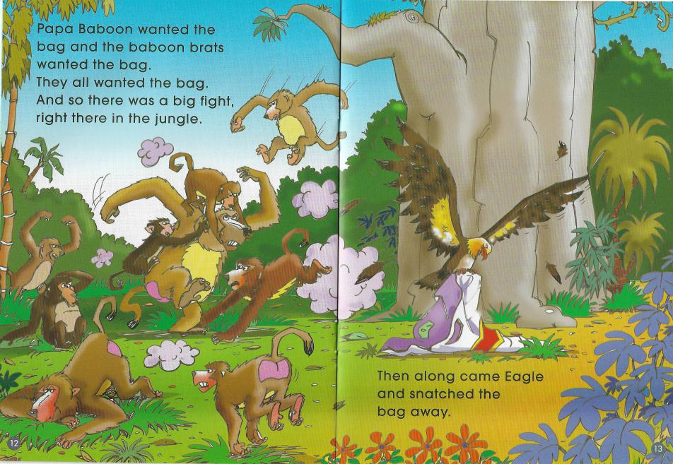
Do you think it’s the end of the story? Why?
What might be the end of the story?

Slide 18
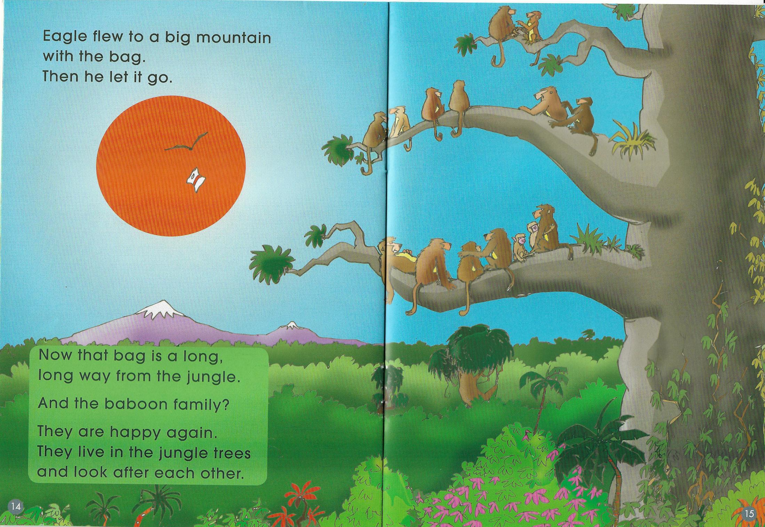

Slide 19
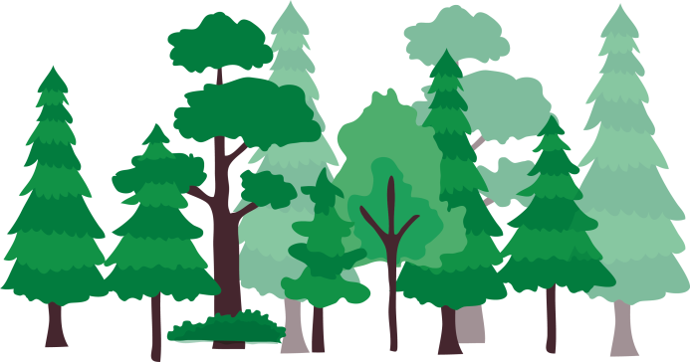
What was the problem of the story?
How did they solve it ?

Slide 20
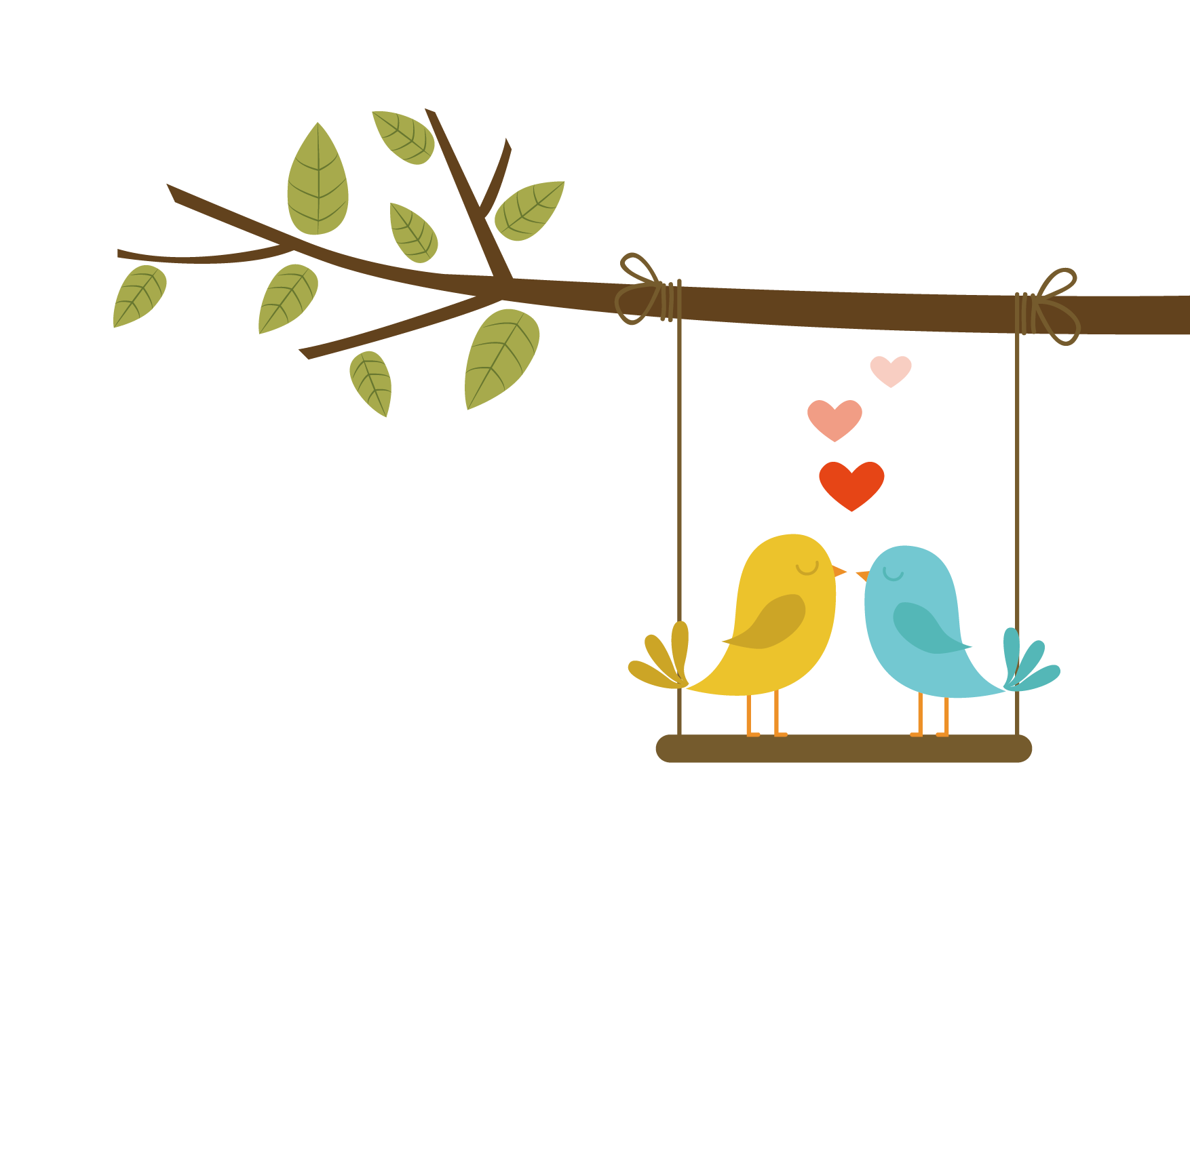

Activity 4 Enjoy Reading
Read after the audio

Slide 21
Activity 4 Enjoy Reading
Read by yourself

Slide 22
Activity 5 Think and talk
If you were a baboon in this story, what would you do when you see the bag?

Slide 23
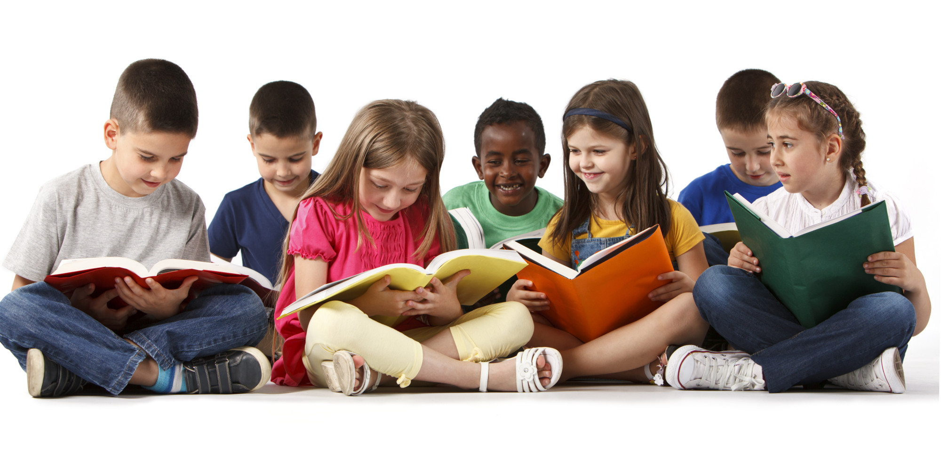
Activity 6 Let’s discuss
What can we learn from the story?
When do you make a choice?
What do you do when you make a choice?

Slide 24
Homework
Draw a mind map about:
What will you do when you have to make a right or good choice ?

Slide 25

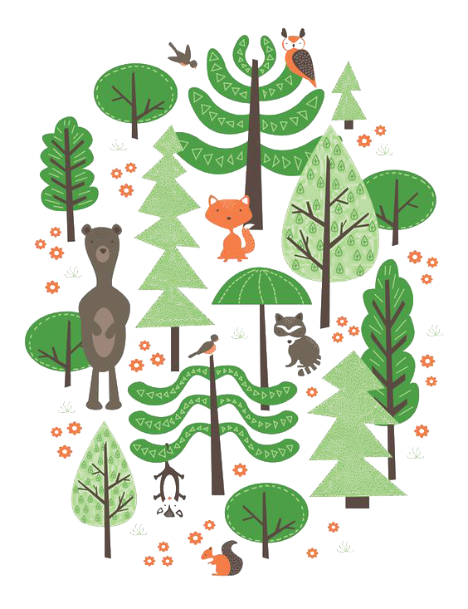
Thank
you~

