Slide 1
选自《多维阅读第9级》
Uncle Al
粗心的阿尔叔叔

Slide 2

What can you see from the cover?
Who is Uncle Al? Why do you think that?
What is Uncle Al like?
What do you want to know from the book?

Slide 3
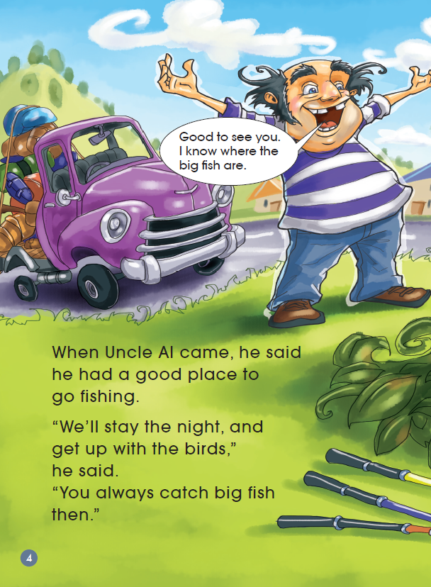
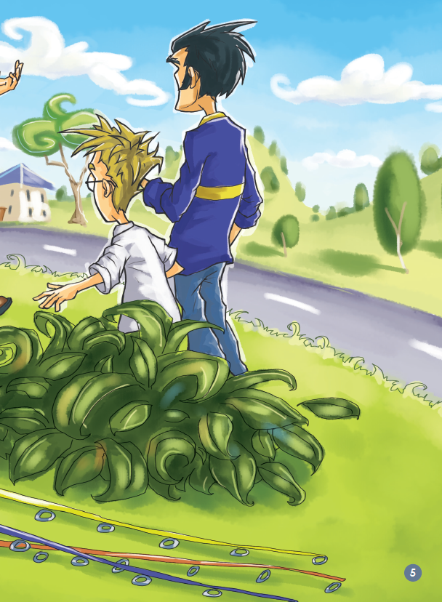
What is Uncle Al doing?
What do we need when we go fishing?

Slide 4
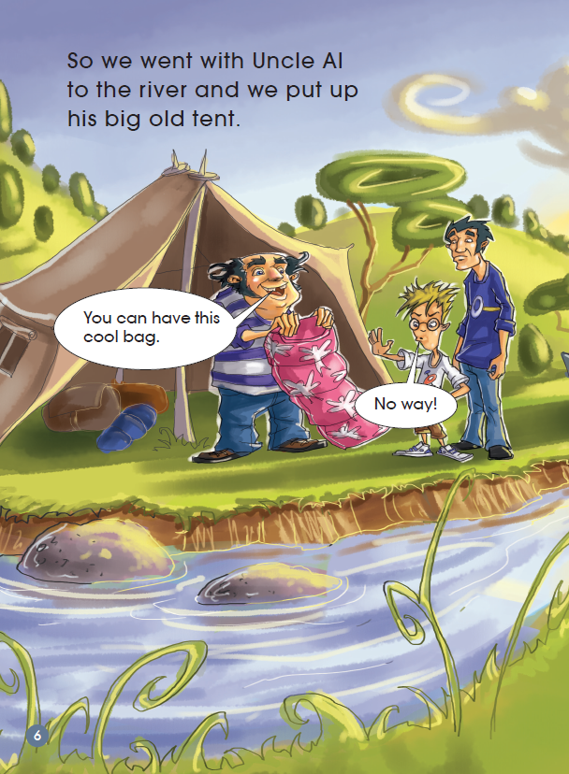
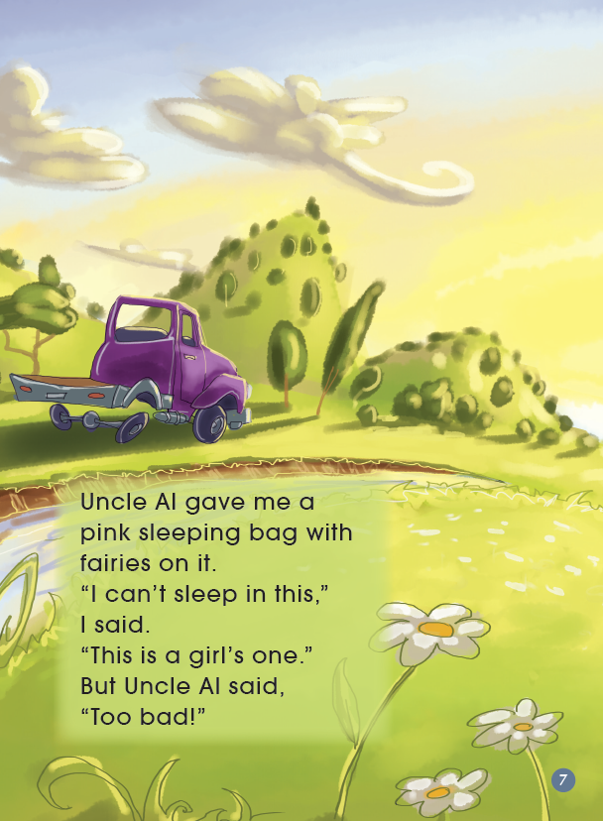
Have you ever gone camping?
What did you sleep in?
How did the boy feel?

Slide 5
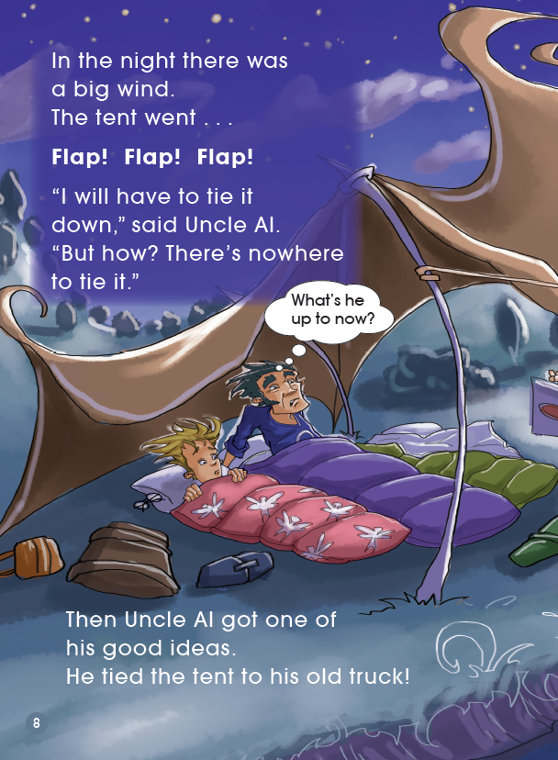
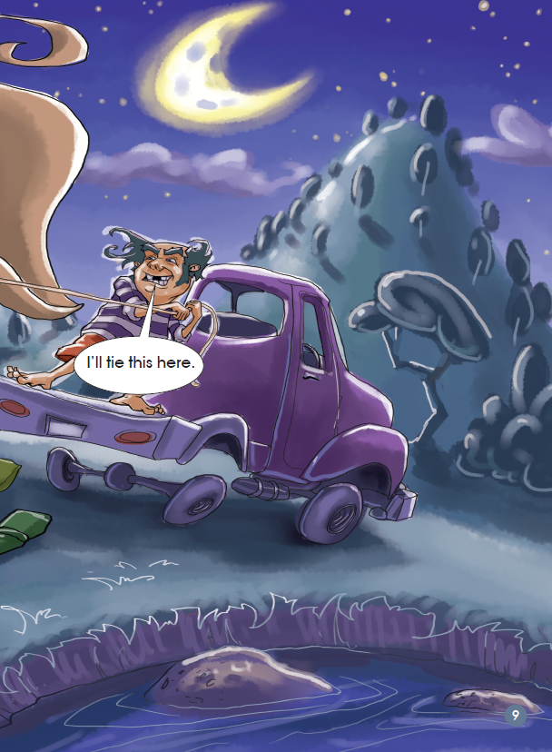
Do you think Uncle Al’s idea was a good one? Why? Why not?

Slide 6
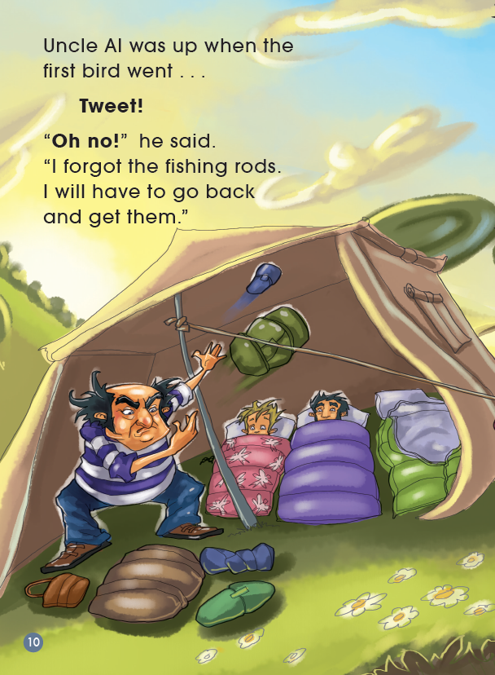
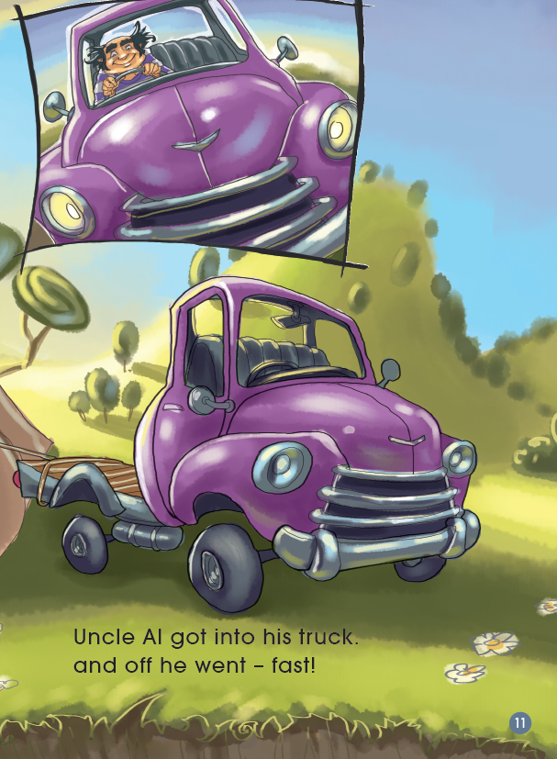
What do you think Uncle Al is looking for?

Slide 7
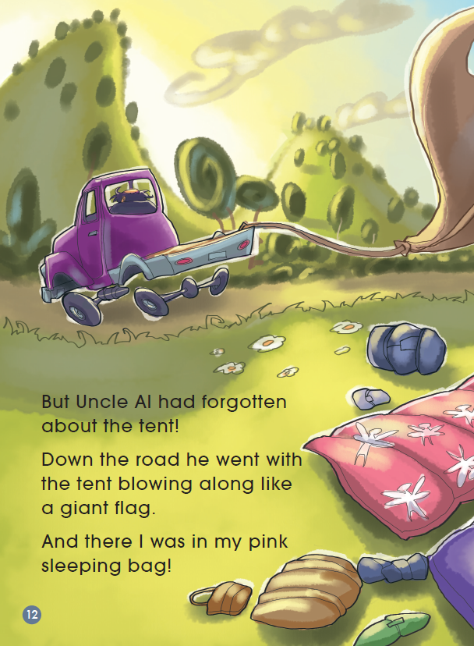
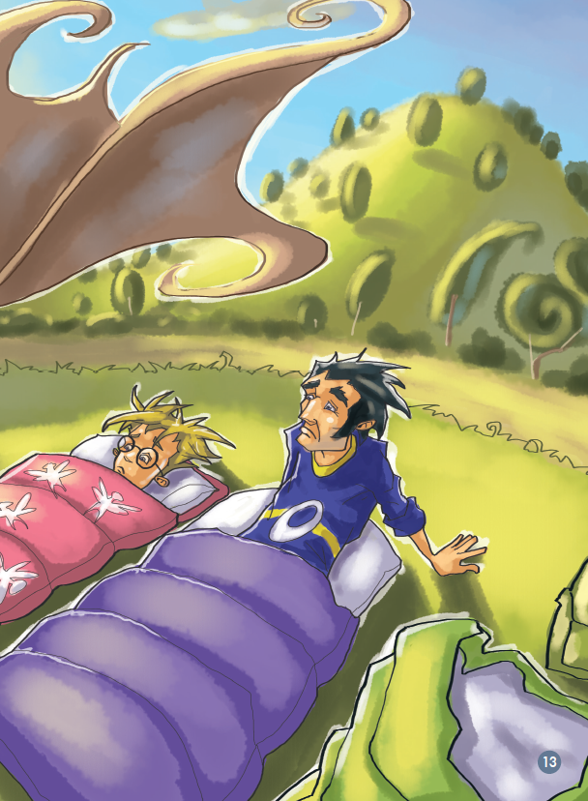
Do you think Uncle Al knows what has happened?
Why do you think that?

Slide 8
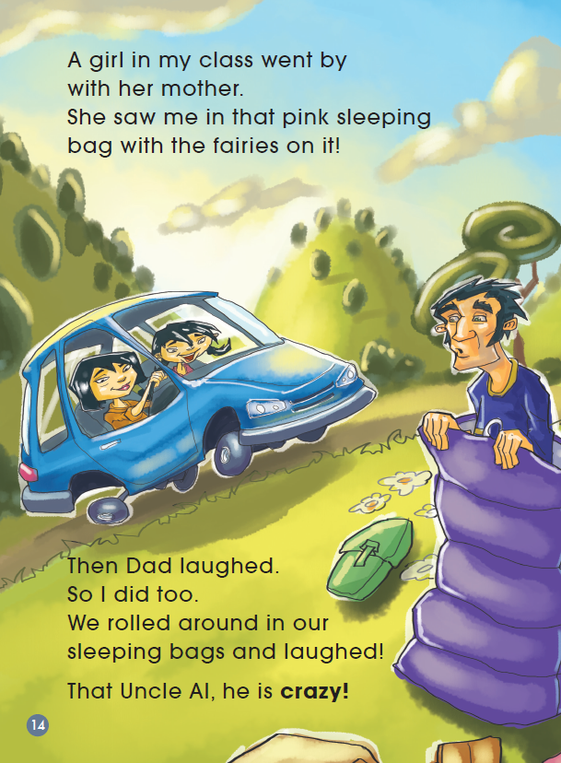
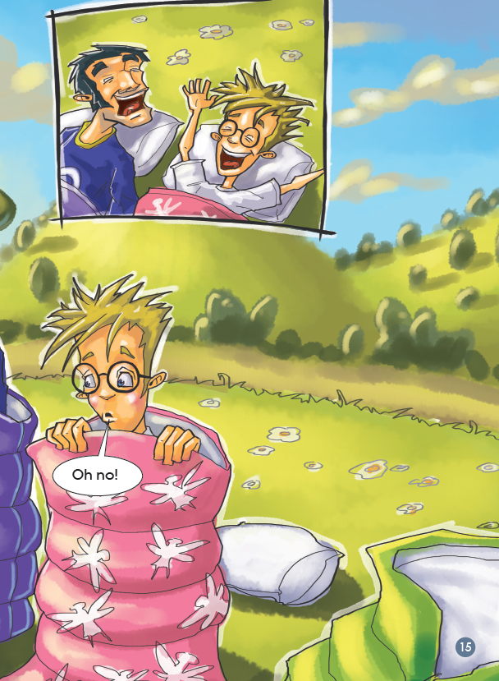
What do you think the people in the car might be thinking?
How do you think Dad and the boy feel?

Slide 9
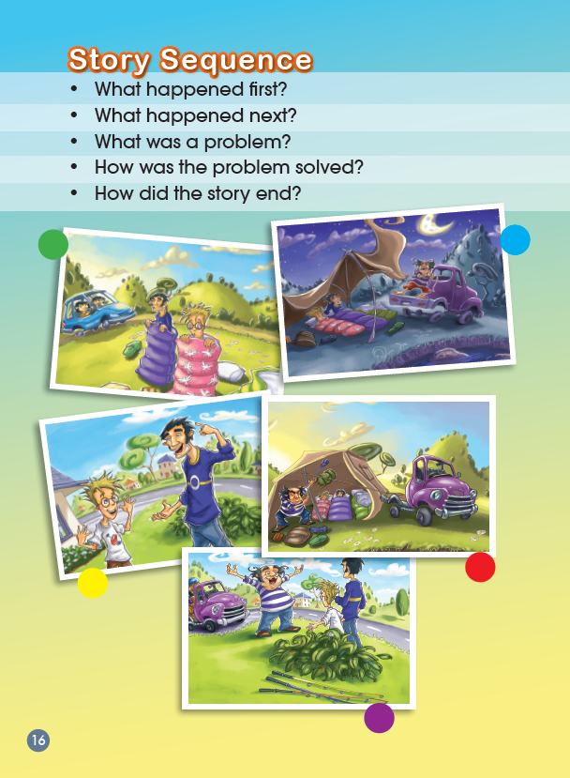
Read the story and finish the chart.
Title: ________________
Characters: ________ Personality: ______________
List all the main events that happened in the story.
What happened first?
What happened next?
What was a problem?
How was the problem solved?
How did the story end?

Slide 10

What does Uncle Al like?

Slide 11
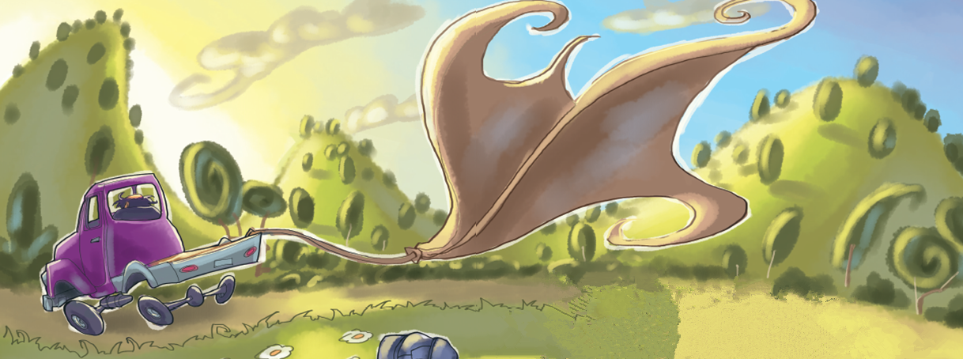
Does Uncle Al remember the family?
Will he go back?
Let’s make up the ending of the story.

Slide 12

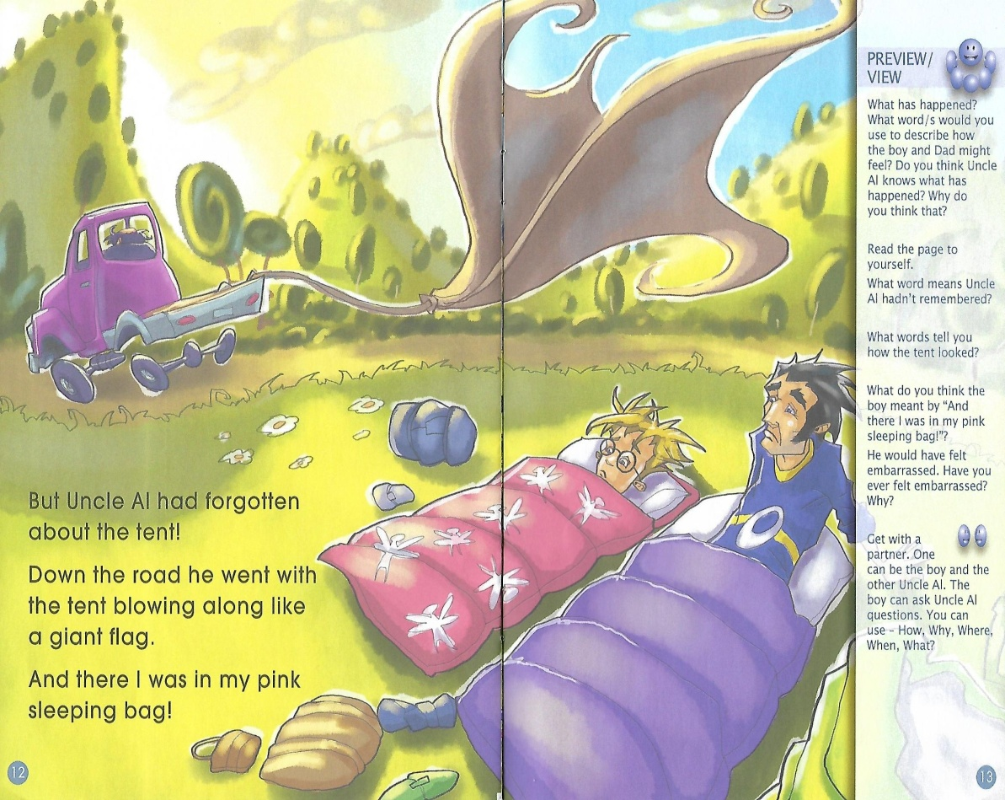
Does Uncle Al remember the family?
Will he go back?
Please make up the ending of the story.

Slide 13
Homework
1. Make up the story ending.
2. Choose one picture from the book and write down what the characters are thinking.

