Slide 1
Bully Bugs
凶猛小虫
选自《多维阅读第9级》

Slide 2
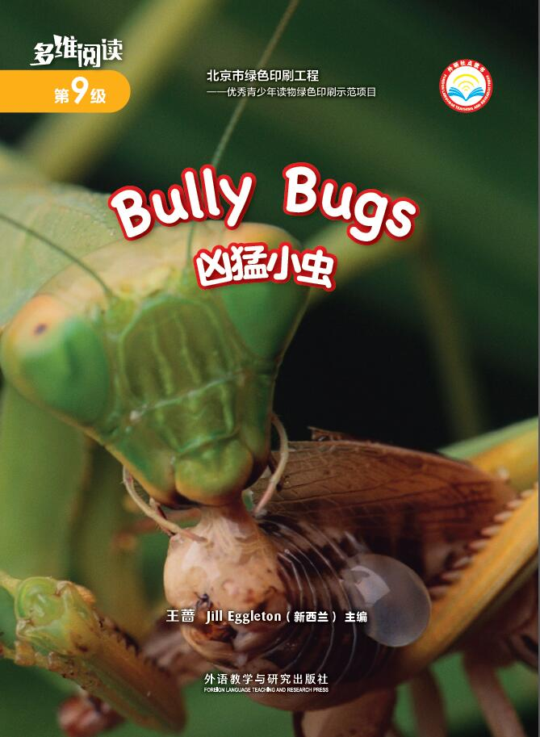
What can you see from the cover?

Slide 3
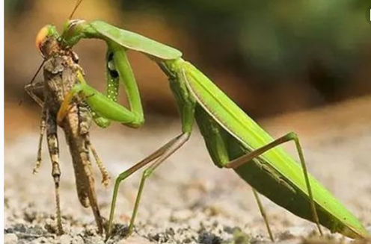
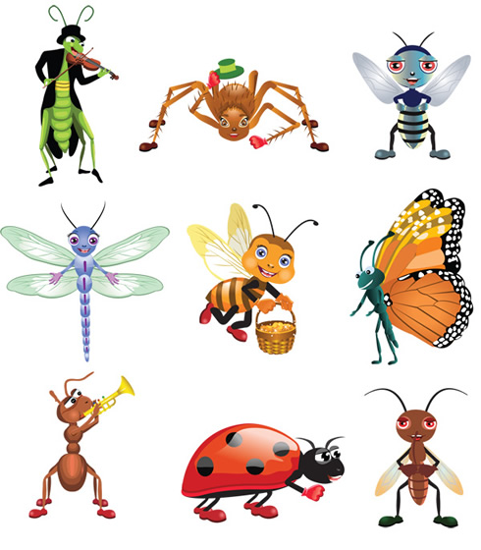
What’s the title?

Slide 4

What bugs do you know?

Slide 5
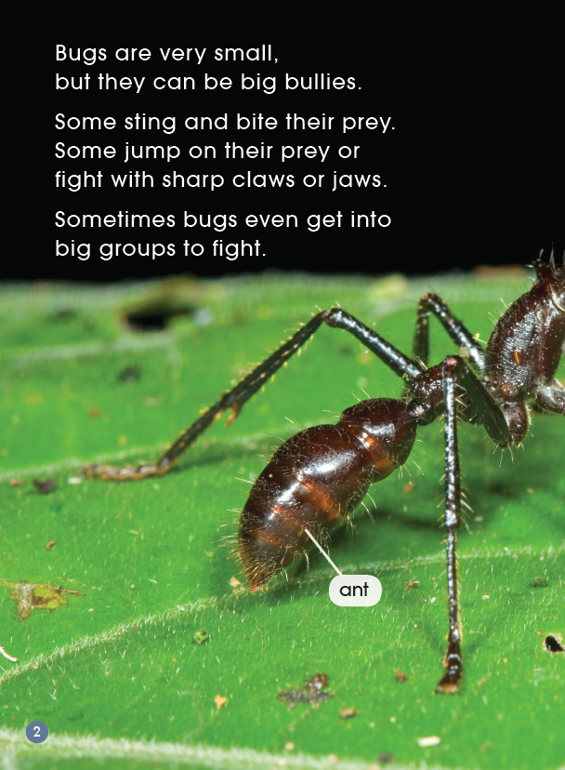
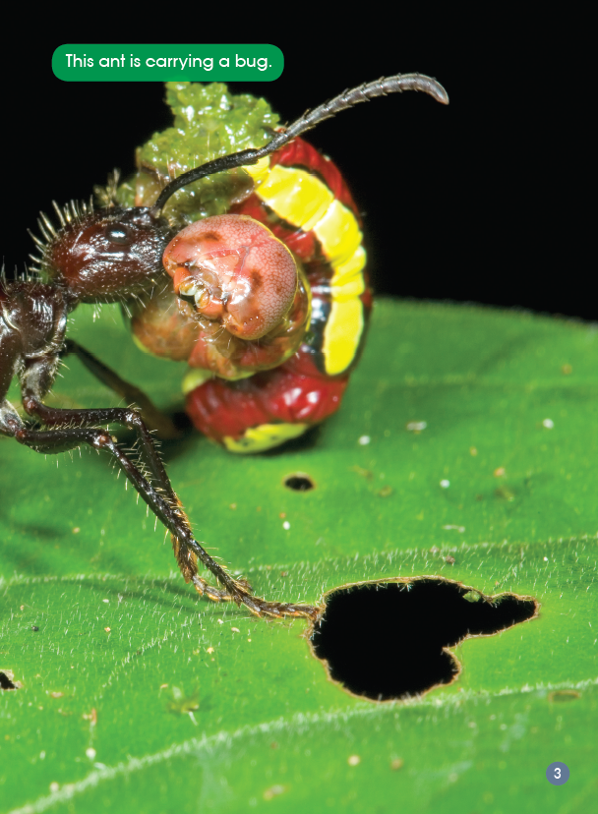

First Reading
Are bugs big or small?
What bugs are there in the book?
What is prey?
What do you think the bugs’ prey might be ?

Slide 6
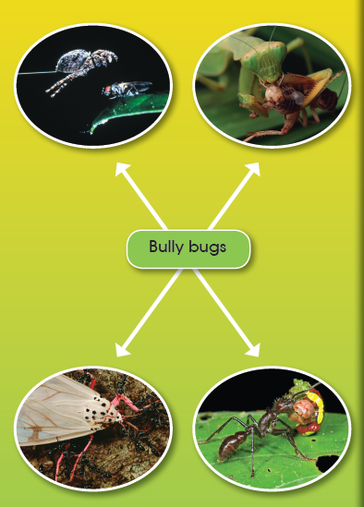

Second Reading
Read the pages about the bugs you are interested in.
P?

Slide 7

Answer the questions about the bug you read.
◊ Where does it live?
◊ Which words tell you something about what it looks like?
◊ Which words describe how the bugs get food ?

Slide 8
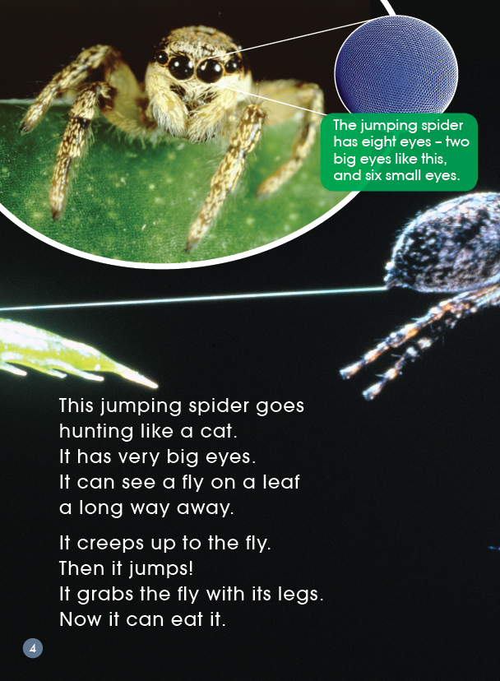
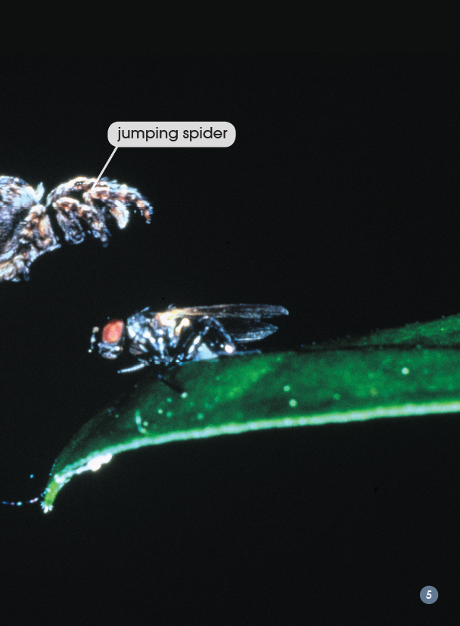

Slide 9
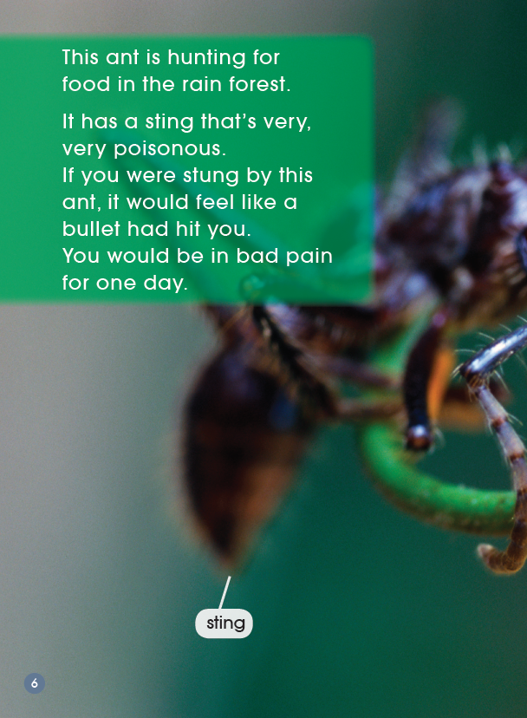
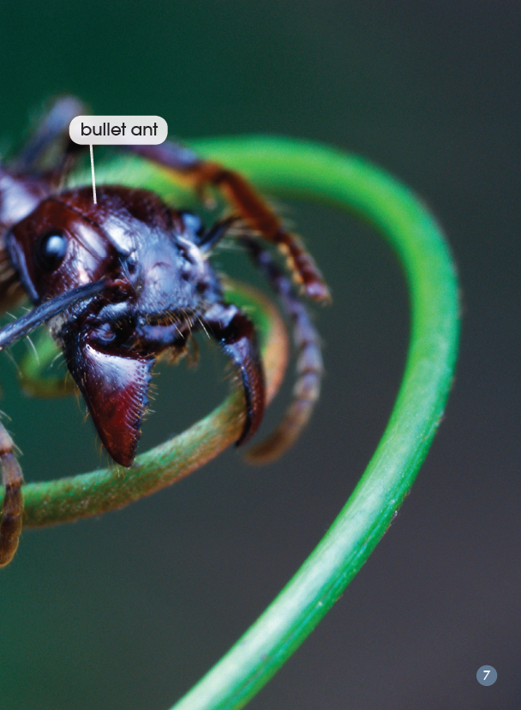

Slide 10
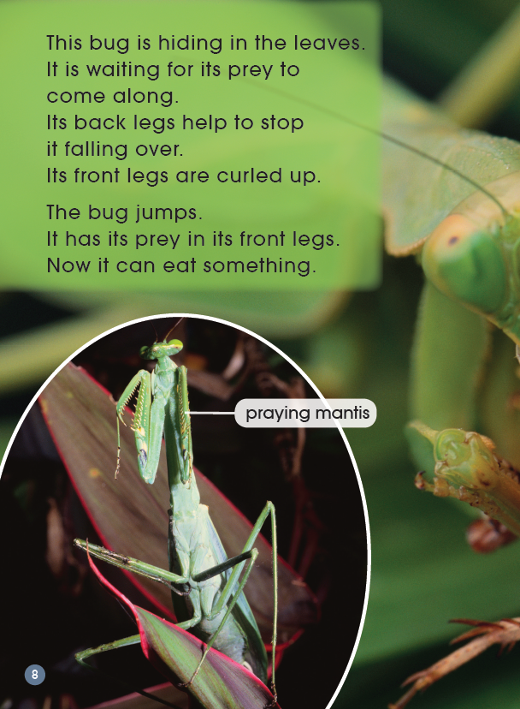
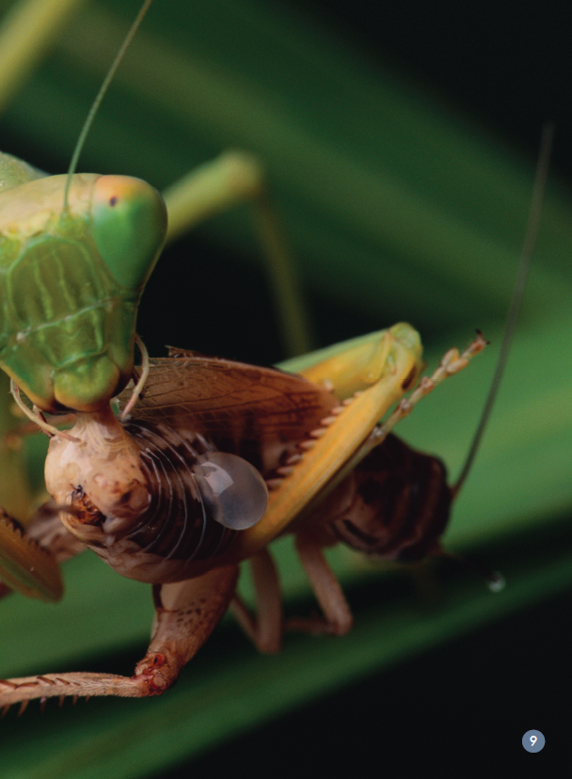

Slide 11
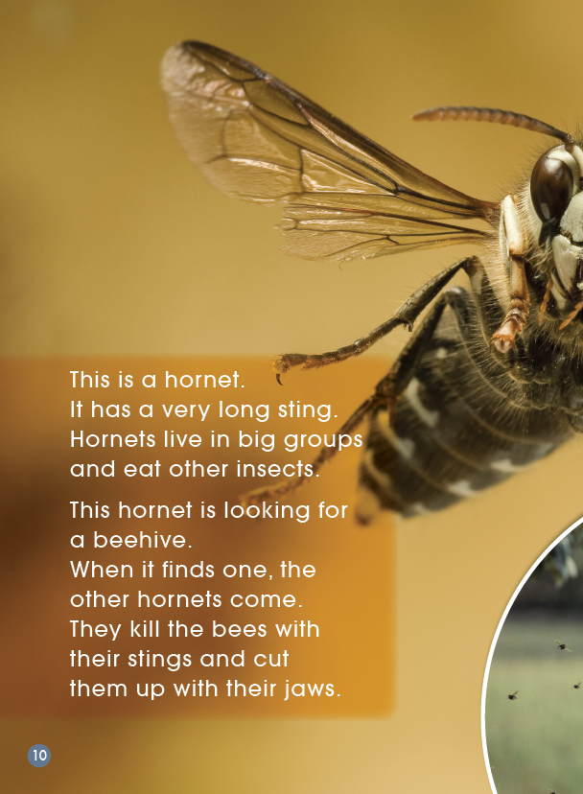
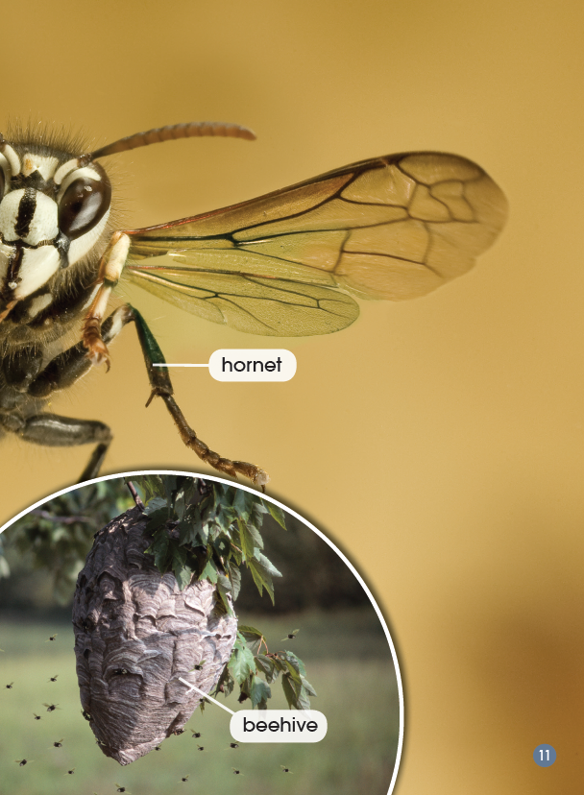

Slide 12
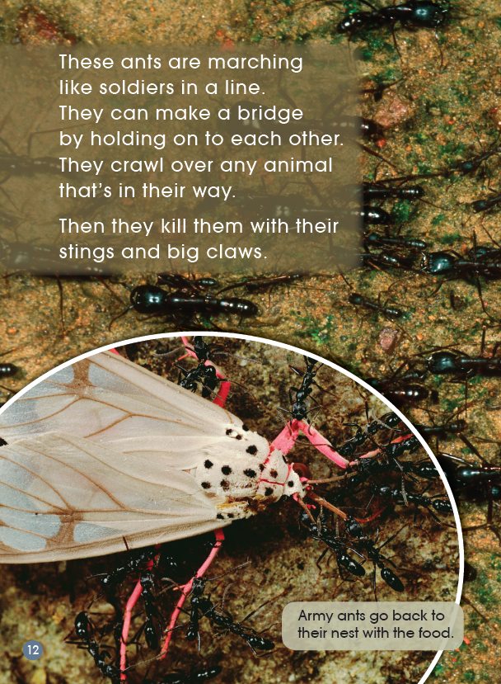
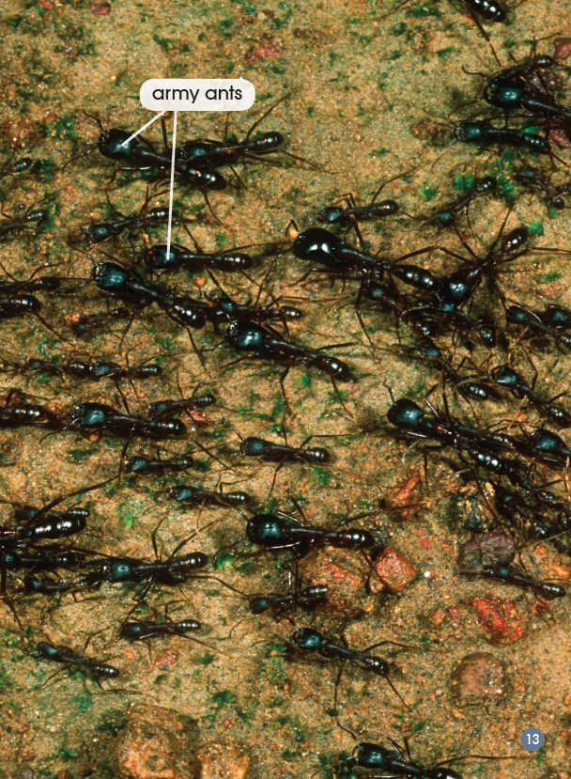

Slide 13
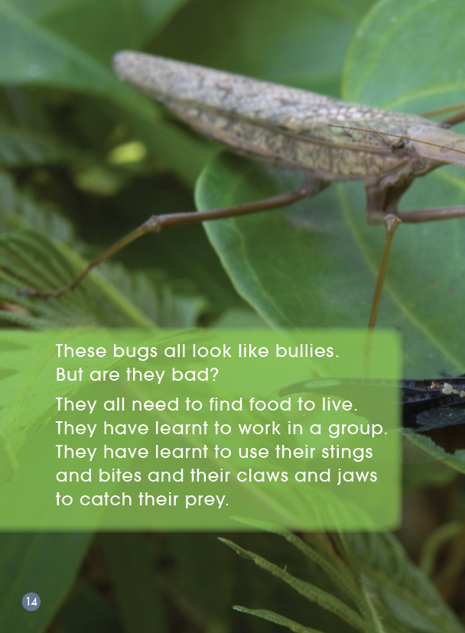
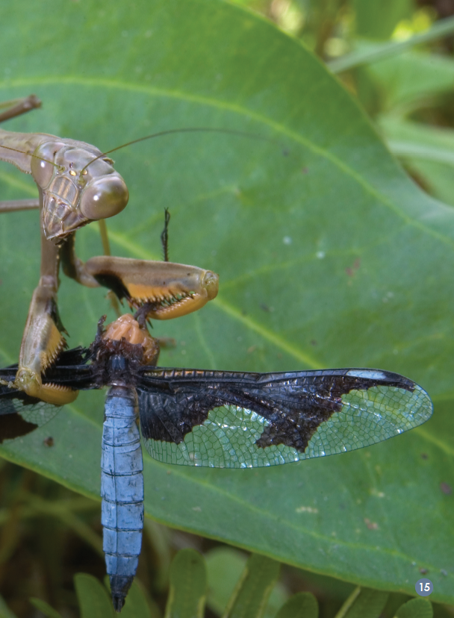

Slide 14
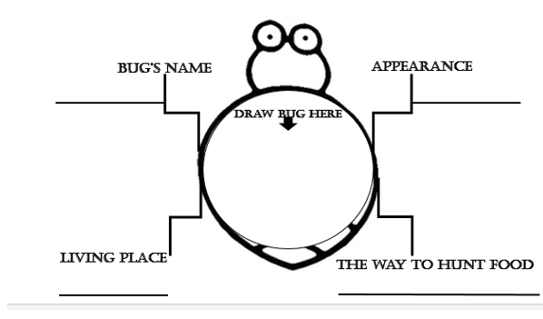
Group Work
Please finish the mind map according to what you read.

Slide 15
Group Work
Please introduce your favourite bug using the mind map. You can use the sentences in the Sentence Box.
Sentence Box
This is…(名称)
It lives in…（栖息地）
It has…（身体特征）
It can… and…（捕食动作）
It gets food with its…（捕食的身体条件）

Slide 16
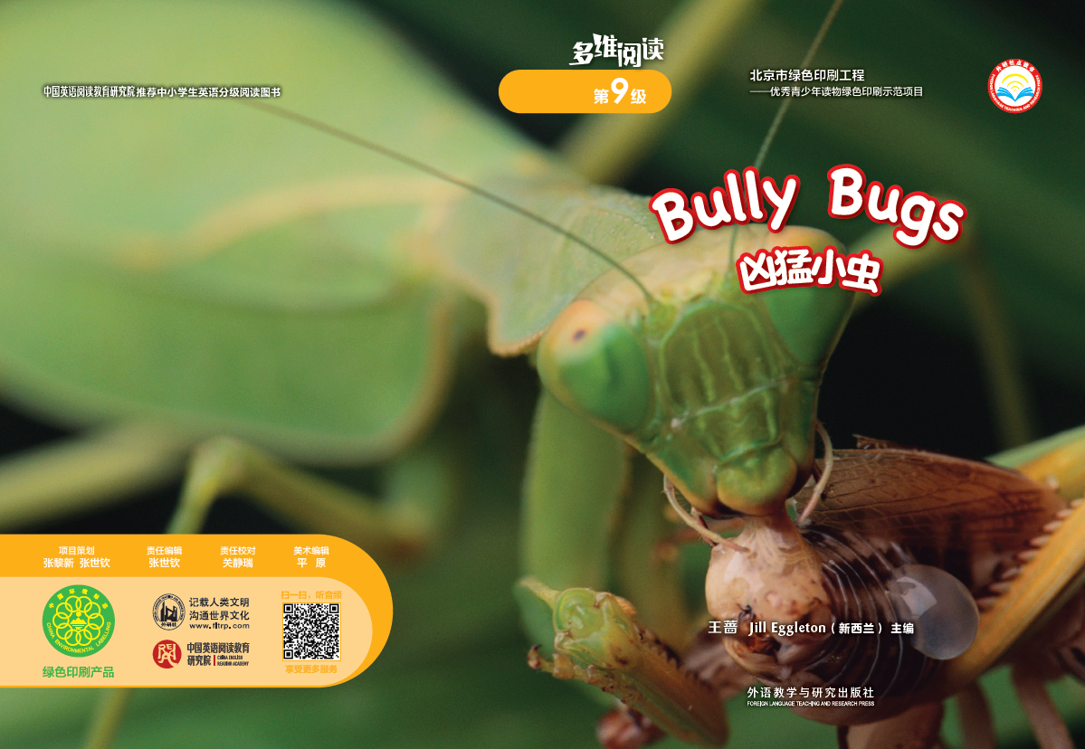

Let’s listen

Slide 17

Quiz Show

Slide 18
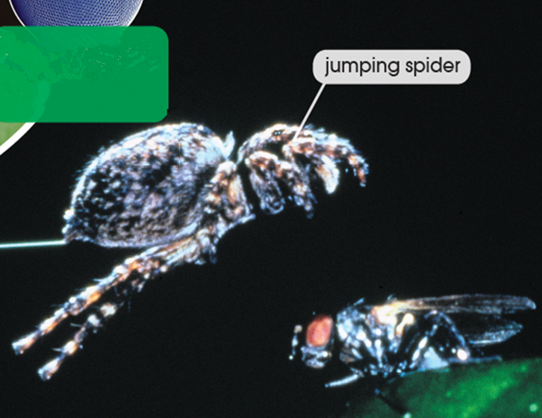
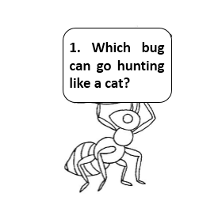

Slide 19
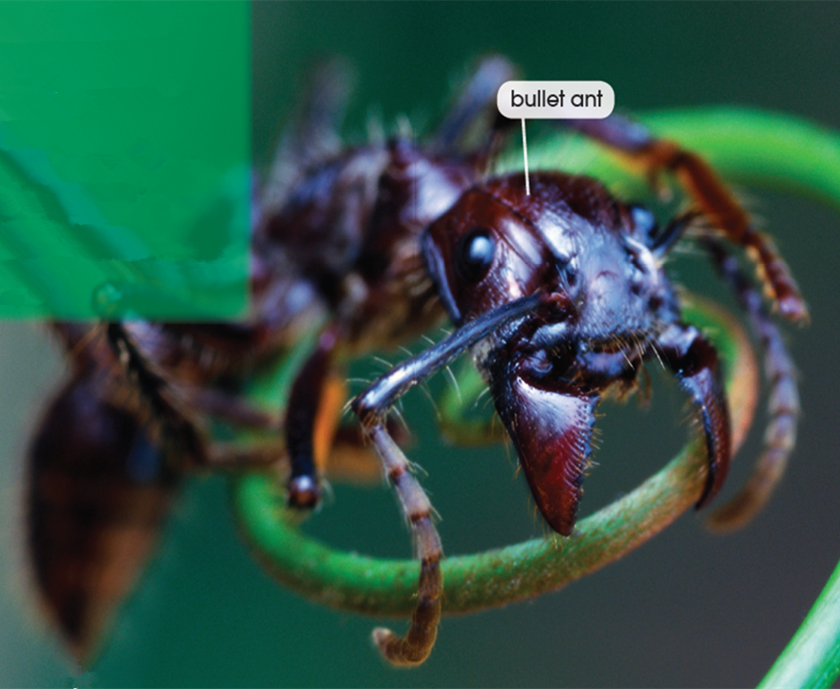
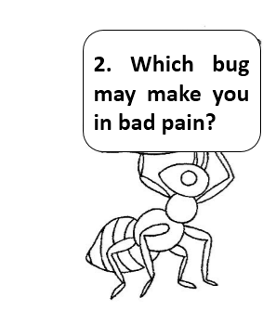

Slide 20
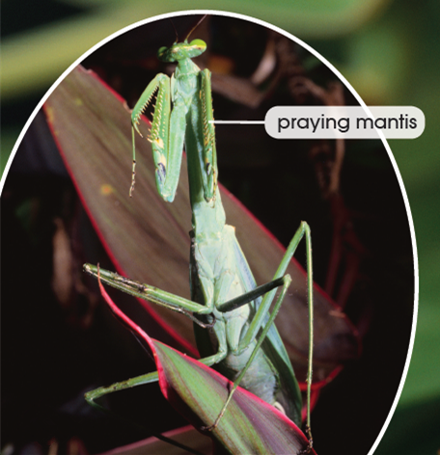
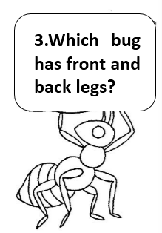

Slide 21
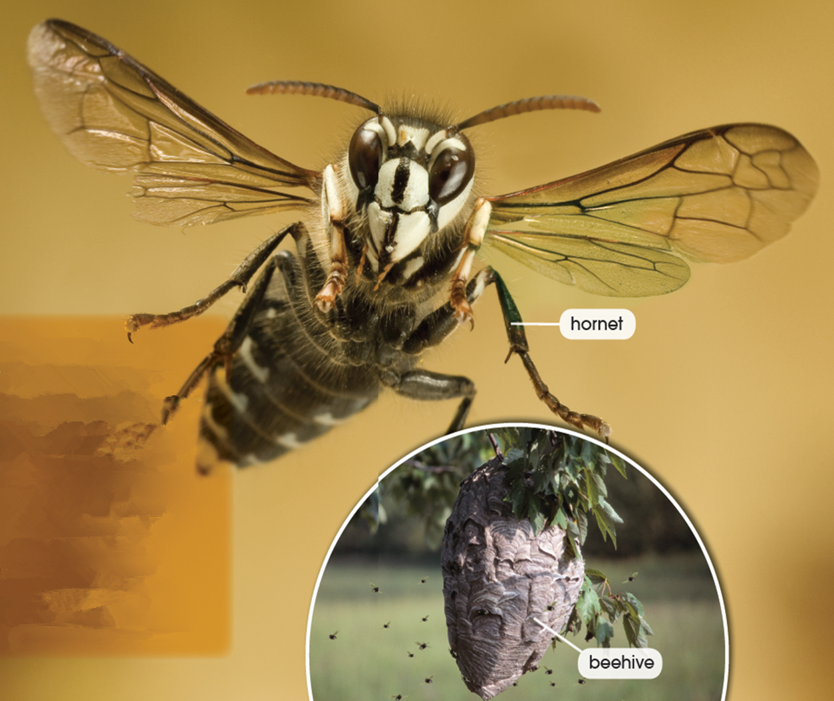
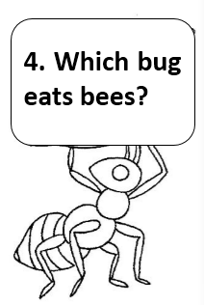

Slide 22
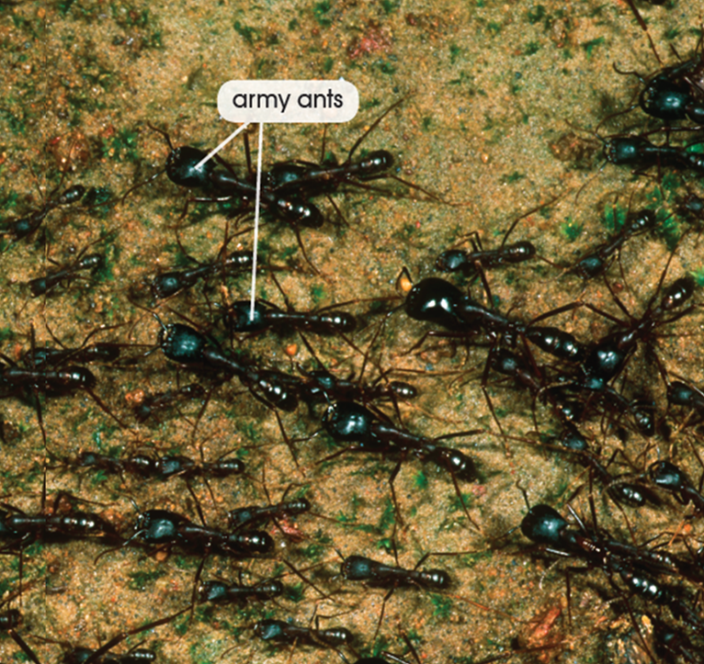
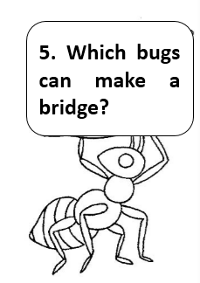

Slide 23
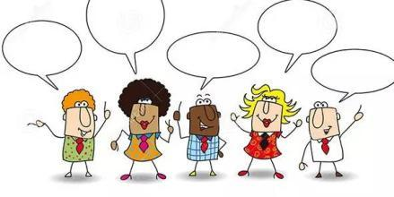
Let’s discuss
Topic 1: How are the bugs similar and
different?

Slide 24
Let’s discuss
Topic 2: These bugs all look like bullies.
But are they bad?
What is your opinion? Discuss in groups.
You can use the sentences in the Sentence Box.
Sentence Box
I think … are bad bugs.
Because they kill/eat…
I think … are not bad bugs.
Because they work in groups/ hunt food for living…

Slide 25
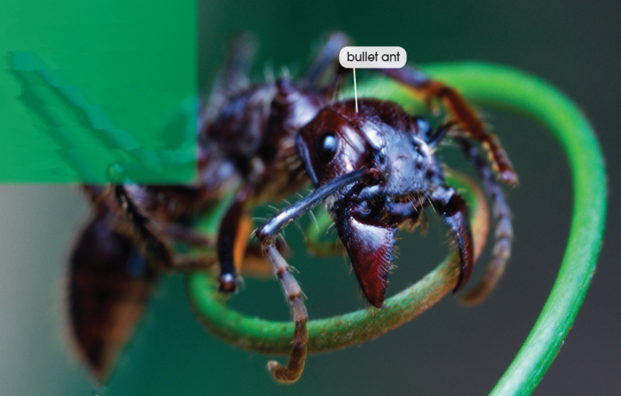
Can you introduce more bugs in this book?
For example：
This is a bullet ant.
It lives in the rain forest.
It has a sting that is very poisonous.
It can sting.
It gets food by its sting.

Slide 26
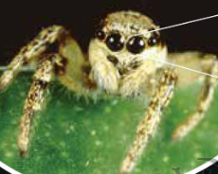
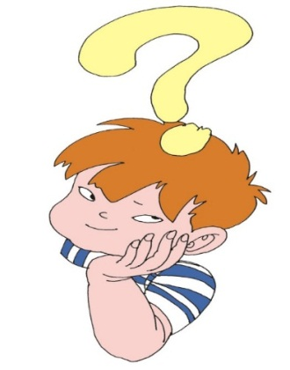
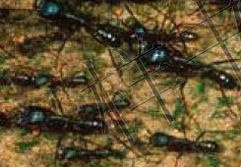
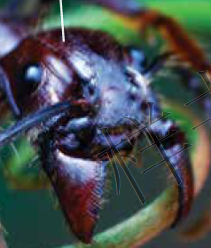
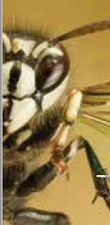
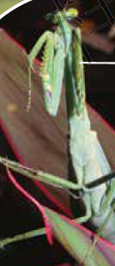
Let’s think
How do you think of the bugs?
If you think they are bad, but they just need food to live.
If you think they are good, but they kill other animals.
What can you learn from the bugs?

Slide 27
Homework
1. Finish the Reading Response about this book.
Nonfiction Chart
Book Title:______________ Author:______________
Numbers of Pages: ____________
What was this book about?
______________________________________________
I knew some facts by reading this book:
Fact 1:_______________________________________
Fact 2:_______________________________________
Fact 3:_______________________________________
I learned some new words by reading this book:
My opinion about this book：

Slide 28
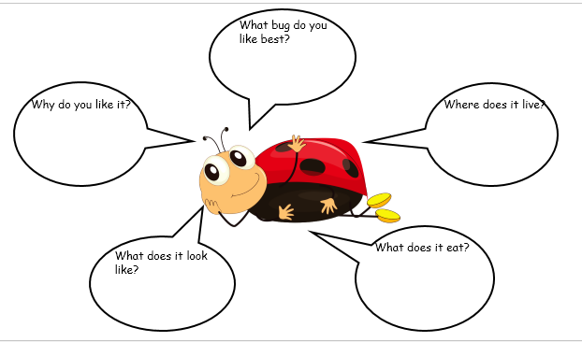
Homework
2. Draw a mind map about the bug you like
and introduce it.

