Slide 1
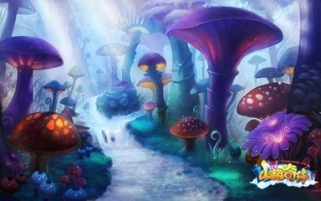
Up Pops a Mushroom
神奇的蘑菇世界
选自《多维阅读第9级》

Slide 2
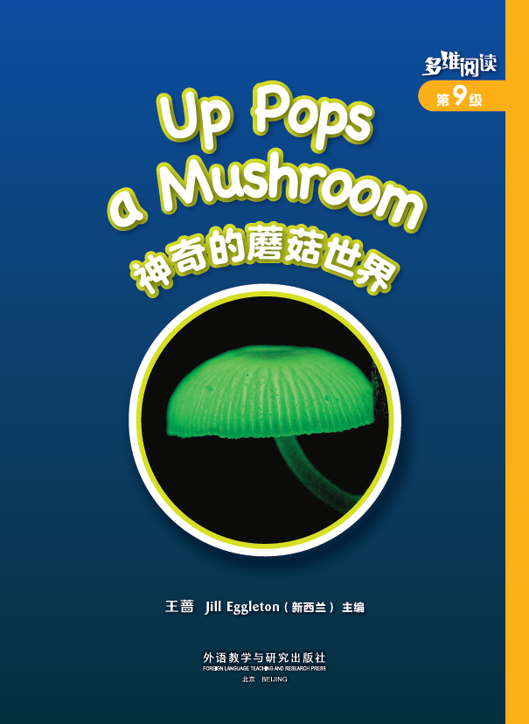
What’s this in the picture?

Slide 3
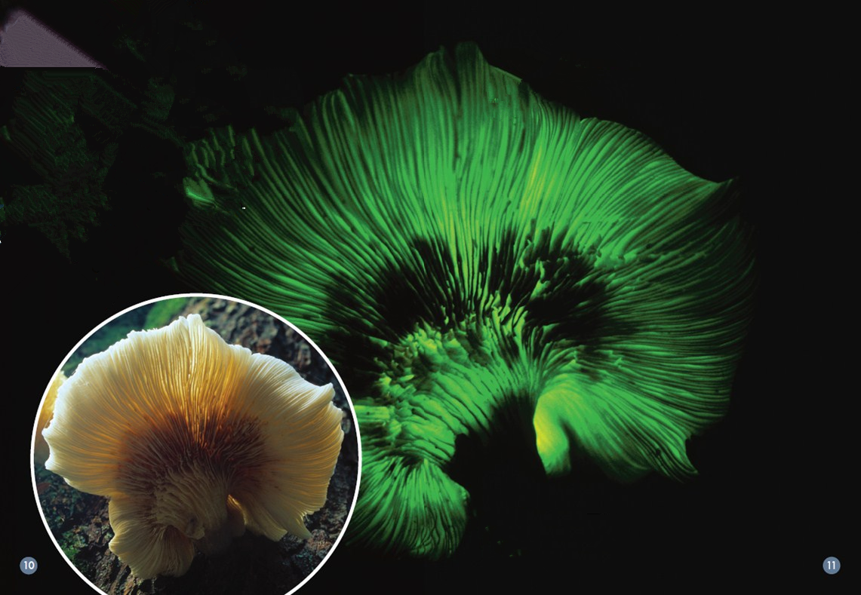

Slide 4
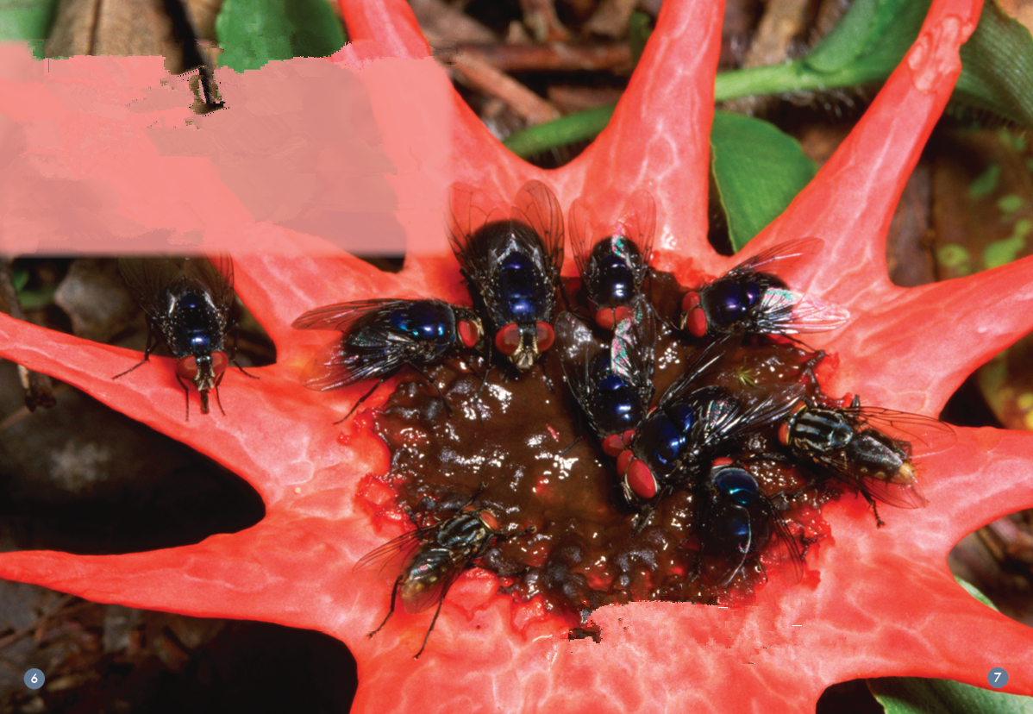

Slide 5
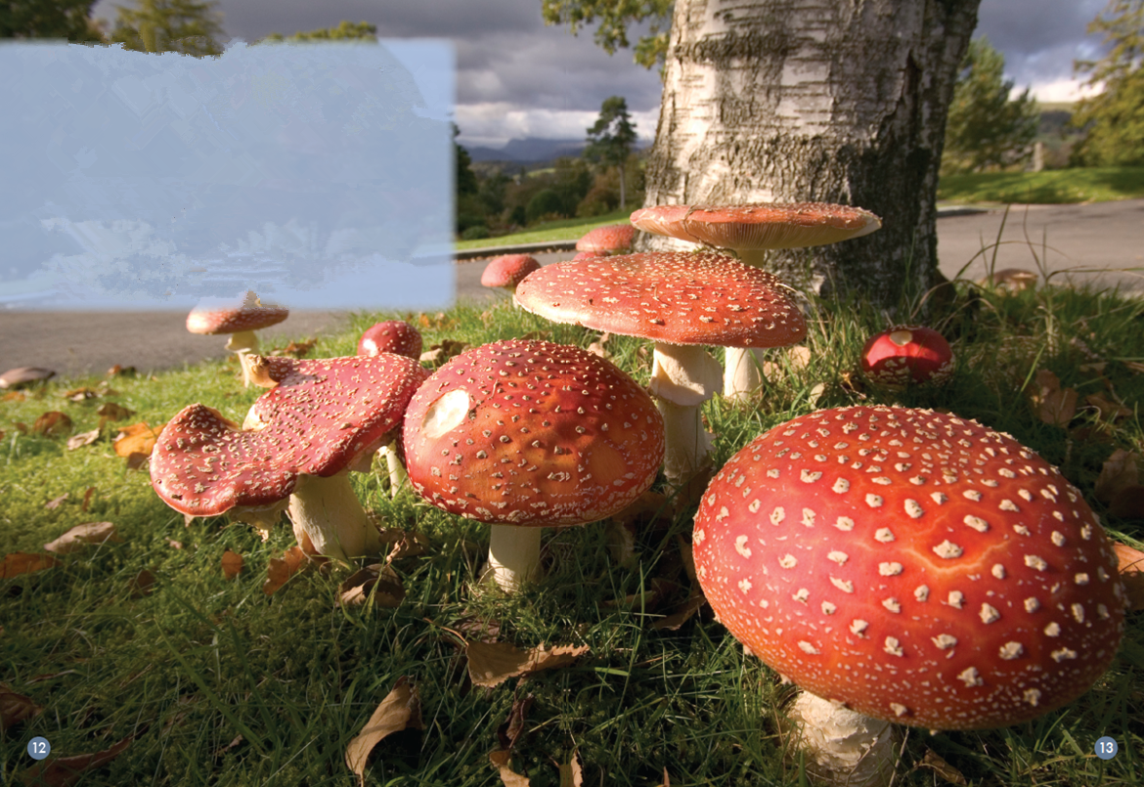

Slide 6
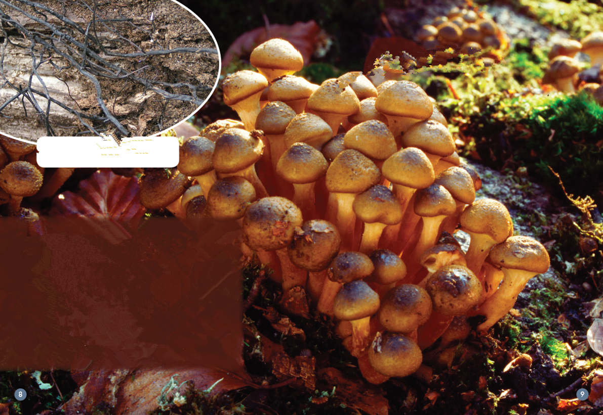

Slide 7
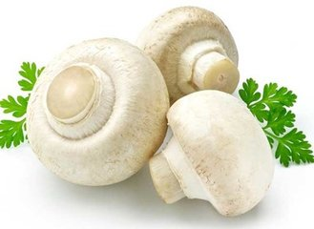
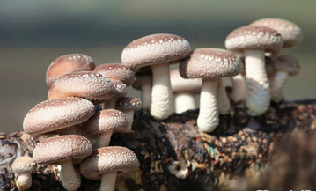
What do you know about mushrooms?
Where do you see them?
What do they look like?
Can we eat them?

Slide 8
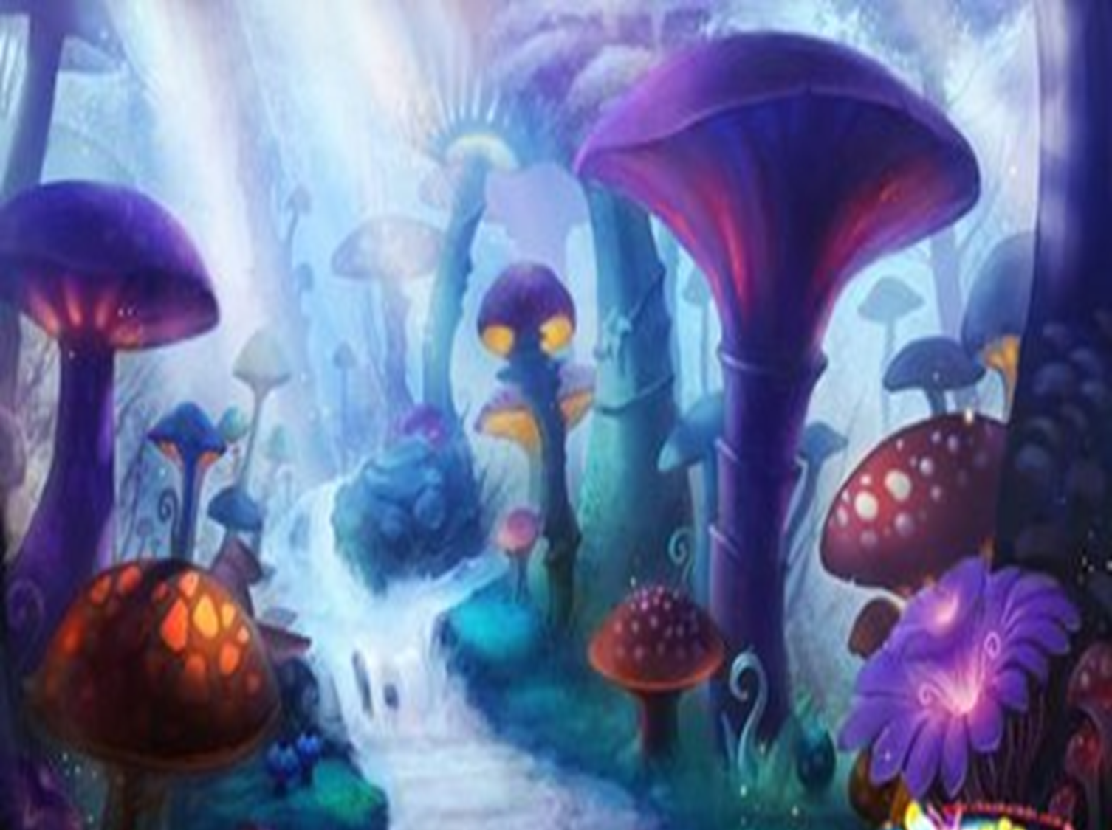
Let’s explore the
wonderful mushroom world!

Slide 9
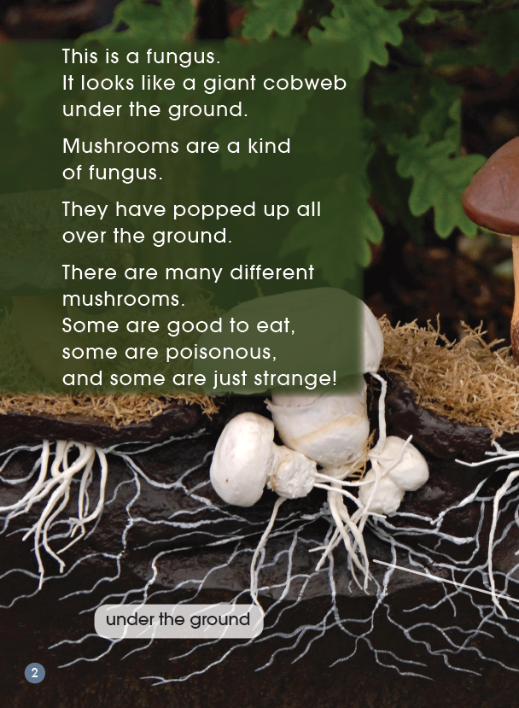
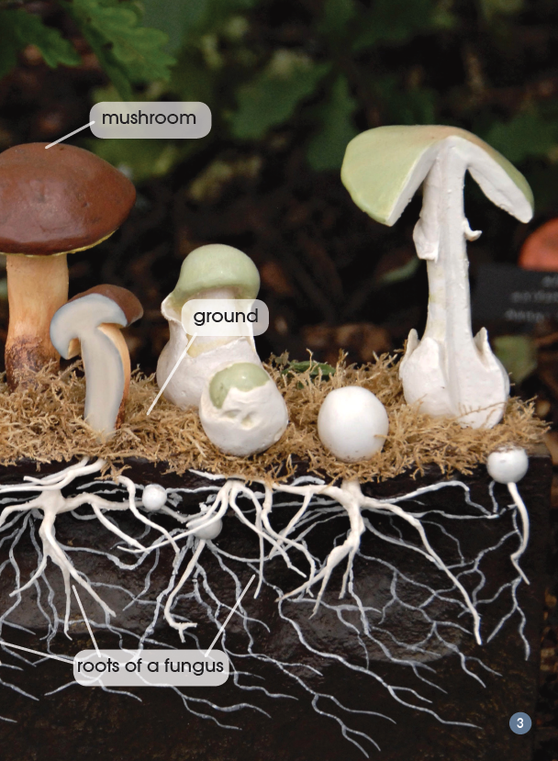
Listen and answer
1. What is mushroom? What does the root look like?
2. Can you eat all mushrooms? Why? Why not?

Slide 10
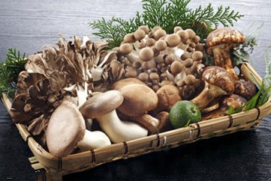
Read and check: What is mushroom?
fungus

Slide 11
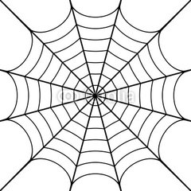
What does the root look like?
cobweb

Slide 12
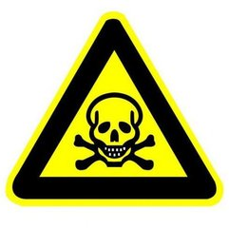
Can you eat all mushrooms? Why? Why not?
poisonous

Slide 13
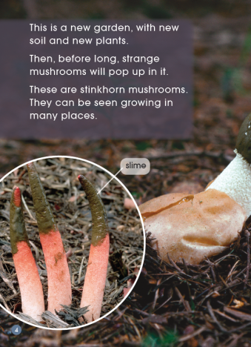
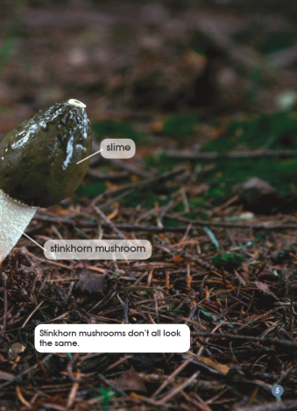
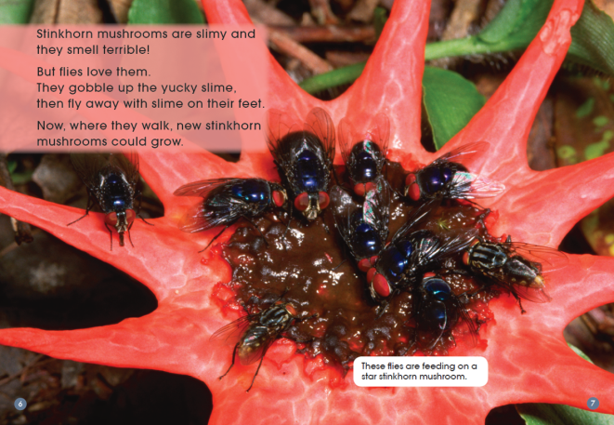
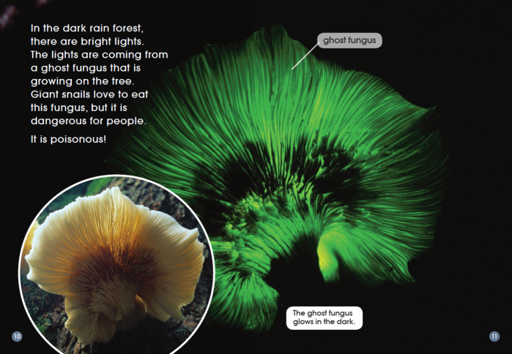
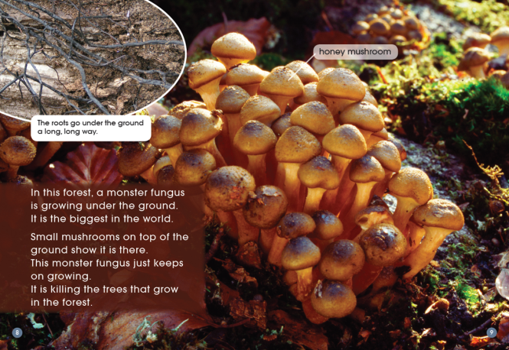
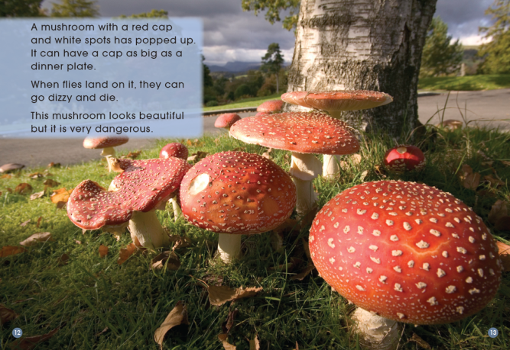
Which one do you want to know?

Slide 14
Read and draw the mushroom,
and write the key words
1. Which mushroom do you want to know?
2. Where do you see this type of mushroom?
3. What does it look like?
4. Would you like to eat a mushroom like this?
Why? Why not?
5. What is something special about this mushroom?
6. What else do you know about this mushroom?

Slide 15
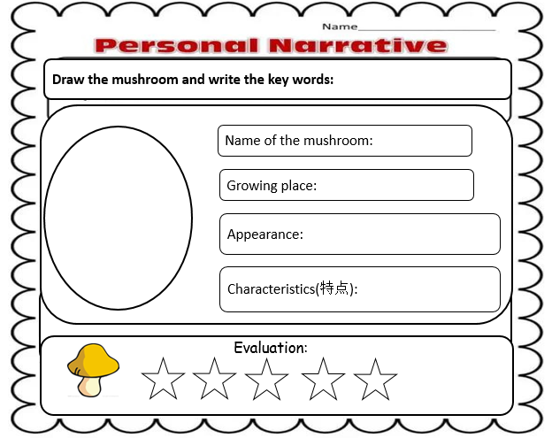
Read and draw the mushroom,
and write the key words

Slide 16


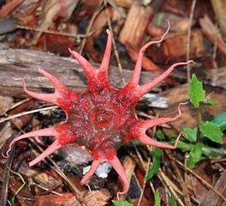
1. Where might you find slime?
2. What other things do you know are slimy?
slime
slimy
stinkhorn mushroom

Slide 17

1. What does “gobble up” mean?
2. How do you know that flies help to spread the star stinkhorn mushrooms?

Slide 18

1. What is something special about this fungus?
2. Why do you think the words “monster fungus” are used?
3. Do you think this fungus should be dug up and got rid of ? Why?
honey mushroom

Slide 19

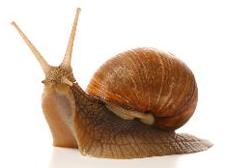
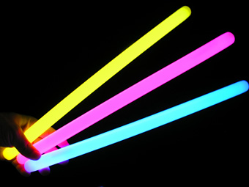
ghost fungus
1. Why do you think it is called a ghost fungus?
2. Does it need light to grow? How do you know that?
3. How do you know this is not a mushroom to eat?

Slide 20

fly agaric mushroom
1. What words make you think these are not small mushroom?
2. How do you know these mushrooms must be very poisonous?
3. Would you touch these mushrooms? Why? Why not?

Slide 21
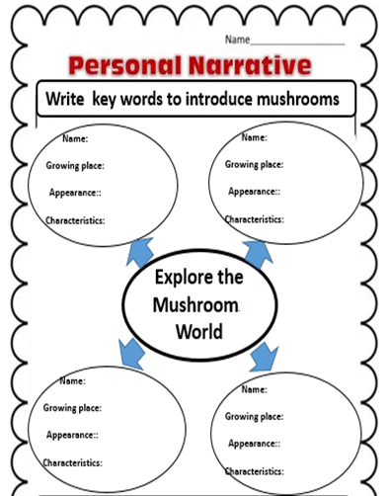
Read, share the information
and write the key words:

Slide 22
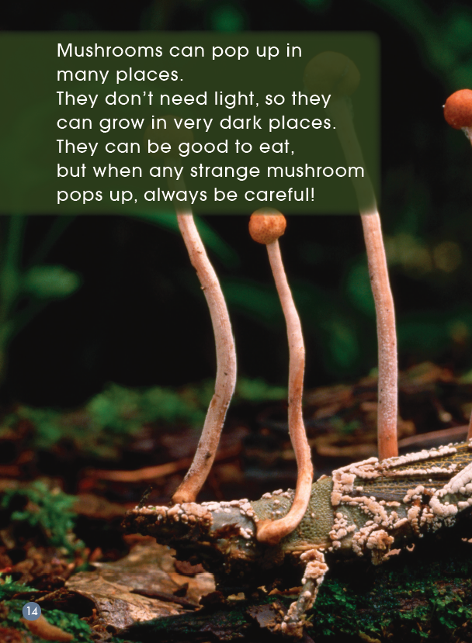
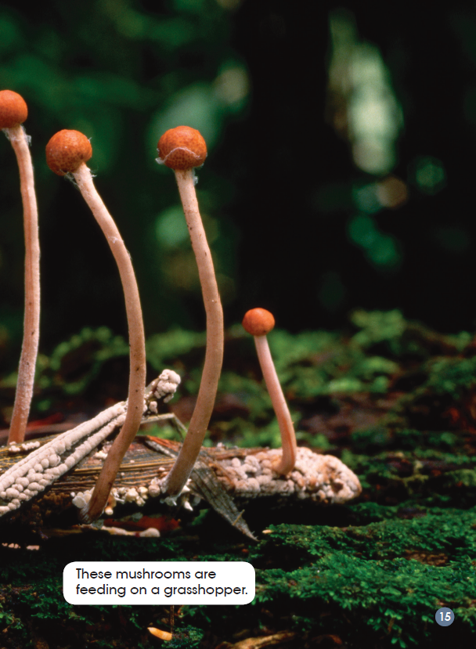
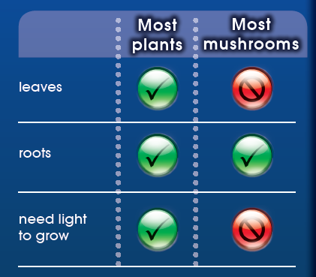
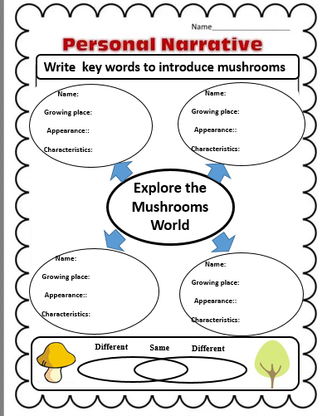
Read and find something similar and different between mushrooms and other plants

Slide 23

Listen and read

Slide 24
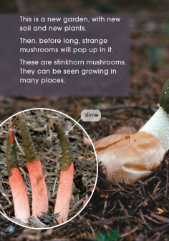

Make a riddle
Name
This is a stinkhorn mushroom .
Growing place
It pops up in the garden.
It is strange, and they don’t all look the same.
Appearance
Characteristics
It is slimy and smells terrible.
What mushroom is it?

Slide 25
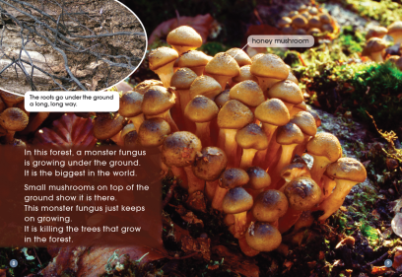
Name
This is a honey mushroom.
Growing place
It pops up in the forest.
It shows small mushrooms on the top of the ground.
Appearance
Its roots can go under the ground a long, long way and it can kill the tree.
Characteristics
What mushroom is it?

Slide 26

Name
This is a ghost fungus.
It pops up on the tree in the dark rain forest.
Growing place
Appearance
It can glow.
Giant snails love to eat it.
But it is dangerous for people.
Characteristics
What mushroom is it?

Slide 27

Name
This is a fly agaric mushroom.
Growing place
It pops up from the ground.
It has a red cap and white spots on the cap. It looks beautiful.
Appearance
When flies land on it, they can go dizzy and die.
It is very dangerous.
Characteristics
What mushroom is it?

Slide 28

Homework
1.Try to find more information about one type of mushroom in the text.
2. Try to introduce a type of new
mushroom that you want to know.

