Slide 1
选自《多维阅读第9级》
Uncle Al Goes to Soccer!
阿尔叔叔去看球

Slide 2

Where have you seen this character before, and what do you know about him?

Slide 3

Based on what you know about Uncle Al, can you guess what will happen?

Slide 4
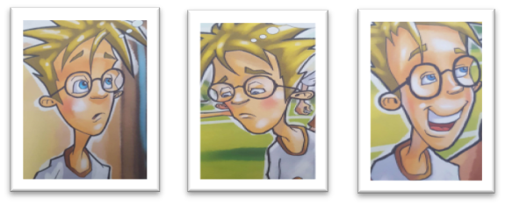
Group work

Slide 5
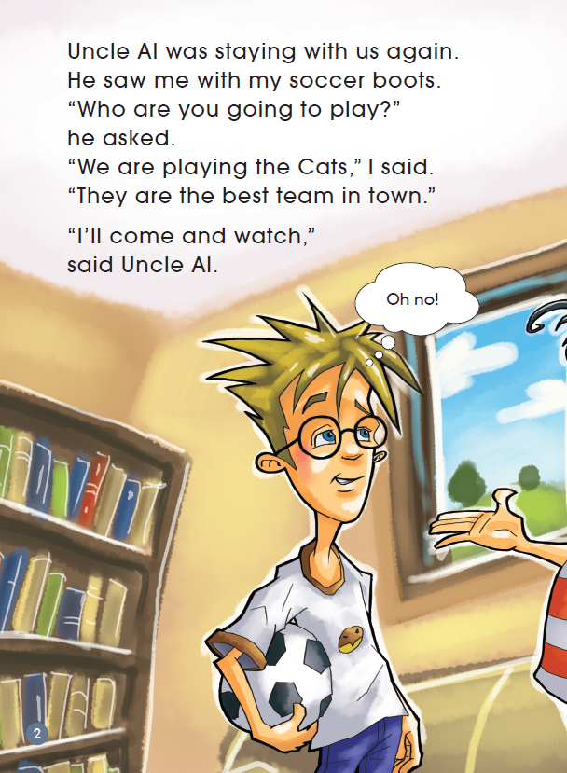
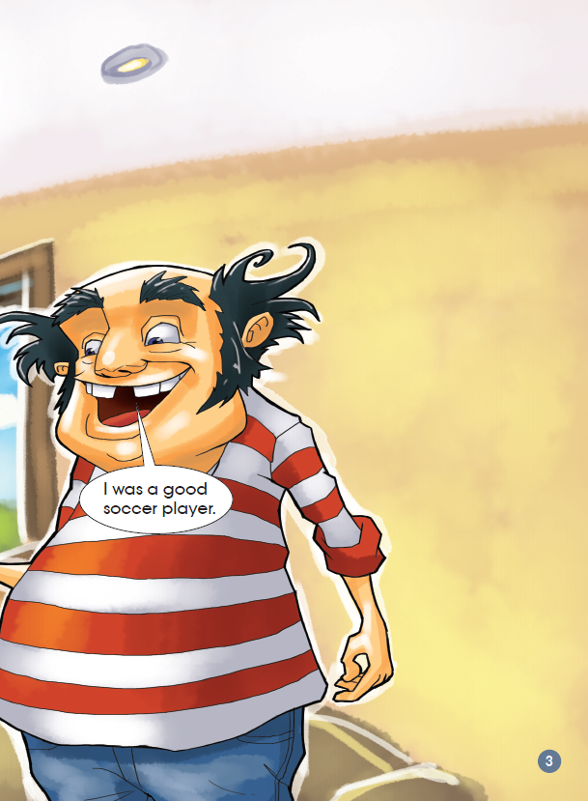
First reading

Slide 6
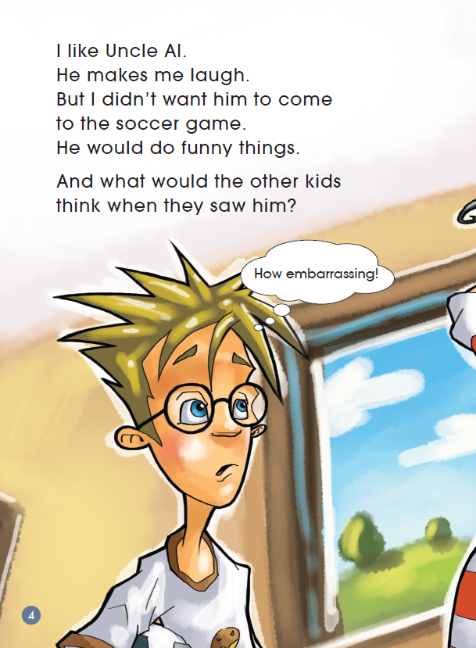
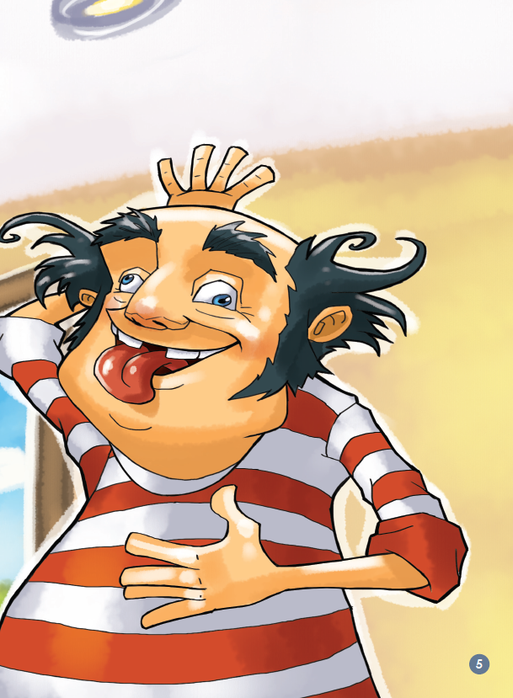

Slide 7
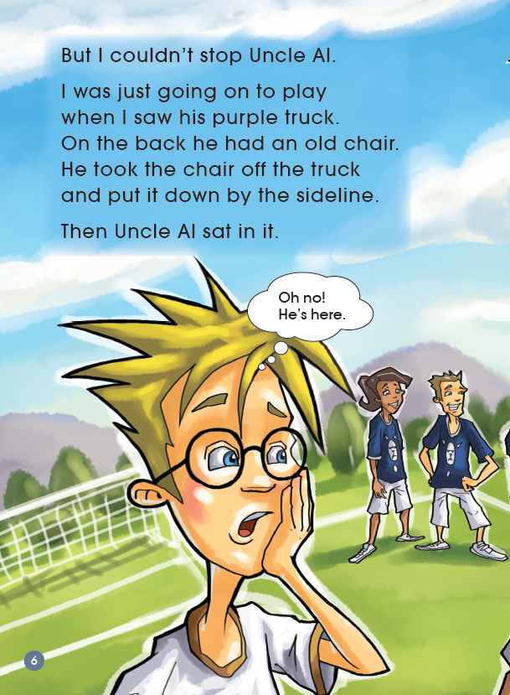
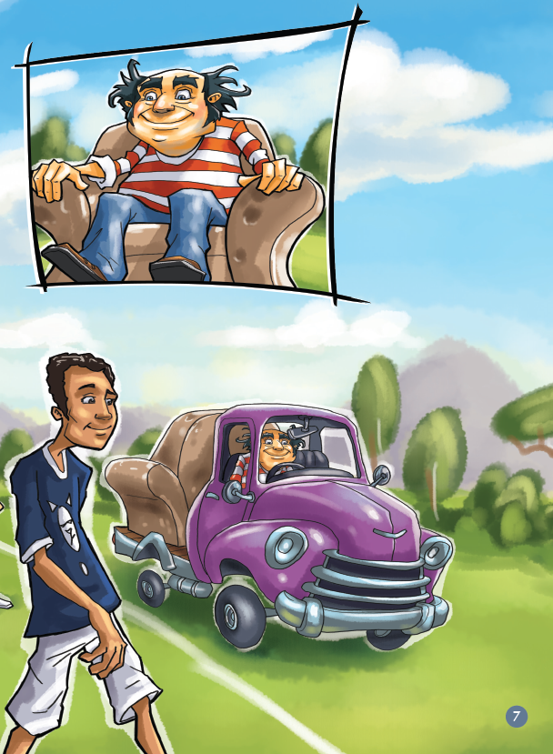

Slide 8
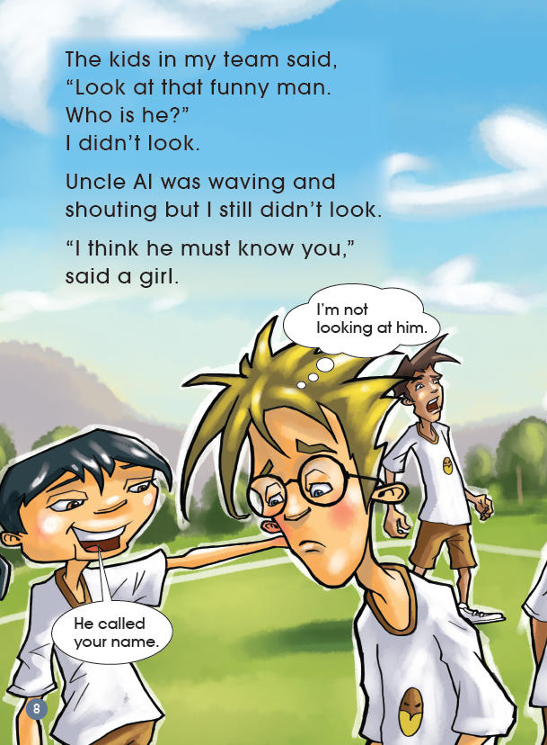
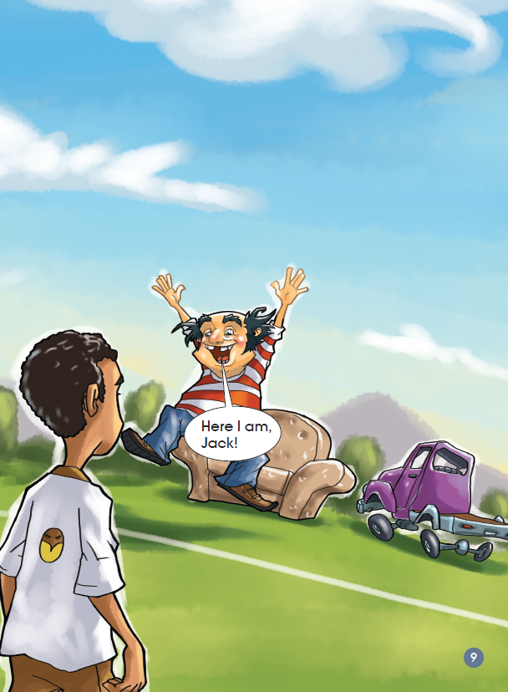

Slide 9
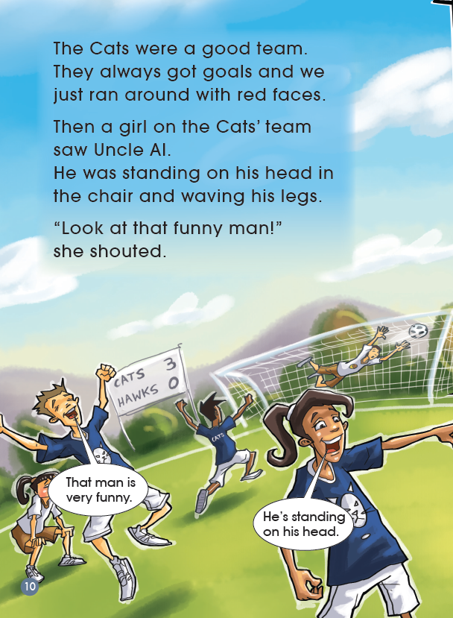
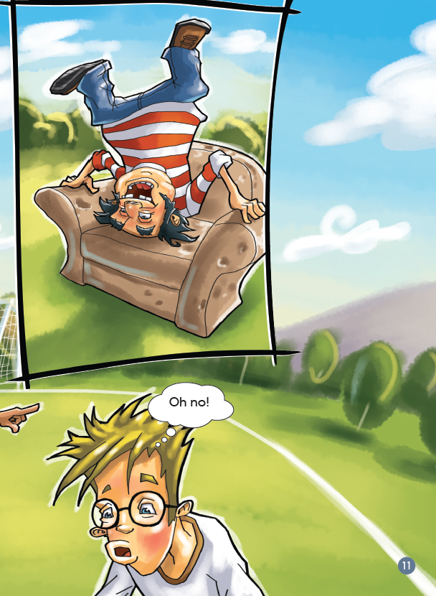

Slide 10
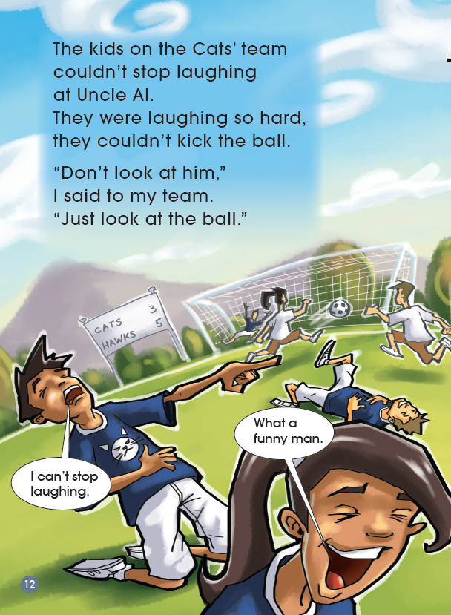
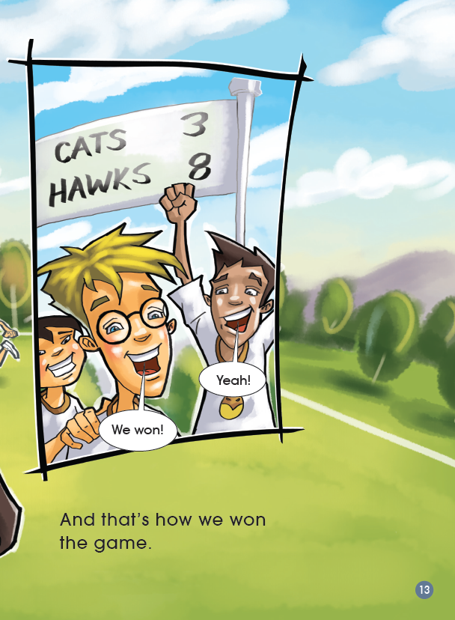

Slide 11
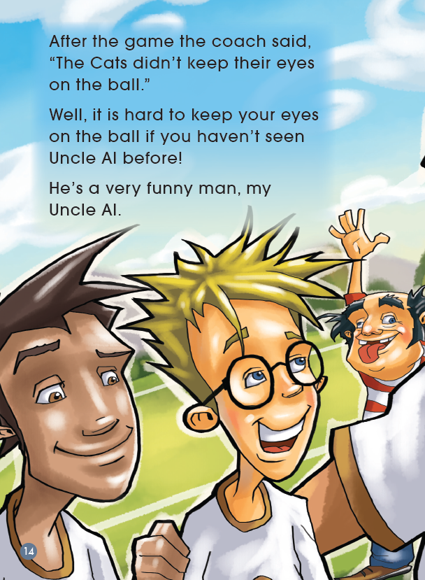
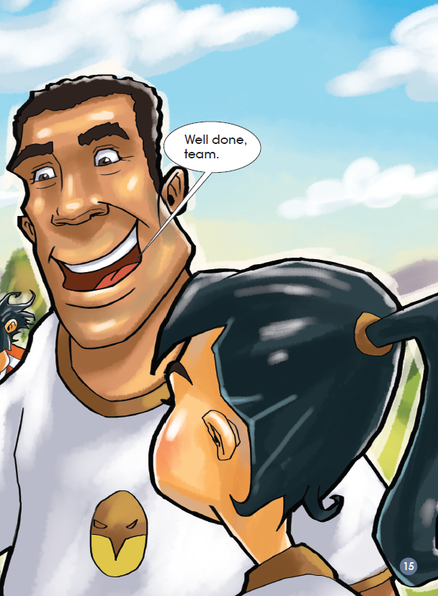

Slide 12
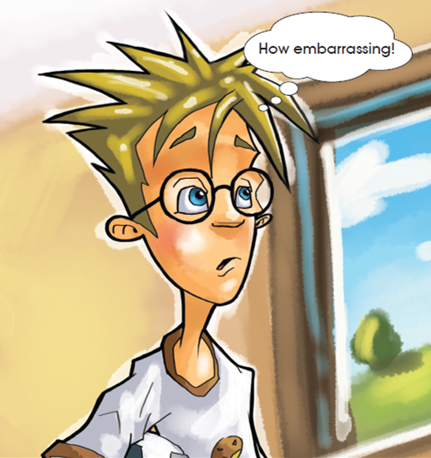
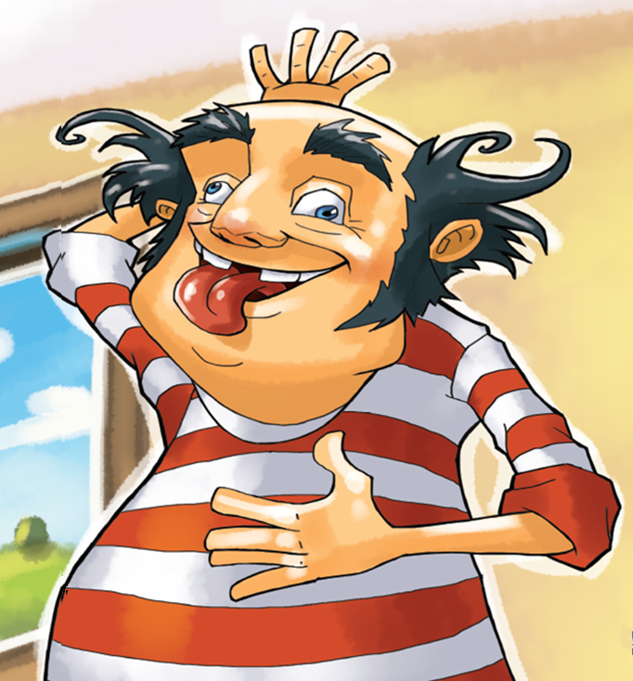
Second reading
embarrassing

Slide 13
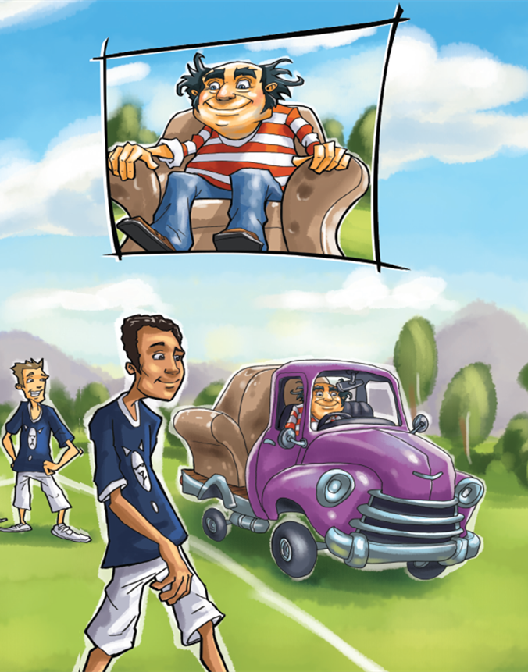
truck
sideline

Slide 14
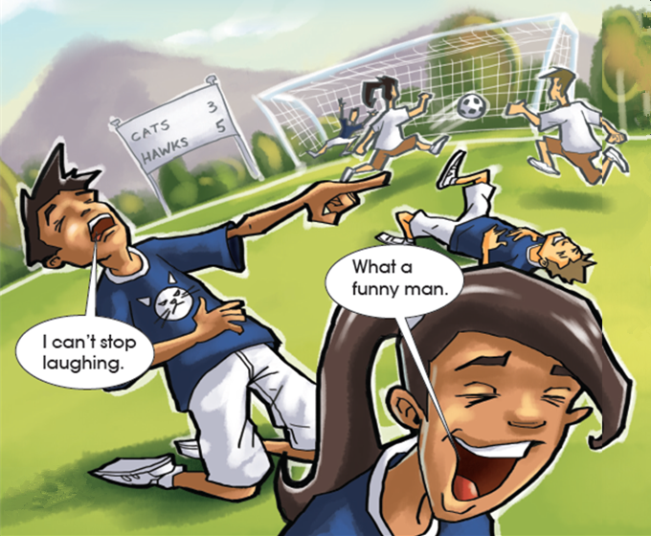
couldn’t stop laughing
can’t stop doing

Slide 15
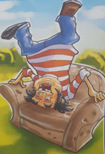
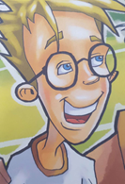
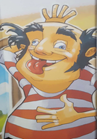
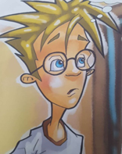
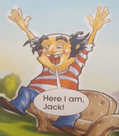
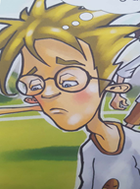
Third reading
What did Uncle Al do?
________________________
How did Jack feel?
____________________
What did Uncle Al do?
__________________________
How did Jack feel?
____________________
Read the story again
Finish the worksheet
Retell the story with worksheet
Share in groups
up
Jack’s mood
Jack’s mood
What did Uncle Al do?
________________________
How did Jack feel?
__________________

Slide 16
Reading circle
Choose one role and finish the task according to worksheet.
Character Captain
Creative Connector
Moral Master
Criticizer

Slide 17
Group sharing
1. Do you have experiences that you felt embarrassed about what your family members did?
2. What did you do and what did you say to them? If you have a chance to change, what would you say and do?

Slide 18
Homework
Draw a person in your family who has made you happy and write a simple description about him/her and what he/she did.

