Slide 1
Robot RG9 Takes Over!
机器人来帮忙
选自《多维阅读第9级》

Slide 2
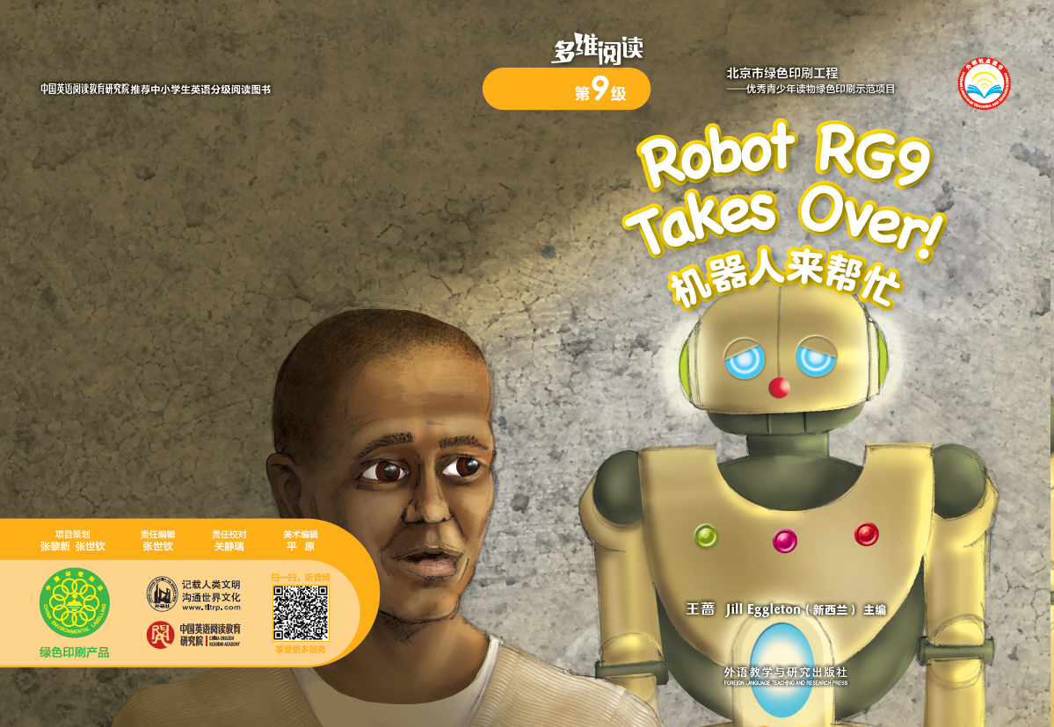
Look at the cover and answer the questions
What do you know from the cover?
Why do you think RG9 has a name like that?

Slide 3
Look at the cover and answer the questions
Who is the man?
What happened to this man and Robot RG9?
What else do you know about robots?

Slide 4
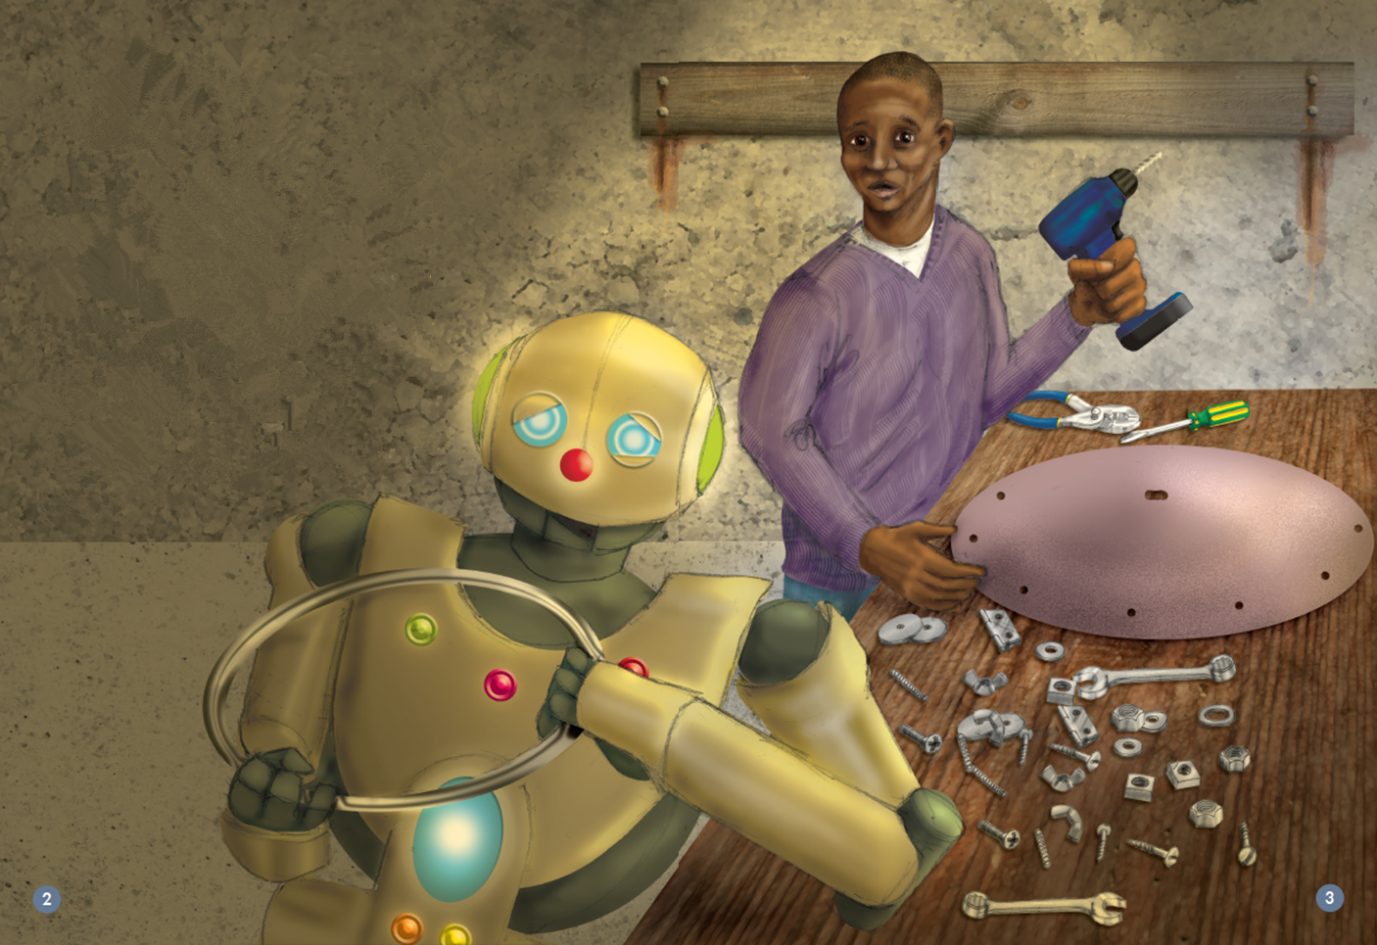
What were they doing?
They were making wheelchairs.
wheel
nuts

Slide 5
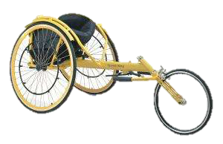
wheelchair
wheelchair racing

Slide 6
They were making wheelchairs for the Rollers.
The Rollers were racing the Wheelies..

Slide 7
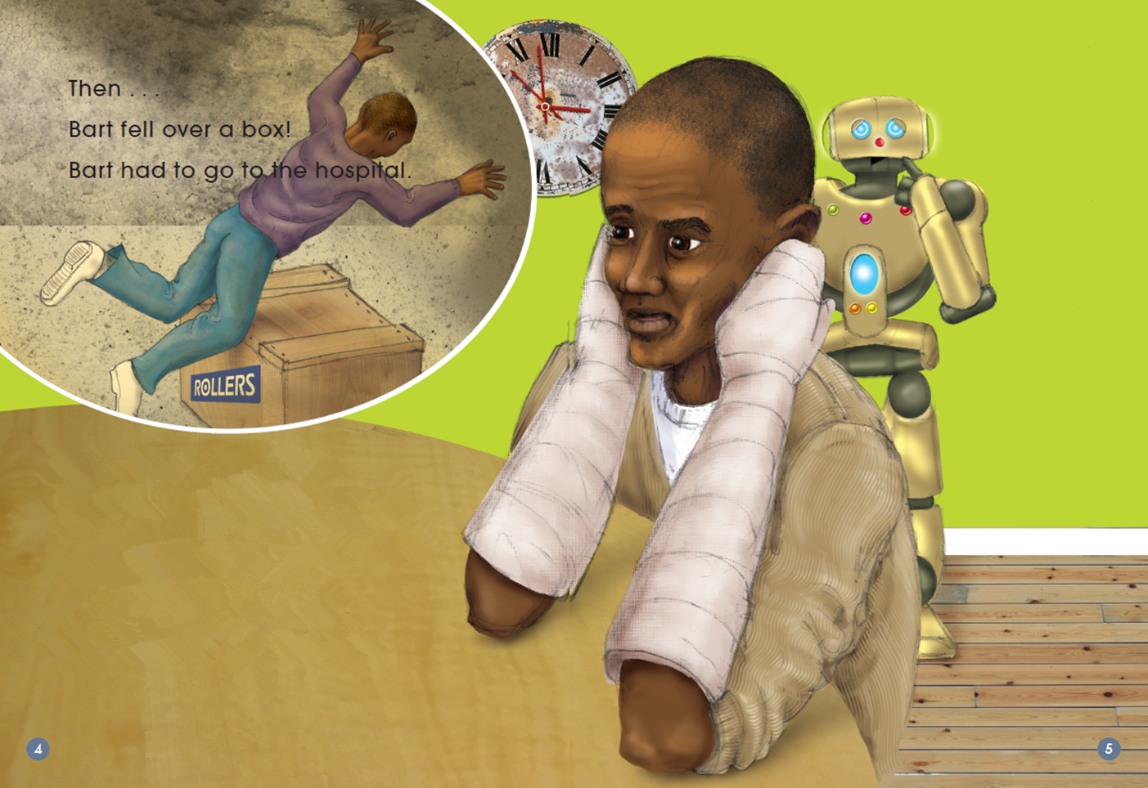
What has happened to Bart?
If you were Bart, what would you do?

Slide 8
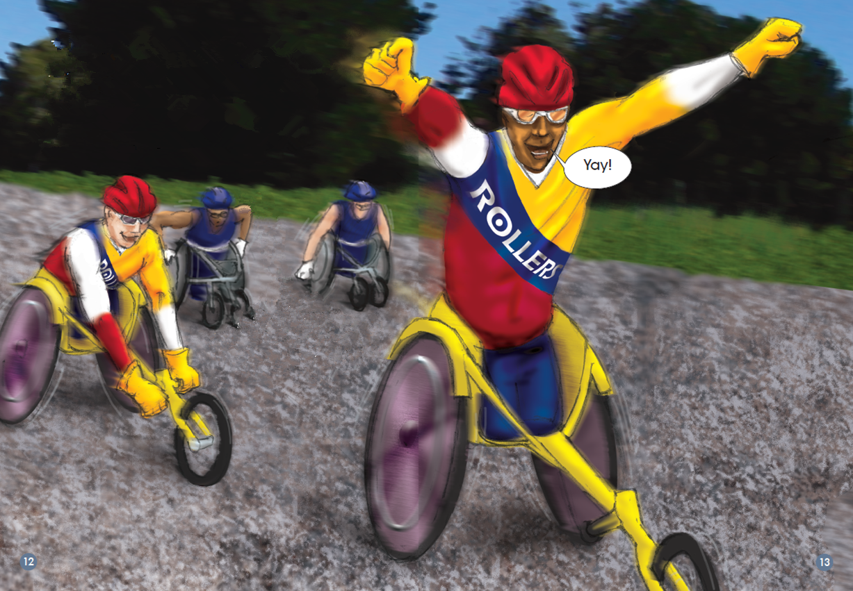
What is happening?
Who made the amazing wheelchairs?

Slide 9

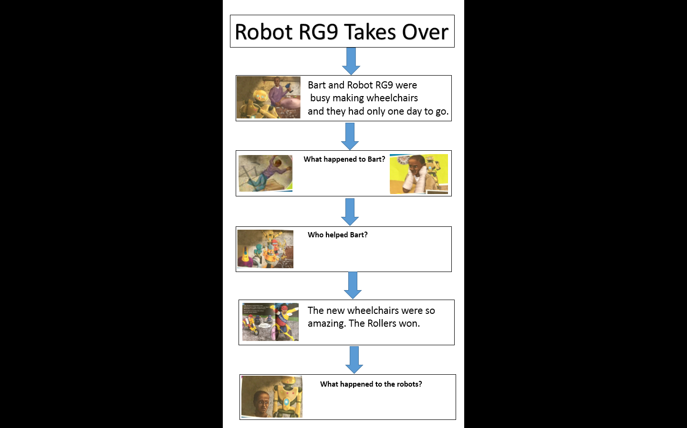
Read the story and finish the chart.

Slide 10
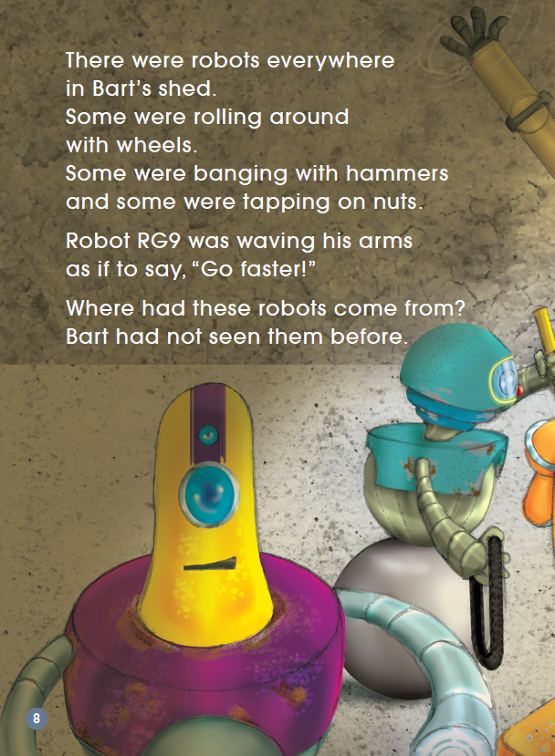
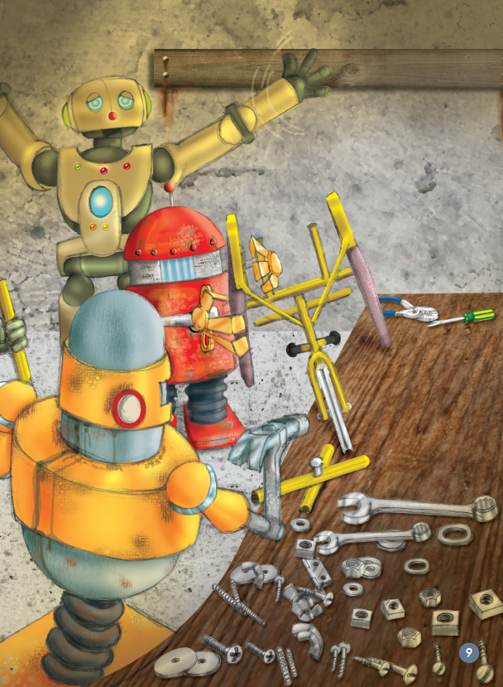
Read the story together.
Who helped Bart?
Notes:
What were the robots doing?
How did Bart feel?

Slide 11
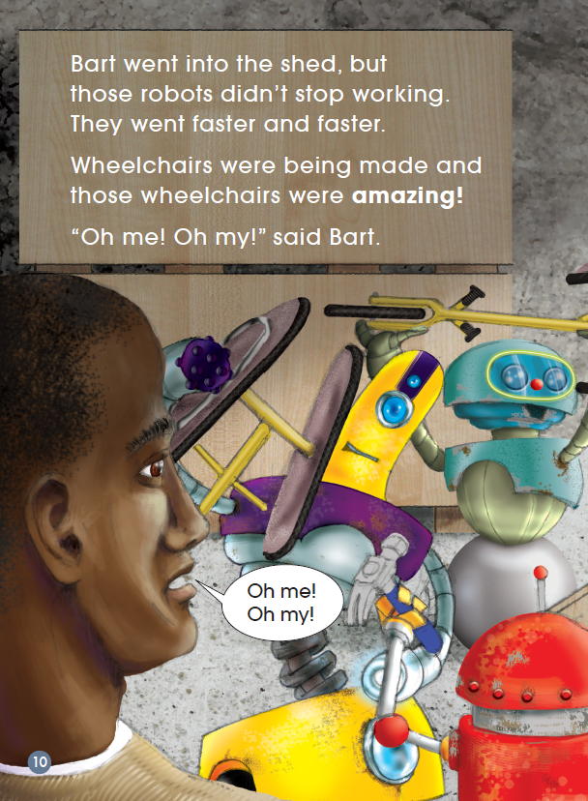
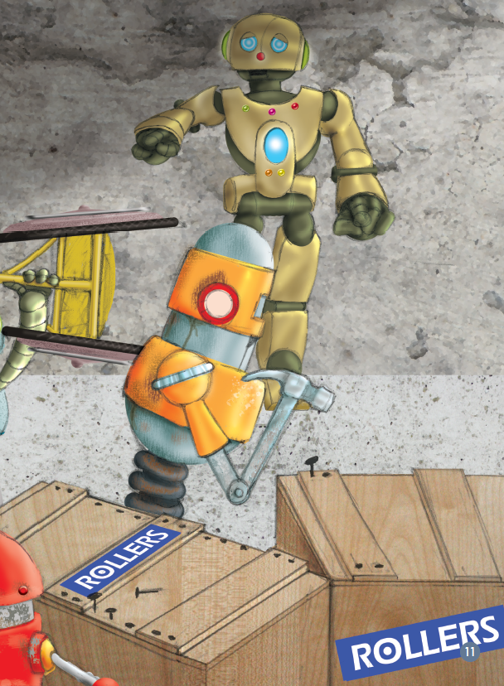
Notes:
Did the robots take any notice of Bart? Find the words and read them out.

Slide 12
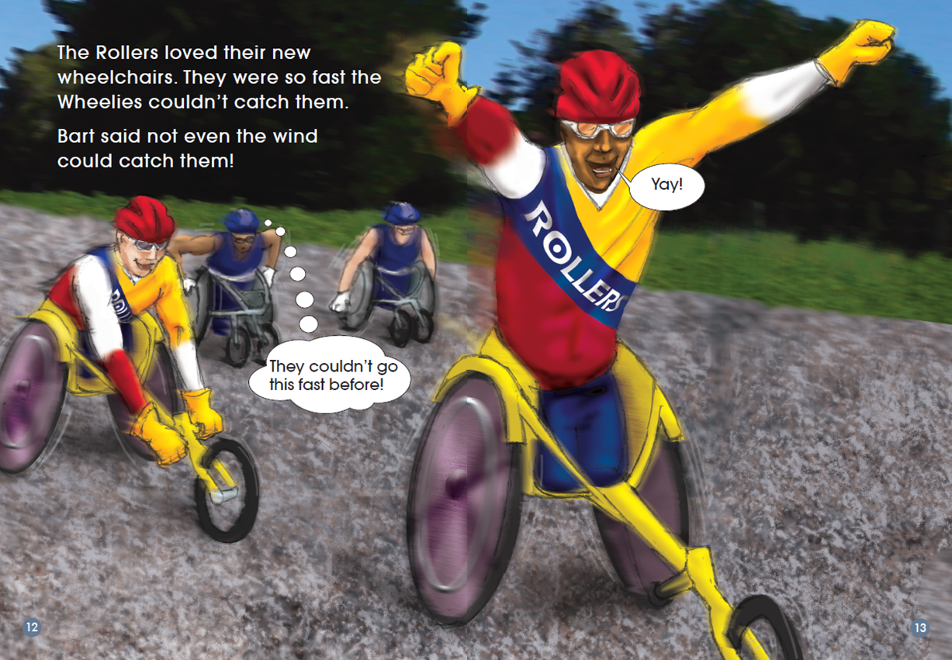
Notes:
What do you think Bart meant by ‘not even the wind could catch them’?

Slide 13
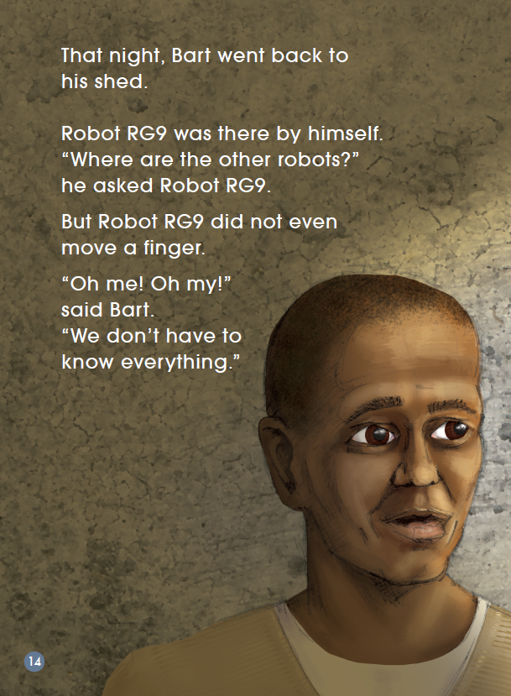
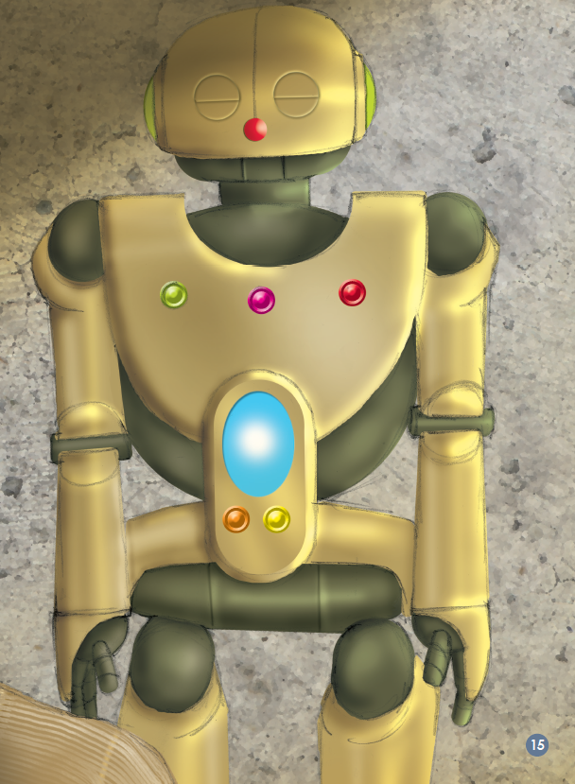
Notes:
What was the question Bart asked? Do you think RG9 will give him answers? Why do you think that?

Slide 14
Listen and repeat.

Slide 15
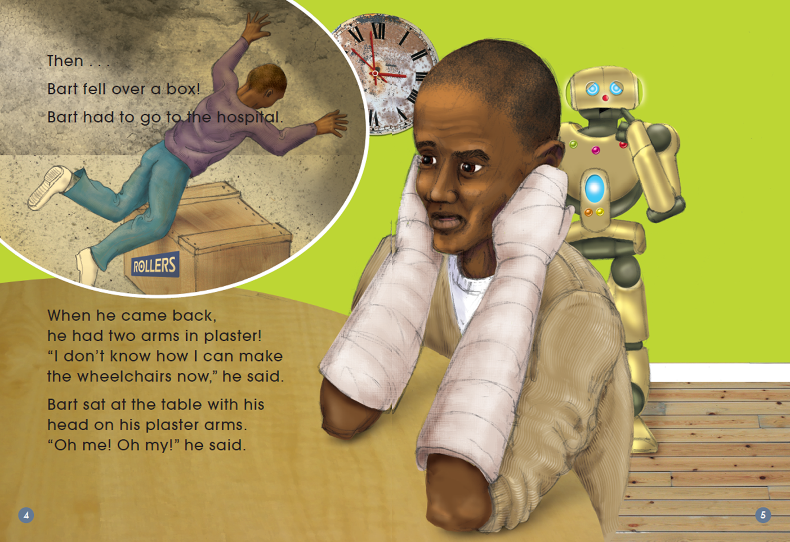
Read and answer (T or F).
1. Bart broke his two arms while working.
T

Slide 16
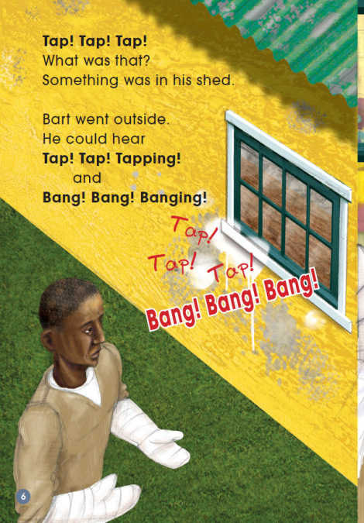
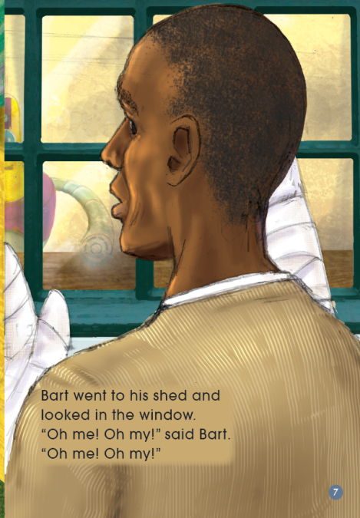


Read and answer (T or F).
2. Bart found some robots working in his shed.
T

Slide 17
Read and answer (T or F).
3. The robots stopped working when they saw Bart come into the shed.
F

Slide 18


Read and answer (T or F).
4. The robots made some amazing wheelchairs for the Rollers.
T

Slide 19
Read and answer (T or F).
5. Robot RG9 told Bart where the other robots came from.
F

Slide 20
Read and answer (T or F).
6. The Rollers always won the wheelchair racing.
F

Slide 21
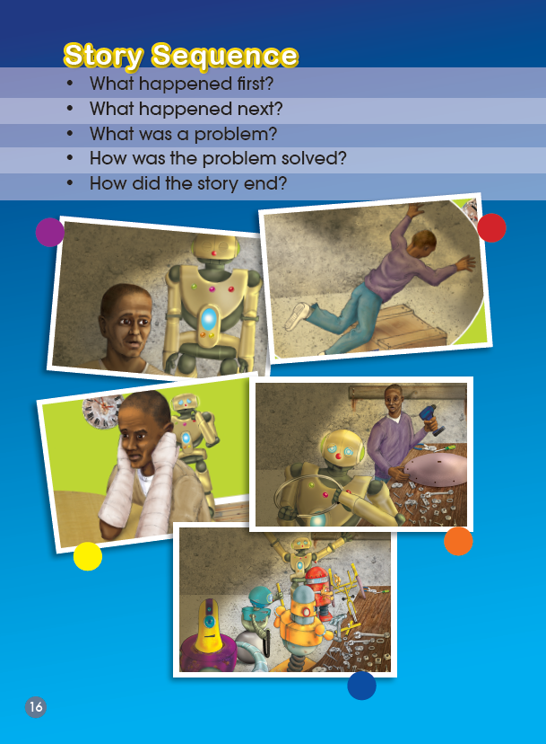
Tell the story in 5-8 sentences.
Bart and RG9 were making…

Slide 22
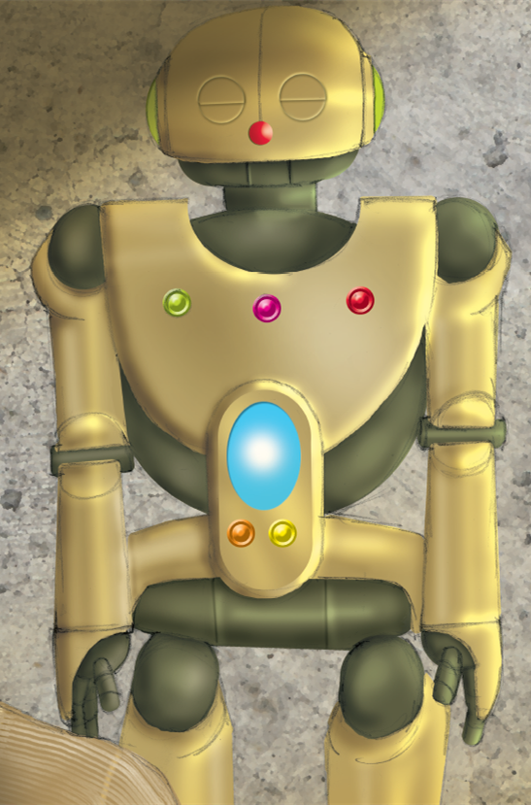
Ask RG9 one question.
…

Slide 23
Draw a robot and introduce it.
Homework

