Slide 1
Rubbish in the River 河中的垃圾
选自
《多维阅读第8级》

Slide 2
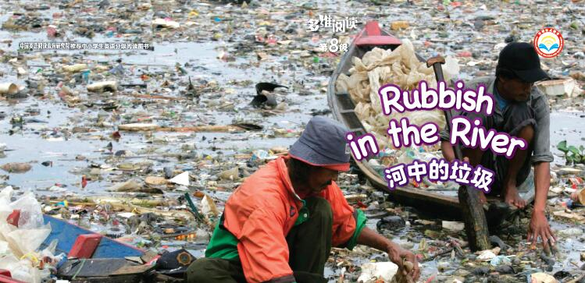
What do you know from the cover?

Slide 3
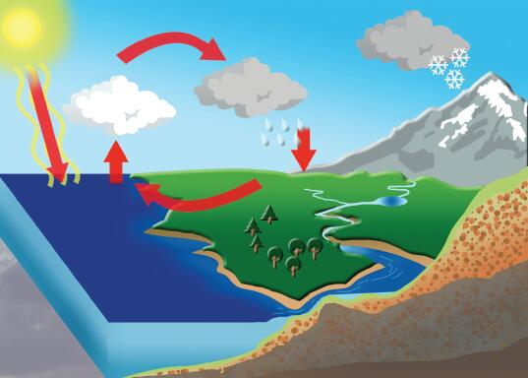
The water cycle

Slide 4
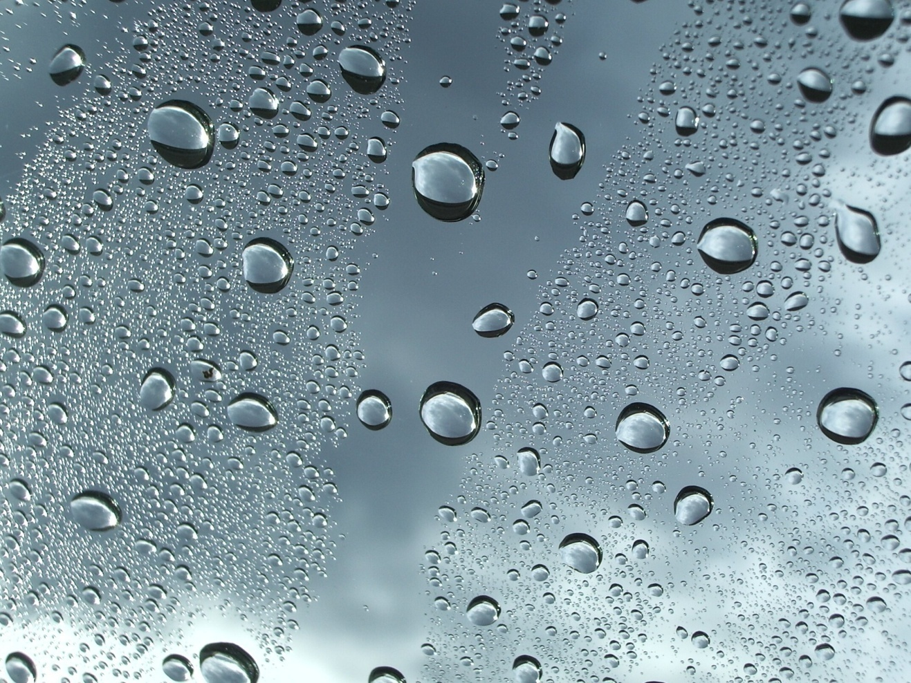
droplets

Slide 5
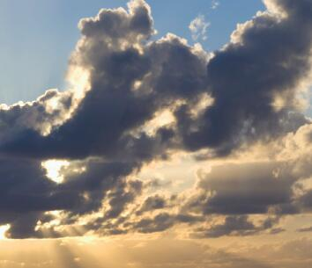
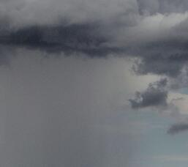
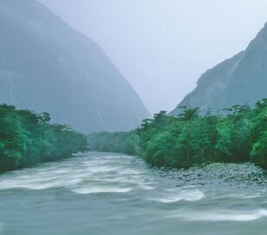
Droplets of water are inside the cloud
The cloud bursts.
It rains.
The rain falls in the ocean or on the land.
What can the rain do after it goes under the ground or into a river?

Slide 6
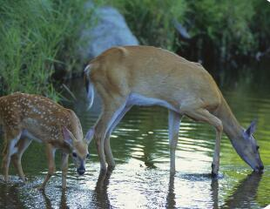
Droplets of water are inside the cloud
The cloud bursts.
It rains.
The rain falls in the ocean or on the land.
People and animals come to the clean water.

Slide 7
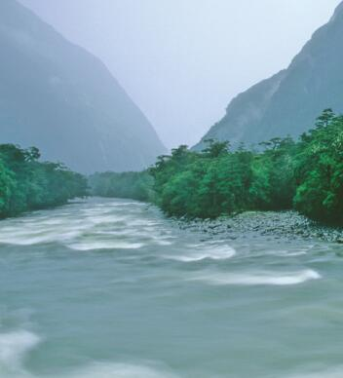
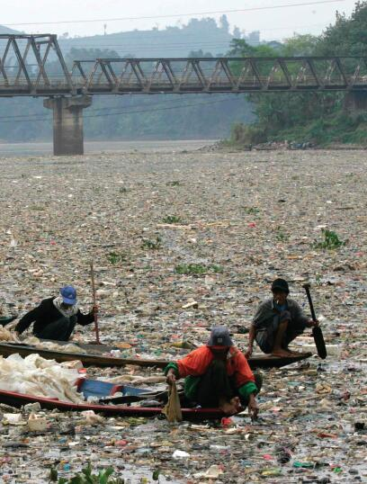
What if the rain fell in a river like this?

Slide 8
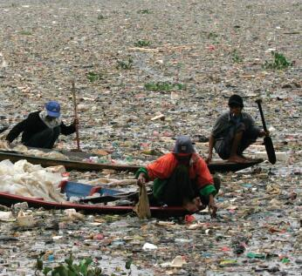
People can’t drink the water.
What if some water in this river went up and came down on Earth?
Animals can’t drink the water.
There were no fish in the river.

Slide 9
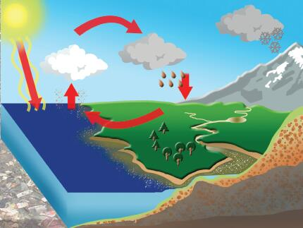
What if some water in this river went up like this…
and came down on Earth?

Slide 10
What differences can you see in the two diagrams?
Use your own words to describe the water cycle in the two diagrams.

Slide 11
What can we do to keep our world clean?

Slide 12
To live a low-carbon life.
What is a low-carbon life?
Saving energy and living a green and simple life.

Slide 13
What’s the motto of a low-carbon life?
Reduce, Reuse, Recycle

Slide 14
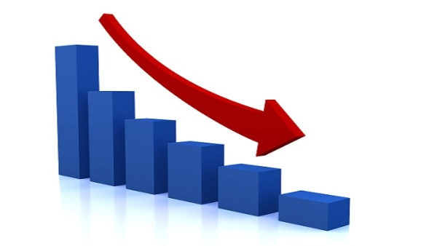
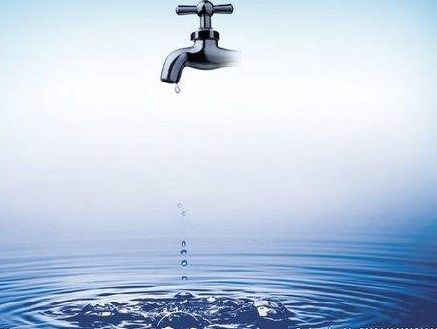
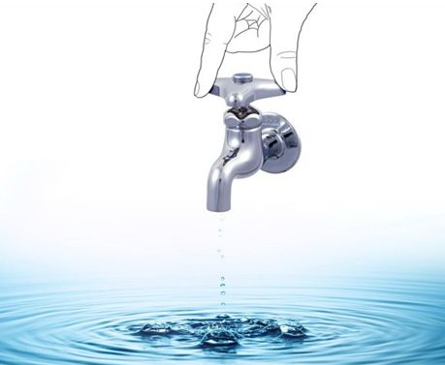
Reduce

Slide 15
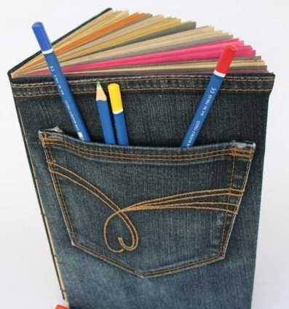
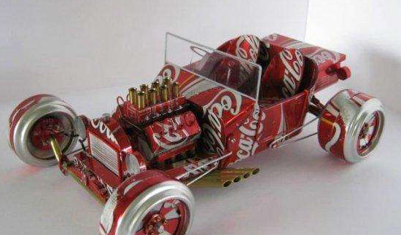
Reuse

Slide 16
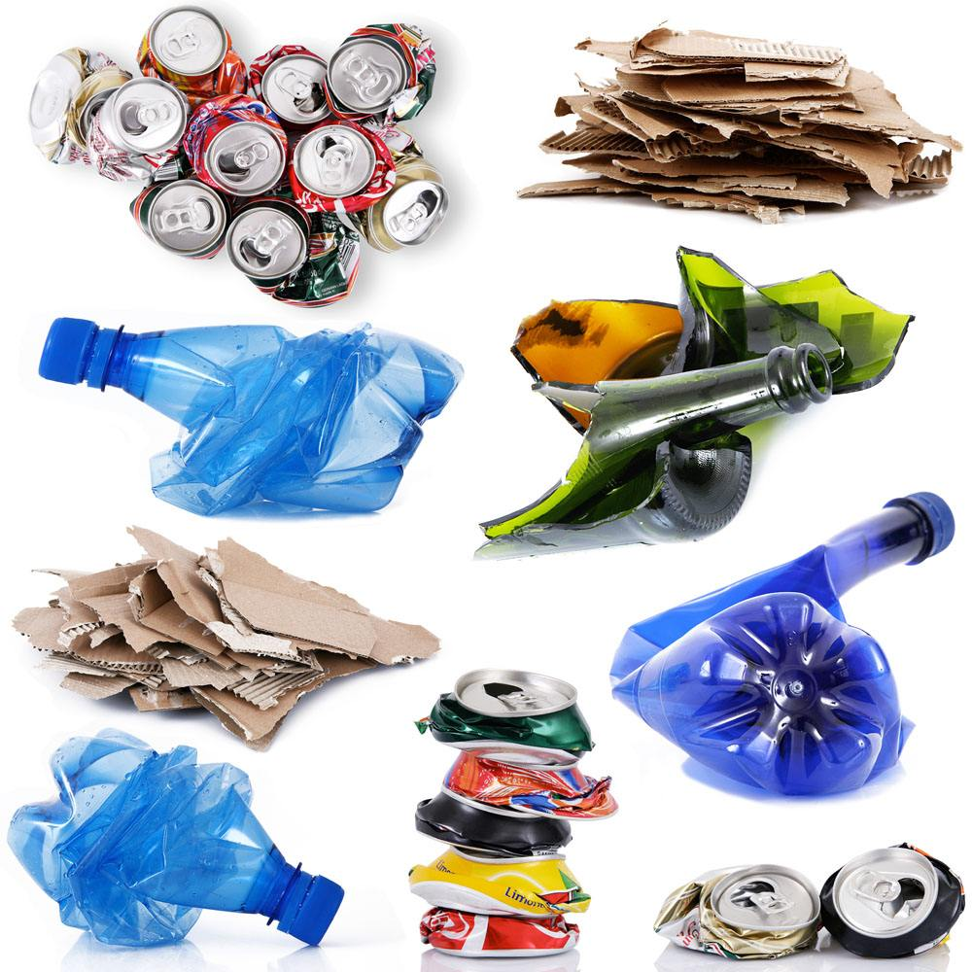
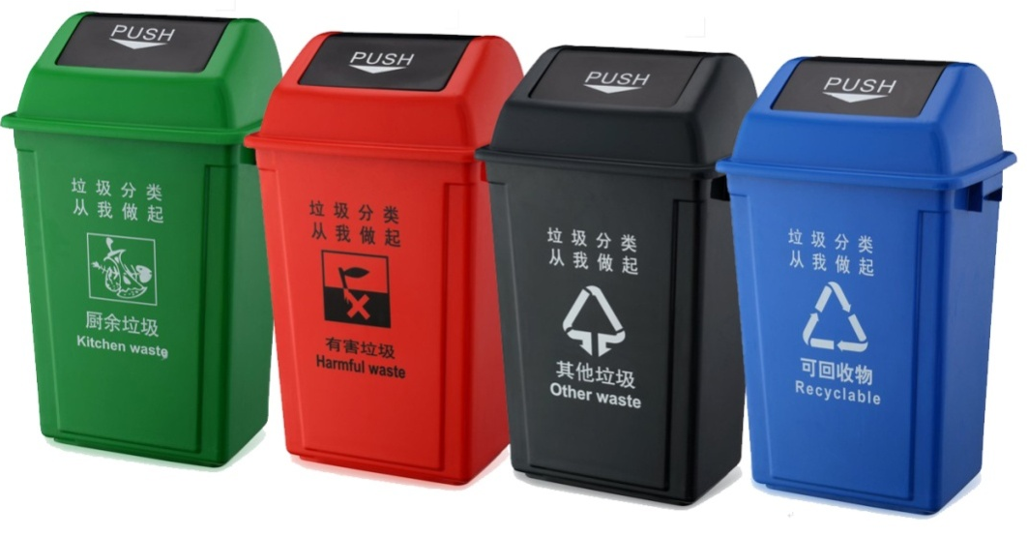
Recycle

Slide 17
Build good habits.

Slide 19
Homework
Make a poster about how to keep our world clean.

