Slide 1
Robot Lander on Mars
火星探测器
选自《多维阅读第8级》

Slide 2
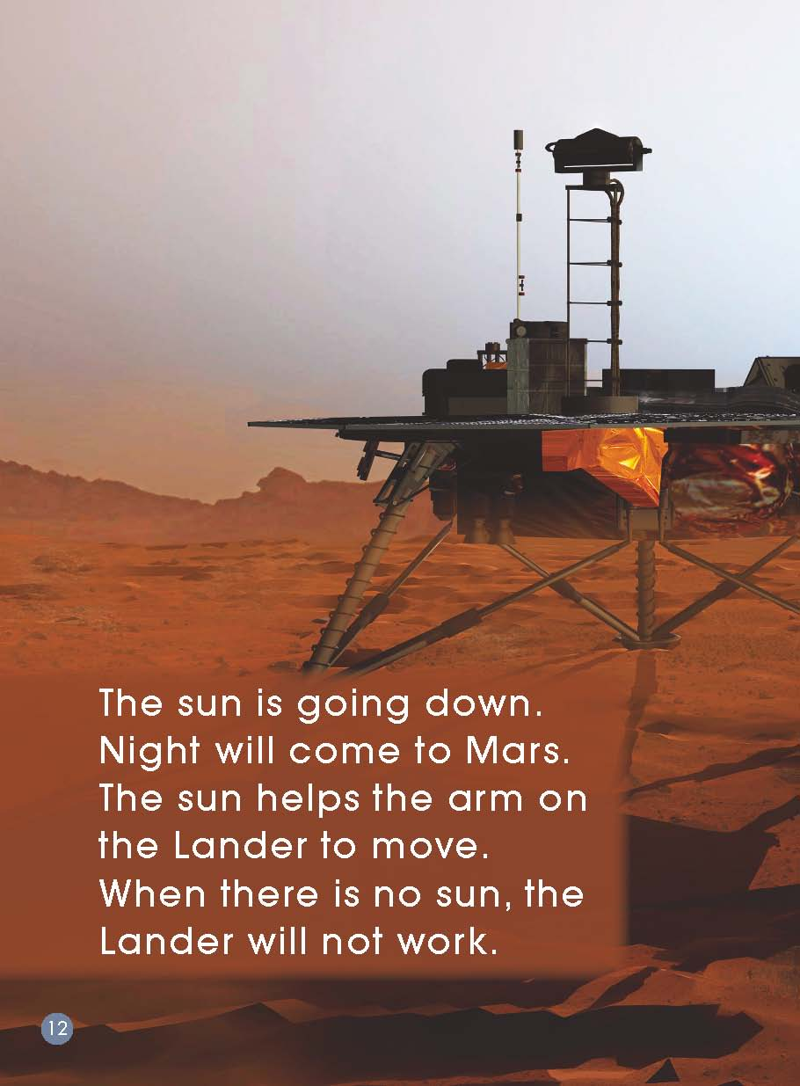
What is this? Can you guess?
Do you know the Robot Lander’s name?

Slide 3
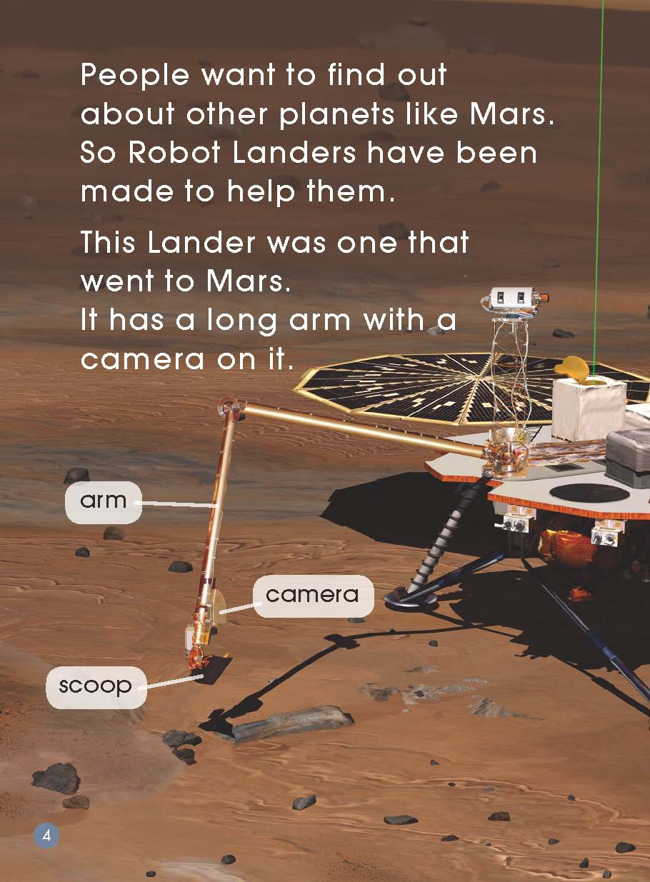
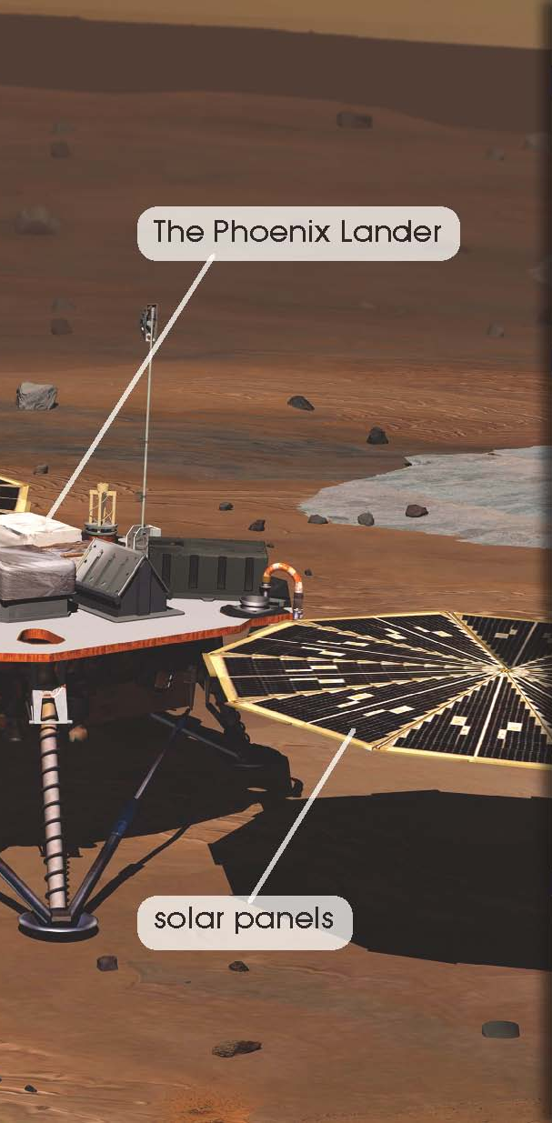
Read Pages 4-5

Slide 4
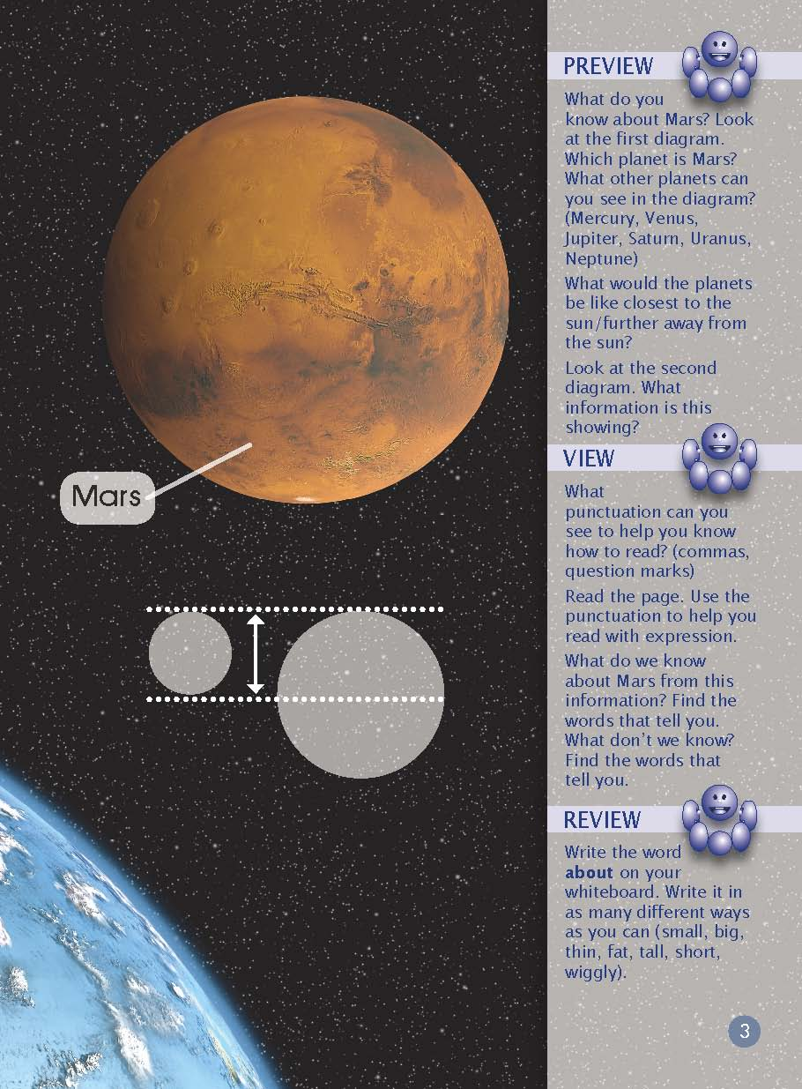
What do you know about Mars?

Slide 5
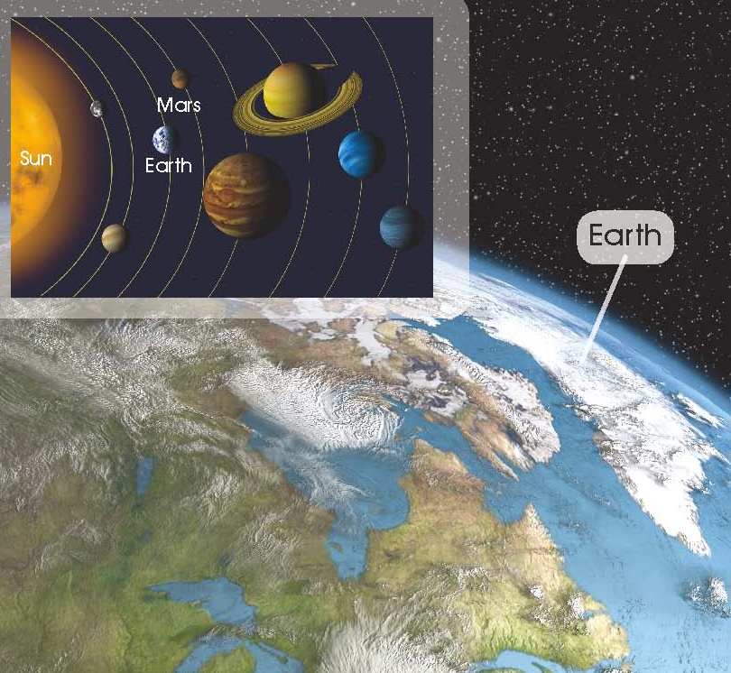
Read Pages 2-3

Slide 6
Read Pages 6-13
How does the Robot Lander work?

Slide 7
Read and Match
B
D
C
A
A
The sun helps the arm on the Lander to move.
When there is no sun, the Lander will not work.
B
The Lander is inside this spacecraft.
The spacecraft blasts into space.
It will take a long time to get to Mars. When the spacecraft is there, the Lander comes down to land on Mars.
C
The Lander digs in the ground to get soil.
People on Earth look at the soil.
D
The Lander is on Mars.
Mars looks like a desert on Earth but it is very cold.
Now the Lander has a job to do.

Slide 8
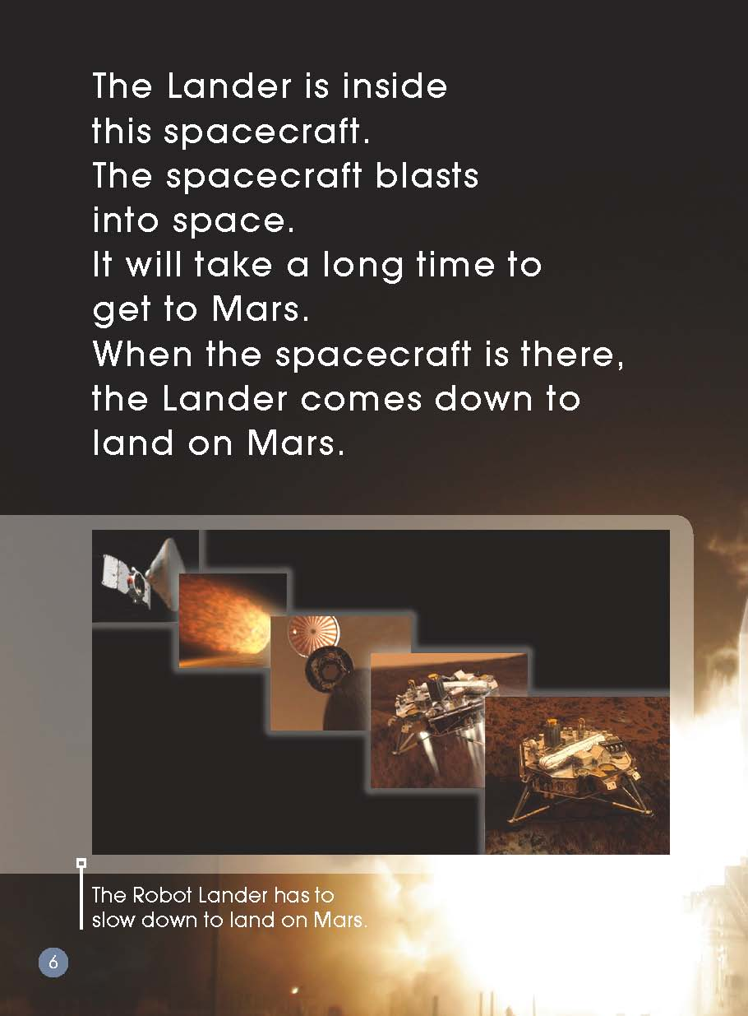
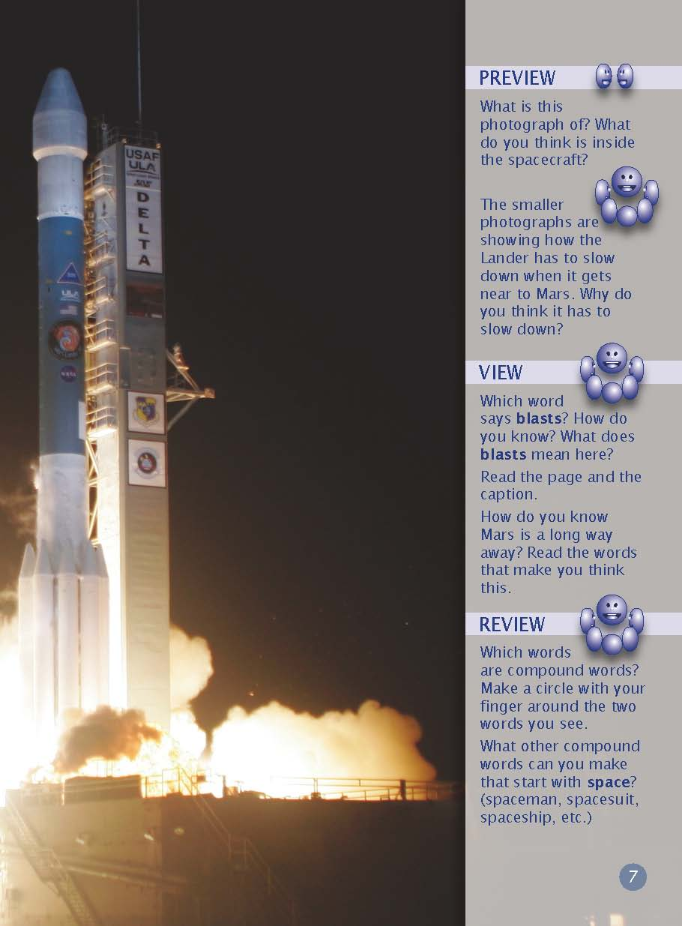
Read Pages 6-13
Why do you think the Lander has to slow down?

Slide 9
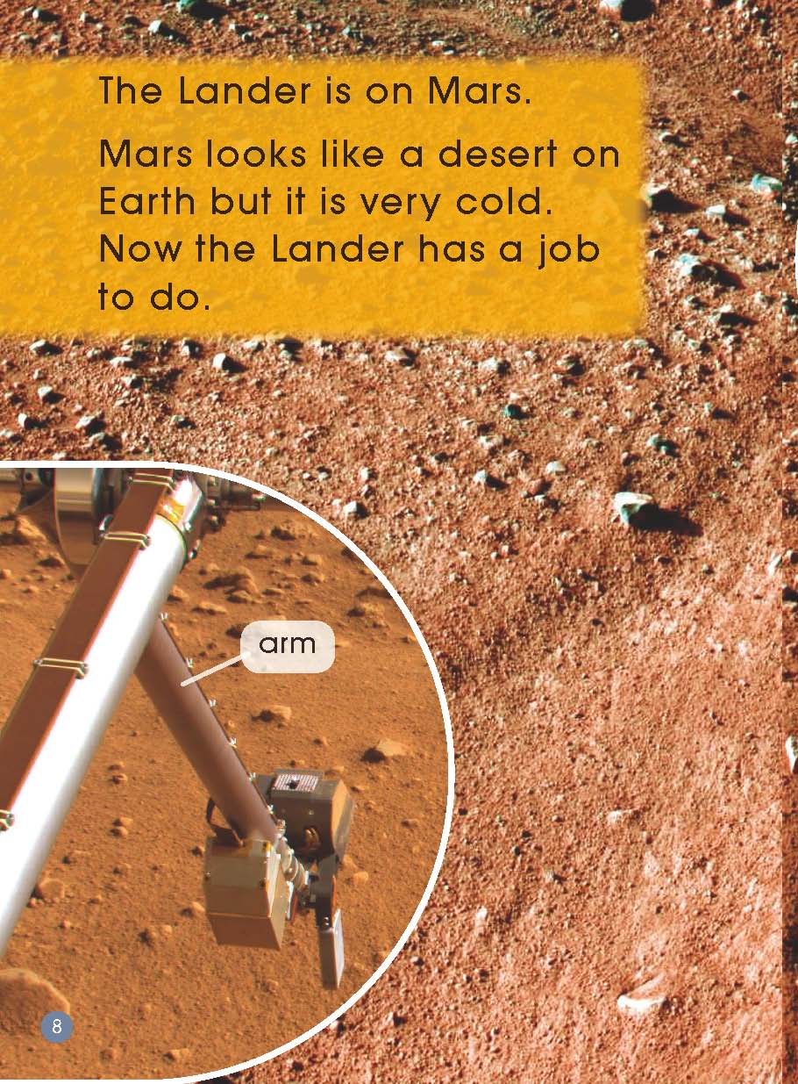
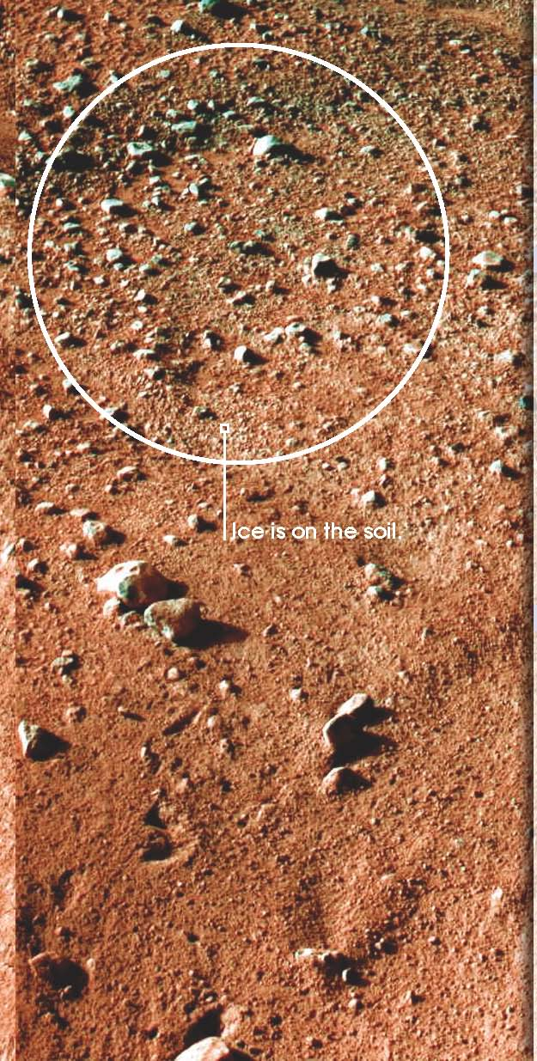
Read Pages 6-13
What do you notice about the soil?

Slide 10
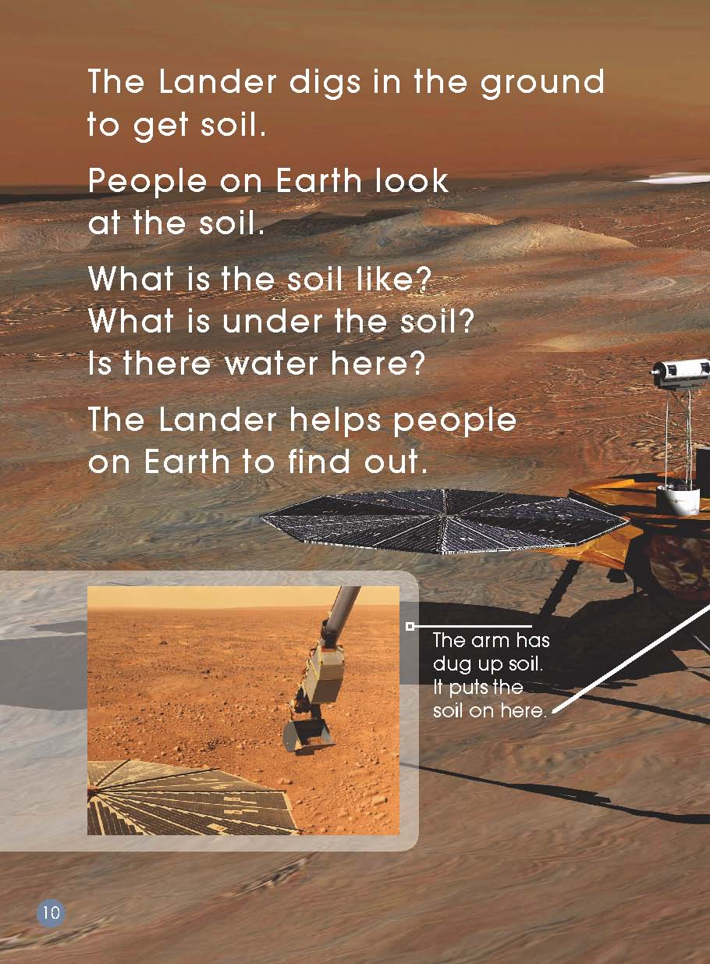
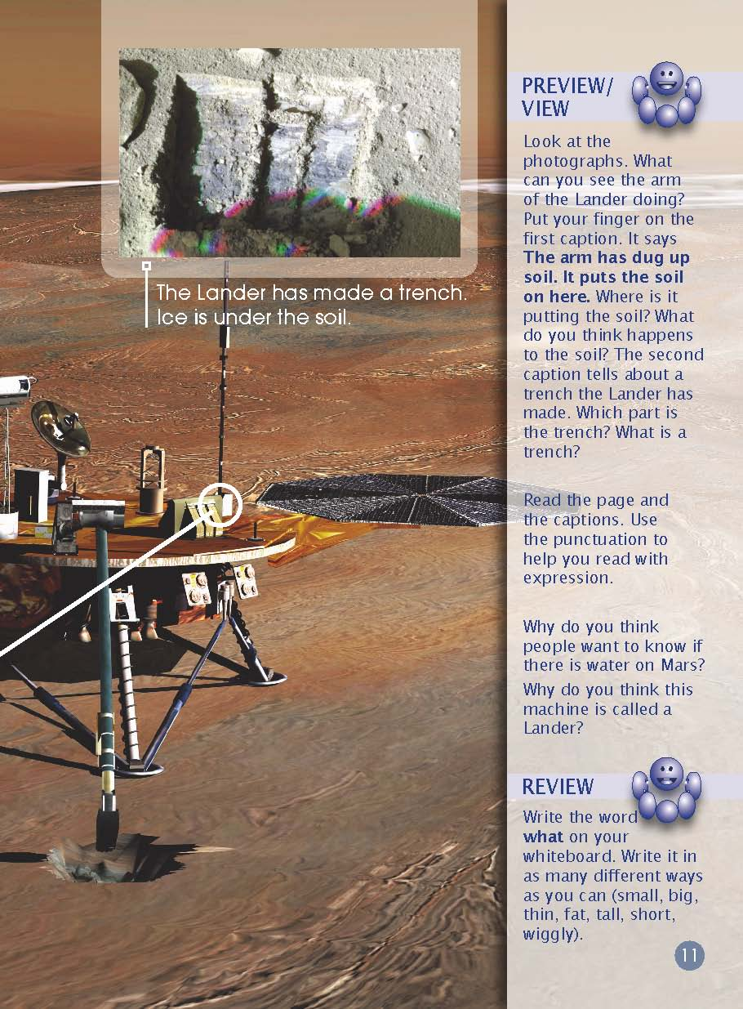
Read Pages 6-13
Why do you think people would look at the soil?

Slide 11
Read Pages 6-13
Is the sun important to the Lander? Why?

Slide 12
Read and Write

Slide 13
Try to find more information about Mars
and write it down.
Mars

Slide 14
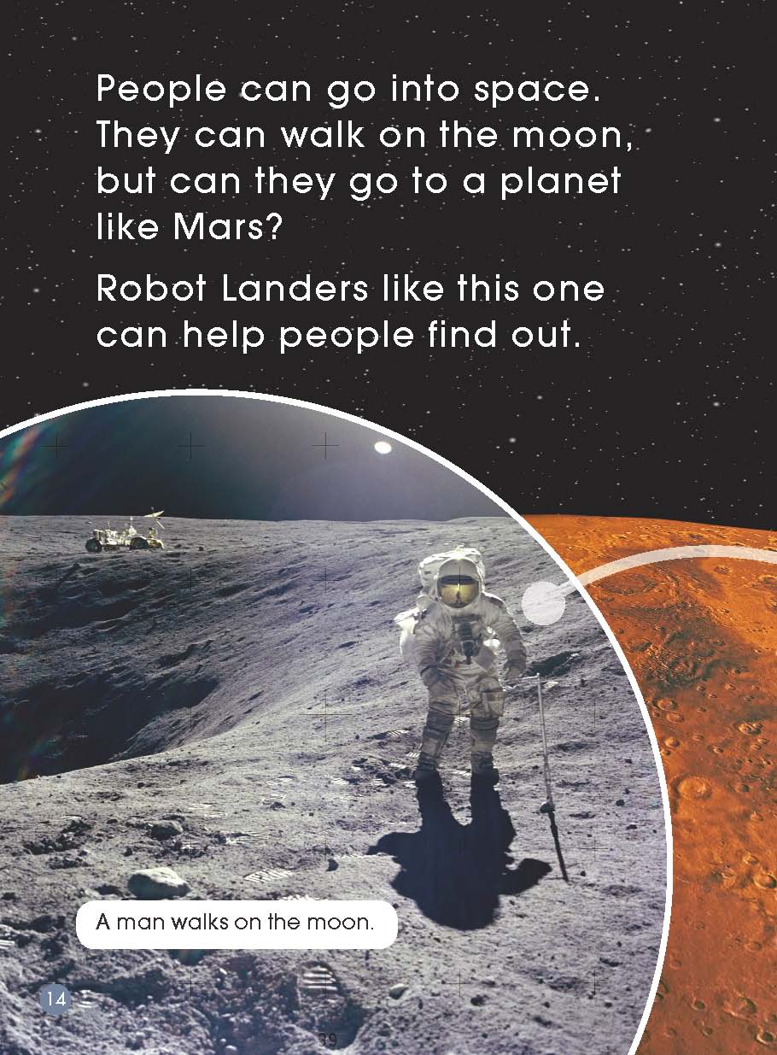
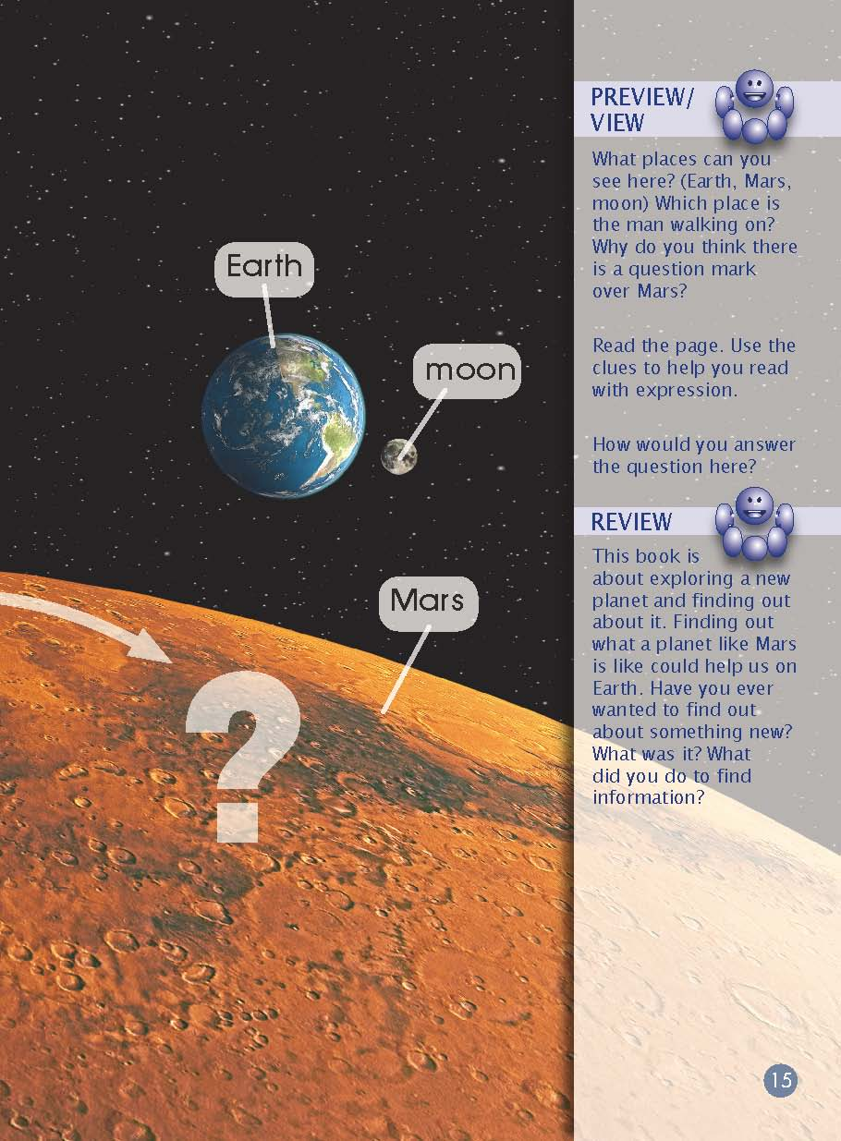
Read Pages 14-15

Slide 15
What are the differences
Between Earth and Mars?
What are the same thing for Earth and Mars?

Slide 16
Find out how Earth is similar to and different from Mars.
Earth
Mars

Slide 17
Do you think people will walk on Mars
one day? Why or why not?

Slide 18
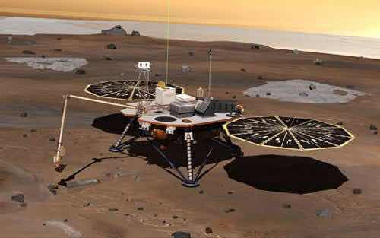

Slide 19
Homework
Listen and read.
Try to find more information about
the Phoenix Lander.
Introduce the Phoenix Lander to your
parents.

