Slide 1
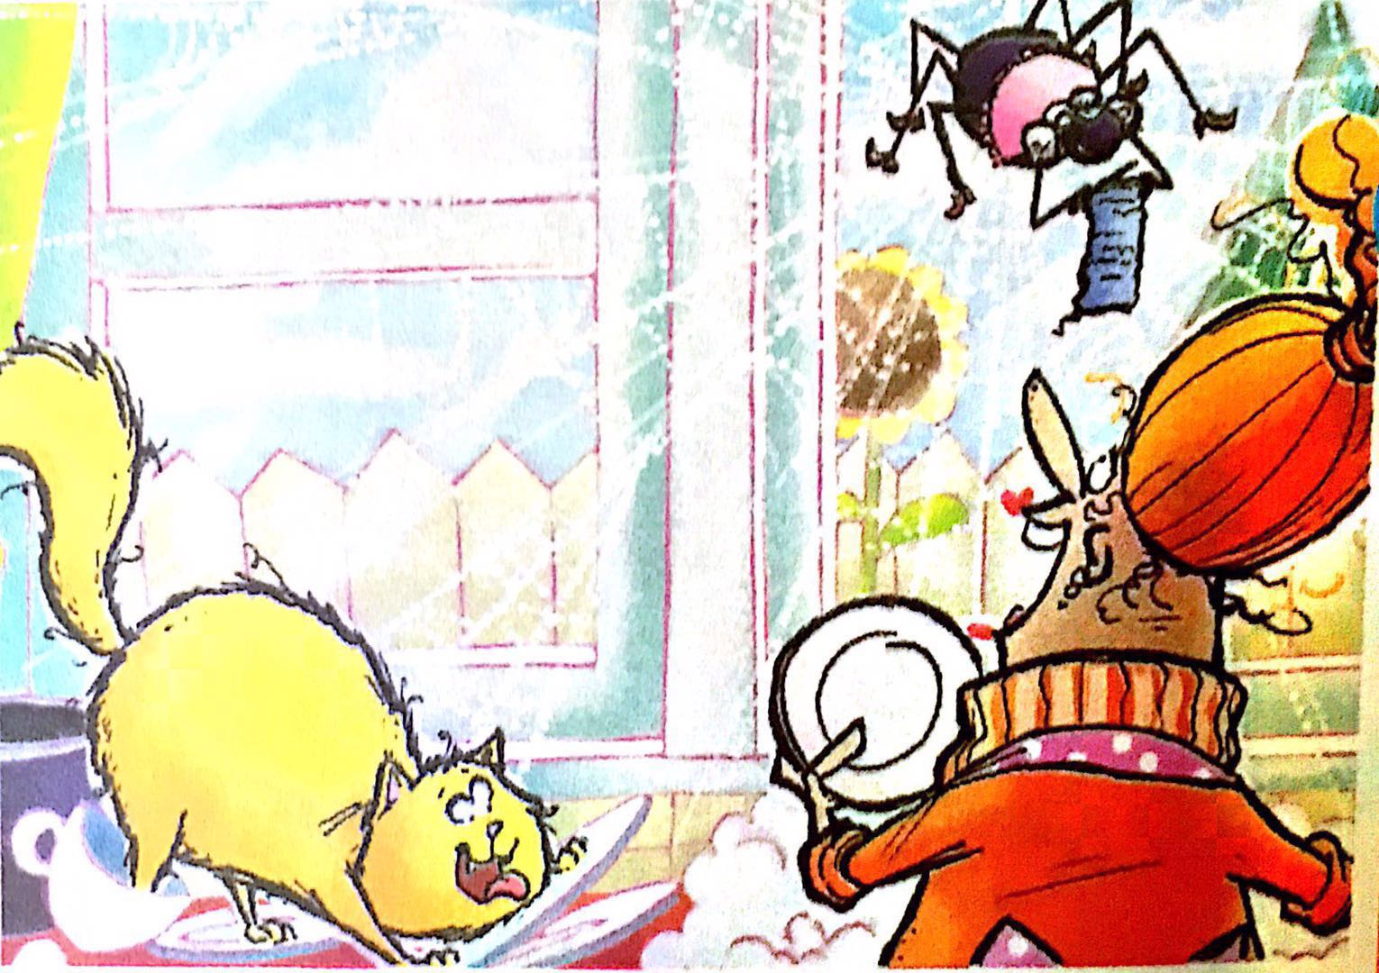
Spider Gets Jealous
蜘蛛又惹事了
选自《多维阅读第8级》

Slide 2
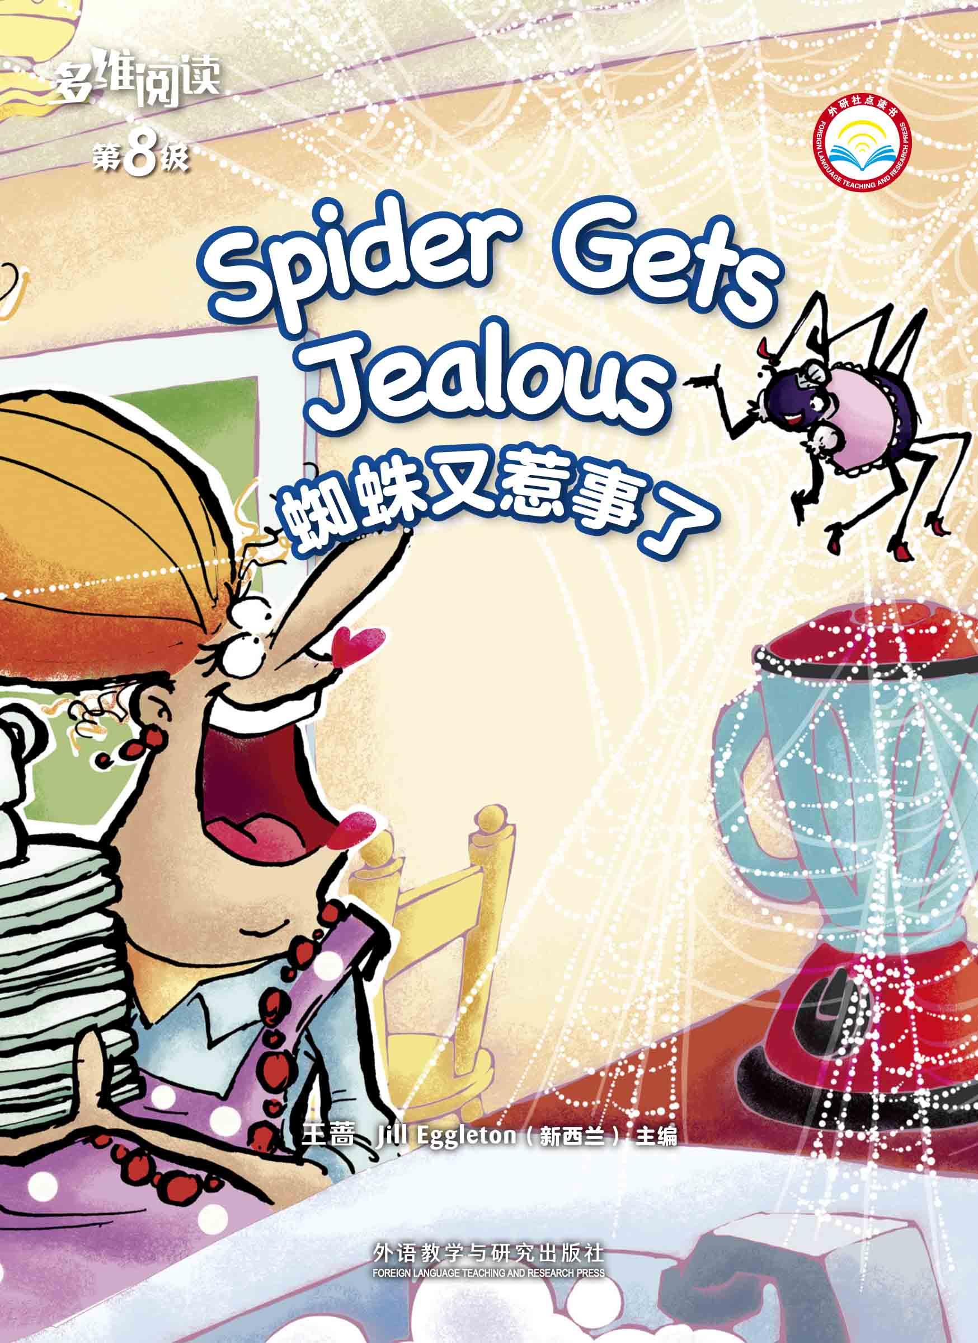
What do you know from the cover?
Title
Author

Slide 3
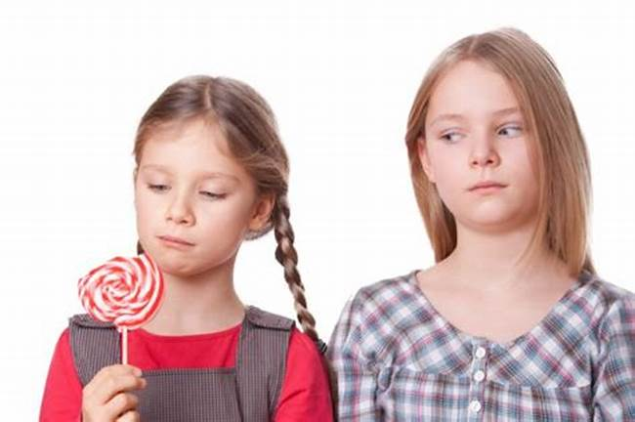
When do you get jealous?
jealous

Slide 4
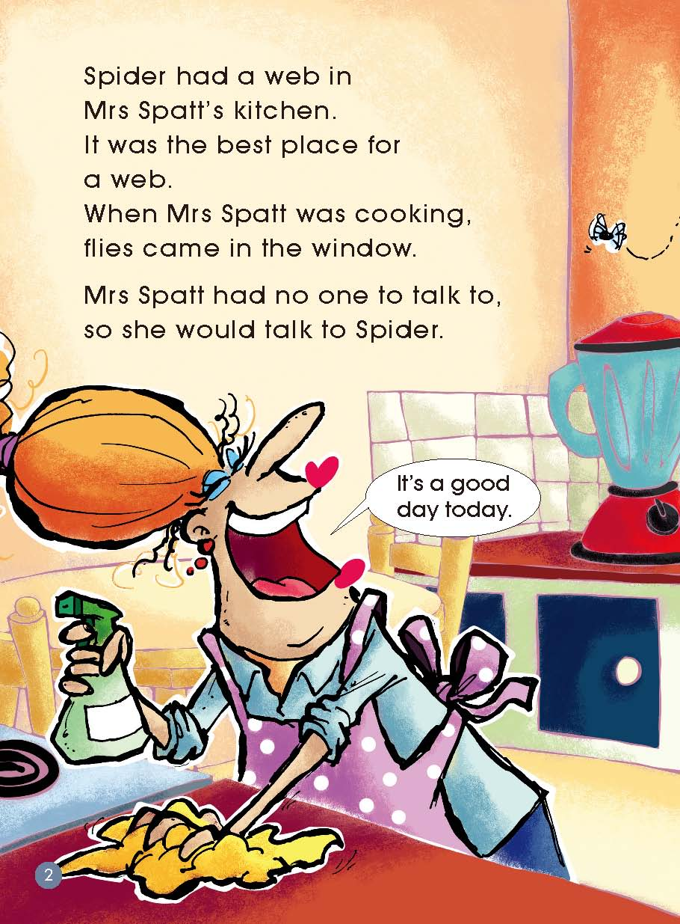
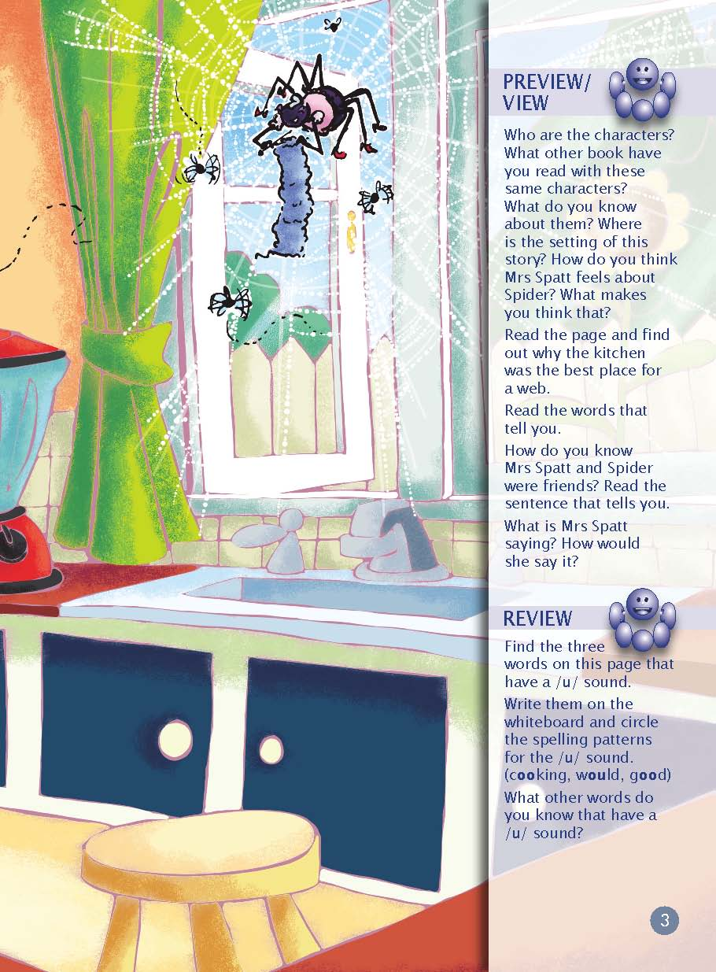
Read Pages 2-3

Slide 5
Read Pages 2-3
Mrs Spatt
Spider
How do you think
they feel about each other?

Slide 6
Read Pages 2-3

Slide 7
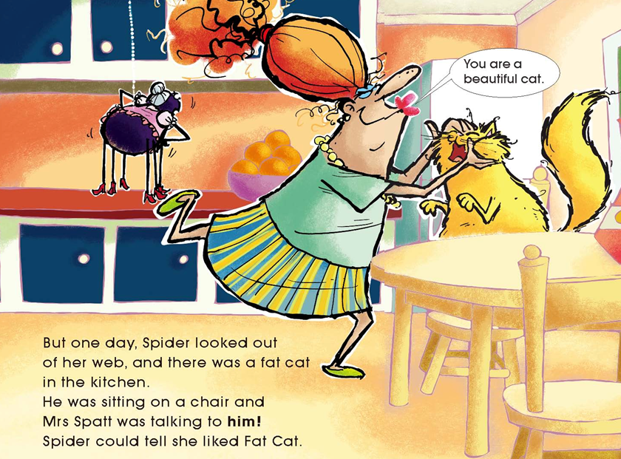
Read Pages 4-7
How does Mrs Spatt feel about Fat Cat?
What does Spider feel?

Slide 8
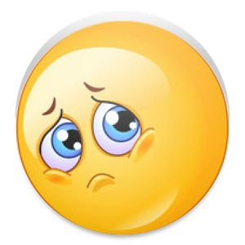
happy
sad
angry

Slide 9
mad =
very angry
angry

Slide 10
Read Pages 4-7
What did Spider do to get attention?

Slide 11
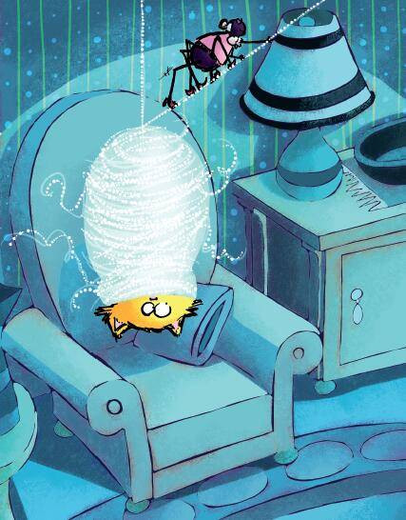
Read Pages 4-7
What did Spider do to fix Fat Cat?
wrap up

Slide 12
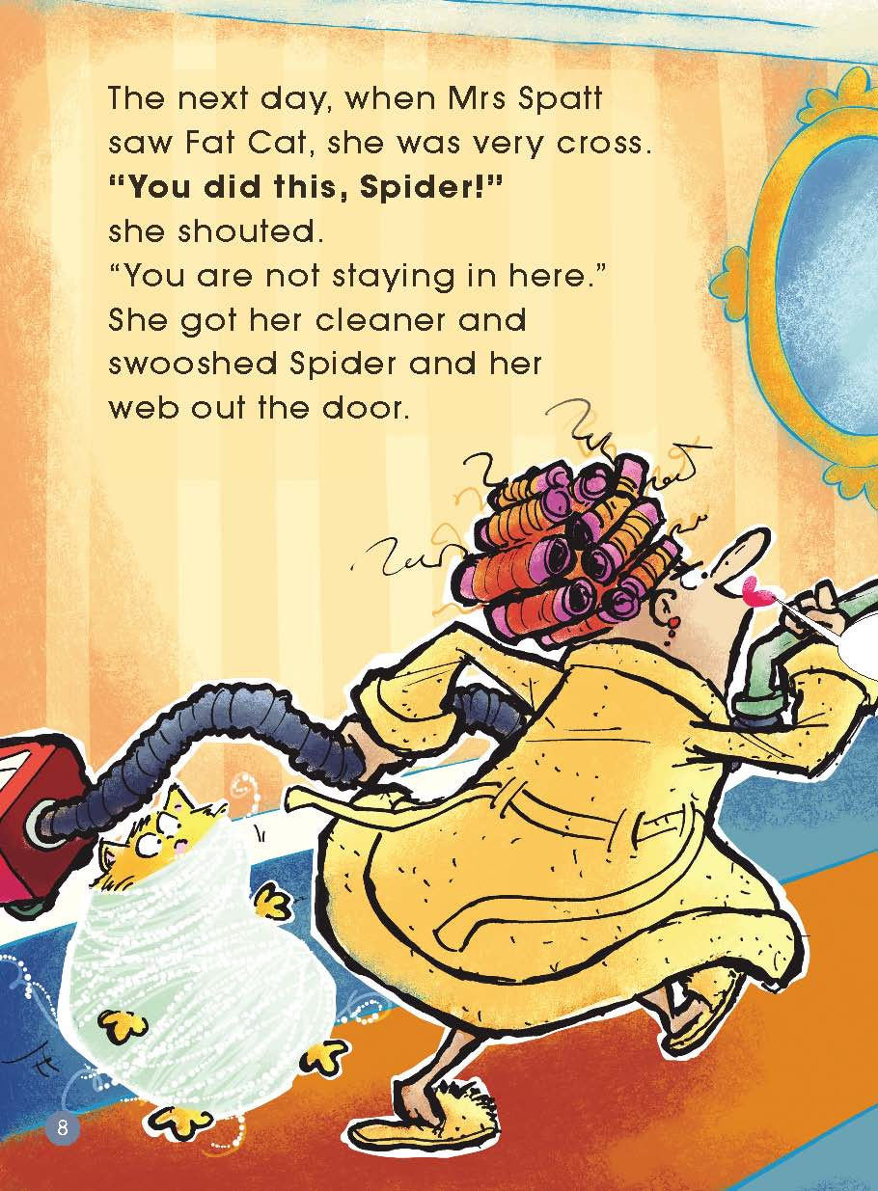
Read Pages 8-15
How did Mrs Spatt feel and what did she do after she found out about Spider’s deed?

Slide 13
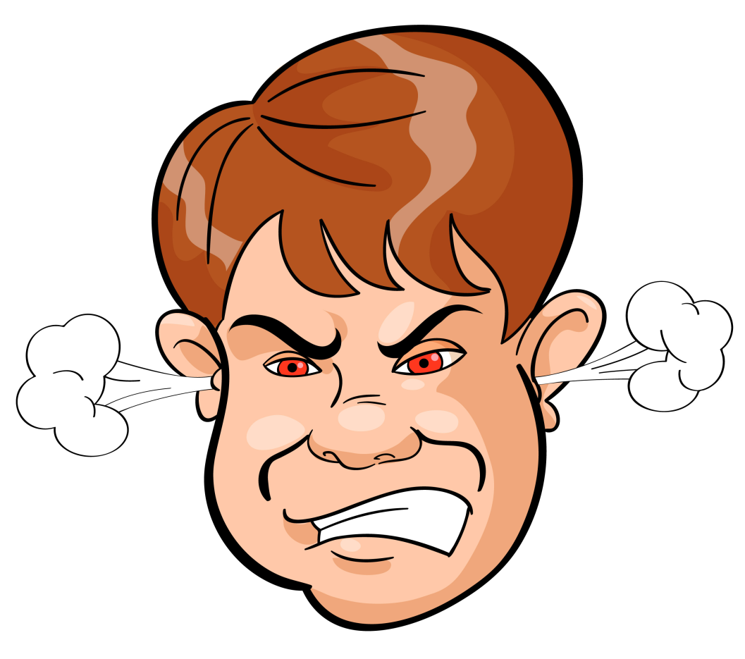
cross

Slide 14
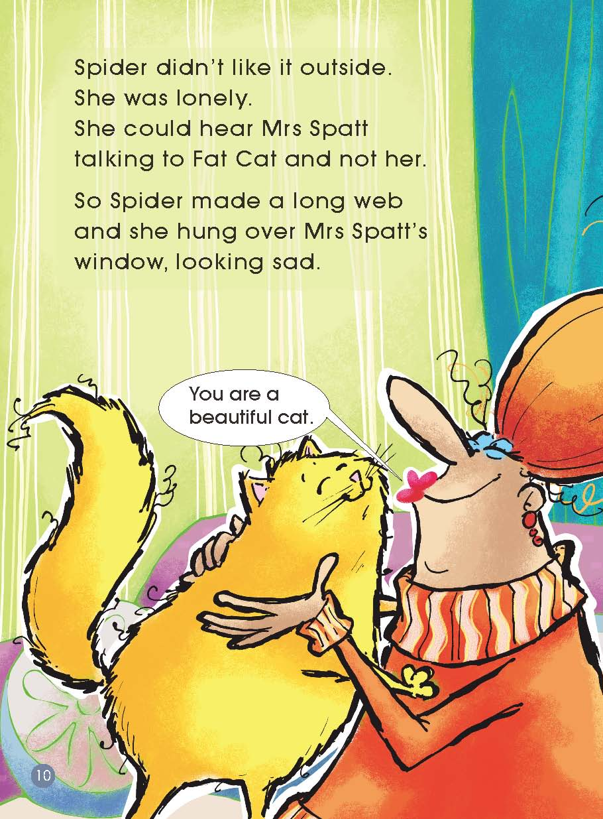
Read Pages 8-15
Where was Spider?
How did she feel?

Slide 15
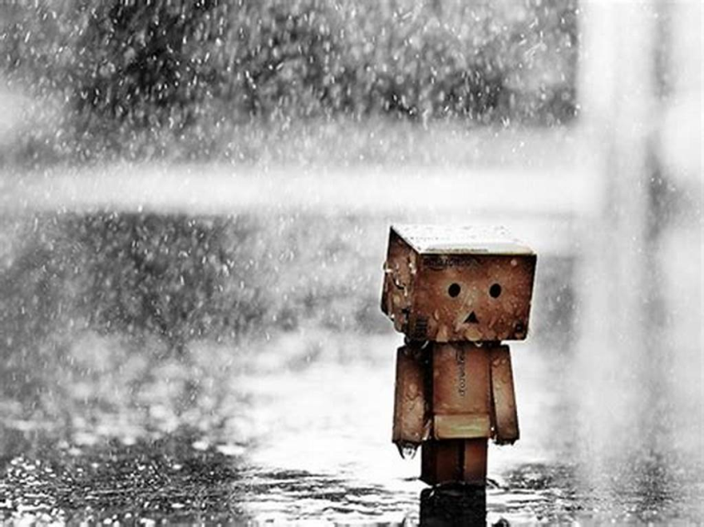
means sad because one has no friends
lonely

Slide 16
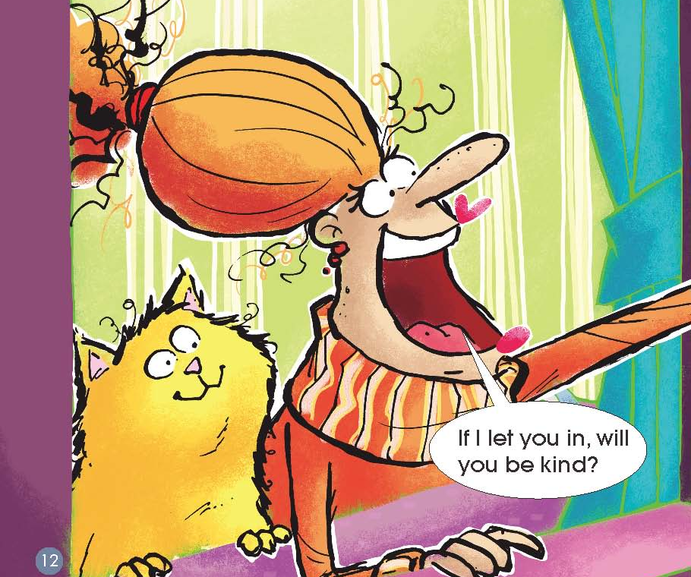
Read Pages 8-15
If Spider wanted to come into Mrs Spatt’s house, what did she need to do?

Slide 17
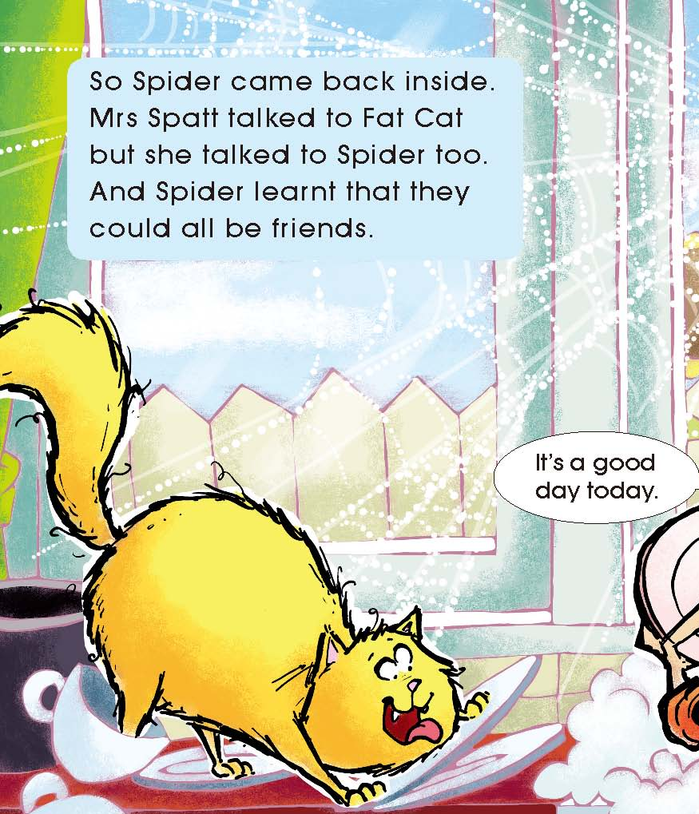
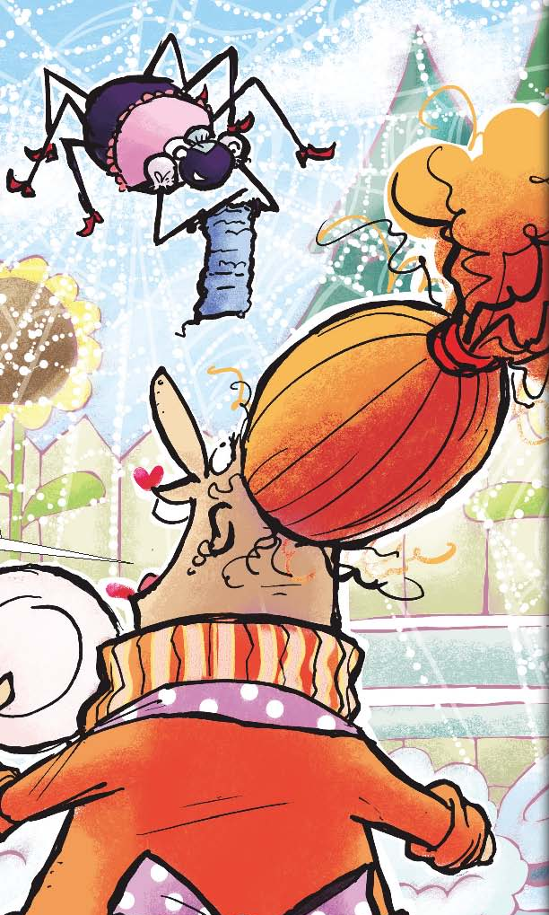
Read Pages 8-15
How was Spider different?

Slide 18
mad
jealous
happy
lonely
kind

Slide 19
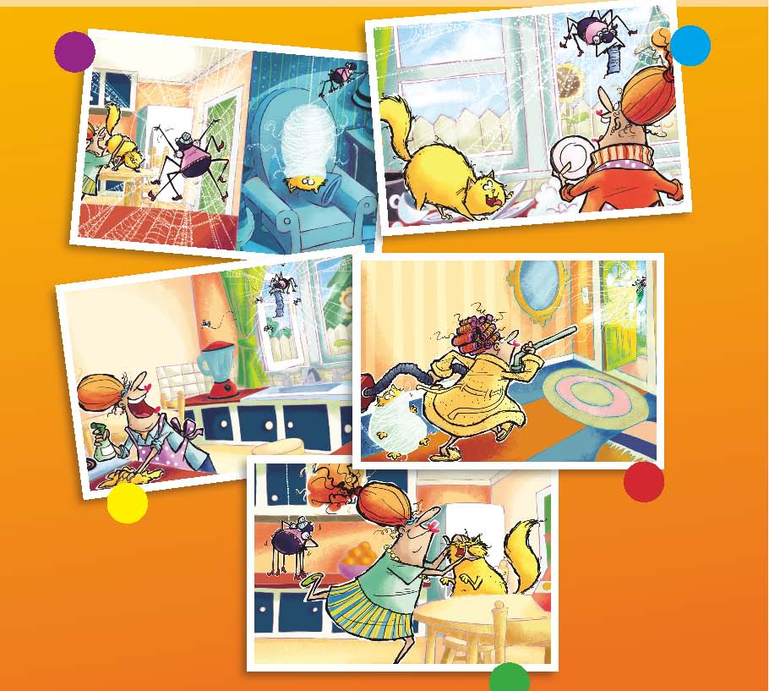
Read and number
5
3
4
1
2

Slide 20
Have you ever felt jealous of someone or something?

Slide 21
What made you feel jealous?
What do you do?

Slide 22
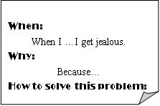
Let’s talk

