Slide 1
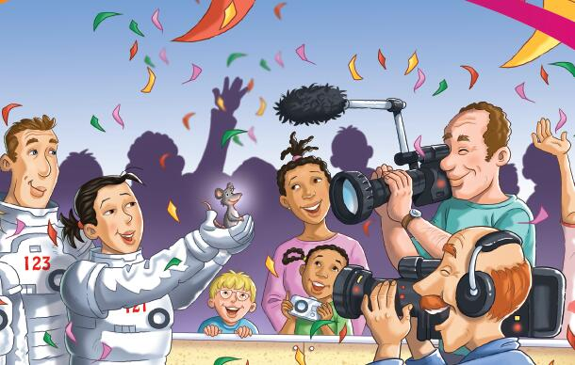
Moon Mouse
明星老鼠的
秘密
选自《多维阅读第8级》

Slide 2
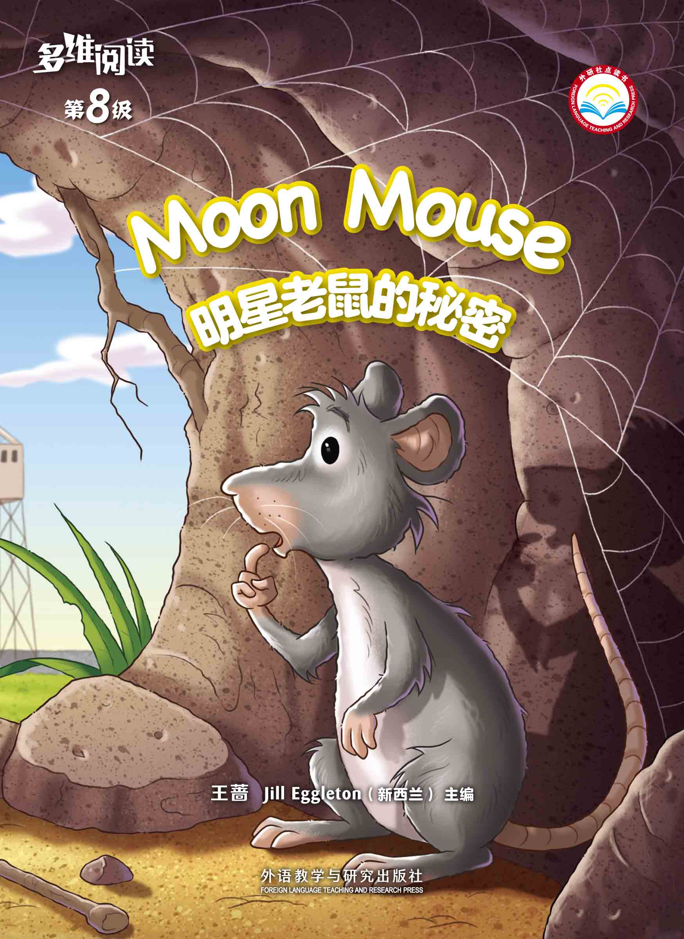
What do you know from the cover?

Slide 3
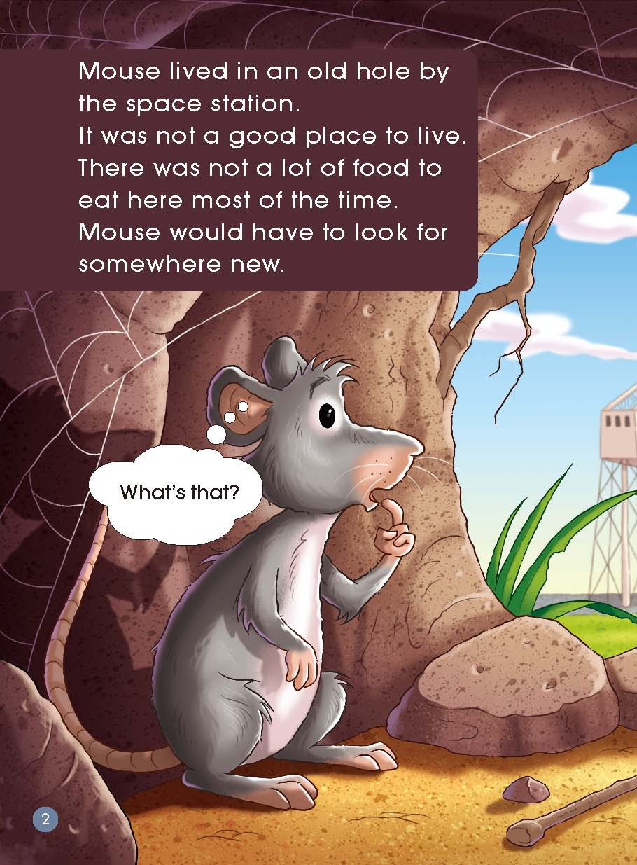
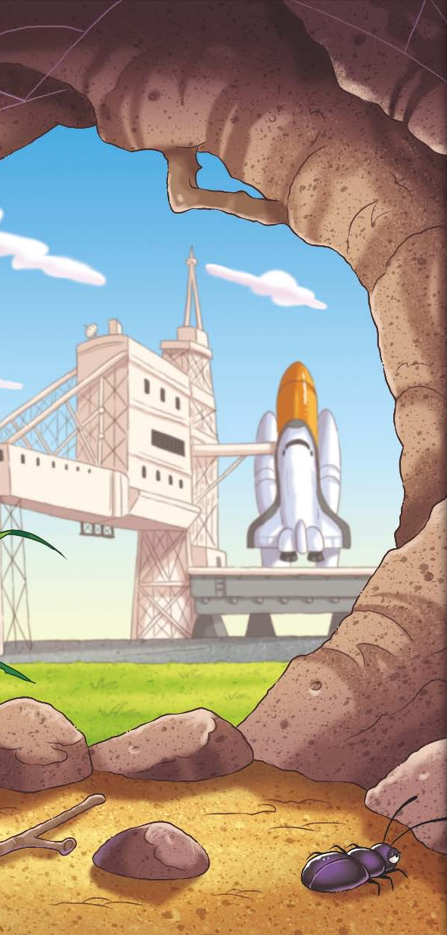
Read Pages 2-3
1. Where did he live?
2. What was Mouse’s problem?
3. Which words tell you how he was going to
solve his problem?

Slide 4
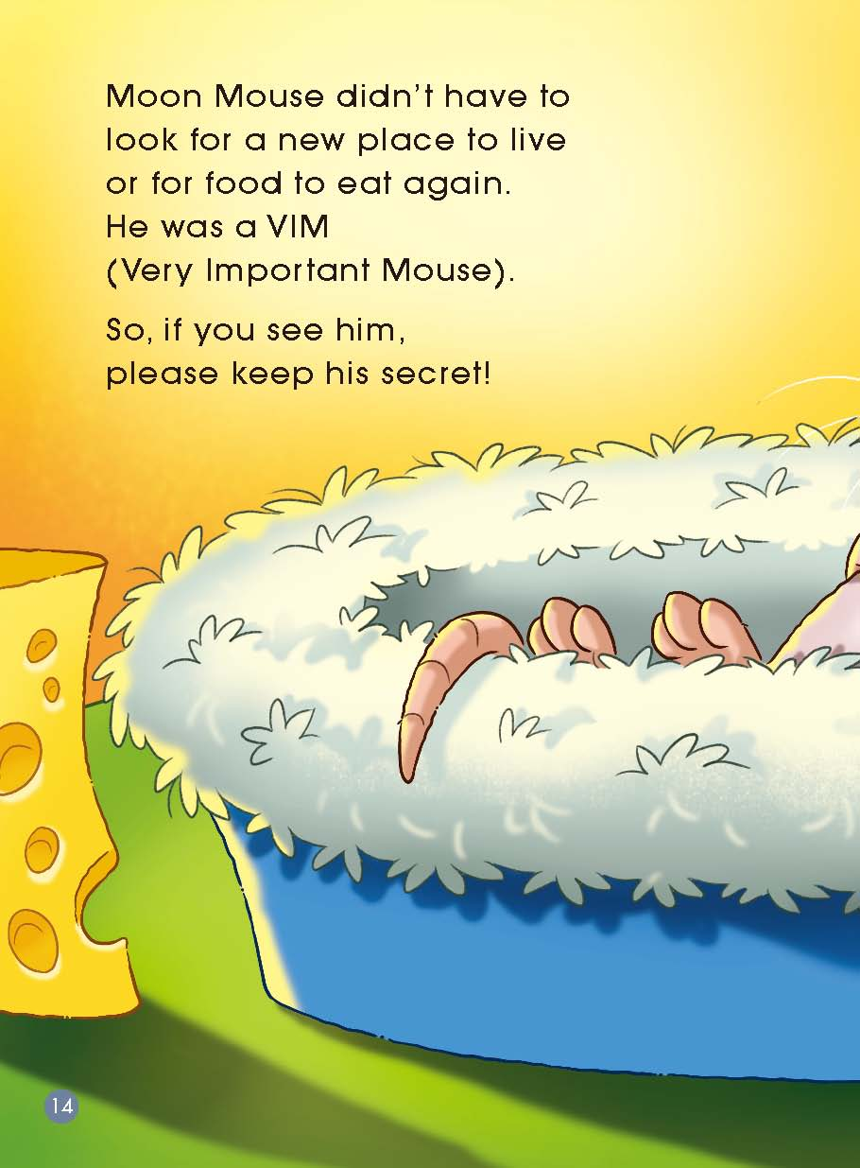
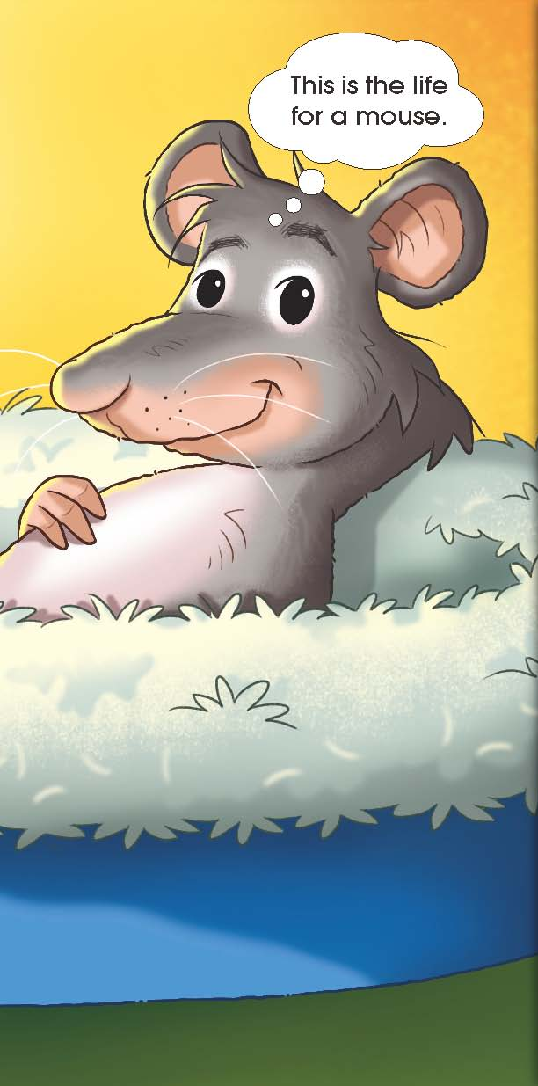
Read Pages 14-15
1. What do you think Moon Mouse’s life will be like now?
2.What words might you use to describe Moon Mouse?
3. What happened to him?
Why do you think it says “please keep his secret”?
(What kind of secrets do we need to keep for him?)

Slide 5
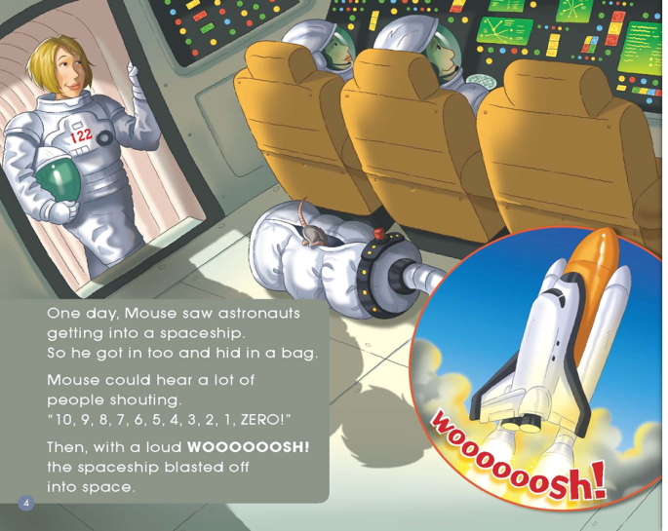
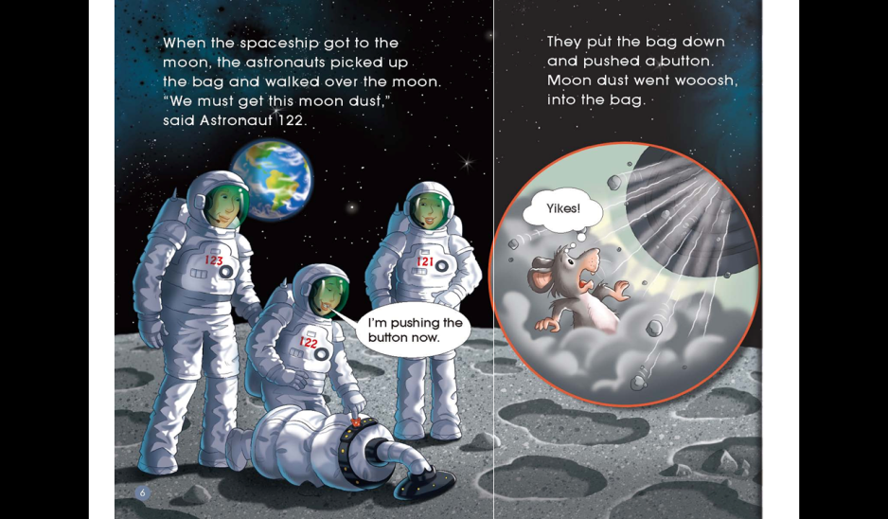
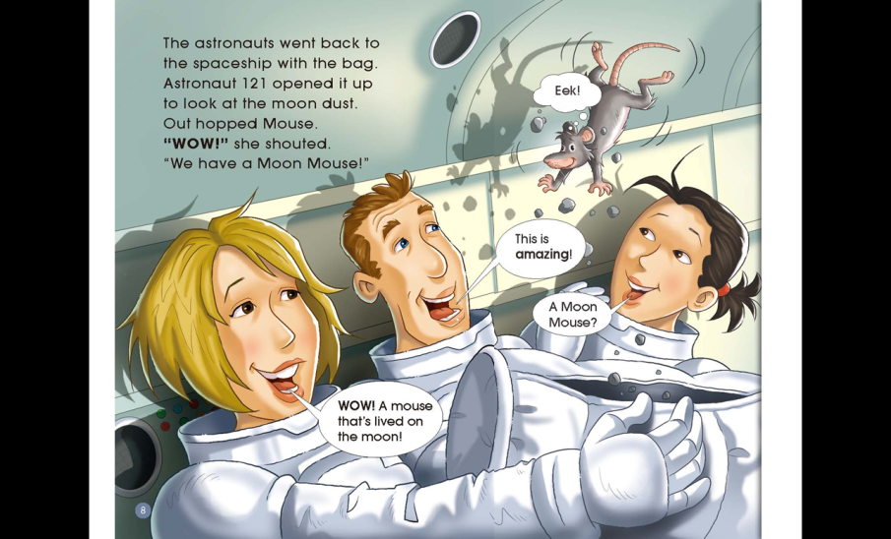
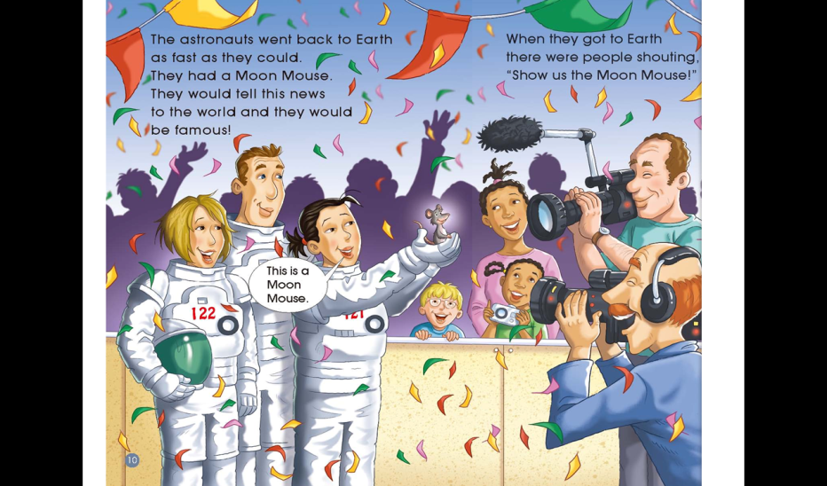
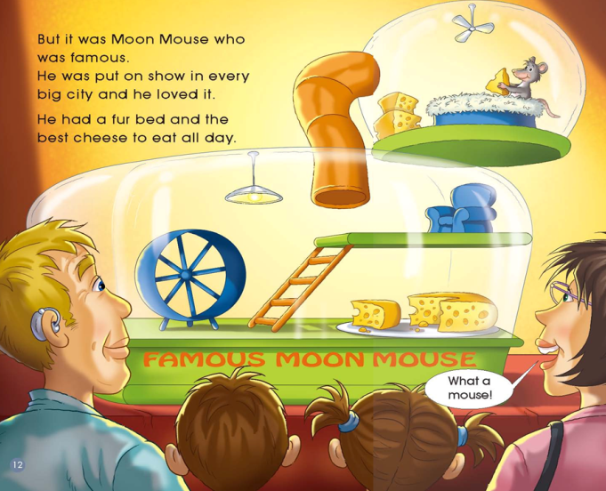
Read Pages 4-13
Jigsaw Reading
What
Which
Why
How

Slide 6
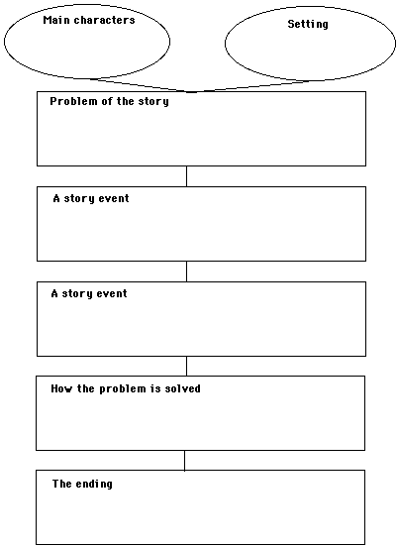

Slide 7
Match and Number
1. Woooooosh!
2. This is the life for a mouse.
3. This is a Moon Mouse.
4. I’m pushing the button now.
5. What’s that?
6. WOW! A mouse that’s lived on the moon!

Slide 8
Frame Froze

Slide 9
Talk about your favorite scene in the story
What was it about?
Who were the characters in this part?
What did they say?
What were their feelings at that time?
Act it out in your group

Slide 10
Mind Reading
In your opinion,
is the mouse lucky or not?

Slide 11
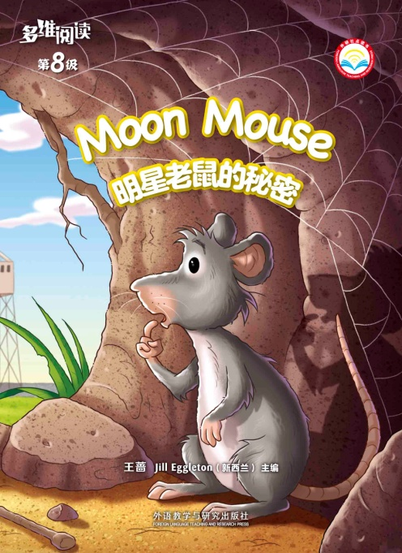
Homework
1. Read and try to retell this story.
2. Tell a lucky thing that has happened to you.

